Slide 1
Data Product Status (2024 Edition)
Robbie Manion
SAGE III/ISS Science Computing Facility

Slide 2
The “SCF”
The Team
Robbie Manion, Mike Heitz, Marsha Larosee
What We Do
Maintain, develop, and operate the algorithms which process SAGE III/ISS data into vertical profiles of aerosol and gas species
Where
Four dedicated servers at LaRC
When
Daily product generation with “expedited” processing (GEOS-IT Met)
Monthly product releases with 3-8 week latency (MERRA-2 Met)
Notes:
- Currently provided to NASA as part of the RSES contract

Slide 3
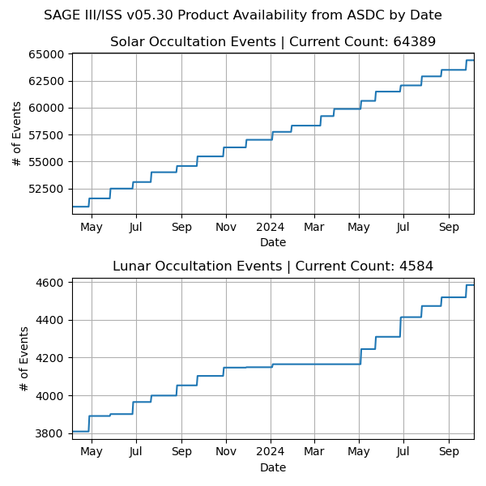
Version 05.30
Products
Level 1 and Level 2 products for solar occultation; Level 2 for lunar
Event-by-event: unformatted, HDF5
Whole month: netCDF4
Distributed by Atmospheric Science Data Center
Lunar hiatus
Aging CCD led to lunar acquisition troubles
Resolved by change to the instrument’s acquisition parameters
Notes:
- V05.30 became publicly available 4-April 2023

Slide 4
Northern Hemisphere Wildfires
Australia Wildfires
Hunga Tonga
Ambae
Raikoke
La Soufrière
Ruang
Notes:
These plots and others are available to you at sage.nasa.gov

Slide 5
Notes:
These plots and others are available to you at sage.nasa.gov

Slide 6
Announcing version 6.0
Target release date: Late January 2025
6.0.0-alpha is available now
Currently processing 6.0.0-beta
Warning: product file changes!
For us, the changes resolve some significant maintainability issues.
For you, we’ll still deliver the usual products, but names and groupings will be a little different in our readers and formatted (HDF5, NetCDF) product files.
lowercase_underscore_separated naming convention, for example
You’ll also see improved documentation, usability, flexibility, and consistency, especially around our Python reader.
As a stopgap for your existing code, we’ll provide a wrapper for the new Python reader which emulates the v5.3 Python readers.

Slide 7
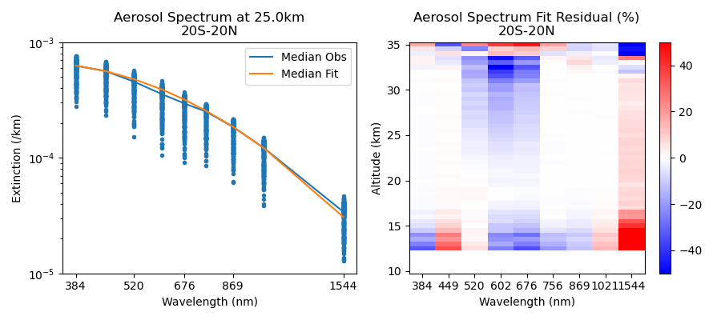
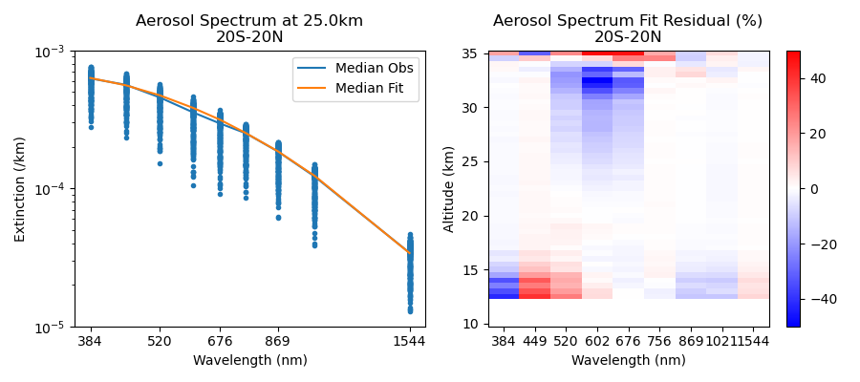
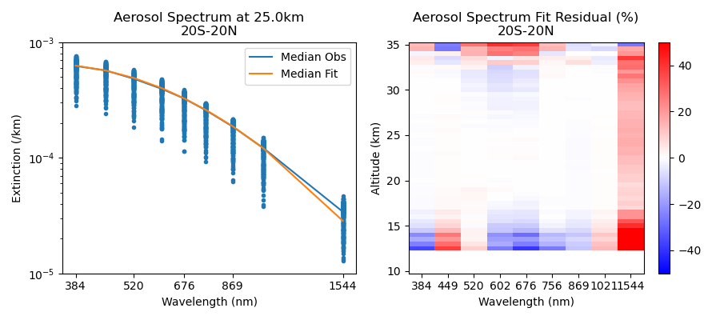
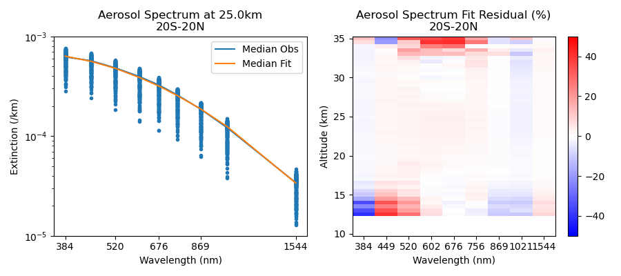
Version 6.0 Improvements
Saying “so long” to the “seagull”
Aerosol extinctions at 520 nm, 602 nm, and 676 nm have been persistently smaller than what would be expected by the power law.
We changed the ozone cross section source from SCIAMACHY version 3.0 (2004) to Serdyuchenko-Gorshelev version 1.0 (2014).
The aerosol extinction spectrum we retrieve now fits much better with the power law model.
June 2021 | 244 events
v5.3
v6.0
Status: In 6.0
Notes:
See Mike Heitz’s talk tomorrow

Slide 8
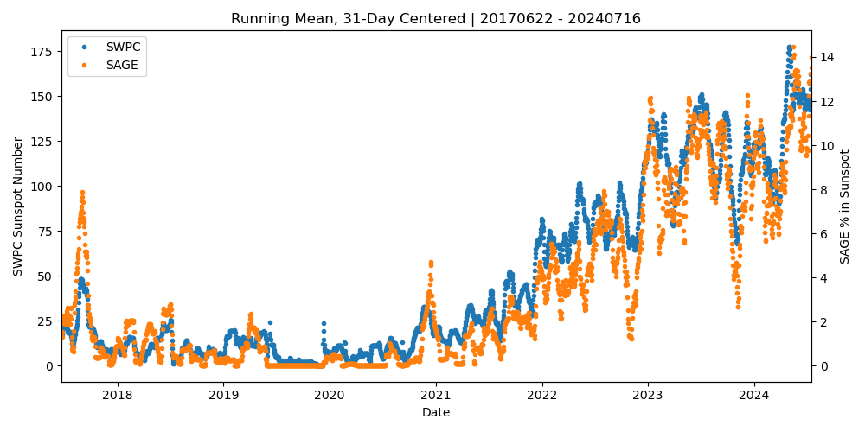
Version 6.0 Improvements
Recovering profiles lost to gaps
When there are too few valid samples to estimate atmospheric transmission, we can lose altitude bins. This leads to onion-peeling failures.
We now linearly interpolate through up to three consecutive missing bins.
Hundreds of profiles are recovered.
Status: In 6.0
Notes:
Mentioned last time

Slide 9
Version 6.0 Improvements
Filtering blockages
ISS modules can partially block line-of-sight, causing oddities in retrieved profiles which aren’t always detected by automated QA.
We mapped blocking modules in our elevation and azimuth domain. At run-time we can consult an ISS manifest to drop scans that venture too near an active blockage zone.
Prototype code changes were developed and tested in July with promising results.
Status: In development

Slide 10
Version 6.0 Improvements
Incorporate additional derived aerosol information, currently available separately, into our solar level 2 product files.
Particle size distribution (In review, included in 6.0.0-beta)
Aerosol/cloud flag (In development, expected in 6.0.0)
Improve estimations of uncertainty. (In 6.0)
Recover disturbance monitoring package-based pointing correction where it was missing. (In 6.0)
Product file housekeeping:
Remove unpopulated products. (In 6.0)
Add some ancillary information like sunspot percentage. (In 6.0)
Replace QA bit flags with self-documenting Boolean values. (In 6.0)

Slide 11
Beyond 6.0.0
Expect patching as necessary, like we did for 5.3
You’ll see patch number increments like 6.0.1, 6.0.2, etc. which are still collectively part of “6.0”. There’s no back-processing for patches as they are only for minor changes and bug fixes which don’t compromise reproducibility.
What’s next?
Examine remaining aerosol biases (most likely linked with ozone retrieval)
Examine sensitivity to increased aerosol loading (not seen during M3M)
Add retrieved pressure and temperature products
Explore methods to reduce noise in H2O
Examine spectroscopy, pressure broadening of NO2
Then…
NO2 diurnal effects (slant path inhomogeneity)
Mesospheric ozone (stray light)
Lunar altitude registration
Lunar NO2 and NO3

Slide 12
Thanks!
Robbie Manion, Science Computing Facility Lead robert.manion@nasa.gov
We speak…
Rob Damadeo, Lead Algorithm Scientist robert.damadeo@nasa.gov
David Flittner, Project Scientist david.e.flittner@nasa.gov

