Slide 1
The Role of SAGE III/ISS and other Global Space-based Aerosol Measurements in Advancing and Sustaining GloSSAC
PI: Mahesh Kovilakam¹
Collaborators: Larry Thomason², Travis Knepp², Adam Bourassa³, and Landon Reiger³
¹ADNET Systems Inc
² NASA Langley Research Center
³ University of Saskatchewan

Slide 2
Background
Global Space-based Stratospheric Aerosol Climatology (GloSSAC) was first created in 2018 (Thomason et al., 2018) to support the climate modeling community for the Coupled Model Intercomparison Project Phase 6 (CMIP6).
GloSSAC is a monthly zonal average aerosol climatology that currently provides stratospheric aerosol extinction and optical depth at 525 and 1020 nm at 5-degree latitude and 0.5 km altitude bin resolutions.
Stratospheric Aerosol Gas Experiment (SAGE) series of measurements are integral part of GloSSAC data
GloSSAC is publicly available via ASDC (https://asdc.larc.nasa.gov/project/GloSSAC). GloSSAC version 2.22 is the latest version, providing zonally averaged monthly data from 1979- 2023.
The Science Directorate at NASA's Langley Research Center: External Peer Review

Slide 3
Users of GloSSAC
GloSSAC is widely used in climate modeling and observational studies.
For the forthcoming phase 7 of the Coupled Model Intercomparison Project (CMIP7), GloSSAC will be utilized as the observational dataset for both quantifying uncertainties in climate forcing and for independent evaluation of climate model output.
Publications and citations
  Journal publications since 2018
    GloSSAC version 1.0 published in Earth System Science Data (ESSD) in 2018
    GloSSAC version 2.0 published in ESSD in 2020
    GloSSAC version 2.2 published in Atmospheric Measurement Techniques (AMT) in 2023
  Citations: over 200 citations
The Science Directorate at NASA's Langley Research Center: External Peer Review

Slide 4
Current Status of GloSSAC
The current utilization of SAGE III/ISS, OSIRIS, and CALIPSO for GloSSAC is affected by the conclusion of CALIPSO mission as of August 1, 2023, and the declining coverage of OSIRIS.
It is important to continue and maintain GloSSAC product as modeling community relies on this observational dataset.
Ozone Mapping and Profiler Suite Limb Profiler (OMPS-LP) is a potential candidate to replace OSIRIS or CALIPSO in the near future.
Two different products of OMPS are publicly available (OMPS(NASA) and OMPS(SASK))
A recent study has shown that OMPS(NASA) is overestimating extinction coefficient by a factor of two below the peak of the aerosol layer following Tonga Eruption in January 2022 (Bourassa et al., 2023).
Therefore, it is critical to evaluate OMPS products before considering its incorporation into GloSSAC.

Slide 5
Proposed Tasks
Evaluate OMPS(NASA)/OMPS(SASK) products and perform comparisons/validations against available space-based and potential in-situ measurements.
Explore the possibility of improving the OMPS(SASK) extinction retrieval by integrating SAGE III/ISS particle size distribution into OMPS(SASK) retrieval algorithm.
Evaluate the improved product using comparisons with SAGE III/ISS
Expand the GloSSAC record by incorporating additional optical parameters, including surface area density and effective radius.
Incorporate OMPS extinction coefficients into GloSSAC with additional optical parameters.

Slide 6
OMPS-LP Aerosol Extinction Coefficients and their Applicability in GloSSAC
Mahesh Kovilakam
Larry Thomason, Magali Verkerk, Thomas Aubry, and Travis Knepp,
SAGE ST Meeting, 22-23 October 2024

Slide 7
OMPS Aerosol Extinction Coefficient
OMPS, launched in 2011, while its primary focus is on monitoring vertical structure of ozone layer, OMPS-LP utilizes the limb-scatter technique to retrieve information about aerosols and related gases.
There are two distinct versions of OMPS aerosol extinction coefficient products, each employing a different retrieval process and producing different aerosol products
The retrieval methodology employed in OMPS-LP version 2.0, referred to as OMPS(NASA), involves establishing a one-to one correspondence between a single limb radiance image and the retrieval of a singular aerosol extinction coefficient profile. Similar to other limb scatter measurements, the OMPS(NASA) procedure requires an assumption regarding the particle size distribution for deriving the scattering phase function. A constant gamma function size distribution derived from the Community Aerosol and Radiation Model for Atmospheres (CARMA) is utilized for this purpose.
We use version 2.1 of OMPS(NASA) that provides extinction coefficients at 510, 600, 675, 745, 869, and 997 nm.

Slide 8
OMPS Aerosol Extinction Coefficient
The University of Saskatchewan provides another variant of OMPS aerosol retrieval, known as OMPS(SASK), which utilizes the tomographic retrieval approach. For size distribution, a single-mode lognormal size distribution with r_{i} = 0.08 and σ = 1.6, where r_{i} is the median radius and σ is the distribution width.
Here, we use version 1.3 of OMPS(SASK) version that provides extinction coefficient at 745 nm.
For consideration in GloSSAC, all datasets are required to be publicly available at a known data center and to have undergone peer-reviewed validation for their stratospheric aerosol products, among other requirements (Thomason et al., 2018). Both OMPS(NASA) (Taha et al., 2021) and OMPS(SASK) (Bourassa et al., 2023) products satisfy these criteria.

Slide 9
Daily zonal averaged measurements
Kelud Eruption
Calbuco Eruption
Tonga Eruption

Slide 10
Monthly Zonal averaged Extinction Coefficient

Slide 11
Monthly Zonal averaged Extinction Coefficient
Tonga Eruption

Slide 12
SAOD (745 nm)

Slide 13
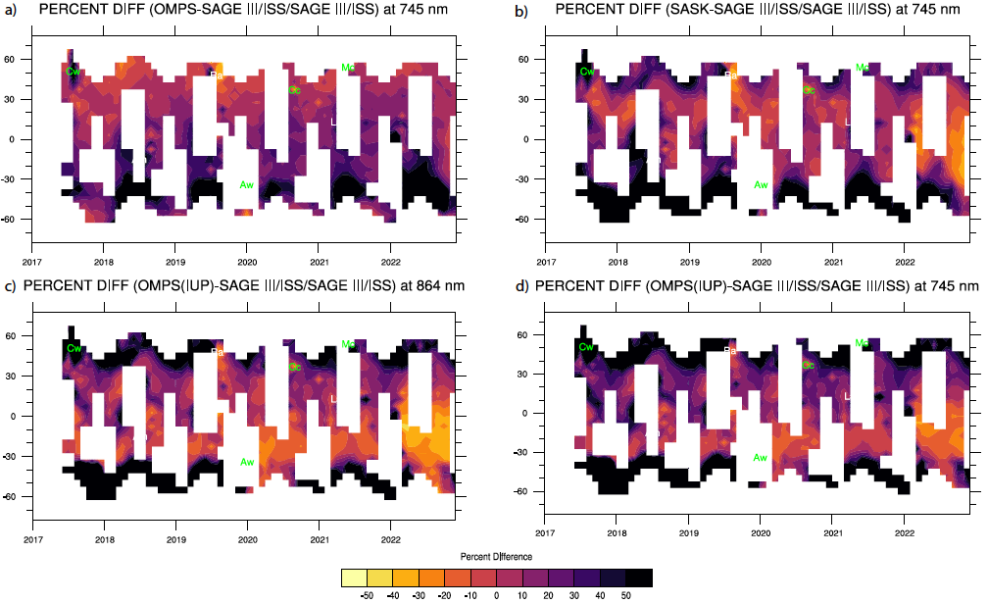
SAOD (745 nm)

Slide 14
SAOD Comparison

Slide 15
Extinction Coefficient (OMPS(NASA) and GloSSAC)
We use GloSSAC (OMPS(NASA)) Extinction Coefficient
at 525 (510) and 1020 (997) nm
Tonga Eruption

Slide 16
SAOD (OMPS(NASA) and GloSSAC)

Slide 17
SAOD Ratio (OMPS(NASA) and GloSSAC)

Slide 18
Global SAOD and Volcanic Radiative Forcing
ERF scaling factor is estimated from the regression slope from Marshall et al. (2020),
which is -20.7 x (1 - e-^{△SAOD}), where △SAOD is the SAOD anomaly computed as deviation from the minimum of the SAOD time series
Finite amplitude Impulse Response (FaIR) model to estimate temperature response from the estimated ERF time series.
We performed six 1000-member ensembles corresponding to the five aerosol optical property datasets used in our study, plus an ensemble with no stratospheric aerosols-induced ERF
 | NASA (Aug 2022) | SASK (Aug 2022) | OSIRIS (Aug 2022) | SAGEIII/ISS (Aug 2022) | GloSSAC (Aug 2022)
△SAOD | 0.036 | 0.013 | 0.006 | 0.010 | 0.010
ERF | -0.730 | -0.261 | -0.115 | -0.214 | -0.215
T | -0.092 | -0.061 | -0.039 | -0.042 | -0.041
Time series of near global 550 nm SAOD (panel a), Effective Radiative Forcing (panel b), and temperature response (panel c) from OMPS(NASA), OMPS(SASK), OSIRIS, SAGEIII/ISS, and GloSSAC. To compute SAOD at 550 nm from 745 nm OMPS(NASA), OMPS(SASK), and OSIRIS, we used a constant Angstrom coefficient of 2.393, while for SAGE III/ISS and GloSSAC we used 1.97 to convert extinction from 525 to 550 nm. The resulting monthly surface temperature response in panel c is estimated from the FaIR model.

Slide 19
Summary and Conclusions
While OMPS(NASA) extinction coefficient is in reasonable agreement with SAGE III/ISS and OMPS(SASK) during relatively background stratosphere, the OMPS(NASA) product exhibits a high bias (exceeding 50%), particularly in the aftermath of perturbed events and in the GloSSAC context, the bias exceeds the allowable differences between the instruments(+/- 20%). This overestimation by OMPS(NASA) leads to an overestimation of the aerosol effective radiative forcing and the associated model-simulated global surface temperature response by about a factor of two.
OMPS(NASA) significantly overestimates aerosol extinction following volcanic events, more so following Tonga eruption across all channels. The results of 750 nm extinction coefficient is in agreement with Bourassa et al ., 2023.
OMPS(NASA) 510 nm channel is significantly overestimated regardless of any volcanic event and is unusable as it can not provide any valuable information.
OMPS(SASK) extinction product at 745 nm shows reasonable agreement with SAGE III/ISS between 40S-40N. However, OMPS(SASK) still have significant shortcomings.
While OMPS(SASK) looks better in comparison to OMPS(NASA), differences exist following large events like Tonga where OMPS(SASK) is underestimated by about 20-30% relative to SAGE III/ISS.
Currently all OMPS extinction products have deficiencies and are showing significant differences relative to occultation measurements, following perturbed events. A revision of NASA product is underway.
Future tasks include exploring the possibility of improving the OMPS extinction retrieval by integrating SAGE III/ISS particle size distribution into OMPS retrieval algorithm.

Slide 20
Backup Slides

Slide 21
SAOD Ratio (OMPS(NASA) and SAGE III/ISS)

Slide 22
 | NASA | SASK | OSIRIS | SAGE III/ISS | GloSSAC
Aug 2022 | -0.09183155 | -0.0605334 | -0.0385227 | -0.0415445 | -0.0407574
Dec 2022 | -0.10546871 | -0.0671944 | -0.0418083 | -0.0462075 | -0.0448315
Anomaly WRT 2021 Mean | -0.06411599 | -0.0210656 | -0.0076467 | -0.0176746 | -0.0165428

Slide 23
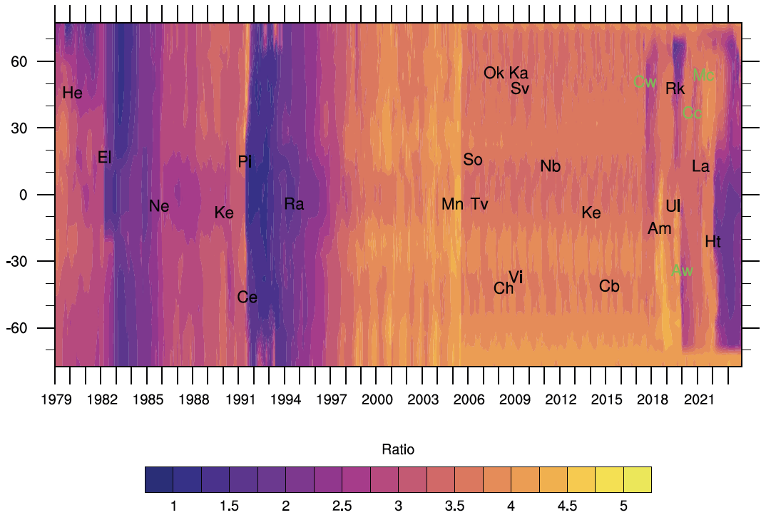
Stratospheric Aerosol Optical Depth Ratio (525/1020 nm)
OSIRIS+CALIPSO period
Major volcanic eruptions (black) and wild fire events (green) with abbreviated two-letter code with their respective latitude and time of occurrence that are listed here. The event names shown are St. Helens (He), El Chichon (El), Nevado del Ruiz (Ne), Kelut (Ke), Pinatubo (Pi), Cerro Hudson (Ce), Rabaul (Ra), Manam (Mn), Soufrière Hills (So), Tavurvur (Tv), Chaiten (Ch), Victoria (Vi), Okmok (Ok), Kasatochi (Ka), Sarychev (Sv), Nabro (Nb), Kelut (Ke), Calbuco (Cb), Canadian wildfire (Cw), Ambae (Am), Raikoke (Rk), Ulawun (Ul), Australian wildfire (Aw), California Creek Fire (Cc), La Soufrière (La), McKay Creek fire (Mc) and Hunga Tonga (Ht).
Notes:
Latitude versus time dependence of stratospheric aerosol optical depth (SAOD) ratio. Major volcanic eruptions (black) and wild fire events (green) with abbreviated two-letter code with their respective latitude and time of occurrence that are listed here. The event names shown are St. Helens (He), El Chichon (El), Nevado del Ruiz (Ne), Kelut (Ke), Pinatubo (Pi), Cerro Hudson (Ce), Rabaul (Ra), Manam (Mn), Soufrière Hills (So), Tavurvur (Tv), Chaiten (Ch), Victoria (Vi), Okmok (Ok), Kasatochi (Ka), Sarychev (Sv), Nabro (Nb), Kelut (Ke), Calbuco (Cb), Canadian wildfire (Cw), Ambae (Am), Raikoke (Rk), Ulawun (Ul), Australian wildfire (Aw), California Creek Fire (Cc), La Soufrière (La), McKay Creek fire (Mc) and Hunga Tonga (Ht).

Slide 24
Aerosol Extinction Coefficient
SASK 869 nm product is now publicly available along with University of Bremen (IUP) product at 869 nm.

Slide 27
Data used in GloSSAC
Instrument | Latitude | Period | Era
SAGE | All latitudes | 1979-1981 | The SAGE period
SAM II | 40-80 N, 10-80S | 1982-1984 | The SAGE gap period
NASA Airborne Lidar | 25 N- 25 S | 1982-1984 | The SAGE gap period
NASA 48-inch Lidar | 10-65 N | 1982-1984 | The SAGE gap period
SAGE II | All latitudes | 1984-2005 | SAGE II era
HALOE | All latitudes | 1991-1993 | SAGE II era
CLAES | All latitudes | 1991-1993 | SAGE II era
CALIPSO | All latitudes | 2006-2021 | OSIRIS/CALIPSO period
OSIRIS | All latitudes | 2005-present | OSIRIS/CALIPSO period
SAGE III/ISS | All latitudes | 2017-present | SAGE III/ISS

Slide 28
References
Thomason, L. W., Ernest, N., Millán, L., Rieger, L., Bourassa, A., Vernier, J.-P., Manney, G., Luo, B., Arfeuille, F., and Peter, T.: A global space-based stratospheric aerosol climatology: 1979–2016, Earth Syst. Sci. Data, 10, 469–492, https://doi.org/10.5194/essd-10-469-2018, 2018.
Kovilakam, M., Thomason, L. W., Ernest, N., Rieger, L., Bourassa, A., and Millán, L.: The Global Space-based Stratospheric Aerosol Climatology (version 2.0): 1979–2018, Earth Syst. Sci. Data, 12, 2607–2634, https://doi.org/10.5194/essd-12-2607-2020, 2020.
Kovilakam, M., Thomason, L., and Knepp, T.: SAGE III/ISS aerosol/cloud categorization and its impact on GloSSAC, Atmos. Meas. Tech., 16, 2709–2731, https://doi.org/10.5194/amt-16-2709-2023, 2023.
Bourassa, A. E., Zawada, D.J., Rieger, L.A., Warnock, T.W., Toohey, M., Degenstein, D.A.: Tomographic retrievals of Hunga Tonga-Hunga Ha’apai volcanic aerosol, Geophysical Research Letters, vol. 50, no.3, p. e2022GL101978, 2023. e2022GL101978 2022GL101978
The Science Directorate at NASA's Langley Research Center: External Peer Review

