Slide 1
SAGE III/ISS Quicklook Website Updates
Kevin R. Leavor
Lead Data Scientist
Mary Cate McKee, Rick Farmer,
Greg Paxton, David Flittner, Marilee Roell
23 October 2024

Slide 2
Overview
The Quicklook (and Expedited) Website(s)
Your Website Team
Managing the Website, but not your Expectations
2024 Updates
Sonde Comparison
Diurnal Separation
Tropopause Filtering
Event Highlights
What’s Next?

Slide 3
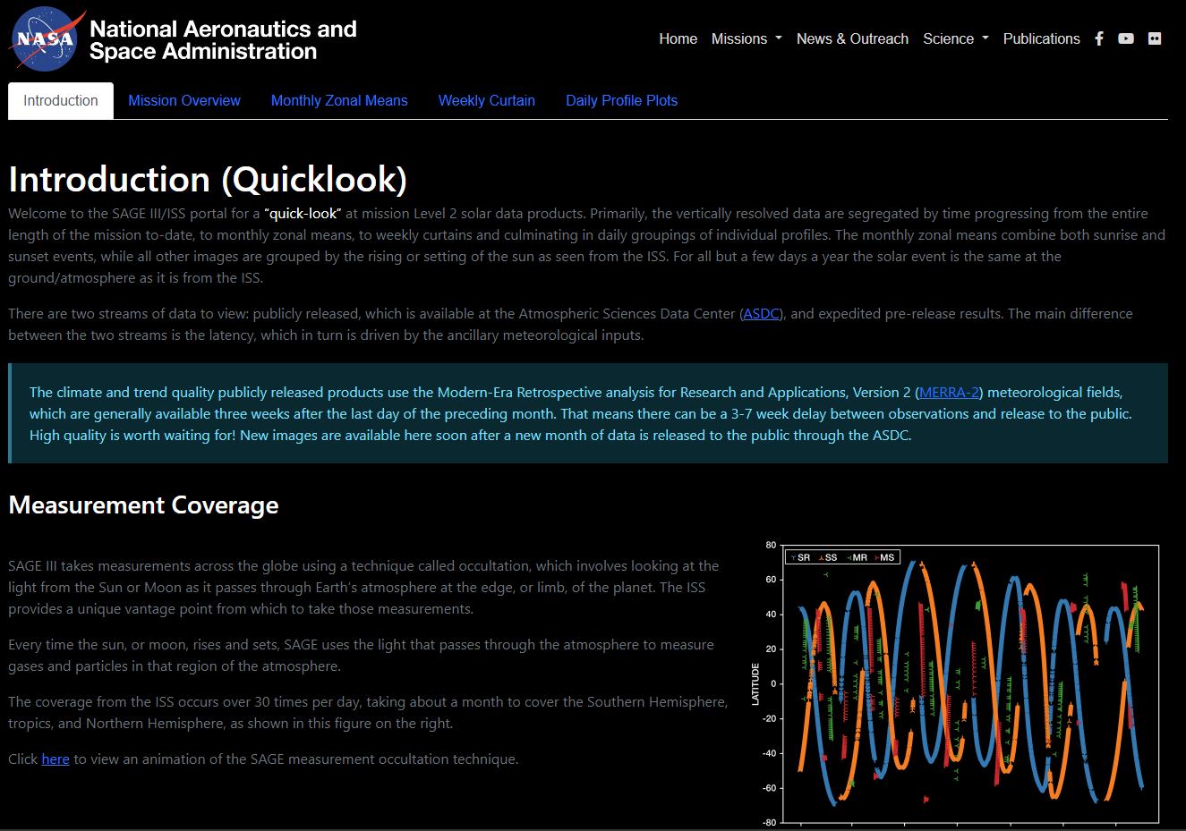
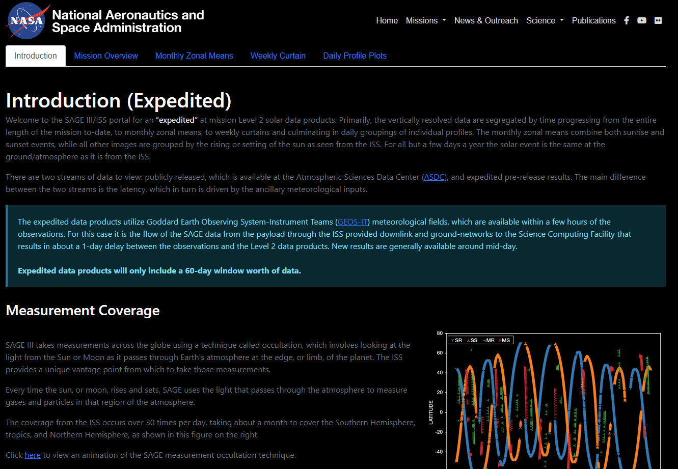
The Quicklook Website
Quicklook – Release Product Version https://sage.nasa.gov/sageiii-iss/browse_images/quicklook/
Expedited – Pre-Release internal product using GEOS https://sage.nasa.gov/sageiii-iss/browse_images/expedited/

Slide 4
The Quicklook Website
But I only remember base URLs! https://sage.nasa.gov

Slide 5
Your Website Team
Science Content
Kevin Leavor
Processing, Management
Mary Cate McKee
Ground validation
David Flittner
Science objectives, content review
Marilee Roell
Science management, content review
Web Content and Support
Rick Farmer
Web development, backend
Greg Paxton
Ground systems management, process review
Caitlyn Stone
Operations, Partner communication

Slide 6
Managing Website Updates
All website features are managed through NASA Agency GitHub
Website backend
Content generation
Issues track required actions
Bugs (what bugs?)
User requests
Feature opportunities
Issues are organized into Milestones
Parallel Milestones are tracked in Projects

Slide 7
Managing Website Updates

Slide 8
Managing Website Updates
3 Servers for Development
Dev server for web development
Test server to merge and review design and content changes
Prod server for public-facing locked version

Slide 9
Website Update

Slide 10
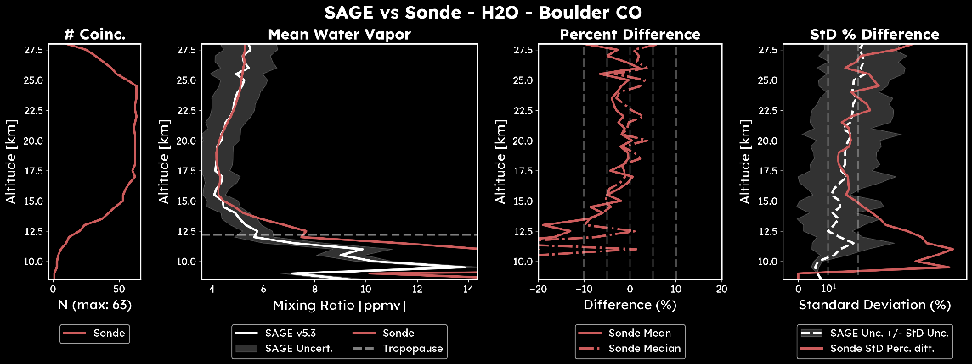
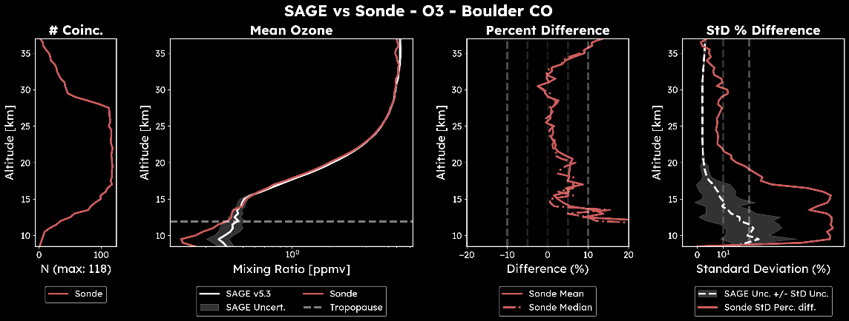
Website Updates – Sonde Comparisons

Slide 11
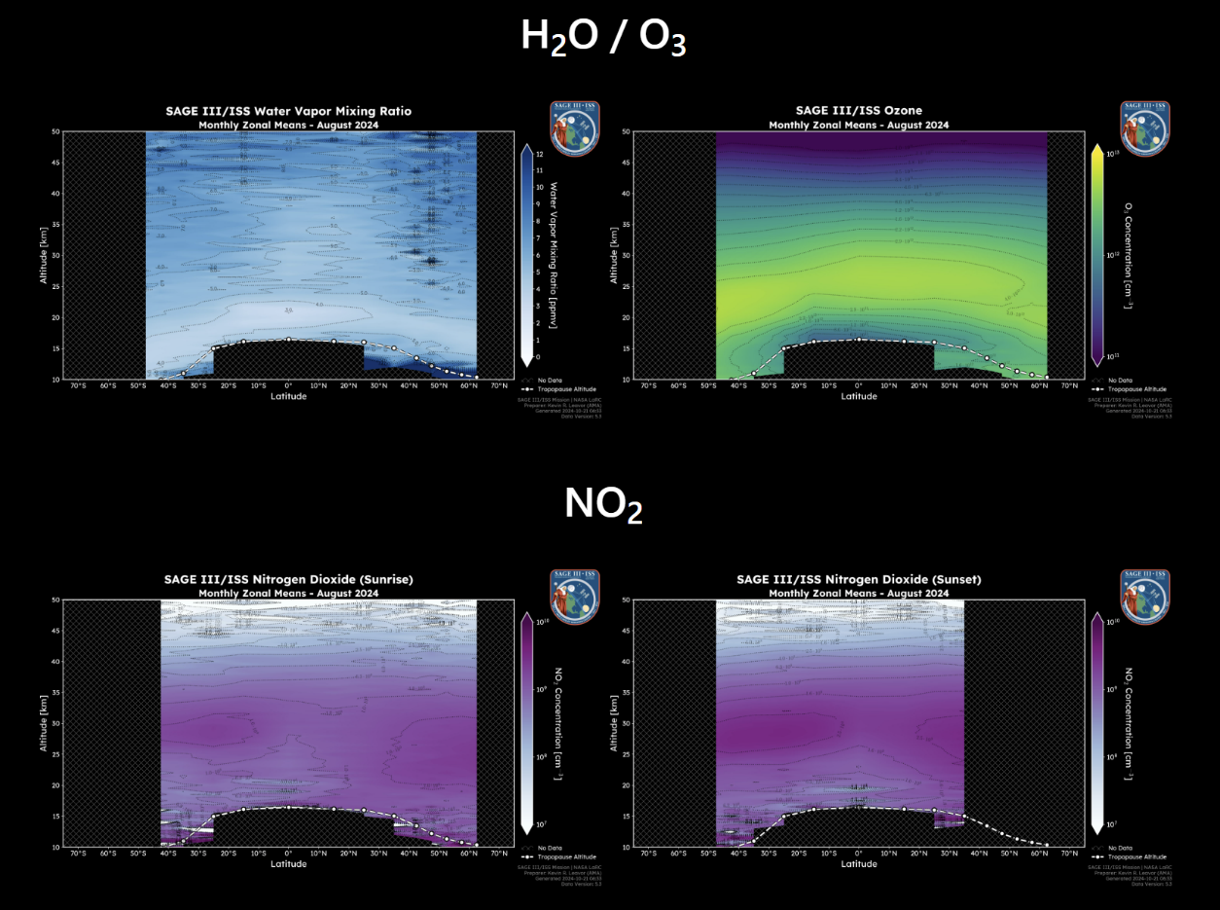
Website Updates – Diurnal Separation (NO₂)

Slide 12
Website Updates – Diurnal Separation (NO₂)

Slide 13
Website Updates – MZM Filtering

Slide 14
Website Updates – MZM Filtering

Slide 15
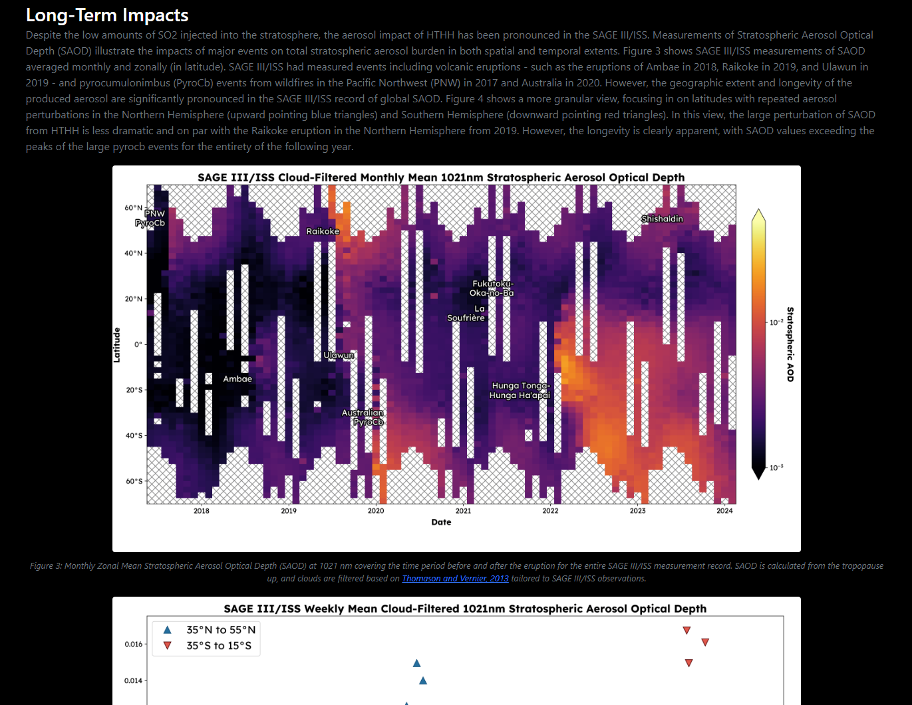
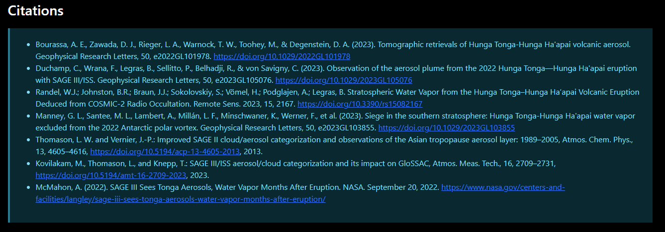
Website Updates – Event Highlights

Slide 16
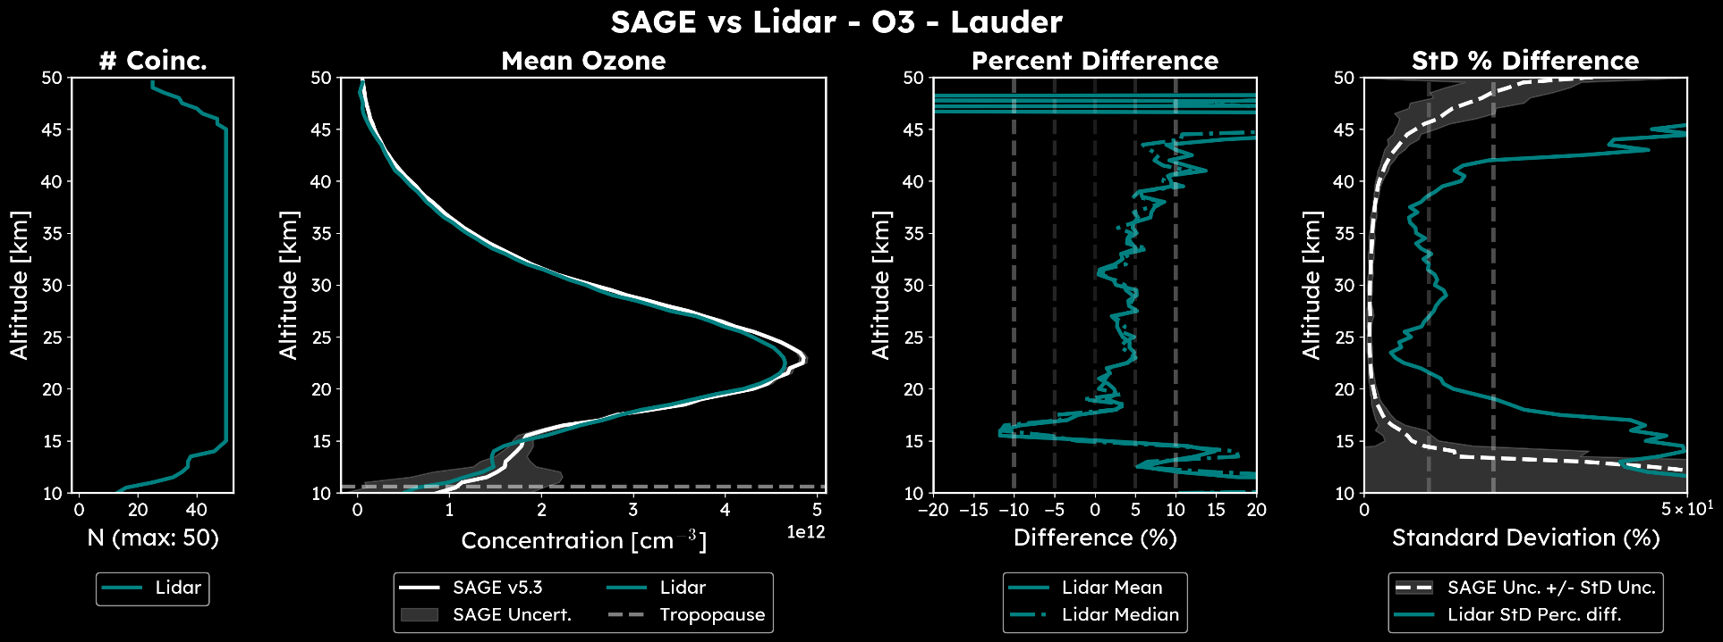
What’s Next?
Adding lidar to comparisons

Slide 17
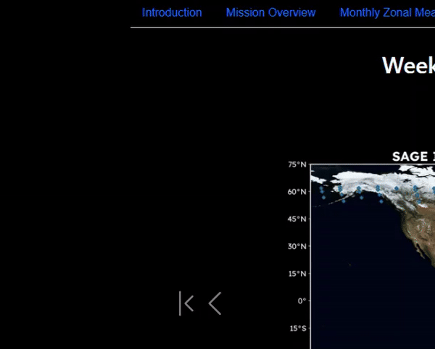
What’s Next?
Adding lidar to comparisons
Additional highlights
Sticky Navigation
Hover content on maps
6.0 Integration
Homogenized data comparisons
Suggestions from YOUR FEEDBACK!
Planning additional updates by EOY and over the next year

Slide 18
Questions
Thanks for your attention and interest!
Contacts for feedback and suggestions:
larc-dl-sage-predictions@mail.nasa.gov
Caitlyn: c.a.stone@nasa.gov
Kevin: kevin.r.leavor@nasa.gov
Mary Cate: marie.c.mckee@nasa.gov
Dave: david.e.flittner@nasa.gov

