Slide 1
SAGE III/ISS Website – Sonde Comparisons Tab
Mary Cate McKee
SAGE III/ISS Data Scientist
Kevin Leavor, Rick Farmer,
Greg Paxton, David Flittner, Marilee Roell

Slide 2
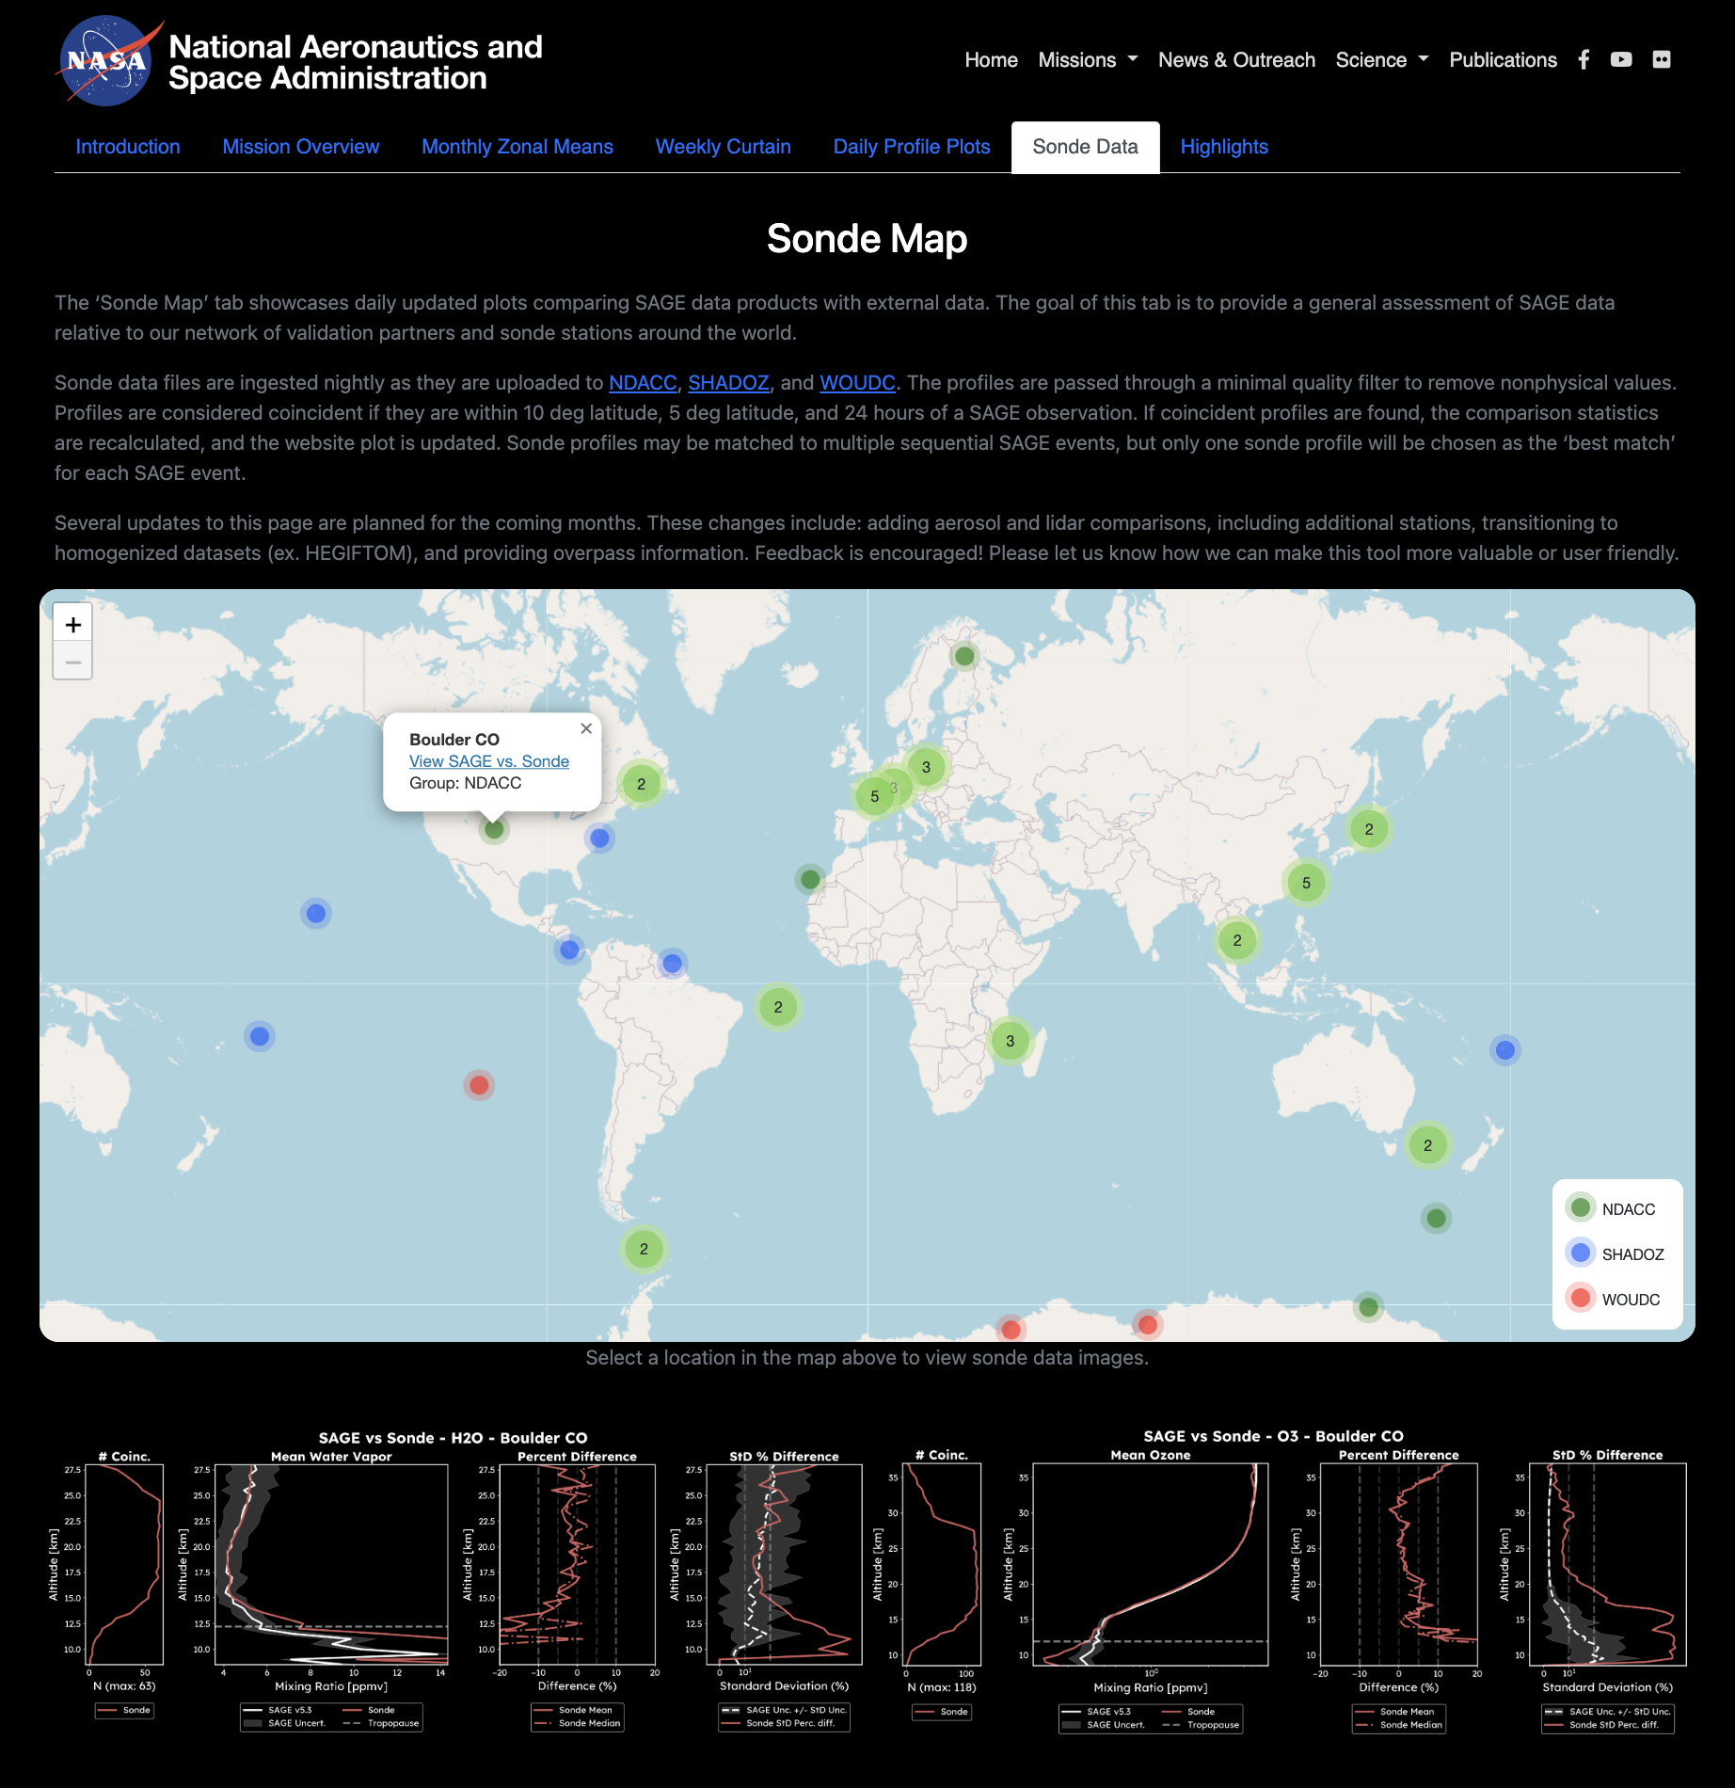
Outline
Introduction
Data Processing
Plot Features
Recent Plot Upgrades
Coming Soon:
Data Additions
Site Changes
Participation
Contact Info

Slide 3
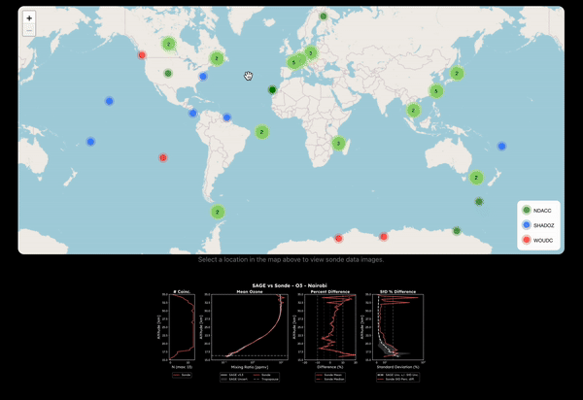
Introduction to Sonde Comparisons Tab
SAGE vs sonde O₃ and H₂O comparison plots
Data sources:
50 stations via NDACC, SHADOZ, WOUDC
2721 coincidences / 12,259 profiles = 22.2%
Goal:
Highlight efforts of validation partners and data providers
Promote collaboration and discussion

Slide 4
Data Processing
Automated process to download and read new files daily
Sonde data filter:
Pressure < 5 hPa, Values < 0
SAGE data filter:
Below tropopause + 1km altitude, Relative uncertainty > 100%
Coincidence criteria:
± 24 hours, ± 5 degrees latitude, ± 10 degrees longitude
Updated plots pushed to the website with any new matches

Slide 5
Plot Features

Slide 6
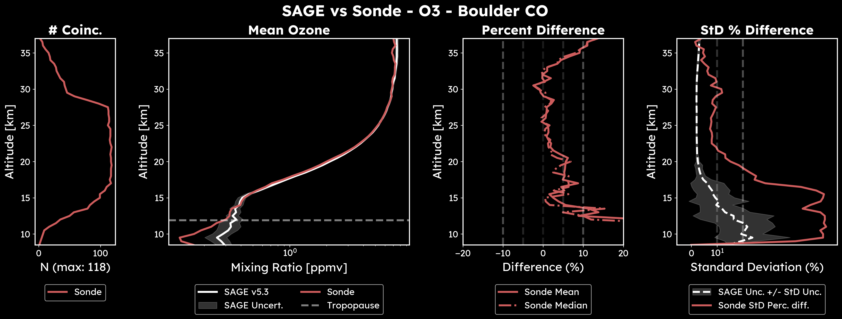
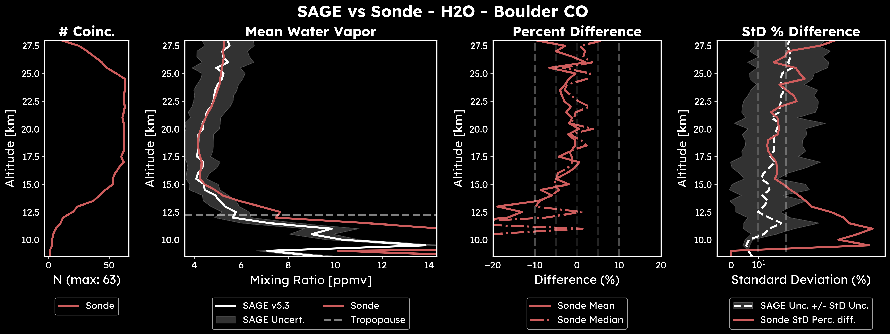
Recent Plot Upgrades
Updated plot style: visually consistent with website content
Units in mixing ratio
Log scale on x-axis

Slide 7
Coming Soon:
Data additions:
Ozone and aerosol lidar comparisons (preview on next slide)
Aerosol sonde comparisons
‘Extra’ data (ex. Short-term campaigns, newly processed data, etc.)
Additional stations
Include homogenized sonde and lidar datasets provided by HEGIFTOM
Site additions:
Overpass information
New plot types (ex. timeseries, scatter plots)
Additional map functionality

Slide 8
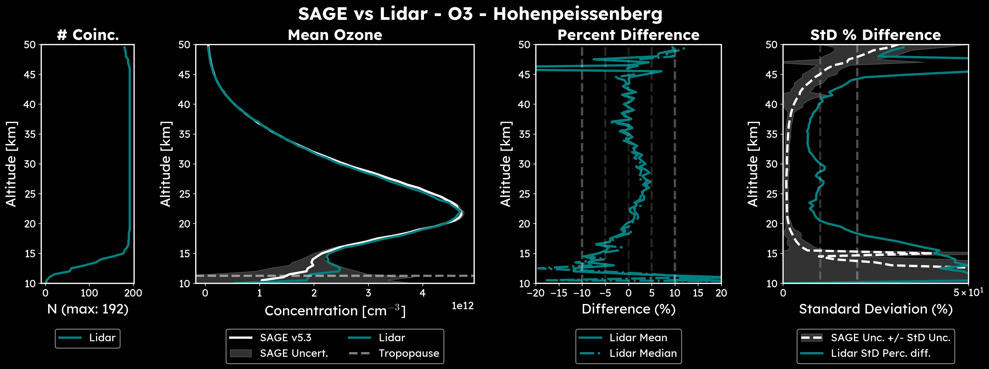
Coming Soon: O₃ Lidar Comparisons

Slide 9
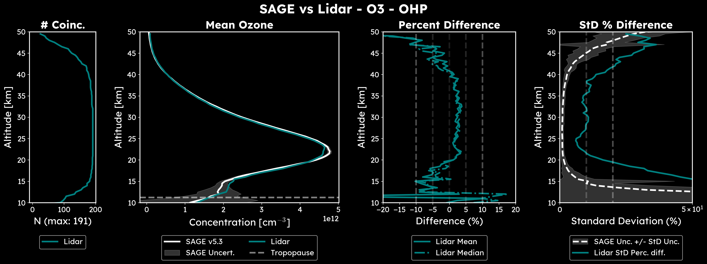
Coming Soon: O₃ Lidar Comparisons

Slide 10
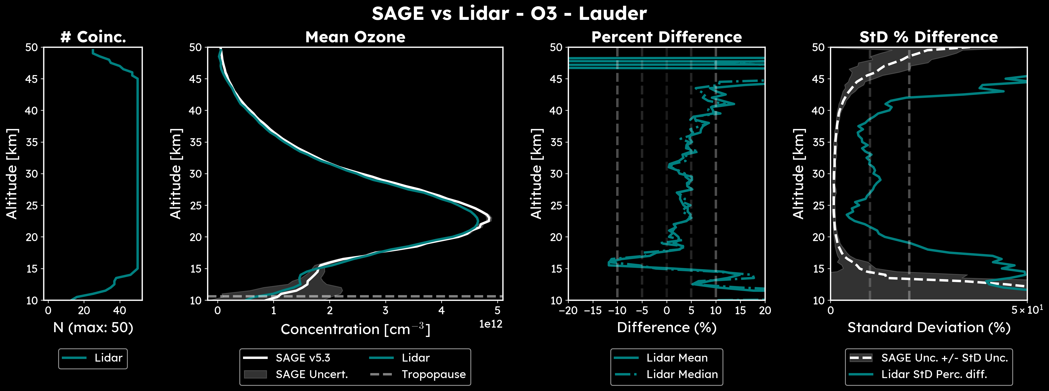
Coming Soon: O₃ Lidar Comparisons

Slide 11
Participation
Predicts: Weekly emails listing upcoming SAGE III/ISS overpasses coincident with your location
Accounts for potential blockages, reboosts, changes in ISS schedule
Specify desired time range
Please reach out to Caitlyn Stone (c.a.stone@nasa.gov ) to be added to event prediction email list

Slide 12
Contact Information
General validation communications, feedback:
larc-dl-sage-predictions@mail.nasa.gov
Data processing, plots, sonde map:
Mary Cate McKee: marie.c.mckee@nasa.gov
Predicts, overpass information:
Caitlyn Stone: caitlyn.a.stone@nasa.gov

