Slide 1
Science Team Meeting
NASA Langley Research Center
10/22/2023

Slide 2
Mission Operations
Jamie Nehrir
Mission Operations Manager

Slide 3
Outline
Mission Operation Overview
What Has Change in the Last Year
Future Work

Slide 4
Ops Overview
Mission Operations Goals
  Commanding and downloading data on a weekly/daily basis
  Respond to anomalies within a timely manner
    Average response is about 4.9 hours (time from the anomaly to returning to science taking)
  Maintaining the health and safety of the SAGE III payload
    Daily engineering checks
    Trending of engineering data and science metrics
    Supply contamination data to ISS for a detailed understanding of the space environment
    Execute maintenance activities (Boresight alignment analysis, Attenuator mechanism trending, CCD Characterization analysis, Azimuth Range of motion execution)
  Process and distribute SAGE III data
    Process Ground Support Equipment (GSE) and Solid State Memory Card (SSMC) in near real-time (8-5 ET)
    Processes 24 hours of SSMC data daily
    Generates daily SCF files
      Level 0 and ancillary data
    Generates and distributes daily ESA/TASI Hexapod data files

Slide 5
Ops Team
SAGE III Payload Operations Center
Jamie Nehrir | Mission Operations Manager
Andrew Peterson | Ground System Lead
Greg Paxton | Ground Systems Manager
Samuel Porter | Deputy Mission Operations Manager
James Farmer | Ground Systems Engineer
Rick Farmer | Ground Systems Engineer
Caitlyn Stone | Payload Engineer
Donald Cleckner | Payload Engineer
James Losey | Payload Engineer/ Contamination Engineer
Kenta Funada | Payload Engineer

Slide 6
SAGE III Operations
SAGE III celebrated its 7th birthday on board the International Space Station
The SAGE III payload continues to operate as expected
SAGE has acquired over 70,000 occultation events!!

Slide 7
Phase-E Totals
7/1/2017 00:00 to 10/2/2024 09:00
Event Type | Total Planned | Total Acquired | Total % Acquired (vs. Planned)
Sunrise | 36927 | 33533 | 90.8%
Sunset | 36922 | 31760 | 86%
Moonrise | 5004 | 1803 | 36%
Moonset | 5334 | 3022 | 56.7%
All Occultation | 84187 | 70118 | 83.3%
Limb | 29372 | 28523 | 97.1%

Slide 8
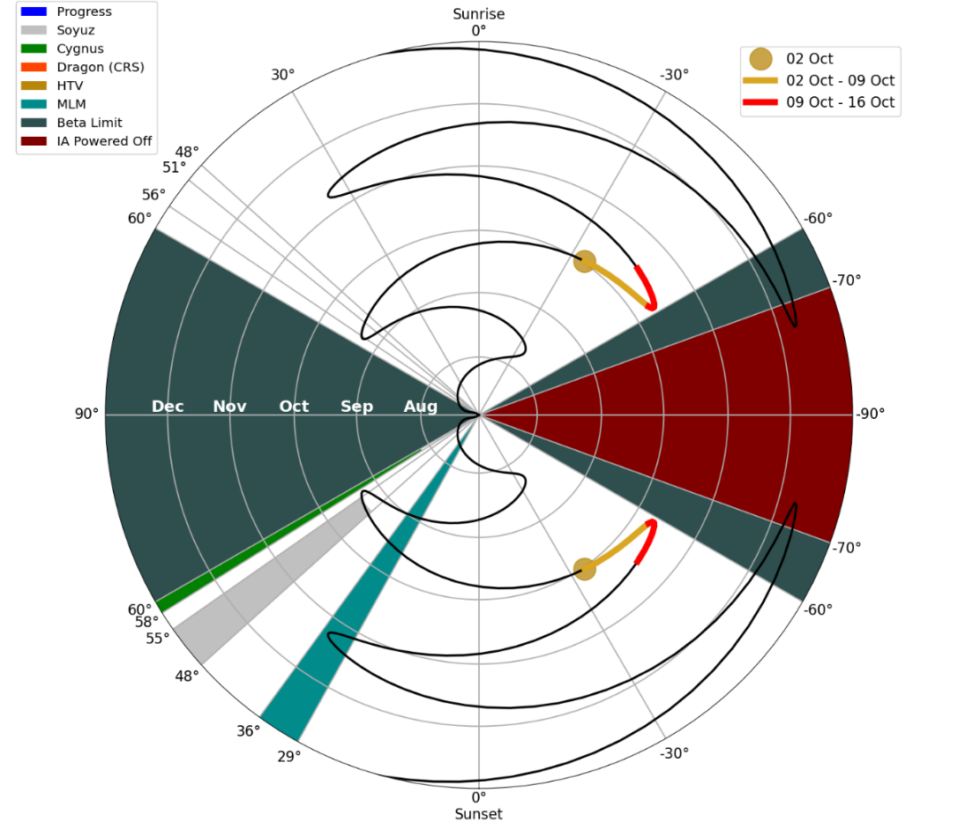
Blockages
The operations team actively monitors blockages from visiting vehicles and reports those to both the science team and external partners on a weekly basis

Slide 9
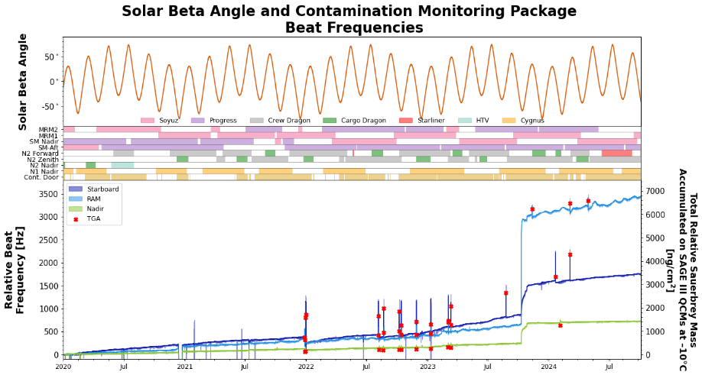
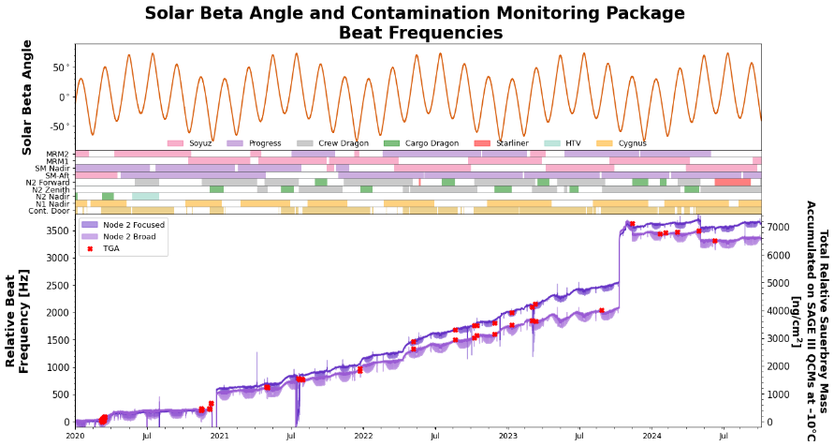
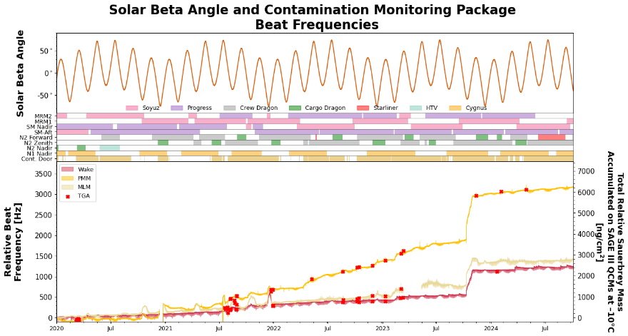
Contamination on ISS
Normal daily contamination on station has remained consistent over the past 7 years
  Outside of the three ISS contamination leaks the contamination on station mainly comes from visiting vehicles. The operations team maintains the safety of the internal optics by closing the contamination window while notable contamination is being measured by the CMP’s.
Node2
Node2 Focus
Wake
PMM
MLM

Slide 10
ISS Contamination Anomalies
Last year during the science team meeting the first two contamination events were mentioned. These events occurred in December 2022 and February 2023
Following last year’s science team meeting in October 2023 a third contamination event occurred. A leak was observed coming from the MLM radiator, this leak was significantly larger than the previous two leaks.

Slide 11
Contamination on ISS Cont.
Refresher: Two unexpected rapid contamination events occurred on station late 2022 and early 2023.
  December 14th, 2022 a Soyuz payload unexpectedly started leaking isooctane. CMP sensors in every direction recorded rapid contamination. By December 15th all sensor started to see desorption.
  February 11, 2023 a Progress payload experienced a similar contamination leak but this time the substance was polydimethylsiloxane which unlike the previous leak did not desorb from any of the sensor surfaces
Soyuz Leak
Progress Leak

Slide 12
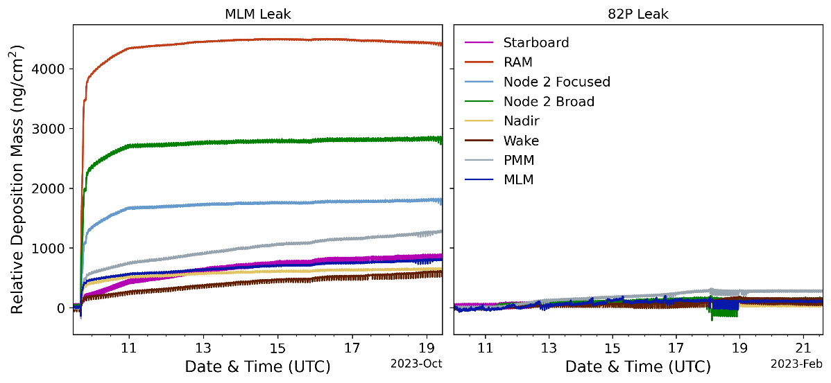
MLM Leak Update
At ~17:20 on 10/09/2023 a leak was reported on Russia’s MLM module. With a total volume of fluid leaked reported to 72 liters of polydimethylsiloxane silicone.

Slide 13
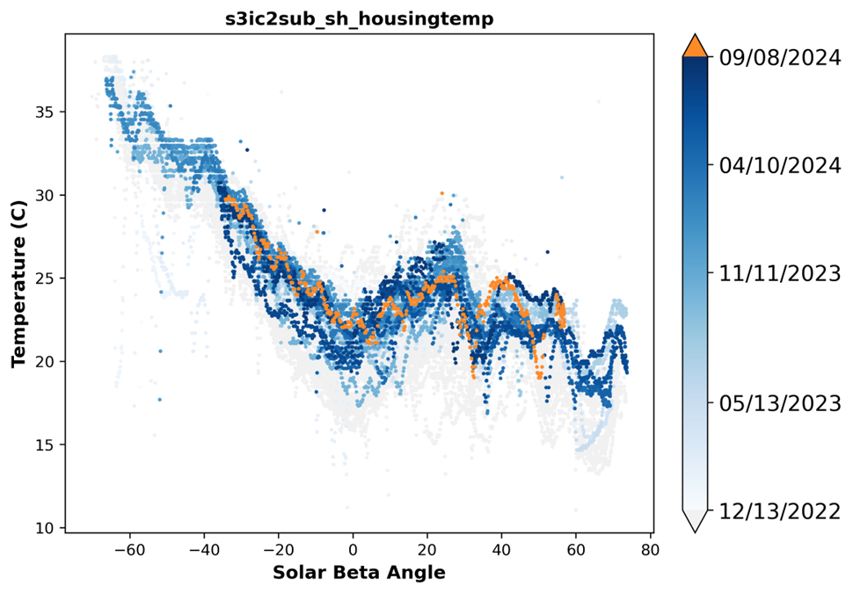
Contamination Cont.
SAGE III has continued to monitor and assess impacts to thermal control surfaces and the science optical train. No notable impacts to our thermal surfaces has been seen.
No significant changes to the optical train have been noted from the these leaks.

Slide 14
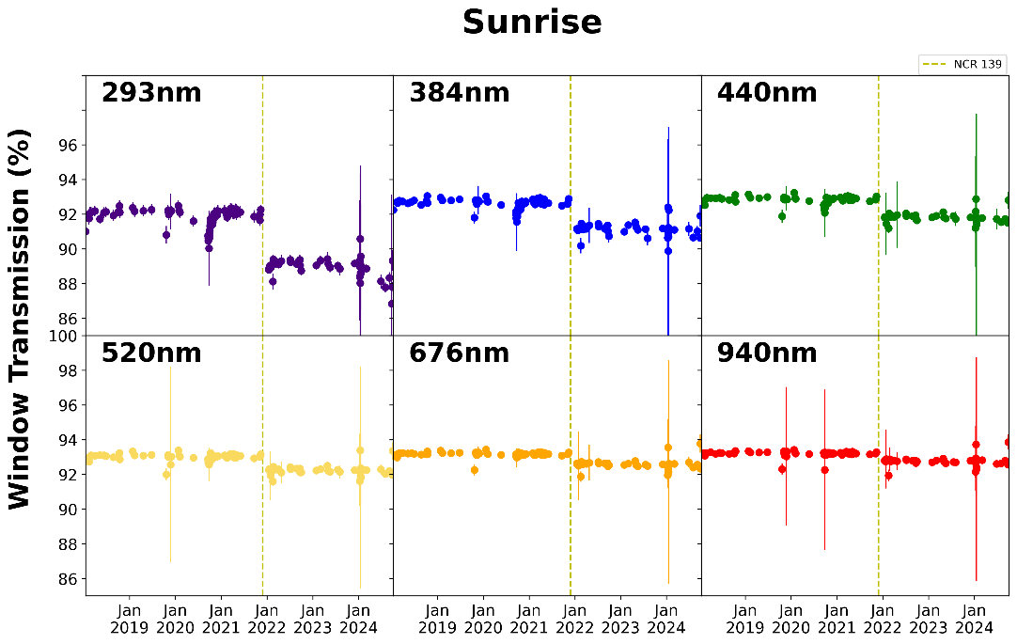
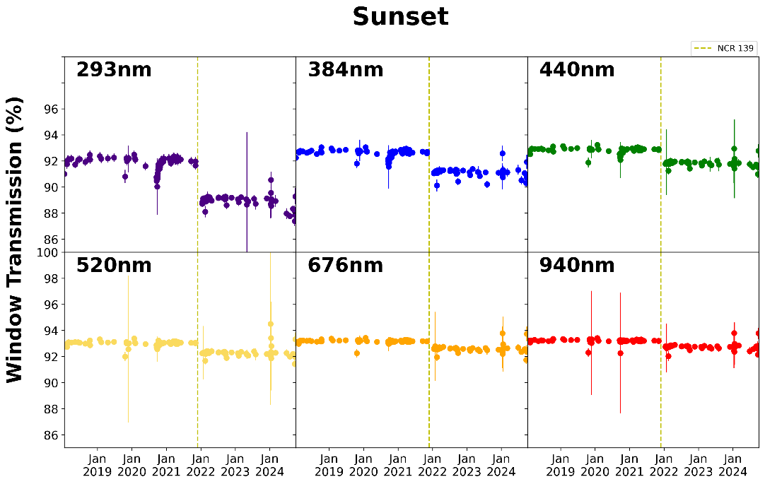
Window Transmission update
SAGE III Transmission through the contamination window
  As presented previously, a single event impulse contamination event occurred on November 29, 2021. The SAGE III team has continued to monitor the transmission, and no additional degradation has been observed.

Slide 15
Payload Trending Highlights
The operations team reviews data daily but an additional extensive review of all data is done annually. Two items of note have been observed
  The main observation for the SAGE III payload is a thermal warming of the entire system. The observed warming of the payload is expected due to the aging of the payload. No unexpected/anomalous warming has been observed!
  Degradation of the Disturbance Monitoring Package laser intensity has been observed.

Slide 16
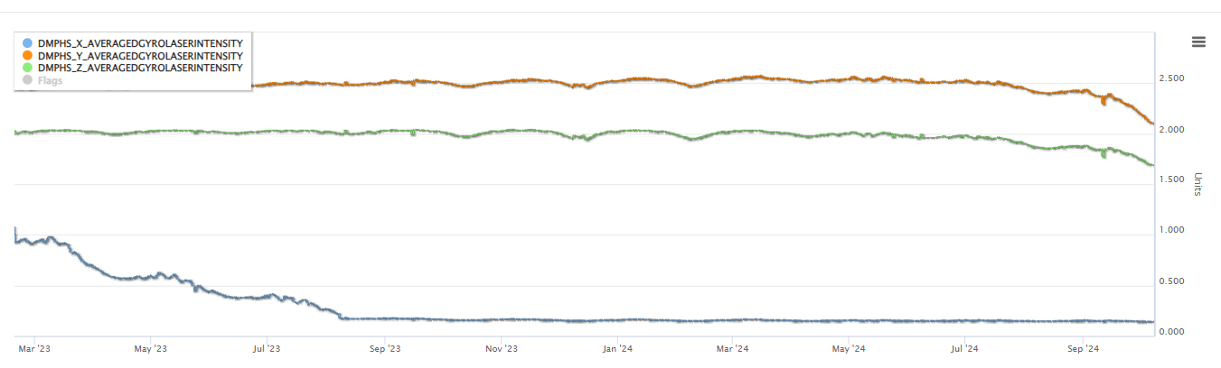
DMP Laser Intensity
The Operations team noted in July 2022 that the X-axis gyro laser intensity was decreasing in intensity, the full degradation of that sensor was observed in August of 2023.
During the last trending review the operations team noted that the Y and Z axis were starting to degrade similar to the X-axis.
X-Axis Laser Intensity
Y-Axis Laser Intensity
Z-Axis Laser Intensity

Slide 17
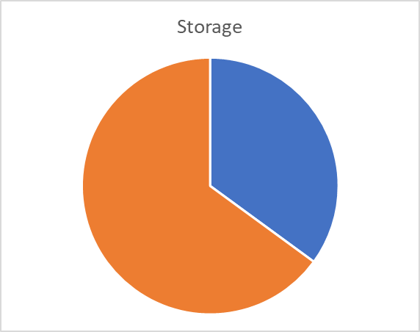
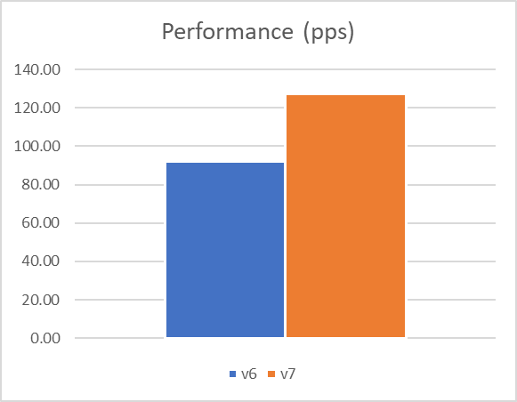
Ground System
New version of ParameterLoader
  35% less storage used
    Current storage will last through 2031
  27% increase in packets processed per second
  Near Real-Time
    Added the NRT DB as a Latest Recorded Value (LRT) table to ease data calls for the website
    All parameters received in NRT are written to a single table with 1 row per parameter
      Previous website calls involved multiple tables with complex JOINs

Slide 18
Future Work
Update Instrument Assembly code to allow for tracking through low clouds.
  The SAGE III engineers along with the science team are working to incorporate a new feature, called smart scanning, which would allow for the SAGE III payload to recapture the sun following an obscuration through a cloud.
  The SAGE III operations team is hoping to load this but with the reduction in operations team the work for this has slowed down but will continue to move forward as availability allows.
A new Robo survey is due for the payload
  The last Robo survey was conducted in 2022 and so it is time for the a new visual survey to see how the surfaces are aging
  This is done when the robotic arm is within our area and contingent on the robotic arm schedule

Slide 19
Questions

Slide 20
Notes on Time Series
Deposition masses are reported relative to the respective start of the time series
The 1-σ error intervals were computed from the solar flux-induced thermal noise on the TQCM crystal beat frequencies
The time series plots show how much contamination was directly deposited onto each sensor. (No vacuum conductance corrections through the sensor inlets are made to derive incident flux)
At ~17:20 on 10/09/2023 a leak was reported on Russia’s MLM module. With a total volume of fluid leaked reported to 72 liters of polydimethylsiloxane silicone.

