Slide 1
Resolving the Aerosol Seagull Problem in SAGE III/ISS 6.0.0 Data Products with Updated Ozone Absorption Cross Sections
M. Heitz, R. Manion, D. Flittner, R. Damadeo, M. Roell

Slide 2
Seagull
Larry Thomason first came up with the description and labeled it as the “aerosol seagull”
A seagull shape to the aerosol spectrum is only possible for rather unique size distributions/composition, which we don't really believe happens in the stratosphere. You could think of the shape as being unphysical.

Slide 3
Introduction
Version 5.30 and previous version had a noticeable dip in the retrieved aerosol vs a power law fit in the 520, 602 and 676 nm channel
Suspected that ozone cross-sections were the problem
Sciamachy version 3, 4 and Serdyuchenko 2014 cross-sections were used to test this hypothesis
Issues with cross-section convolution involving the point spread function, solar spectrum and the Serdyuchenko cross-sections delayed the discovery of the “solution”

Slide 4
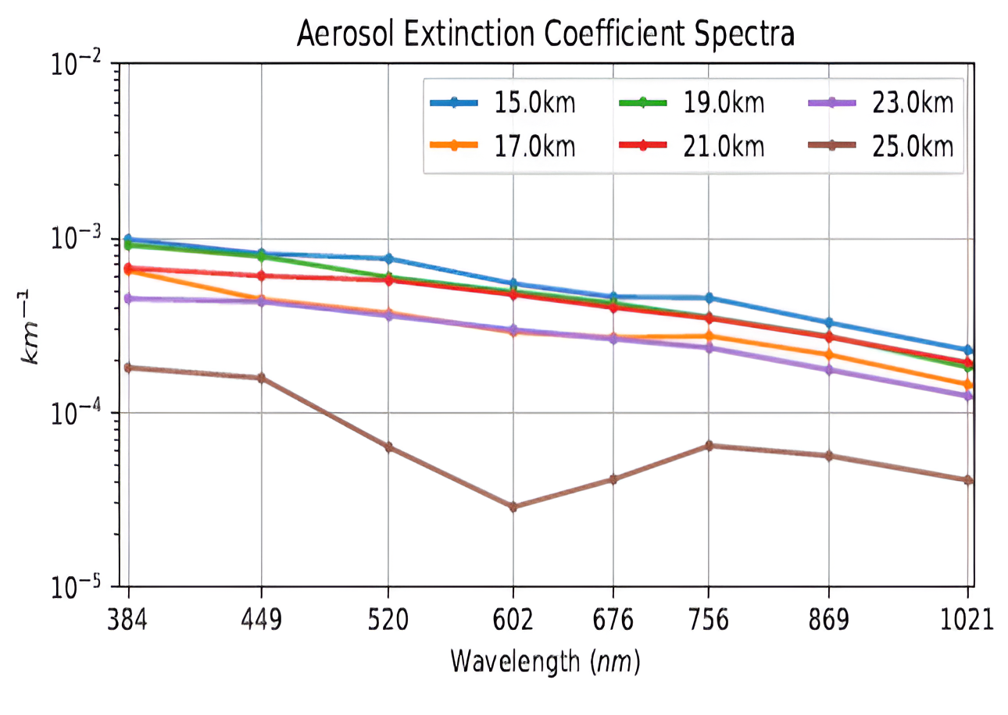
Single event example

Slide 5
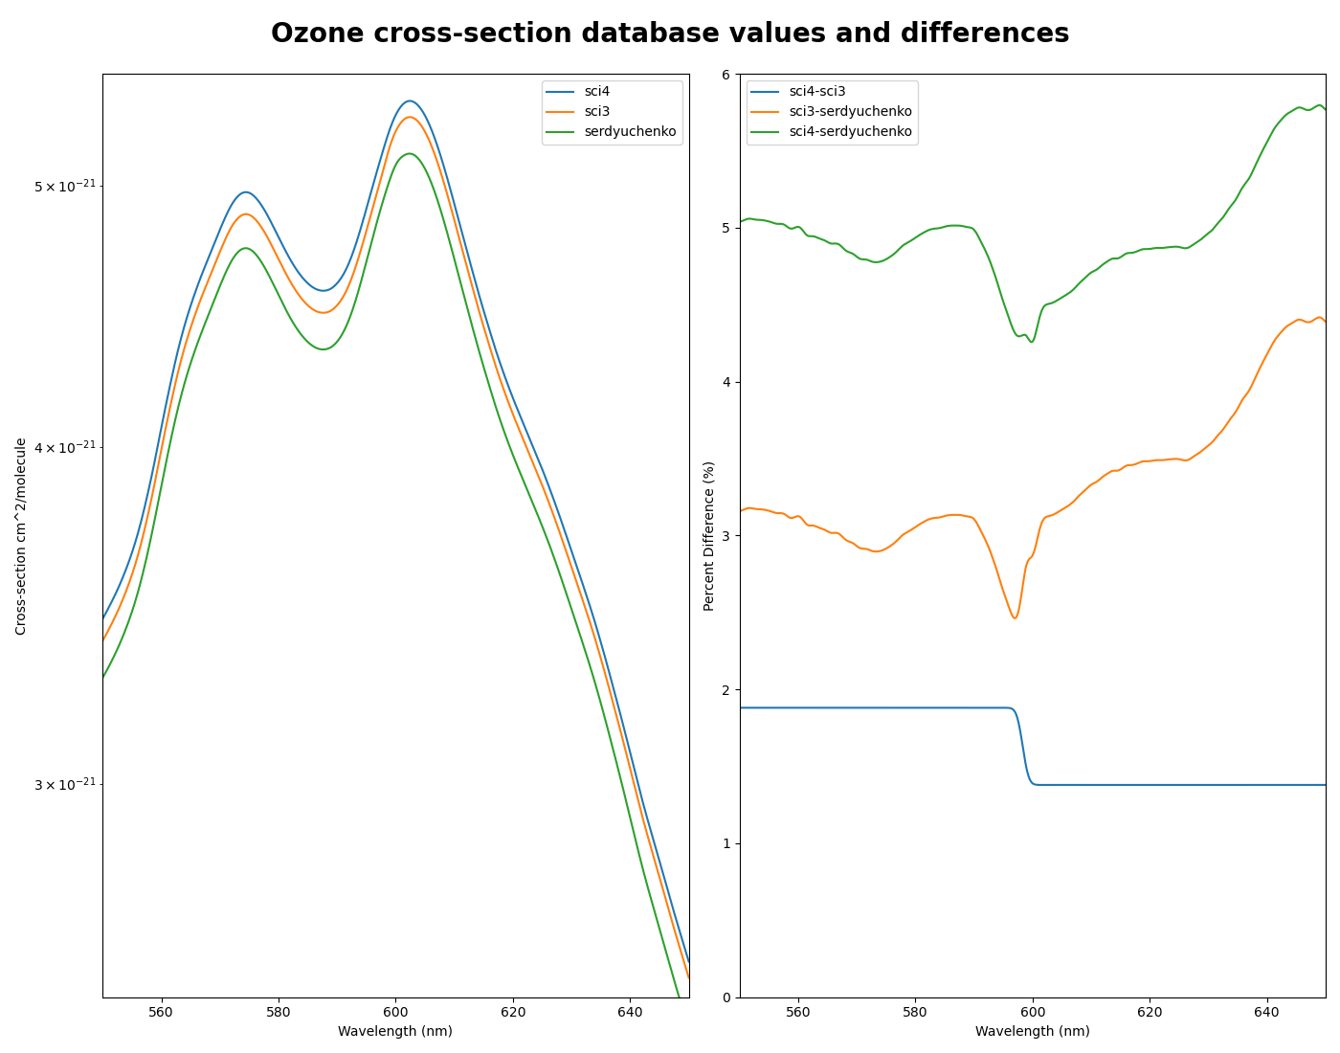
Cross-section comparisons
Blue: SCIAMACHY Version 4.0 (2012)
Orange: SCIAMACHY Version 3.0 (2004)
Green: Serdyuchenko-Gorshelev Version 1.0 (2014)
Green: Sciamachy 4 – Serdyuchenko 2014
Orange: Sciamachy 3 – Serdyuchenko 2014
Blue: Sciamachy 4 – Sciamachy 3

Slide 6
New Spectroscopy Module
With the testing of a new ozone cross-section database it was proposed that a new spectroscopy module would be created
Previous work had pre-convolved the cross-sections and generated lookup tables to be referenced
New module generates the cross-sections convolutions event by event
Now using TSIS-1 HSRS version 2 solar spectrum data https://doi.org/10.1029/2022EA002637

Slide 7
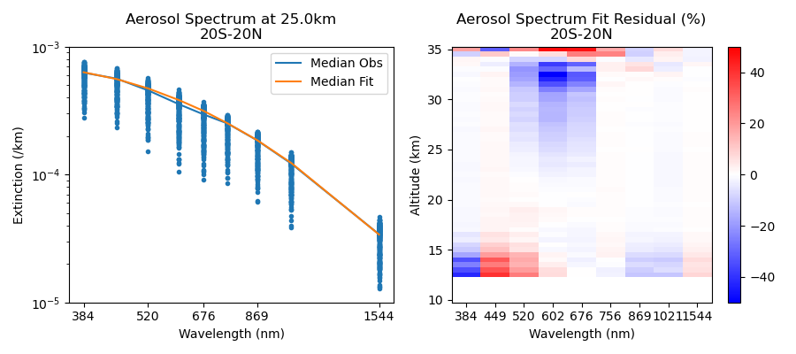
June 2021 Version 5.3 Sciamachy 3

Slide 8
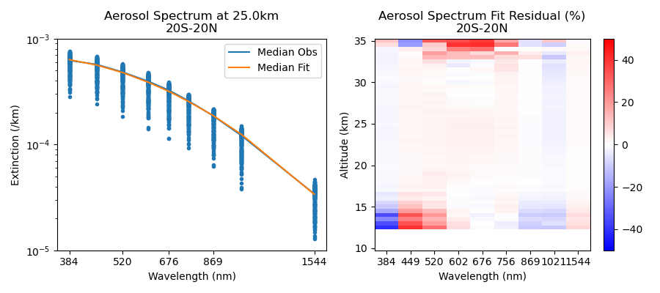
June 2021 Version 6.0.0 Serdyuchenko

Slide 9
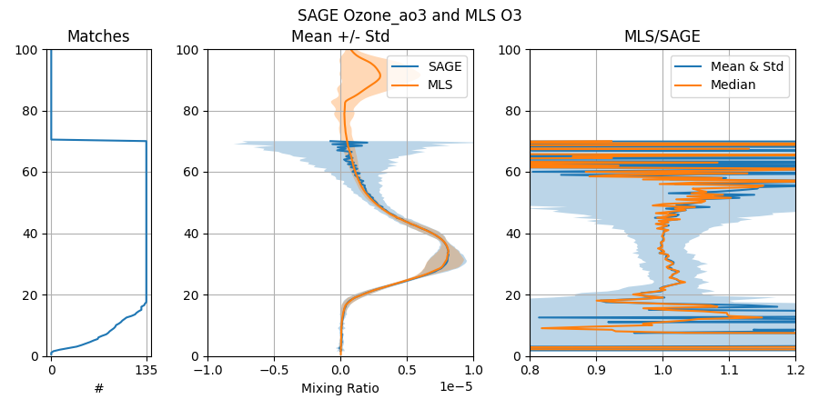
Version 5.30 vs MLS version 5

Slide 10
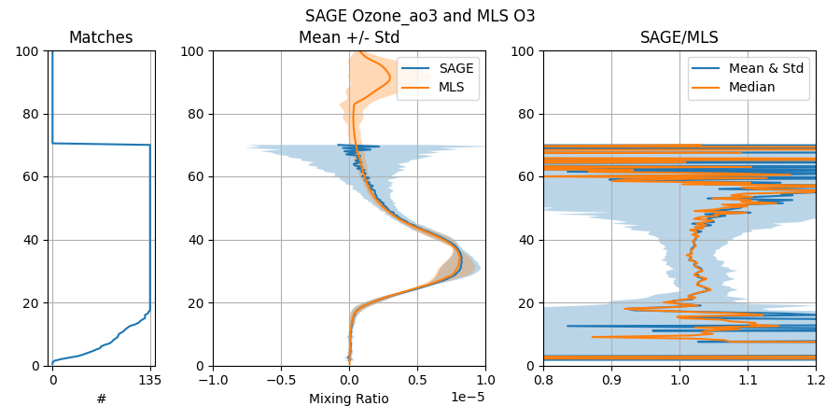
SAGE III/ISS version 6.0.0 vs MLS version 5

Slide 11
Conclusions
Noticeable improvements to the aerosol seagull have been achieved with the Serdyuchenko 2014 cross-sections
A slightly positive bias is now seen but of a much smaller magnitude than the seagull negative bias
An increase in the amount of ozone being retrieved is seen which leads to a ~2% difference in comparison to MLS version 5.

Slide 12
Future Work
Further work into the point spread functions will be investigated
Attempt to remedy the high bias in the shorter wavelength pixel groups and the low bias in the higher wavelength pixel groups used in the AO3 retrieval.

Slide 13
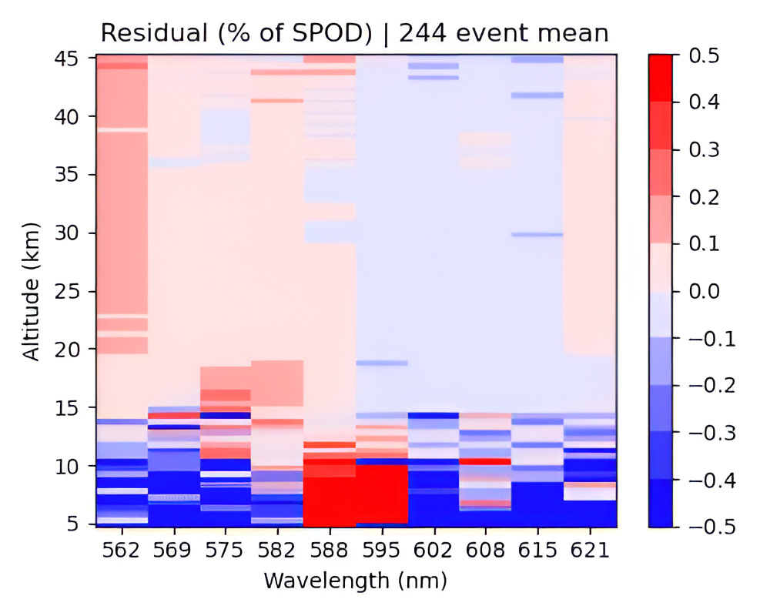
10 pixel groups used in ao3_ozone

Slide 14
Acknowledgments
SAGE III/ISS is a NASA Langley managed mission funded by the NASA Science Mission Directorate within the Earth Systematic Mission Program.
Enabling partners are the NASA Human Exploration and Operations Mission Directorate, International Space Station Program and the European Space Agency.
AMA personnel are supported through the RSES contract
SAGE III/ISS data can be found at https://asdc.larc.nasa.gov/project/SAGE%20III-ISS

Slide 15
Questions?
Contacts:
Michael Heitz
michael.l.heitz@nasa.gov
David Flittner
david.e.flittner@nasa.gov
Robert Damadeo
robert.damadeo@nasa.gov

