Slide 1
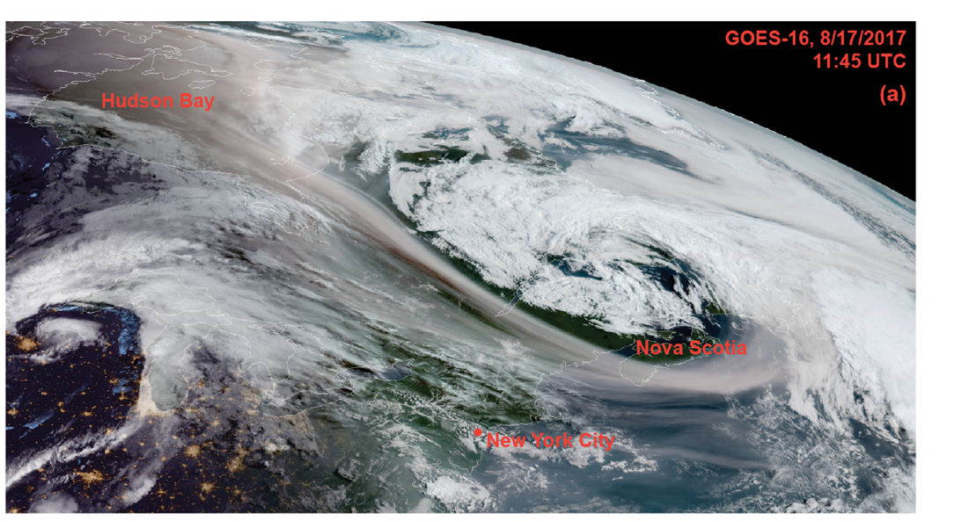
Smoke Transport into the Stratosphere
smoke

Slide 2
Outline
Fires: Do they influence stratospheric aerosol loadings ?
The Pacific North West (PNW) Fires in August 2017
Influence of PNW on stratospheric aerosol loadings seen by SAGE III/ISS
Initial transport of the plume to the stratosphere through GEOS-Chem simulation
Conclusion/future works.

Slide 3
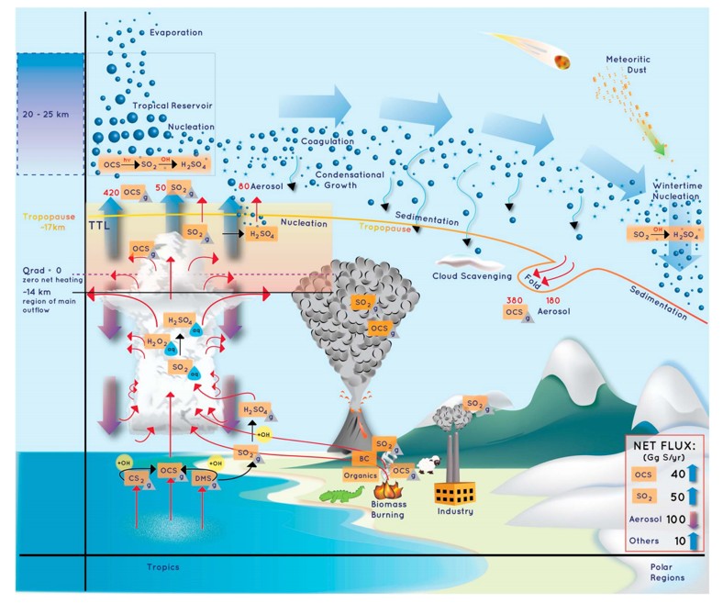
Stratospheric Aerosol: Are there Significant Missing Sources ?
Initial mass estimate from the 2017 Pacific NorthWest fire yield equivalent mass loadings of a mid-size volcanic eruption (0.1-0.3 Tg). Peterson et al., 2018
Increase in large wildfires observed across boreal forests may result in increasing influence.
Kremser et al., 2016

Slide 4
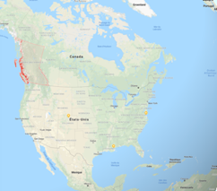
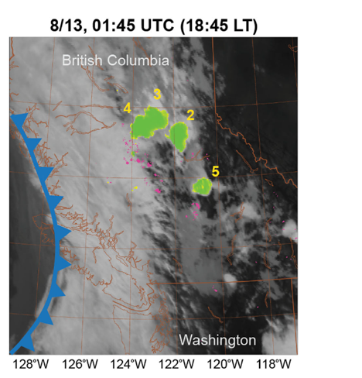
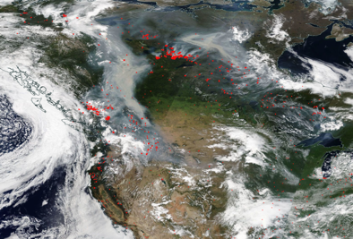
The Pacific NorthWest Fire (August 2017)
PyroCb observed through Cloud Top Brightness temperatures (GOES-16)
FIRES
Cold front
Fires
Cold front
Warm air moving
From SW
Peterson et al., 2018
MODIS/Terra August, 13th
Multiple PyroCb clouds observed ahead of a cold front and triggered by warm air
PyroCb clouds reaching up to tropopause levels (11-12 km)

Slide 5
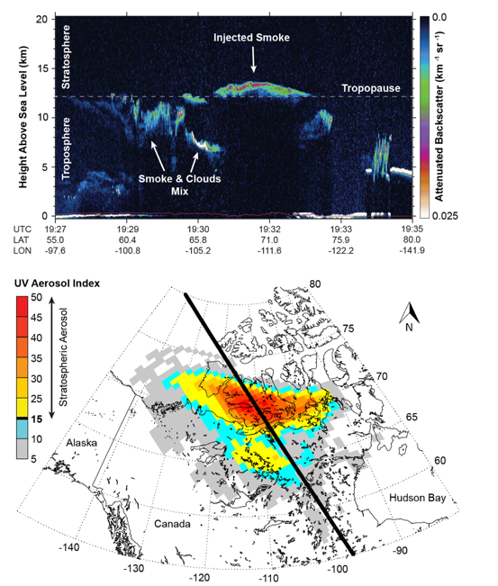
Smoke in the stratosphere seen by CALIPSO
smoke
CALIPSO daytime overpass on August, 14th-Plume top near 14 km likely into the stratosphere
UV aerosol Index show the horizontal extension of the smoke plume : 800,000 km2.
How was the plume transported ?
Direct PyroCb injection and/or other mechanisms ?
Peterson et al., 2018
Notes:
7 AI is sensitive to the altitude of the lightabsorbing
smoke particles that make up pyroCb plumes (e.g.,
black and brown carbon), with stratospheric layers corresponding
to the largest values (e.g., >15–20).1 On 14 August, AI values
measured over a large portion of northern Canada exceeded
those of any known pyroCb plume on record2

Slide 6
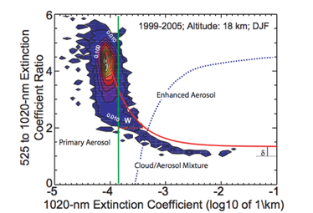
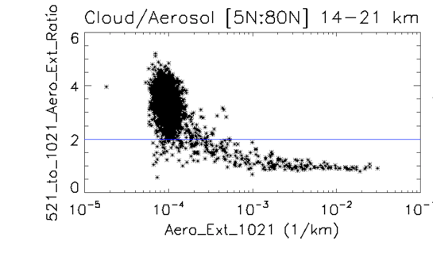
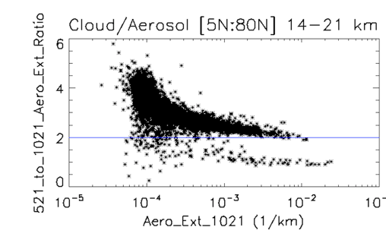
SAGE III/ISS analysis: cloud/aerosol separation approach
Before Fire
After Fire
June 2017
Septembre 2017
Smoke
Thomason 2013
0
0
1
1
Ice clouds
Ice clouds
0
0
Extinction ratio (521nm_to_1020nm) is size dependent. Ratio tends toward 1 for large particles
New cluster of points low extinction ratio and high extinction likely the signature of smoke
Use extinction ratio threshold of 2 to remove clouds

Slide 7
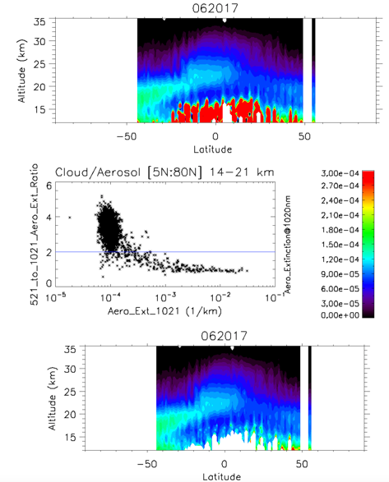
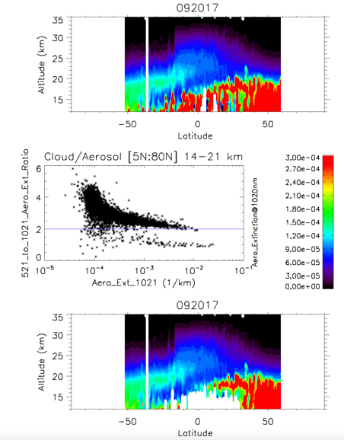
SAGE III/ISS analysis cloud/aerosol separation
June 17
Sept 17
FILTER
FILTER
0
0
Cloud removed
Cloud removed
Ice clouds removed in the tropics
Retain aerosol layers in September 17 consistent with smoke from the PNW fire

Slide 8
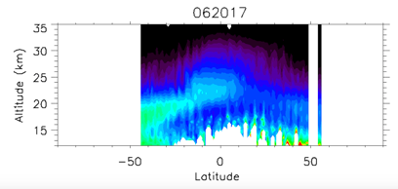
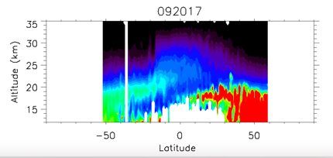
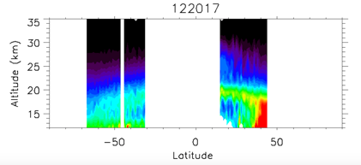
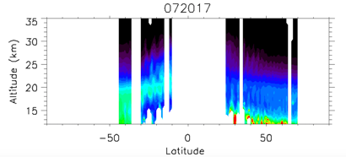
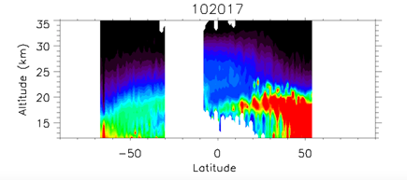
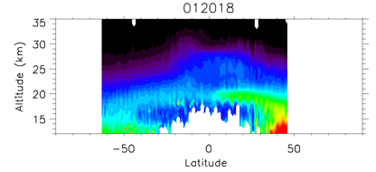
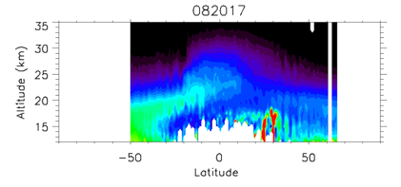
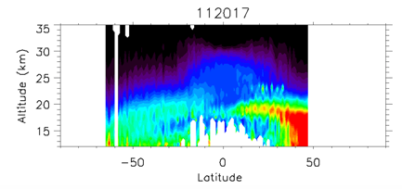
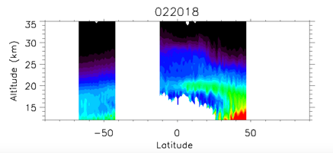
SAGE III/ISS aerosol analysis 06/2017 to 02/2018
Sept
17
Dec
17
June
17
23 km
Aerosol Extinction@1020nm
July
17
Oct
17
Jan
18
24 km
August
17
Nov
17
Feb
18
19 km
24 km
Aerosol plume in the NH observed from Aug 2017 and up to Feb 18
Plume top raising ; 19 km in Aug 17; 23 km in Sept and 24 km in Nov 17; too fast compared to expected slow ascent by BD circulation
Additional mechanism needs to be involved : Slow ascent by radiative heating

Slide 9
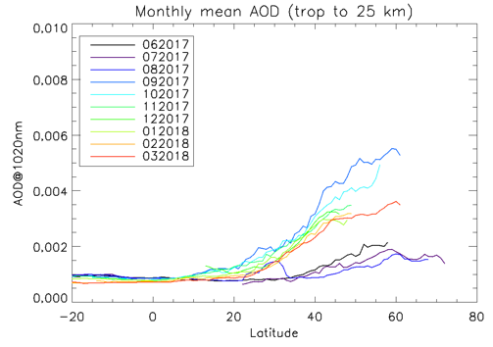
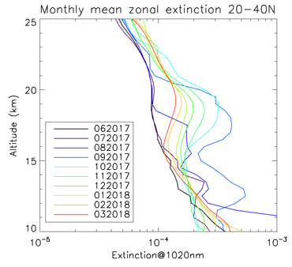
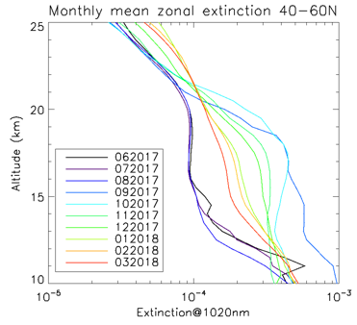
SAGE III aerosol analysis : Transport and AOD
1
2
Plume ascent
2
1
Significant increase (up to factor 5) after August 2018 visible up to 25 km
Ascent of the smoke plume into the stratosphere [20:40 N]
Increase of stratospheric AOD up to 10N
Decay of the smoke layer

Slide 10
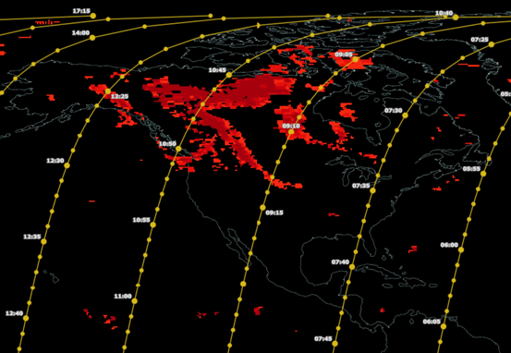
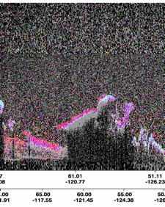
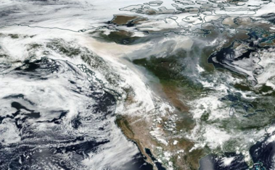
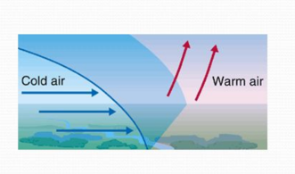
Smoke initial transport by cold front
CO plume from AIRS/Aqua
CALIOP/CALIPSO August 13th 2017
B
Cold front
smoke
A
CALIPSO track
B
A
B
A
Cold front
Cold front
smoke
High backscatter and color ratio values consistent with smoke
CALIPSO orbit track crossed the cold front (A-B)
Smoke and CO observed on top of the cold front

Slide 11
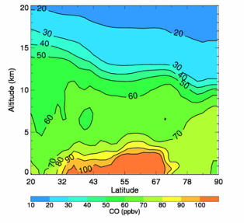
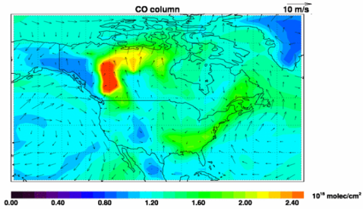
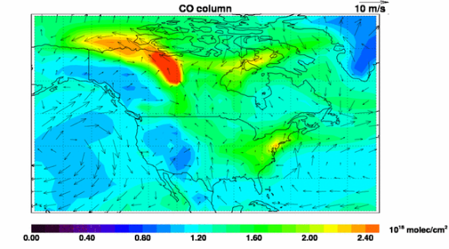
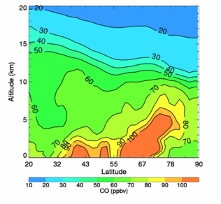
GEOS-Chem Simulates PNW Wildfire CO Plumes (Aug. 2017)
24h average, Aug. 13
140W-70W, Aug. 13
GEOS-Chem v11-01
driven by MERRA-2 reanalysis (2°x2.5°, 72 vertical layers)
QFED daily biomass burning emissions for 2017, based on MODIS fire & geolocation products (Darmenov and da Silva, NASA TM 2015)
Smoke uplift from the cold front up to 9-10 km captured by the model
Cold front
140W-70W, Aug. 15
24h average, Aug. 15
Smoke uplift
Cold front

Slide 12
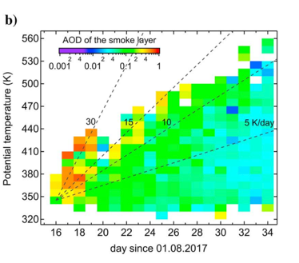
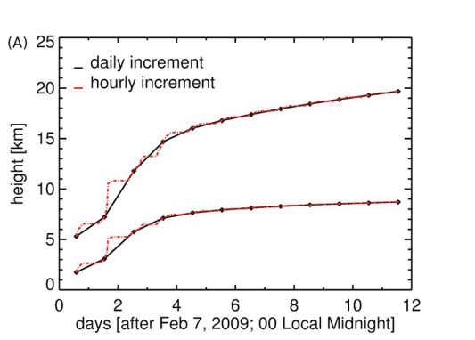
The solar escalator
Slow ascent by radiative heating during the first month
Slow uplift of smoke
Khaykin et al., 2018
DE LAAT ET AL 2018.: SELF-LIFTING AEROSOLS
Vertical dispersion of the smoke plume colored according to AOD
Pixels with same colors tend to follow diabatic heating rates
Consistent with lift of the smoke plume by radiative heating.
Notes:
Need to check COSMIC GPS data

Slide 13
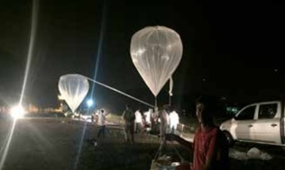
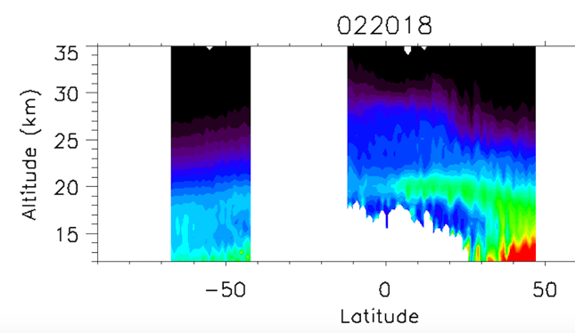
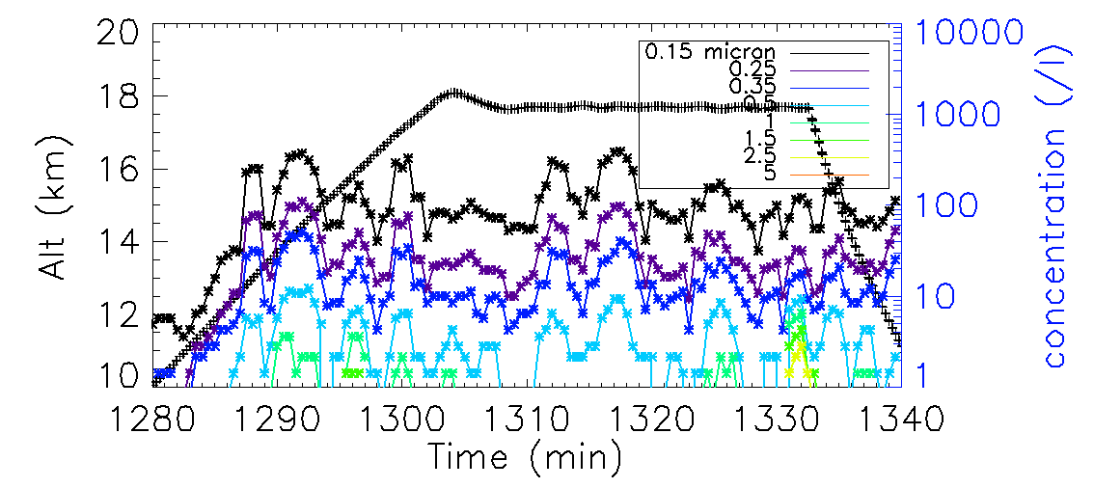
Long-range transport in the tropics
SAGE III/ISS
Feb
18
Balloon test campaign in India in Feb 2018
Aerosol enhancement near 18 km that are consistent with the smoke plume
Offline Ionic Chemical analysis reveals enhancement of SO4 (94ng/m3) and Ca (174 ng/m3) : first chemical characterization of stratospheric smoke

Slide 14
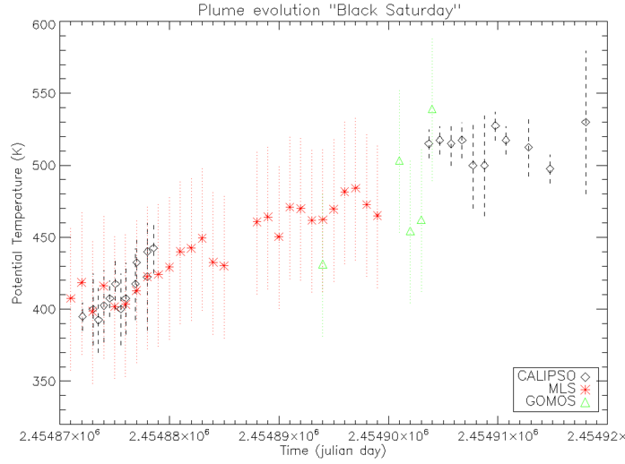
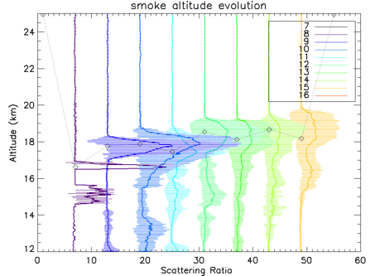
Not unprecedented…..
Black Saturday, Australia, Feb 2009
Fire
Feb 7th
0
10 d
20 d
30 d
40 d
Black Saturday in Australia
Diabatic Ascent of the plume ~100 K in 2 months
Smoke plume evolution observed by CALIPSO

Slide 15
Conclusion
PNW influenced stratospheric aerosol loadings for months/ Equivalent to a moderate volcanic eruption
Transport processes are still uncertain: Direct PyroCb injection, synoptic scale transport by cold front, slow ascent through radiative heating.
SAGE III/ISS key measurements to follow the vertical evolution of the smoke over months (slow ascent by radiative heating)
PNW was not an isolated case since another extreme fire influenced the stratosphere since 2009. May become increasingly important.

Slide 16
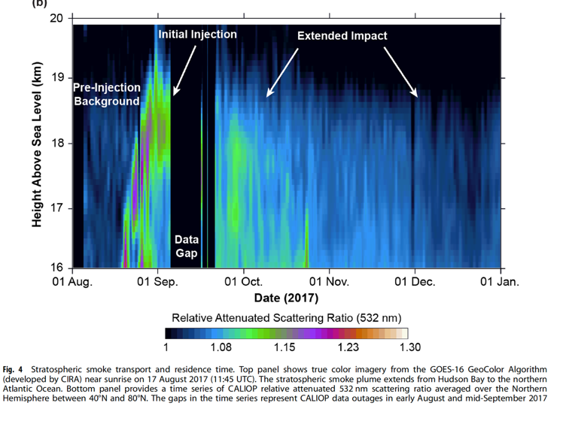
Very quick CALIOP analysis missing a number of things :
Slow ascent of the plume into the stratosphere (not at all discussed in the text)
How did the plume reached 19-20 km
Occasional plumes also found deep in the middle stratosphere (not discussed)

Slide 17
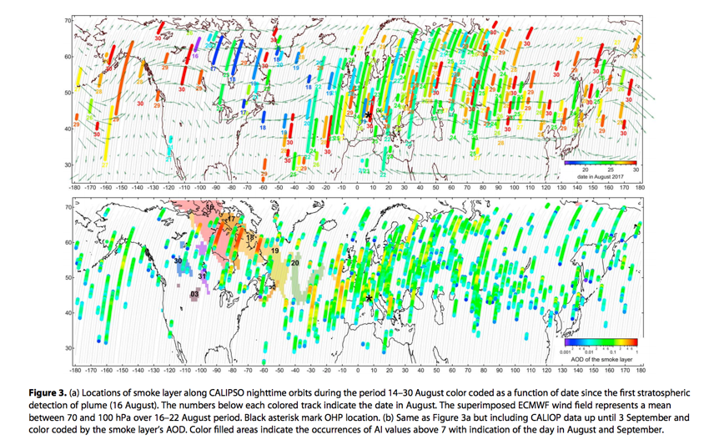
Khaykin et al., 2018

Slide 18
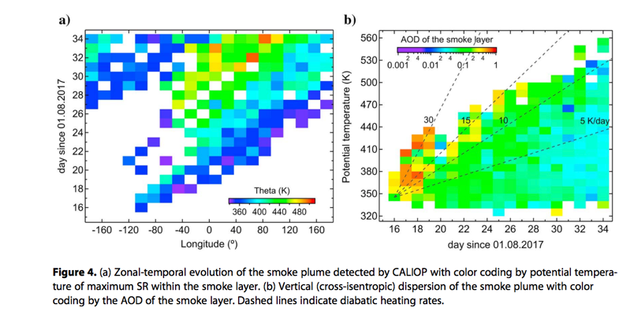
Khaykin et al., 2018

Slide 19
Analysis

Slide 20
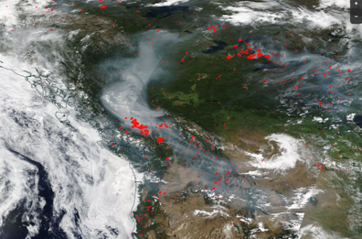
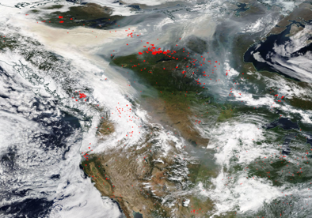
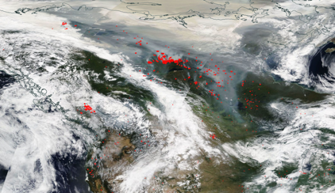
08/11
MODIS/Terra
And Fire detection by VIIRS
08/12
08/13
Smoke
08/14
Smoke
Smoke
Smoke

Slide 21
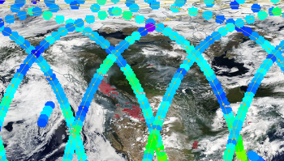
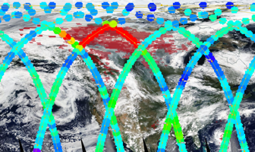
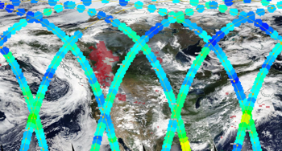
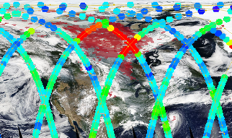
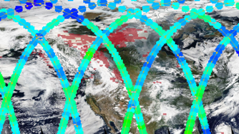
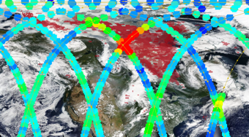
08/11
08/14
CO plume evolution
- Red pixels :AIRS/Aqua >140ppb
- Filled circle is MLS CO at 215 hPa (~12-13 km)
08/12
08/15
- No CO plume detected in UT before 08/14 but MLS went through the plume on 08/13
08/13
08/16

Slide 22
August, 14th

Slide 23
August, 15th

Slide 24
Cloud filtering SAGE III/ISS data

Slide 27
Stratospheric smoke
https://www-air.larc.nasa.gov/missions/TOLNet/docs/meeting/May2018/Day5/knepp_presentation_sage_aerosol_val.pdf

