Slide 1
Using SAGE III measurements and numerical models to investigate aerosol, cloud, and water vapor physical processes in the upper troposphere/lower stratosphere region
E. J. Jensen PI
CoIs: R. Ueyama, A. Dessler

Slide 2
Goals of the Proposal
Development of a SAGE III cloud-detection algorithm for both occulations and limb scans. The algorithm will be evaluated by comparison with OMPS-LP, CALIOP, and high-altitude aircraft aerosol and cloud measurements. Cloud products generated with our algorithm will be provided for community use.
Use of the SAGE III cloud product, along with OMPS-LP cloud products, to quantify the occurrence of high-altitude, optically-thin tropical tropopause layer (TTL) cirrus.
Combine SAGE II, HALOE, Aura MLS, and SAGE III data into a unified multi-decadal record of stratospheric water vapor.
Use of forward and backward trajectory models to analyze the dehydration process in the tropical upper troposphere, and use of the SAGE III, CALIOP and OMPS-LP cloud products as well as SAGE III and MLS water vapor products to constrain simulations of optically thin TTL cirrus and water vapor.

Slide 3
Team Mapping
Cloud algorithm development (occultation and limb scans) – Kummer and Schoeberl
Quantify cloud layer occurrence and statistics – Jensen, Avery, Schoeberl, Kummer
Development of multi-decadal water vapor product - Dessler
Use water vapor/cloud trajectory models – Jensen, Ueyama, Schoeberl, Dessler

Slide 4
Goals for Cloud Product Proposal
Produce an algorithm that can be used to generate a standard cloud product from SAGE III extinction.
Compare different candidate algorithms and their performance
First focus on the tropics due to linkages between clouds, dehydration and water vapor
Evaluate our product against OMPS-LP, CALIOP, and SAGE II
Better understand the optical properties of thin clouds and aerosols

Slide 5
Existing Cloud Aerosol Sensors
Sensor | Advantage | Disadvantage
CALIOP | Highly sensitive to clouds and aerosol backscatter High vertical resolution (50 m) Polarization (ice vs liquid aerosols) | No swath Only 2 channels
SAGE III | Long path extinction, highly sensitive to aerosols and clouds Multiple channels -> size distribution Good vertical resolution (0.5 km) | 200km path Measurement only at occultations
OMPS-LP | Long path scattering, highly sensitive to clouds and aerosols Multiple channels Moderate vertical resolution (1.4 km) | 200 km path Interpreting the data requires RT code Limited swath

Slide 6
SAGE III Cloud Algorithm Physical Basis
Aerosol extinction is expected to have a wavelength dependence.
Cloud extinction is expected to have weak or no wavelength dependence.
Cloud extinction will generally exceed aerosol extinction.
Algorithms therefore can use an extinction color ratio as well as absolute extinction to discriminate between clouds and aerosols.

Slide 7
Two existing SAGE cloud algorithms
Thomason Algorithm (2-λ)
Kent Algorithm (3-λ)
Described in Thomason and Vernier [2013]
Uses two wavelengths 520 and 1021 nm extinction ratios
Can be used with SAGE II to extend the data record
Described in Kent et al. [2007]
Uses three wavelengths, 520, 1021 and 1550nm extinction ratios
Since 1550 nm channel is used, this method cannot be used with SAGE II

Slide 8
Using the Existing Cloud Algorithms
Cloud is detected if:
3-λ (Kent algorithm)
Color Ratio (520/1020 and 1020/1550 ext.) < ~1.5 for both ratios
Does not use the magnitude of extinction
2-λ (Thomason algorithm)
Color Ratio (520/1020 ext.) < 2 and Log₁₀(1020 ext.) > -3.7
Uses magnitude of extinction
For both algorithms if a cloud is not detected, but the profile is terminated, we assign a cloud top height 0.5 km below the termination height.

Slide 9
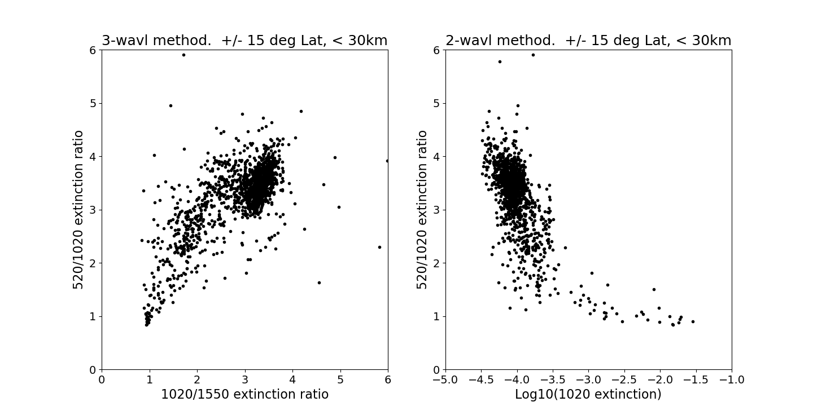
Look at some SAGE III extinction profiles (June 2017 – March 2018)
2-λ
3-λ
Aerosols
Ratio 520/1020 threshold = 2
Clouds
Clouds
Log(1020extinction) = -3.7

Slide 10
Yet another algorithm…. Spectral Radiative Signature (SRS) algorithm
SRS was developed to analyze clouds from OMPS-LP radiance profiles
Based on cloud observations and RT calculation in Chiu et al. [2009].
In SRS the difference in extinction at two wavelengths is compared to the total extinction at those wavelengths.
Our Notation:
Average extinction at 520 nm and 600 nm
Average extinction at 1020 nm and 1550 nm
Total Extinction
(spectral) Differential extinction
The shape of the y=f(x) curve is surprisingly independent of whether we are measuring radiance or extinction.

Slide 11
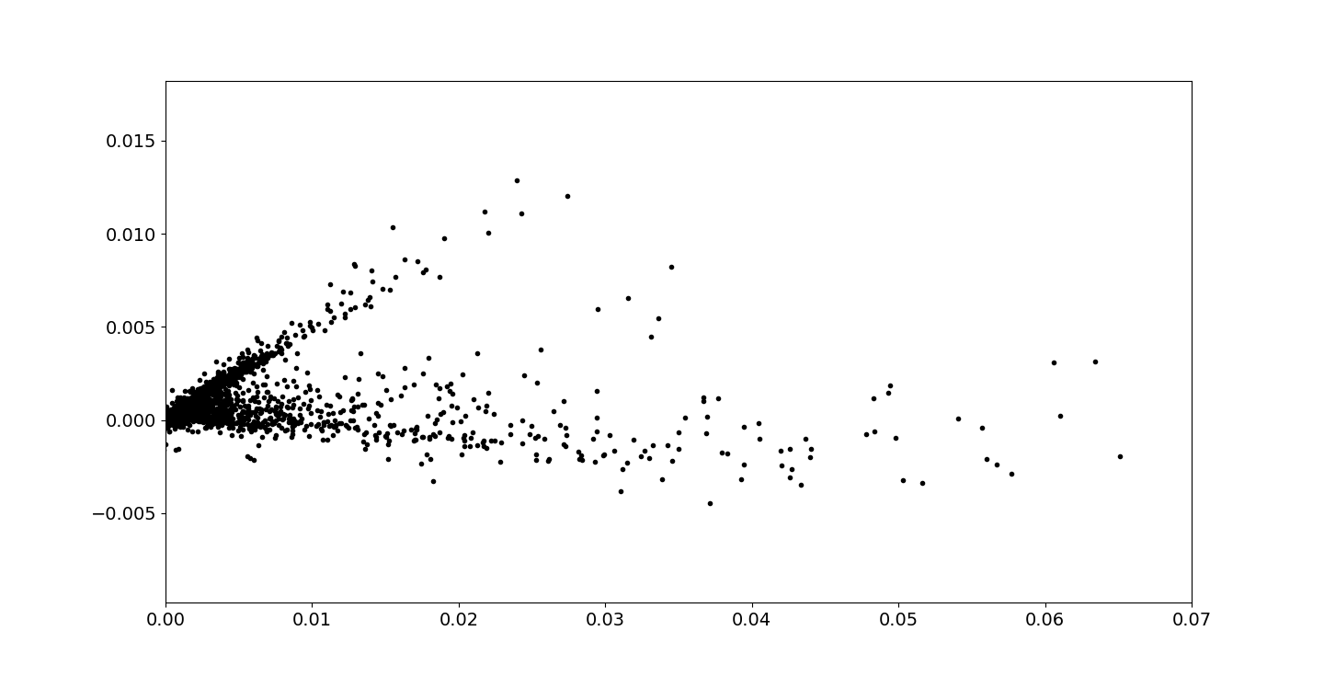
SRS Algorithm
SAGE III Extinction Data
Smaller
Particles
Aerosols
Clouds
k_{s}- k_{L} [km⁻¹]
Larger
Particles
Less Opaque
More Opaque
k_{s}+ k_{L} [km⁻¹]

Slide 12
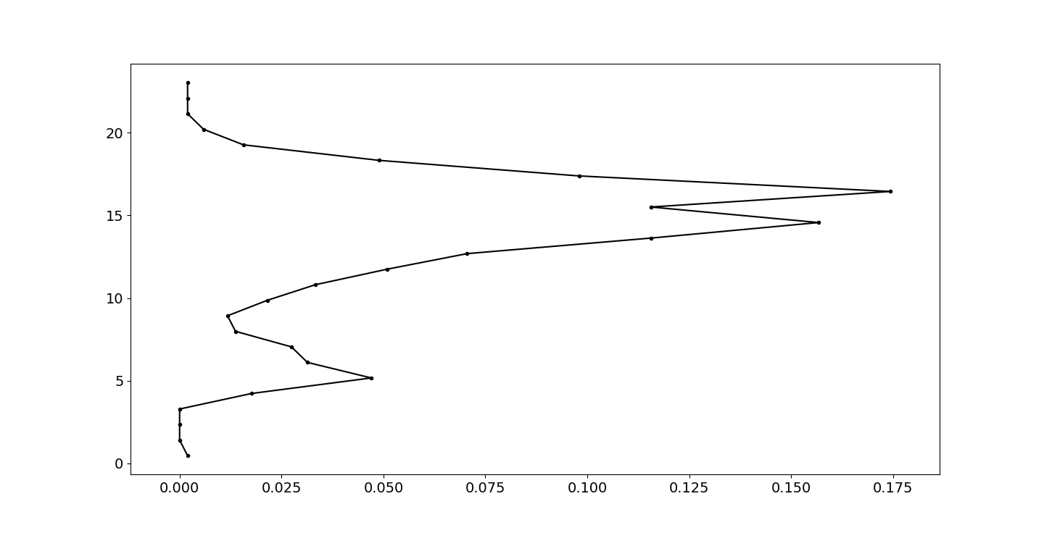
Preliminary SAGE III Tropical Cloud Frequency Using 2-λ Algorithm (other algorithms give same results)
+/- 15º Latitude – all longitudes
Peak around 16 km
Occasional cloud up to 18 km
Height [km]
Occurrence Frequency

Slide 13
Conclusions
Initial results show that we can discriminate between clouds and aerosols.
SAGE III can provide size information about thin clouds and aerosols for low extinction (k < 0.1) events.
For thick clouds (k > 0.1) the size information is limited.
To compare with other measurement (OMPS-LP, CALIOP, MODIS) we need to carefully consider the sample volume and the viewing geometry.

Slide 14
References
Thomason, L. W. and Vernier, J.-P.: Improved SAGE II cloud/aerosol categorization and observations of the Asian tropopause aerosol layer: 1989–2005, Atmos. Chem. Phys., 13, 4605-4616, https://doi.org/10.5194/acp-13-4605-2013, 2013.
G. S. Kent, K. H. Sage, C. R. Trepte, and P.-H. Wang, "Stratospheric Aerosol and Gas Experiment III cloud data product," Appl. Opt. 46, 1261-1278 (2007)
Chiu, J. C., Marshak, A., Knyazikhin, Y., Pilewski, P., and Wiscombe, W. J.: Physical interpretation of the spectral radiative signature in the transition zone between cloud-free and cloudy regions, Atmos. Chem. Phys., 9, 1419-1430, https://doi.org/10.5194/acp-9-1419-2009, 2009.

Slide 15
Backup Slides

Slide 16
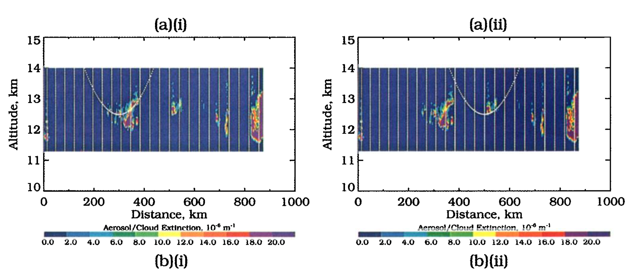
Three potential sources of error when retrieving cloud top height from SAGE III (from Kent et al. 1997)
Low height bias from tangent height assignment
Low extinction (volume average)
Inhomogeneous clouds along the path
~0.2 km bias for cloud above 16 km
2. Low extinction
3. Inhomogeneous cloud
SAGE Optical Path
1. Low height bias
3. Inhomogeneous cloud

