Slide 1
Mesospheric Ozone: Product Status and Potential Improvements
Darrell Dolliver
Robbie Manion, Robert Damadeo, David Flittner

Slide 2
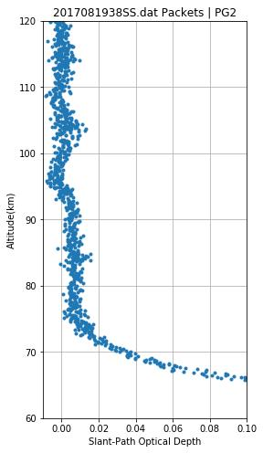
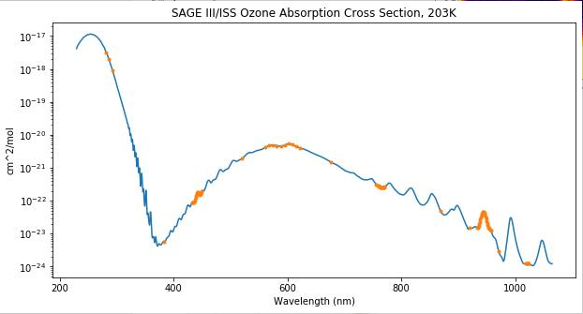
Source of the Mes O3 measurement
The SAGE instrument acquires data using pixels with a width of 1 nm. This information is consolidated into pixel groups.
Mes O3 uses a single pixel group centered around 286 nm to measure transmission and Optical Depth for Mesospheric O3.

Slide 3
Mes O3 Basics
Algorithm outline
Input transmission
Correct transmission for stray light
Calculate Optical Depth
Remove Rayleigh scattering contribution to Optical Depth
Use O3 absorption cross section to get O3 slant-path column density

Slide 4
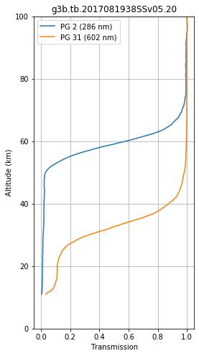
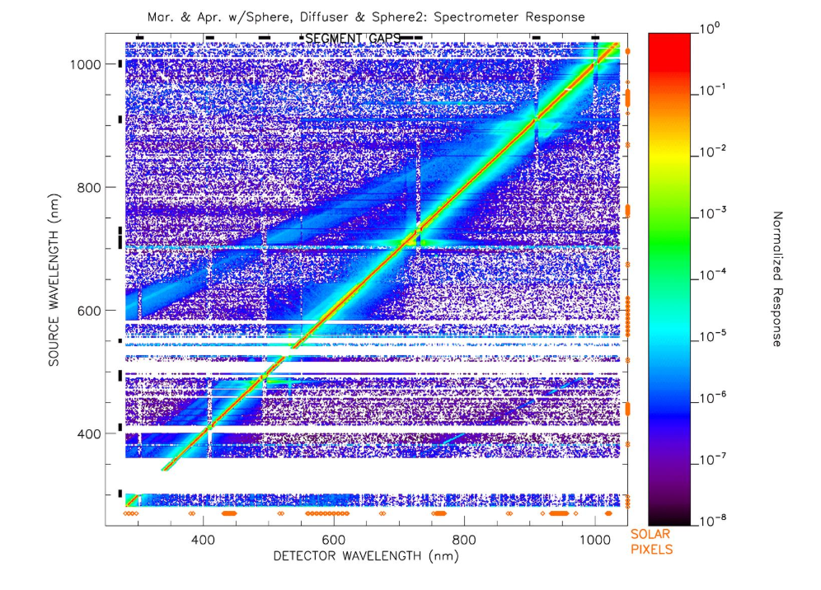
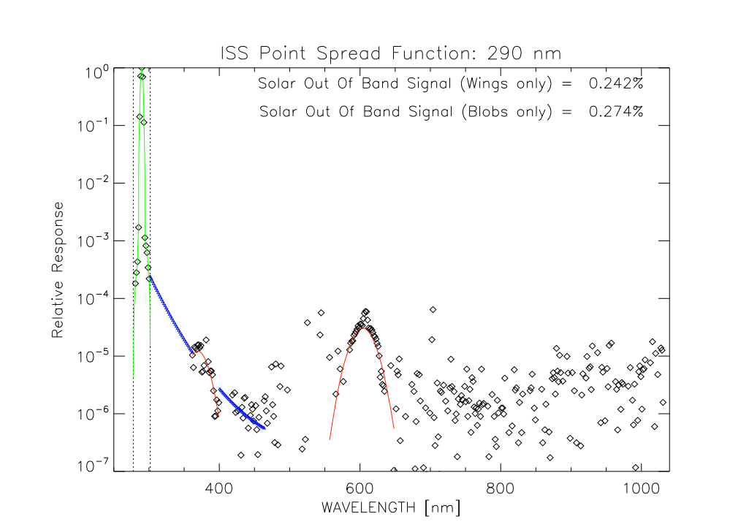
Stray light issue
Input light from other wavelengths contributes to the signal in the region important for Mes. O3

Slide 5
Comparison to Atmospheric Chemistry Experiment
Searched for SAGE/ACE events that matched within a day, 2° of latitude and 1000 km
Applied an event type to ACE events and further restricted matches to similar types
Converted ACE result to number density
Filtered SAGE results to match vertical resolution of ACE

Slide 6
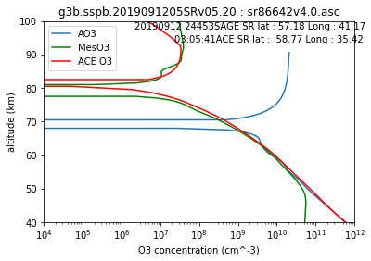
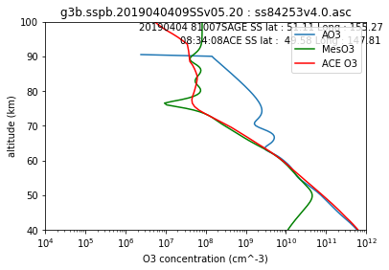
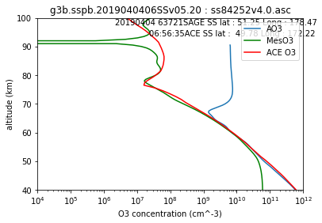
Example Event Matches

Slide 7
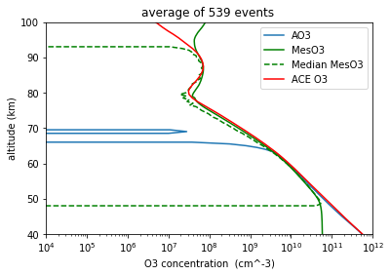
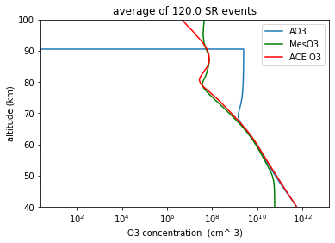
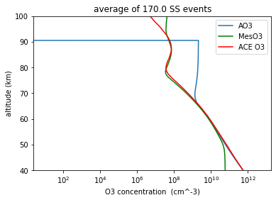
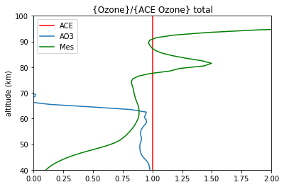
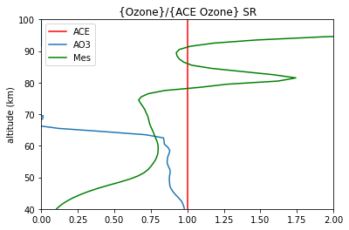
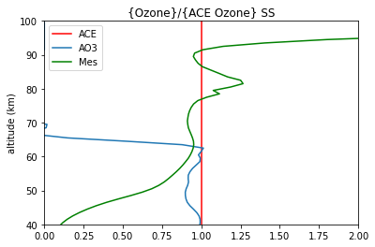
Average SAGE and ACE results 2018-2019

Slide 8
Possible improvements
Use more pixel groups
Improve O3 cross-section library
Improve stray light correction- implement it at the level of input count data

Slide 9
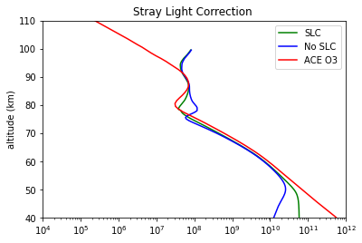
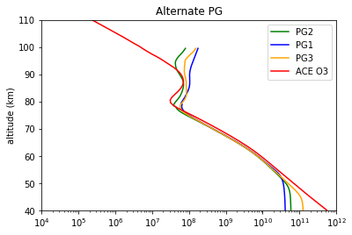
Experimental results
Current Stray light correction does seem to be an improvement over no correction.
Alternate Pixel groups give a very similar result- it may be beneficial to include them in the product.

Slide 10
Conclusion
Current MesO3 algorithm compares faily well with ACE (generally within 20% on average between 50-80 km.
Similar result achieved with use of alternate UV PG argues that they may be useful in a revised algorithm.

