Slide 1




DEFINITIVE Trends in lowermost Stratospheric OZONE & Tropopause height derived from SHADOZ soundings (1998 to 2019) based on paper in press in jgr-atmospheres https://doi.org/10.1029/2021JD034691
  REPORT TO SAGE-III/ISS SCIENCE TEAM
  Virtual Meeting 5 November 2021
  Anne Thompson, anne.m.thompson@nasa.gov
  Ryan Stauffer, ryan.m.stauffer@nasa.gov

Slide 2
Road Map
Motivation: Satellite products used to determine trends in tropospheric and LMS (lowermost stratosphere, 15-20 km) ozone show need for better vertically resolved data
Ozonesondes provide such measurements at fixed locations, hundreds of profiles with high accuracy. Radiosonde data give coincident PTU (tropopause height)
Tropical Trends (1998-2019) in O₃,Tropopause Height (TH) computed with the GSFC MLR applied to SHADOZ*. Assume QBO, ENSO, IOD oscillations, annual & seasonal cycles
Summary: (1) Both FT (free tropospheric) & LMS O₃ trends vary regionally and seasonally; (2) LMS ozone losses maximize mid-year, correlated with increase in TH; (3) Trends moderated when re-determined with TH-referenced coordinates; (4) FT O₃ trends are seasonally strong, Feb.-May, at 4 of 5 stations, but are relatively small on average over the year +(0-4)%/decade
*Southern Hemisphere Additional Ozonesondes
Title: Regional and “Seasonal Trends in Tropical Ozone from SHADOZ Profiles: Reference for Models and Satellite Products” by AM Thompson, RM Stauffer, K Wargan, JC Witte, DE Kollonige, JR Ziemke, https://doi.org/10.1029/2021JD034691

Slide 3
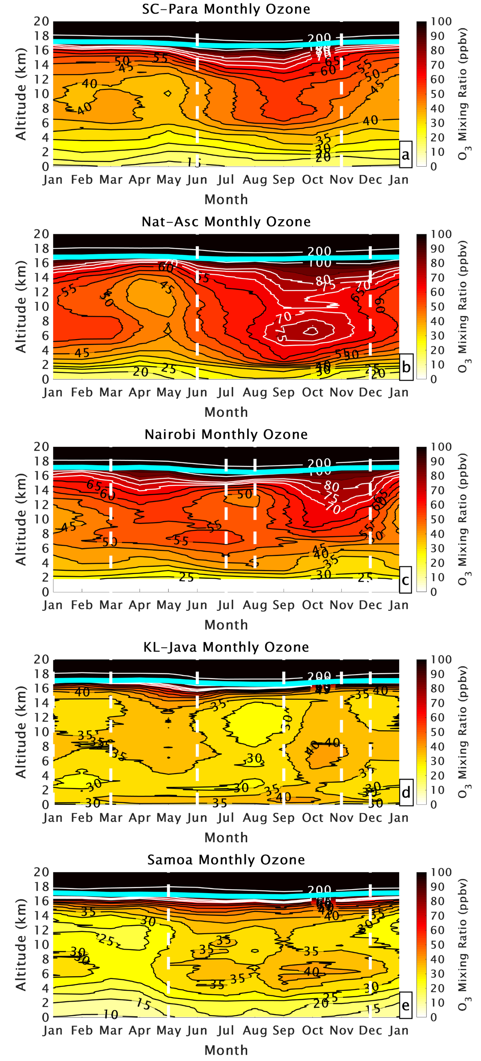
SHADOZ Climatology: O₃ Seasonal & Regional Variability
Use 22-yr SHADOZ data (1998-2019) to compute trends in O₃ & 2 dynamic indicators radiosonde-based
Sonde advantages over satellite data
(1) More precise O₃ than satellite data in LMS
(2) Regular fixed site sampling at ~100-150 m
resolution gives FT and LMS trends from one dataset
(3) In-situ profile data, full zonal coverage
(4) Radiosondes give tropopause height (TH)
Data presented from 5 “sites,” 3 combo (Upper)
Seasonal O₃ (Below). TH in cyan
TH annual cycle is ~ 1km, with minimum mid-year
“Seasonal” O₃ transitions (white vertical lines), represent alternations in dominant dynamic influences, ie convection vs advected pollution (Thompson et al., 2012)
SC-Para Nat-Asc KL-Java

Slide 4
Data and Trend Analysis (1998-2019) with GSFC MLR Model
Trends in monthly mean O₃ and TH (alt. of 380K θ) determined using Goddard (GSFC) Multiple Linear Regression (MLR) model with QBO, ENSO as MEI, IOD terms, seasonal, annual cycles.
Table lists station locations, profile #, climate index terms (MEI, QBO, IOD) for best model fit. Changes in %/decade, annual average, for LMS (15-20 km), lower FT (5-10 km), upper FT (10-15 km) show distinct regional variability, strong seasonality.
Trend in LMS O₃: 3 sites show -3 to -6%/decade, 2 sites -0.4%, +0.6% /decade. Max Loss, J-A-S
SITE | LAT/LONG | PROFS | MLR TERMS | LMS (%/dec) | 10-15 km (%/dec) | 5-10 km (%/dec)
SC-PARA | 5.8,-55/-0.92,-90 | 1227 | MEI+QBO | -3.1 | 1.5 | -1.5
NAT-ASC | -5.4,-35/-7.8, -14 | 1436 | MEI+QBO | -0.4 | 3.9 | +1.6
NAIROBI | -1.3,37 | 941 | MEI+QBO | +0.6 | -0.2 | +0.6
KL-JAVA | 2.7,101/-7.5, 113 | 786 | MEI+QBO+IOD | -5.8 | -0.6 | +1.9
SAMOA | -14,-171 | 795 | MEI+QBO | -2.8 | +2.5 | +1.4

Slide 5
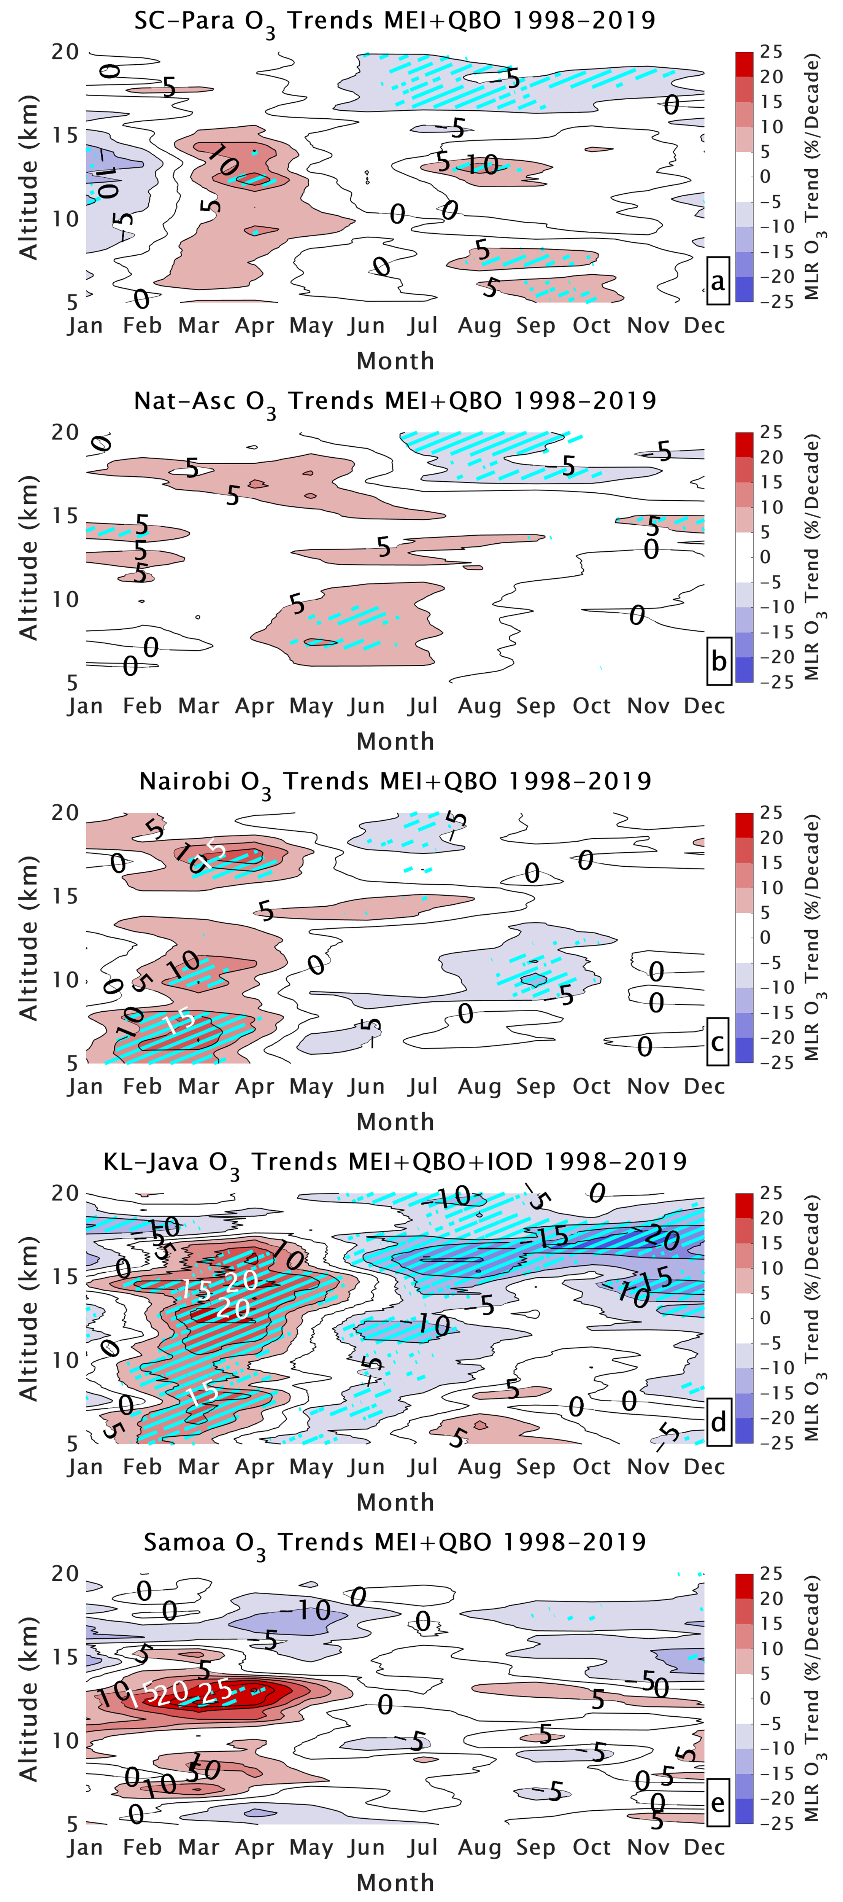
What Do Trends Look Like? Similar for 4 of 5 Stations
LMS ozone = 15-20 km. Upper FT = 10-15 km. Lower FT = 5-10 km. Contours based on 100 m-resolution calculations. All trends in %/decade change, 1998-2019
Red shades indicate ozone has increased. Blue shades indicate decrease
Note LMS ozone decreases/losses June or later, ranging in layers 5-20%/decade, latter only at KL-Java

Slide 6
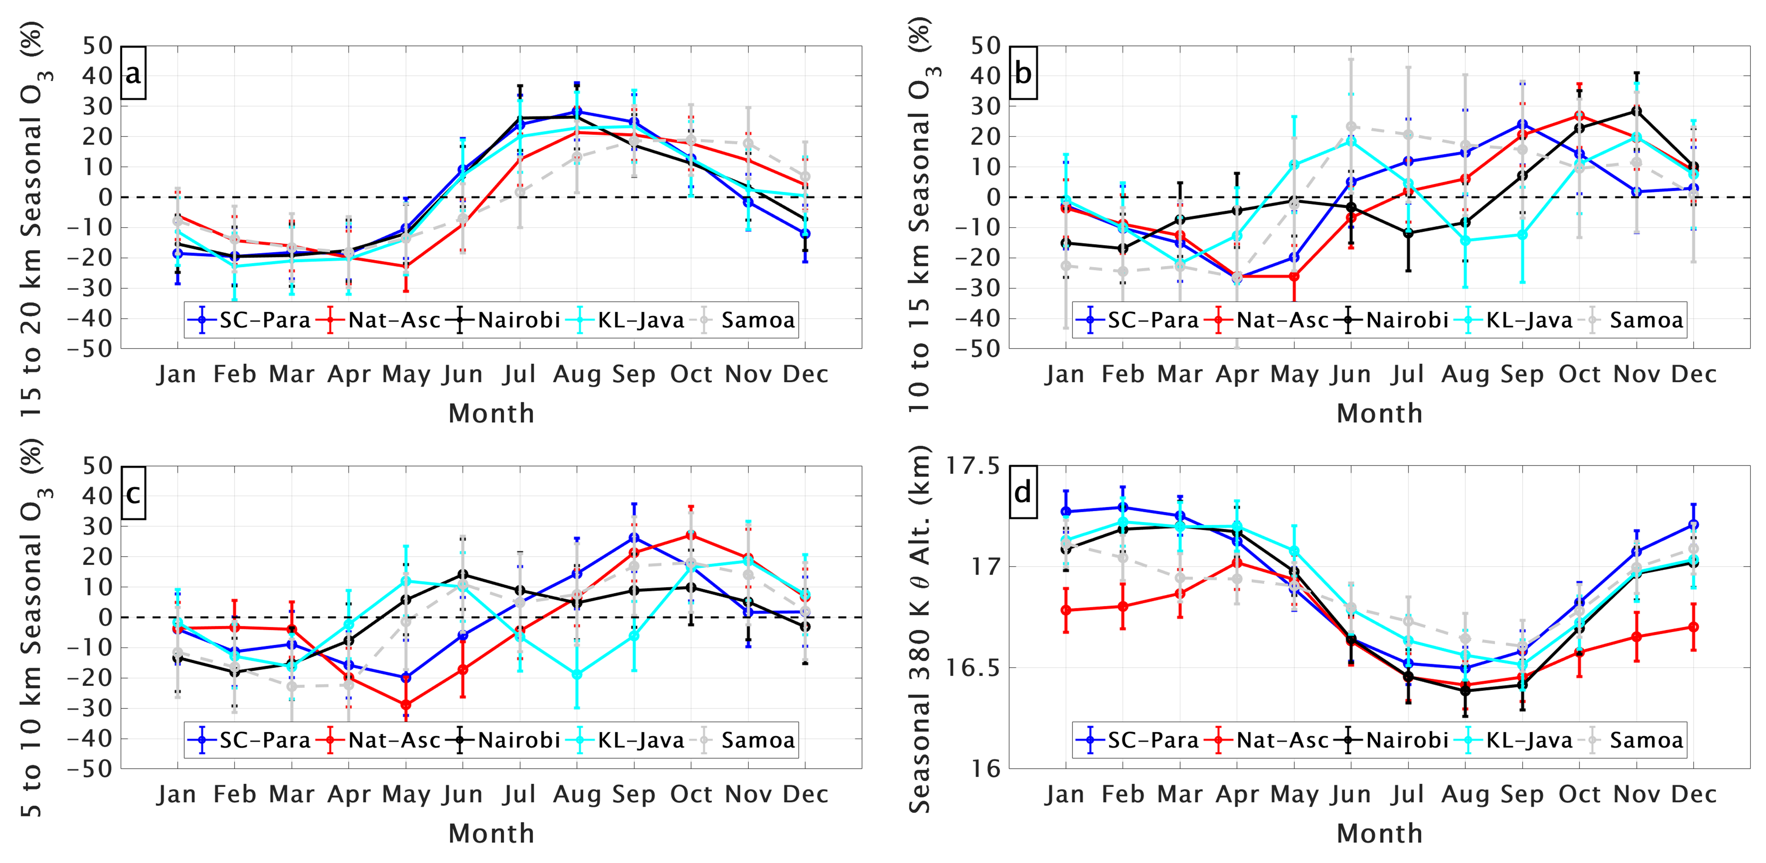
LMS Ozone Losses Coincide with
Season of Maximum LMS Ozone
Monthly LMS Ozone Seasonality
Losses at
Annual Max
Prior slide showed monthly LMS O₃ losses are largest July-Sept. This coincides with seasonal LMS O₃ maxima (upper), as indicated in monthly anomaly from annual mean in 15-20 km layer
The trend, ozone loss at annual maximum, will flatten LMS O₃ cycle.
Lower image shows this is season of minimum in TH (~ 1 km annual cycle)
Is there a connection between mid-year LMS O₃ trends and TH? See next slide
Occur at
TH Minimum

Slide 7
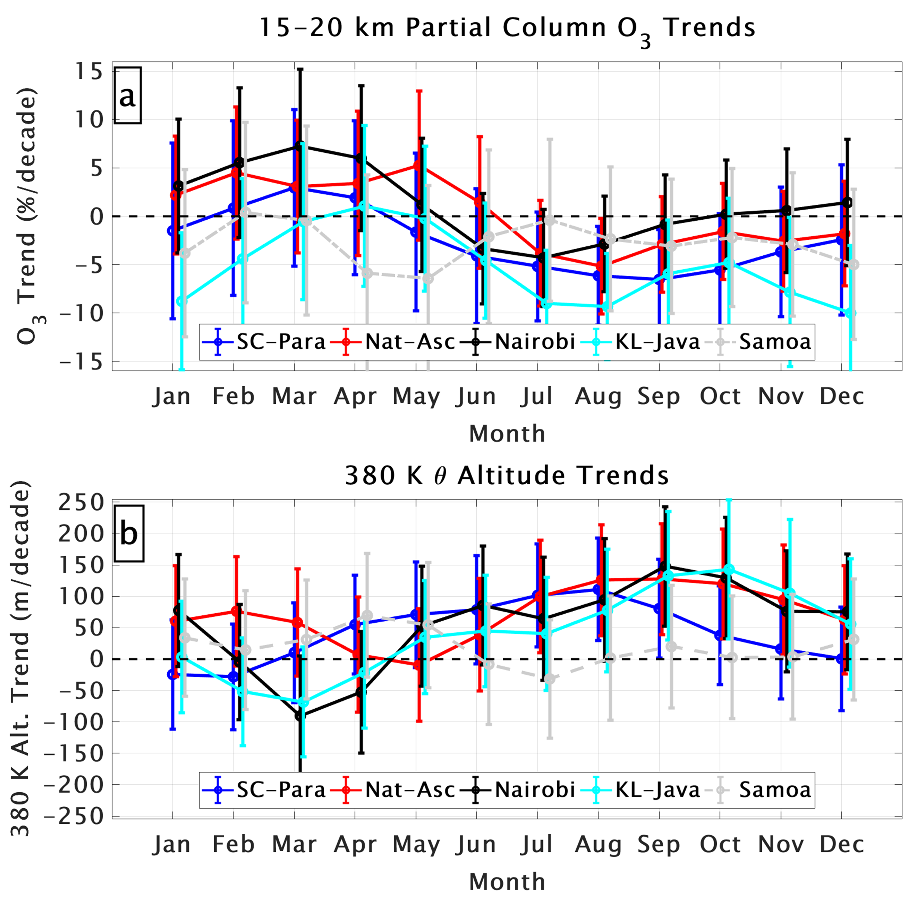
Summary Trends – LMS. Compute LMS Altitude-defined
Segments (Left) vs Tropopause-defined (Right)
Altitude-defined LMS O₃, TH Trend TH+5 km LMS- Mid-Year Trends Disappear
Ozone
Loss
  Why do these results matter? Because there is
  much concern about LMS ozone loss in “Ozone
  Trends” community. If ozone is disappearing
  in LMS, it could mean that ODS are undermining
  “global stratospheric ozone recovery”.
  Our results imply this is not a worry!
Positive
TH trend

Slide 8
What Next? Way Forward
Make SHADOZ monthly means and model output available to International Assessments like UNEP/WMO (2022) and TOAR-II (Joint NOAA, CNRS/Toulouse Lead Chapter) – our results are the “gold standard”
Collaborate with modelers (our lab and GMAO) to determine where model improvements are needed. We have already diagnosed model issues near the tropopause: R. M. Stauffer et al., JGR, 2019
Ditto for optimizing SWOOSH, other SAGE-based products in tropics (GEOS-SCREAM?)
Investigate potential role of changing convection in both FT (early year) and LMS ozone changes

Slide 9
Summary
LMS Tropical Ozone Trends: Five stations display 5-10% monthly LMS O₃ loss when TH increased 100-150 m (July-Sept); recomputing with TH-referenced LMS removes trend
Tropical FT Ozone Trends (1998-2019) based on 5 SHADOZ stations show strong regional differences and seasonality but modest overall trends, +(1-4)%/decade
Use SHADOZ Ozone, TH Data & Best-Fit Model Trends as Reference for Assessments (LOTUS, TOAR-II). Compare LMS and Tropo. O₃ satellite products and models. Do they agree by station and seasonally? If yes, you can trust the products & model results!
PI, 1998-
5/2021
PI, 6/2021- Archiver
6/2019-
THANK YOU,
FOR YOUR
ATTENTION!
PAPER PREPRINT --https://doi.org/10.1029/2021JD034691

Slide 10
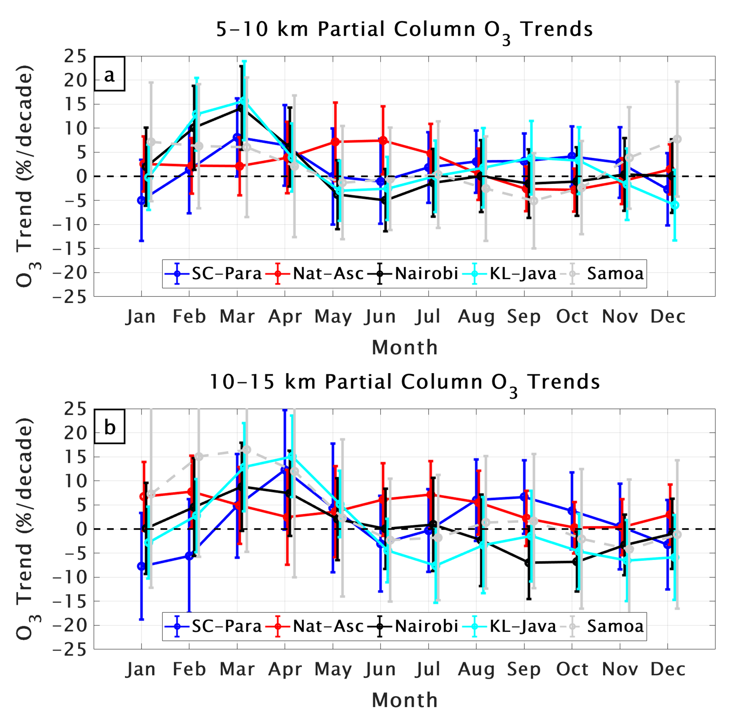

Summary FT Ozone Trends, Paper Figure 7 (Left)
More Uniform Trends in LFT Mean Magnitude, + (1-4)%/yr
Early Yr
Increase, 5-10 km
+(1-2)%/dec
+(0-1)%/dec
+(0-2)%/dec
+(2-4)%/dec
What do other studies say? Why are SHADOZ results
Important?
IAGOS Aircraft Landing/Takeoff FT O₃ trends in tropics +(2-3)%/decade have no data above 10-11 km
Satellite products, most from Aura era (2004-2019) are larger, but uncertain in bdy-layer, t’pause characteristics
SHADOZ data “background,” suggest dynamic impacts that might underlie pollution-driven ozone increases
Early Yr Increase, less
uniform afterward

Slide 11
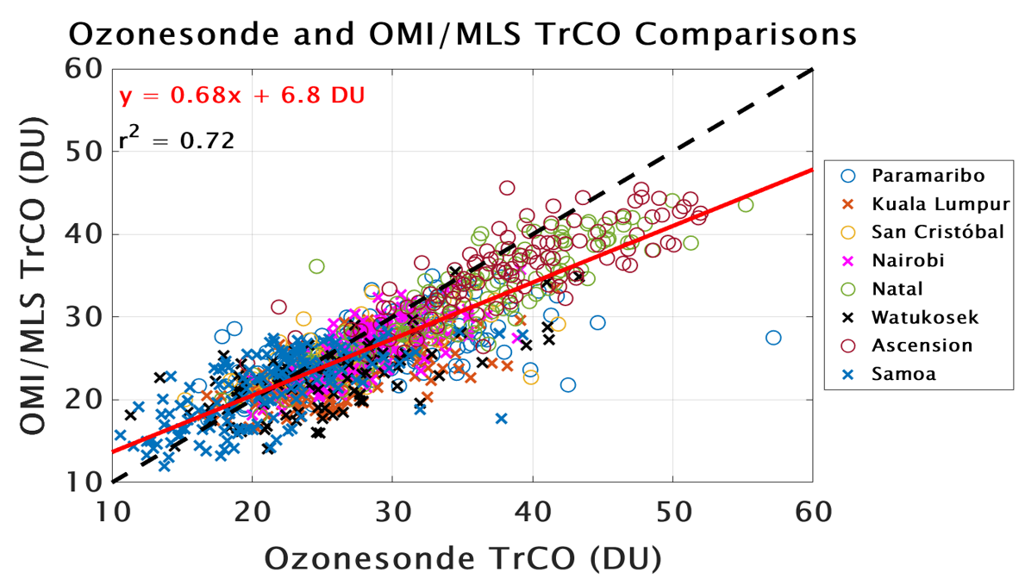
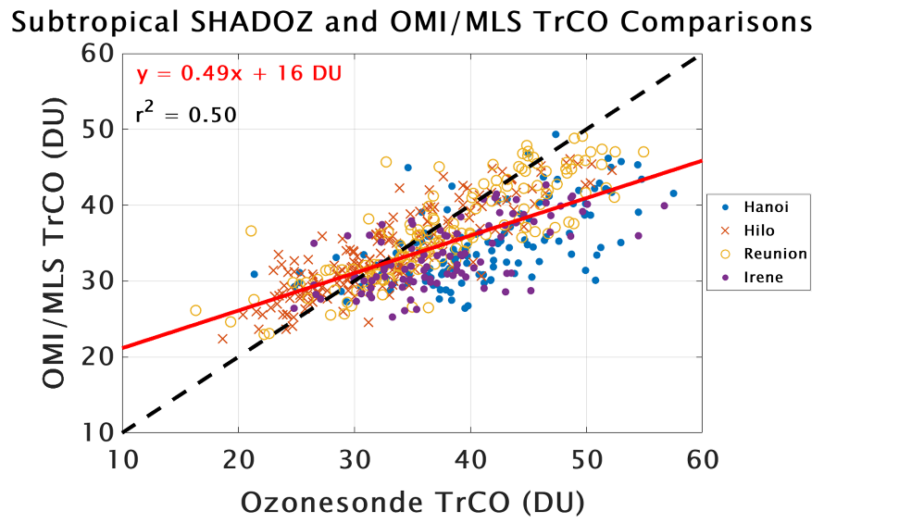
Summary Comparison of OMI/MLS Tropo Column
Ozone (TrCO, DU) over SHADOZ Sites (2005-2019)
Left: OMI/MLS underestimate compared to SHADOZ for 8 tropical stations in Paper
Right: OMI/MLS agreement and correlation degrades in subtropics
➔ Caution for trends applications except possibly in deep tropics

