Slide 1
The JPL lidar atmospheric composition observations for NDACC:
A review of the multi-decadal ozone, temperature, aerosol, and water vapor profiles at JPL Table Mountain Facility, California (TMF) and Mauna Loa Observatory, Hawaii (MLO)
Thierry Leblanc
Jet Propulsion Laboratory, California Institute of Technology
Wrightwood, CA USA
With well-deserved credits for present TMF Lidar Team Members:
Mark Brewer Fernando Chouza
Darryl Koon
Patrick Wang
… and well-deserved credits for past Lidar Team Members:
Maria-Jose Granados-Munoz Tony Grigsby Dave Haner
Jeff Howe
Guillaume Kirgis
Stuart McDermid
Marty Schmoe
Dan Walsh
© 2022 California Institute of Technology Government sponsorship acknowledged

Slide 2
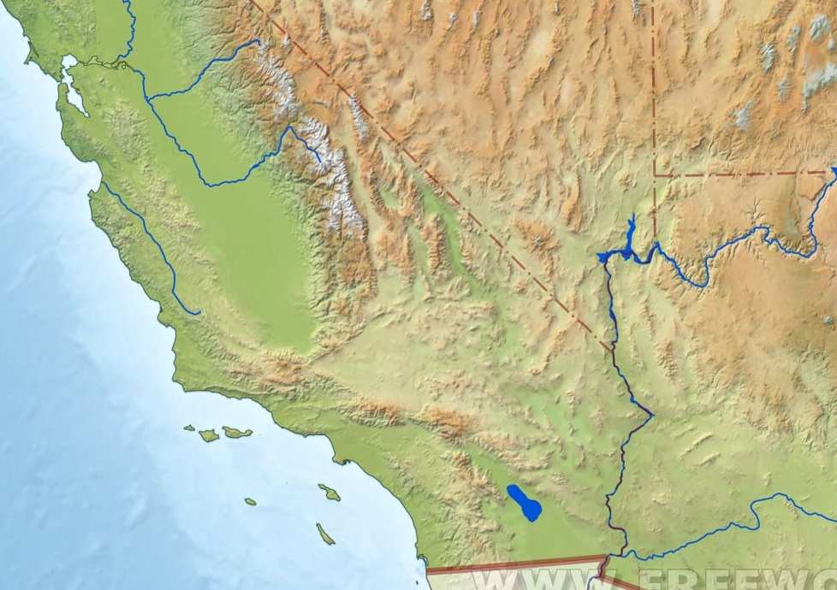
Where is TMF?
TMF
In the San Gabriel Mountains Elevation: 2285 m (7300 Ft) 2-hour drive from JPL Pasadena
JPL

Slide 3
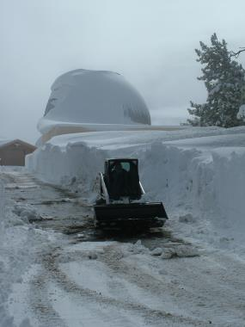
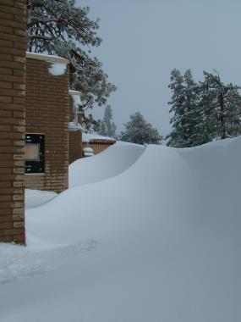
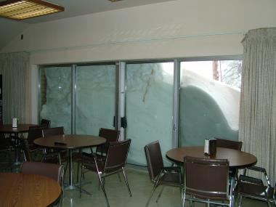
Southern California?...
Access to lidar building
Dining area
Microwave radiometer somewhere under…

Slide 4
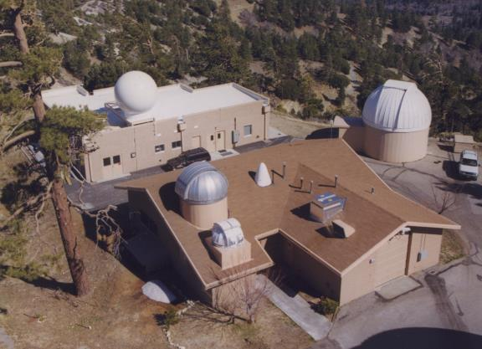
JPL-TMF Lidar Group Home Base
1988-present: Stratospheric ozone, aerosols and temperature lidar (NDACC)
GPS TPW
Microwave radiometer (NDACC)
ECC ozonesonde
2005-present: Water vapor lidar (NDACC)
PTU radiosonde
1999-present: Tropospheric ozone lidar (NDACC)
Frost-point hygrometer sonde
Surface ozone monitor

Slide 5
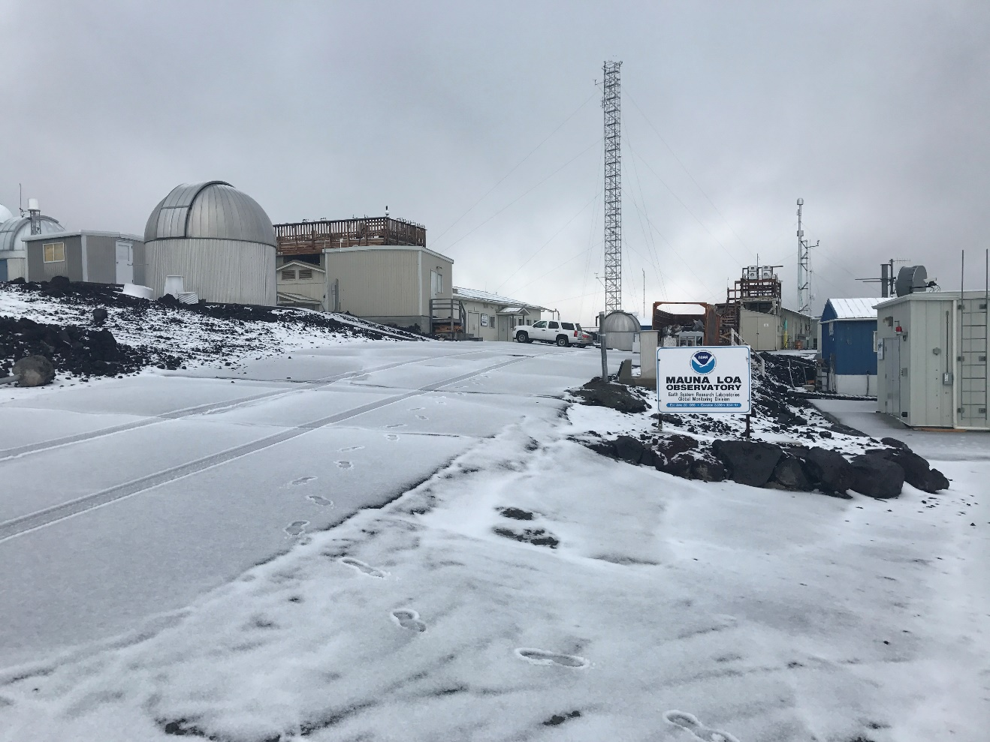
Also managed by the JPL-TMF Lidar Group
1993-present: Stratospheric ozone, aerosols and temperature lidar (NDACC)
At Mauna Loa Observatory, Hawaii (MLO)
The TMF Lidar Group (4.5 FTE) manages 15 long-term atmospheric products, including 8 products archived at NDACC

Slide 6
What is NDACC?
Network for the Detection of Atmospheric Composition Change (formerly known as “NDSC”)
International network of 70+ high-quality, remote-sensing research stations
Observe and understand the physical and chemical state of the stratosphere and upper troposphere
Assess the impact of stratosphere changes on the underlying troposphere and on global climate
Detect trends in overall atmospheric composition and understand their impacts on the stratosphere and troposphere
Establish links between climate change and atmospheric composition
NDACC Website: http://www.ndaccdemo.org/
NDACC Data Handling Center: https://www-air.larc.nasa.gov/missions/ndacc/
NDACC Lidar Working Group website: https://lidar.jpl.nasa.gov/ndacc/index_ndacc.php

Slide 7
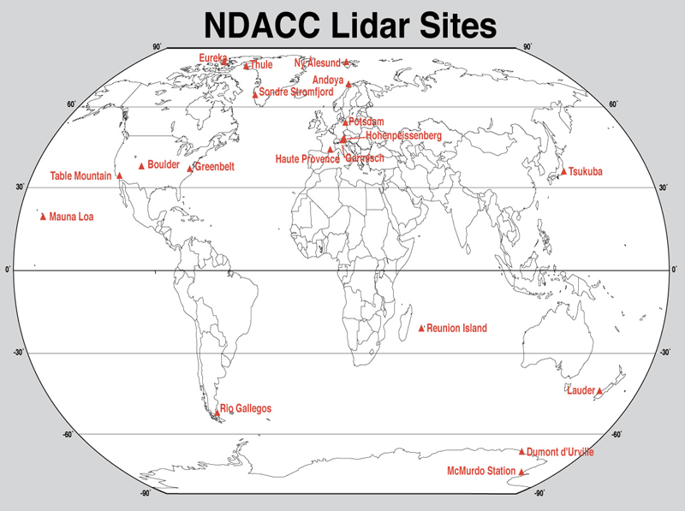
NDACC Lidars: (Almost) Global Network
Sodankyla
London
Payerne
Rome
Potenza
Huntsville
TMF and MLO are the 2 NDACC sites managed by the TMF Lidar Group
Dome C
Deep tropics not covered!

Slide 8
What is Lidar?
Lidar (LIght Detection And Ranging) is an active remote sensing technique
One or more laser beam(s) sent in the atmosphere
Laser light backscattered by atmospheric molecules and particles, collected by telescope
Amount of light (raw lidar signal) analyzed as a function of time, i.e., altitude (high temporal and vertical resolution)
Lidar atmospheric composition applications:
Vertical profiles of ozone, water vapor, temperature, wind, cloud and aerosol properties (also, CO₂, CH₄, NO₂, and more)
Temporal resolution can range from seconds to days
Vertical resolution can range from meters to a few kilometers

Slide 9
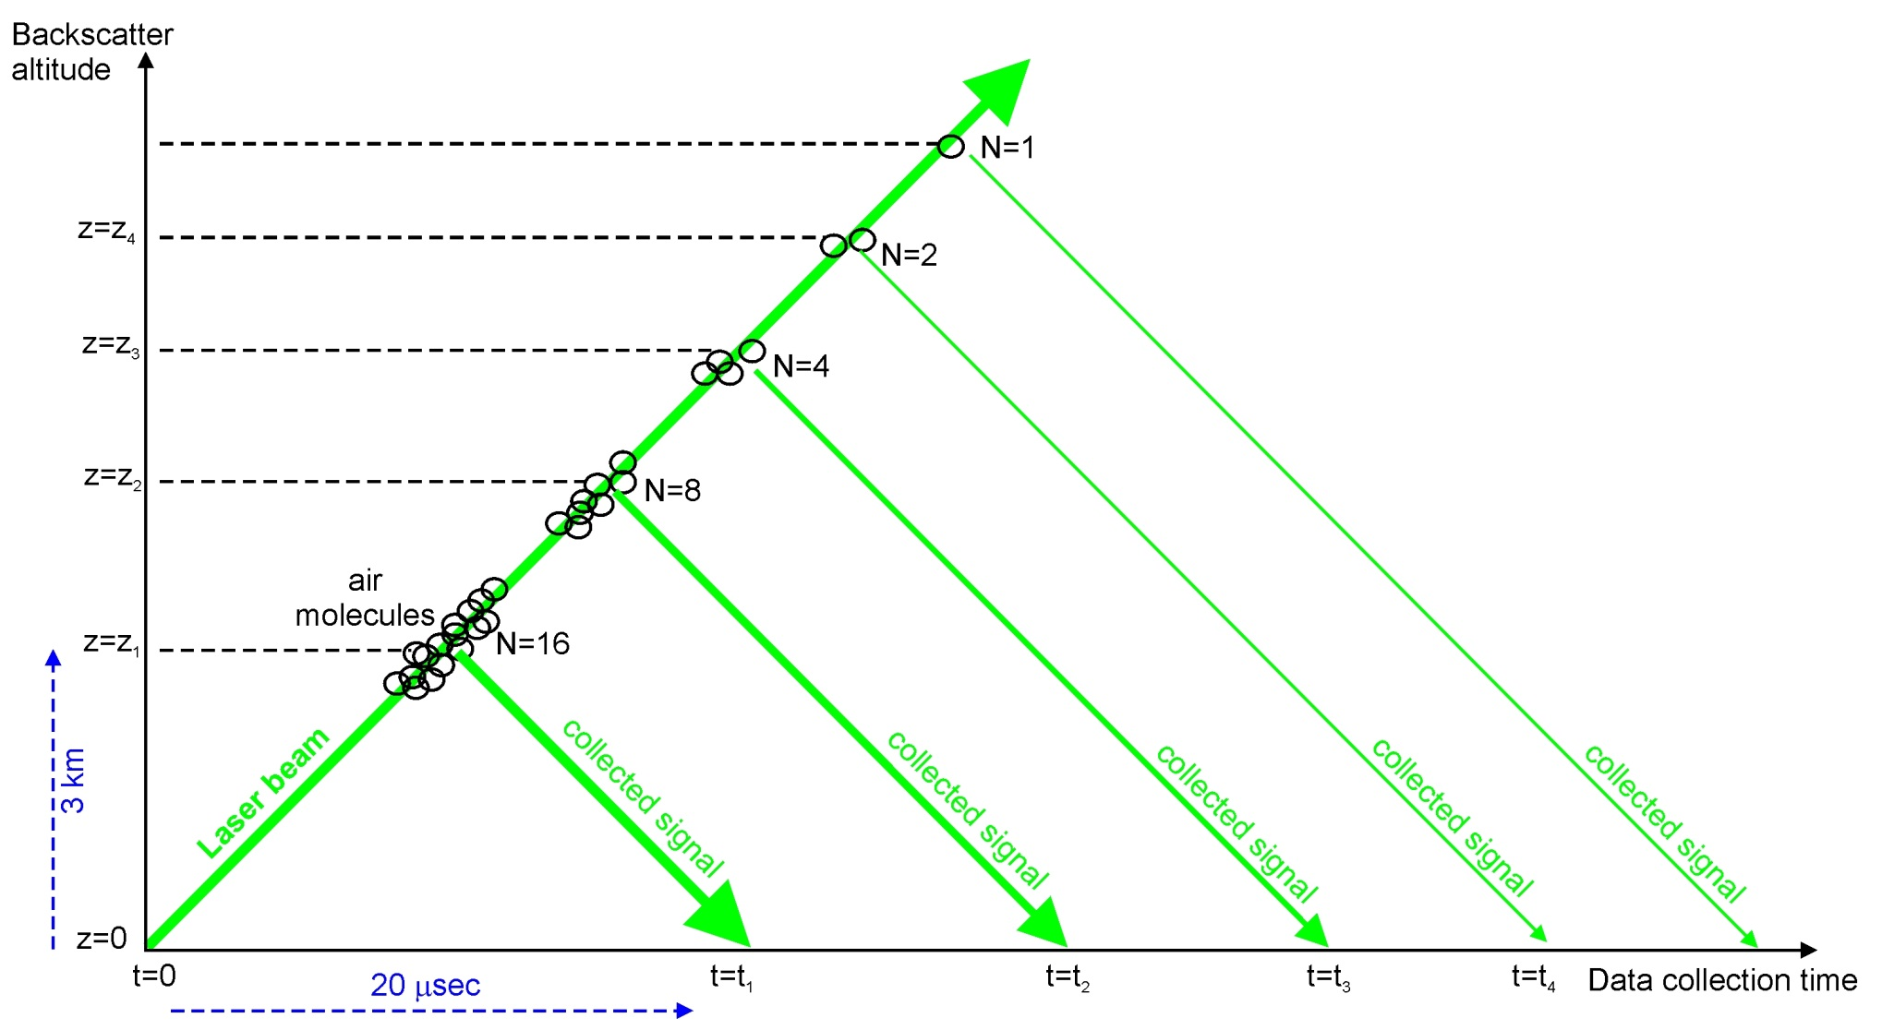
Lidar Specificity
1. Active remote sensing: Signals sampled as a function of time, i.e., geometric altitude ➔ High sampling resolution (~meters)
2. Eulerian measurement: Signals reflect the temporal evolution of the atmosphere at a fixed location ➔ Produce “2D curtain plots” at various timescales (alt. vs. time)
3. Integration/averaging: Signals may be acquired continuously for hours/days at a time ➔Large number of profile averaging options, and therefore science applications ➔ Wide range of associated uncertainties
4. Backscatter: Collected signal is proportional to the number of backscattering molecules ➔ Intensity decreases exponentially with altitude (5+ orders of magnitude in 20 km)

Slide 10
Lidar Equation
Photon counts detected
Backscatter intensity
Lidar receiver efficiency terms and viewing geometry
Photon counts emitted by laser
Laser beam extinction on the way back
Laser beam extinction on the way up
r = range
δr = sampling resolution
subscript E = emitted
subscript D = detected
subscript L = lidar
subscript M = molecule
The idea behind the lidar technique:
Build receiver channels at specific wavelengths and spectral widths to target specific types of scattering or extinction process

Slide 11
JPL Lidar Capabilities
What species?
➔
1- Ozone DIAL (stratosphere): 12-50 km Prec. 1-20% Accur. 4%
➔
2- Ozone DIAL (troposphere): 0-20 km Prec. 1-20% Accur. 4%
➔
3- Temperature Rayleigh: 20-90 km Prec. 0-10 K Accur. 0.5 K
➔
4- Temperature vib.-Raman: 8-40 km Prec. 0-10 K Accur. 0.5 K
➔
5- Water vapor vib.-Raman: 0-20 km Prec. 0-20% Accur. 3-10%
➔
6- Clouds and aerosols: 10-50 km Prec. 1-20% Accur. 1-10%
Precision degrades with altitude and improves with integration time
Accuracy depends on altitude and species measured

Slide 12
JPL-TMF Lidar Capabilities: Stratospheric Ozone
What species?
➔
1- Ozone DIAL (stratosphere): 12-50 km Prec. 0-20% Accur. 4%
➔
2- Ozone DIAL (troposphere): 0-20 km Prec. 0-20% Accur. 4%
➔
3- Temperature Rayleigh: 20-90 km Prec. 0-10 K Accur. 0.5 K
➔
4- Temperature vib.-Raman: 8-40 km Prec. 0-10 K Accur. 0.5 K
➔
5- Water vapor vib.-Raman: 0-20 km Prec. 0-20% Accur. 6%
➔
6- Clouds and aerosols: 0-50 km Prec. 1-20% Accur. 1-10%
Precision degrades with altitude and improves with integration time
Accuracy depends on altitude and species measured

Slide 13
Ozone Differential Absorption Lidar (DiAL)
Use the extinction part of the lidar equation, more specifically: the absorption by ozone
Laser beam is partially absorbed along the laser beam path
Intensity of absorption depends on wavelength
➔ Use 2 wavelengths λ₁ and λ₂ with different absorptions
The Lidar equation is reverted to access N_{O3}: P_{D} ➔ d/(log(P_{D}))/dz
Self calibrating method: No need for calibration

Slide 14
TMF and MLO Stratospheric Ozone DIAL Ozone, 10-50 km
Emitter: - 1 Excimer laser: 308 nm, 60 W, 200 Hz rep. rate - 1 Nd:YAG laser: 355 nm, 5 W, 50 Hz rep. rate - Mirrors, beam expanders, motion controller for beam alignment
Receiver: - 1 large telescope (91 cm diam.) for high-intensity Rayleigh (25-50 km) and Raman channels (10-35 km) - 2 small telescopes (10 cm diam.) for low-intensity Rayleigh channels (10-35 km) - Mechanical chopper, dichroic beam splitters and interference filters for spectral separation - Fast transient recorders for high sampling rate (e.g., 40 ns for 15 m sampling resolution)
Strengths: - Mature technique (30+ years) - DIAL technique does not require calibration
Caveats: - 3% accuracy limited by uncertainty in the ozone absorption cross-sections - Requires expensive excimer laser - Daytime measurements not possible with standard equipment
Applications: - satellite validation - long-term monitoring (ozone depletion and recovery) - process studies (ozone chemistry, stratosphere-troposphere exchanges)

Slide 15
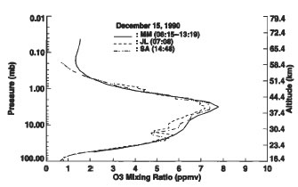
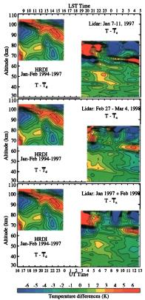
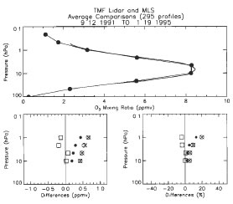
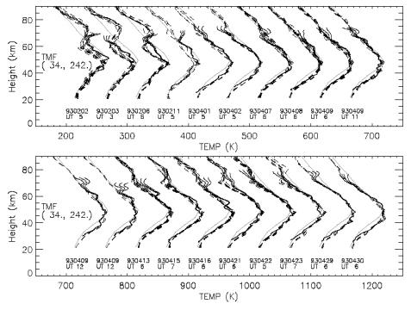
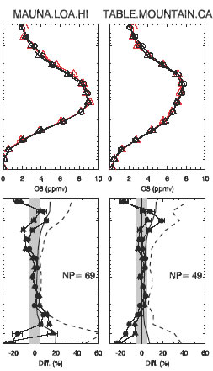
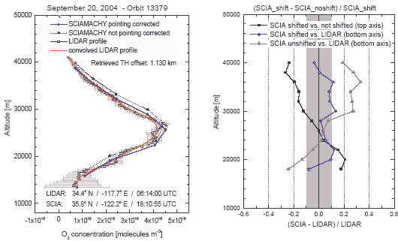
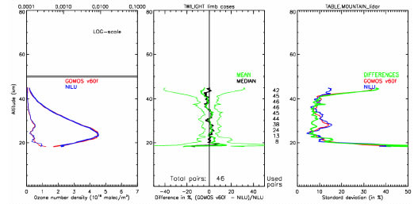
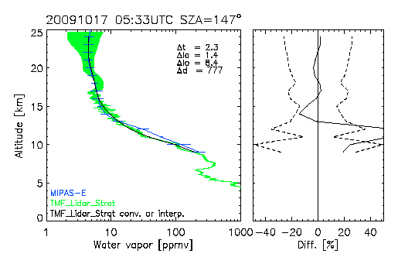
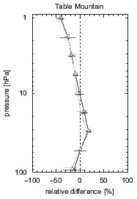
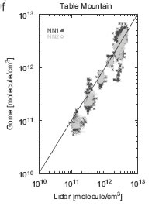
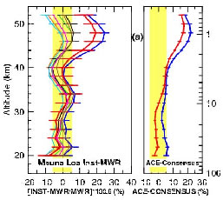
JPL Lidar Group: 3 Decades of Satellite Validation
SAGE-II O3 Tsou et al., 1995
UARS-MLS O3 Froidevaux et al., JGR, 1996
HRDI T Leblanc et al. JGR, 1999
UARS-MLS T
Wu et al., JASTP, 2002
SCIAMACHY O3
Von Savigny, ACP, 2005
Validation of 30+ products measured onboard satellites
GOMOS O3 Meijer et al., 2006
MIPAS H2O
Stiller et al., AMT, 2012
Aura-MLS O3 Jiang, JGR, 2007
GOME O3 Iapaolo, JQSRT, 2007
ACE FTS O3 Dupuy et al., ACP, 2008

Slide 16
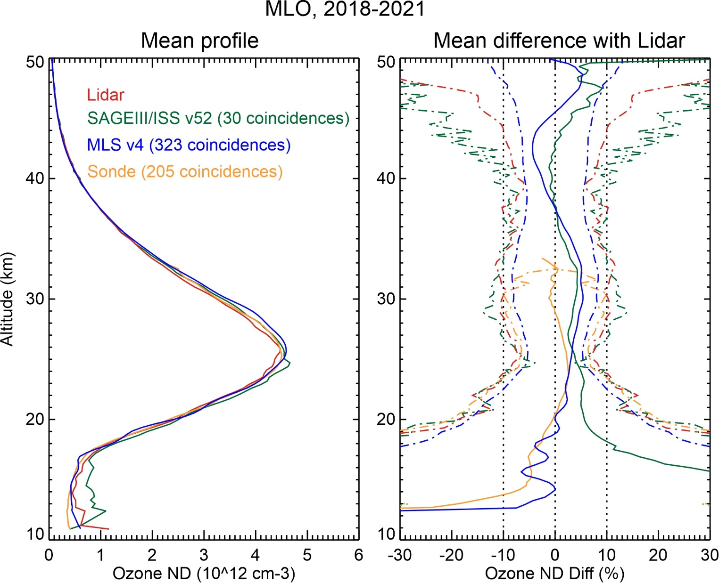
Stratospheric Ozone Lidar-satellite-sonde comparison (MLO)
SAGEIII/ISS v52 within 0-5% of lidar 20—45 km
High bias below 20 km
MLS v4 within 0-5% of lidar 13—50 km
O3sonde (Hilo) within 0-5% of lidar 15—33 km

Slide 17
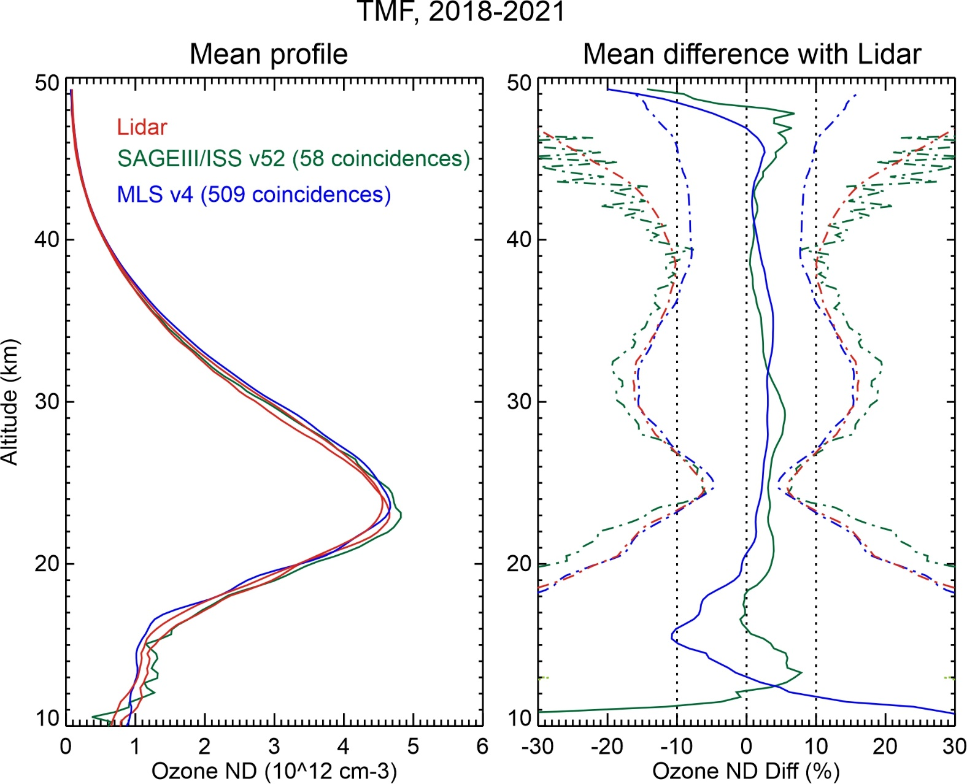
Stratospheric Ozone Lidar-satellite-sonde comparison (TMF)
SAGEIII/ISS v52 within 0-5% of lidar 15—48 km
MLS v4 within 0-5% of lidar 18—49 km
Low bias 14-18 km

Slide 18
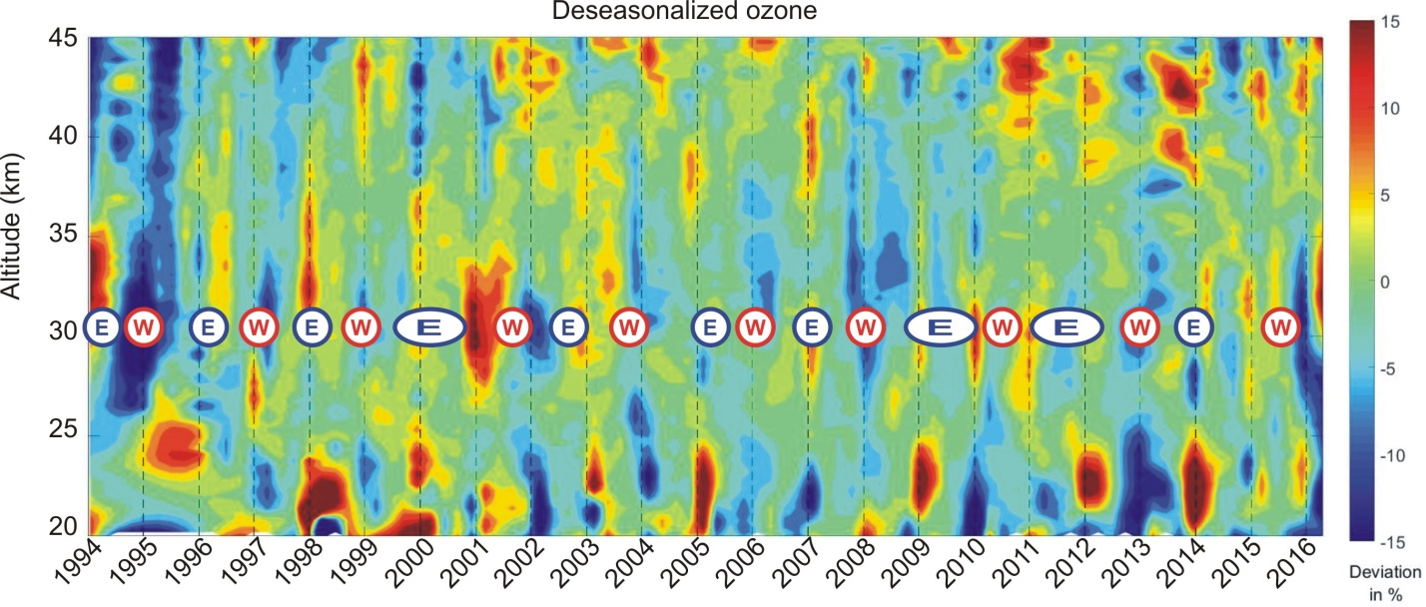
Long-term Variability of Ozone Monitoring at MLO
The Quasi-Biennial Oscillation (QBO):
(Adapted from Leblanc et al., 2001)
At MLO, ozone positive anomalies typically correlate with the Easterly phase of the QBO

Slide 19
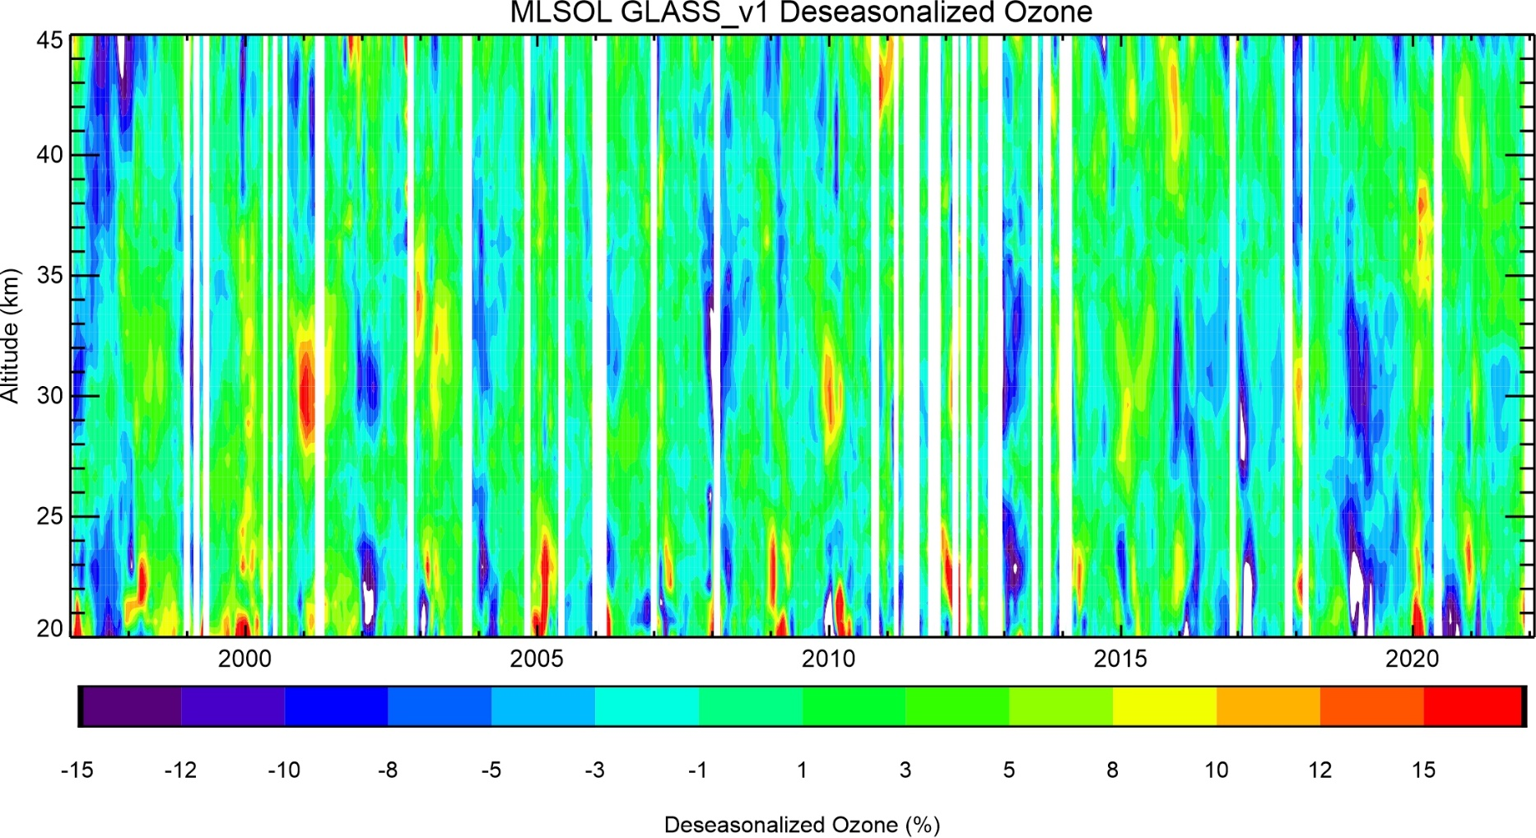
Long-term Variability of Ozone Monitoring at MLO (2)
Hints of trends?….

Slide 20
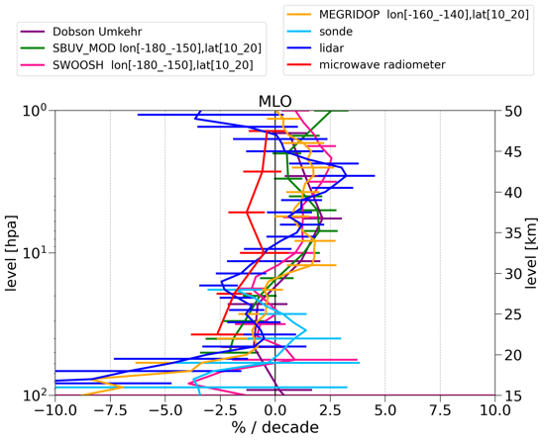
MLO lidar contribution to
WMO Ozone Assessments and SPARC LOTUS/LOTUS2
(Godin-Beekman et al., submitted, 2022)
(Steinbrecht, Person. Comm., 2022)

Slide 21
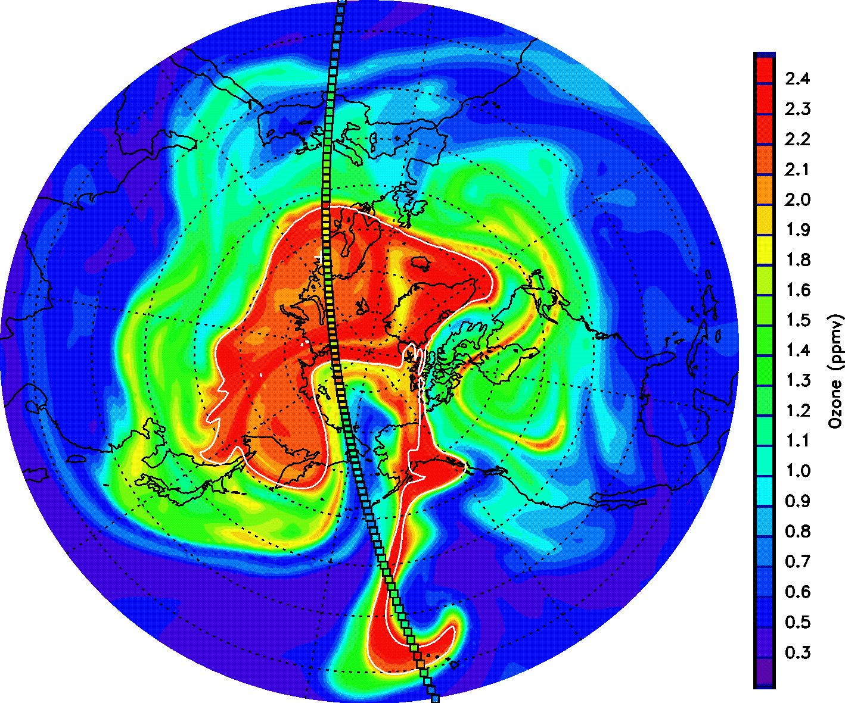
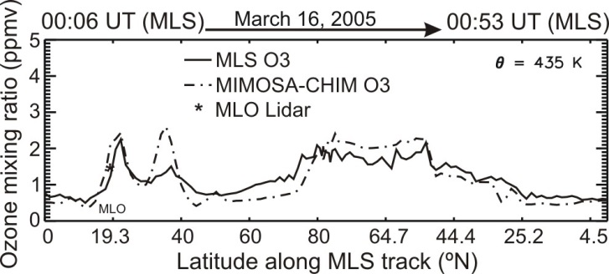
Lidar vs. Model and Satellite
Springtime polar ozone transported to the tropics (March 2005):
Ozone modeled by MIMOSA CTM at 435 K (approx. 18 km)
Aura-MLS ozone superimposed (small colored squares)
High ozone (>1.5 ppmv) simultaneously observed by MLO lidar (star), MLS and MIMOSA
(Leblanc et al., 2006)

Slide 22
JPL-TMF Lidar Capabilities: Temperature
What species?
➔
1- Ozone DIAL (stratosphere): 12-50 km Prec. 0-20% Accur. 4%
➔
2- Ozone DIAL (troposphere): 0-20 km Prec. 0-20% Accur. 4%
➔
3- Temperature Rayleigh: 20-90 km Prec. 0-10 K Accur. 0.5 K
➔
4- Temperature vib.-Raman: 8-40 km Prec. 0-10 K Accur. 0.5 K
➔
5- Water vapor vib.-Raman: 0-20 km Prec. 0-20% Accur. 6%
➔
6- Clouds and aerosols: 0-50 km Prec. 1-20% Accur. 1-10%
Precision degrades with altitude and improves with integration time
Accuracy depends on altitude and species measured

Slide 23
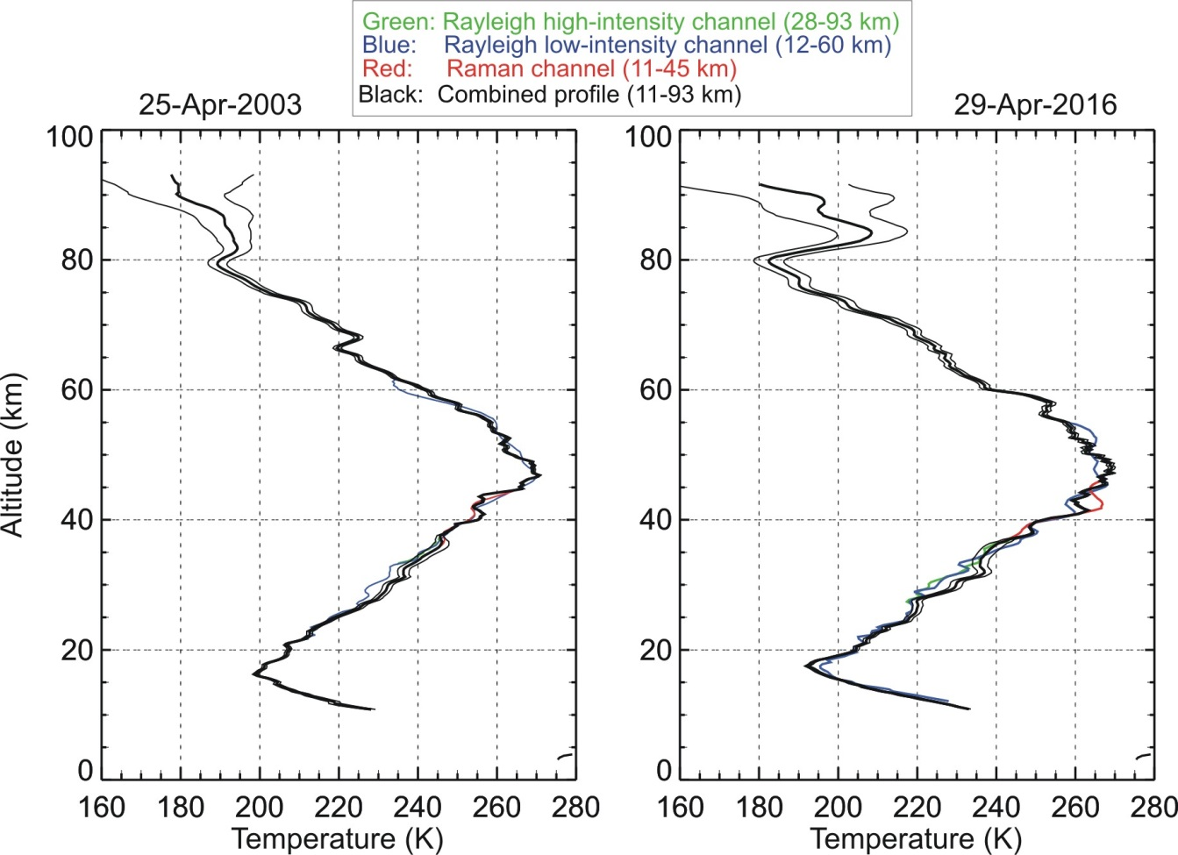
Two Examples of Rayleigh/Raman Temperature Profiles (MLO)
Larger uncertainty at the top, due to: 1) Lower precision (STNR) 2) Large uncertainty on a priori “tie-on” temperature
Impact of aerosols: - Rayleigh channel yields too cold temperatures ➔ Must use Raman channel below 30 km

Slide 24
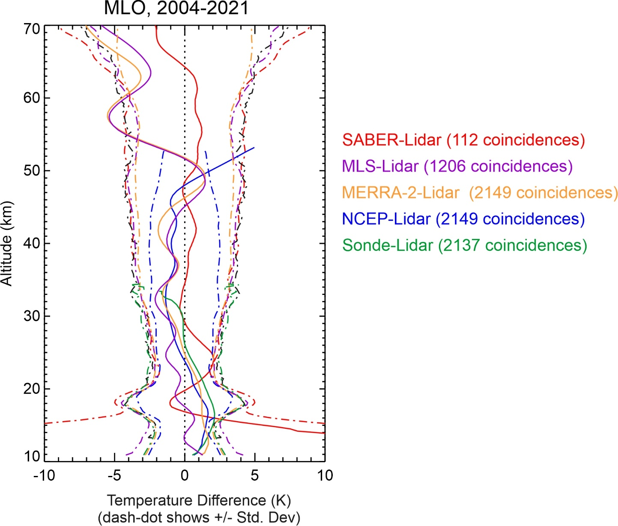
Temperature Validation example (Mauna Loa)
Main take-home messages:
- MLS (purple) shows 3-6 K cold bias in mesosphere Possibly a tidal bias
- MERRA-2 (yellow) driven by MLS in upper strato. and mesosphere
- Agreement within +/-2K between SABER (red) and lidar (30-65 km)
- NCEP (blue) too warm above 47 km (warm bias)
- MERRA-2 and NCEP driven by sonde (green) below 27 km
- 1-2 K bias at the tropopause ➔ Lidar cold bias suspected (aerosol extinction)

Slide 25
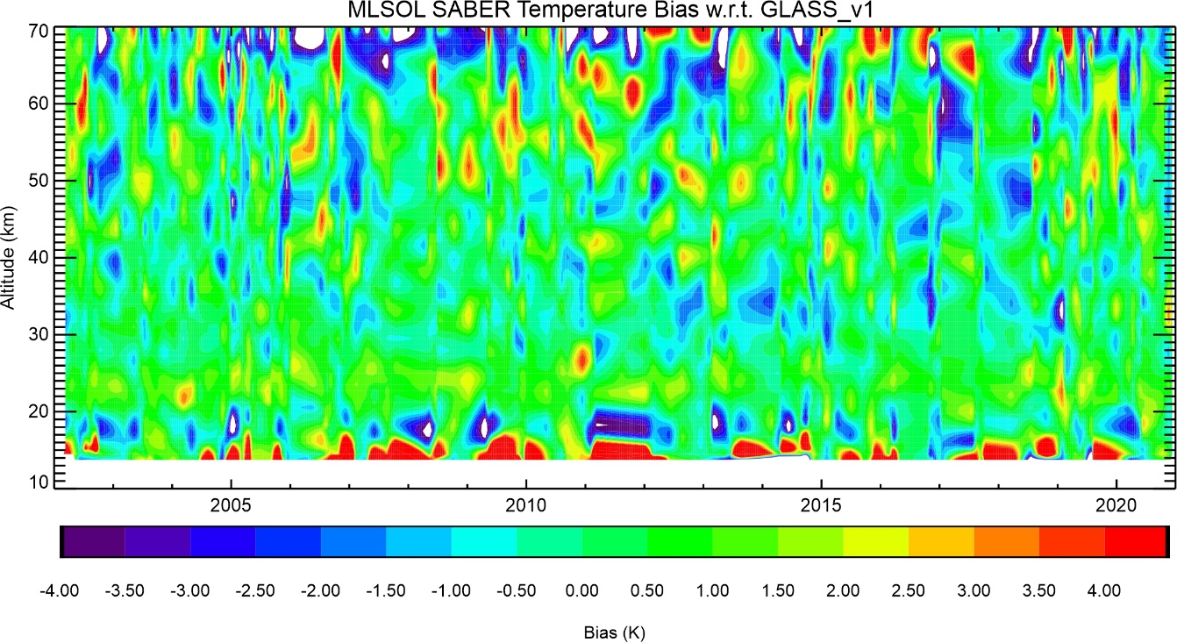
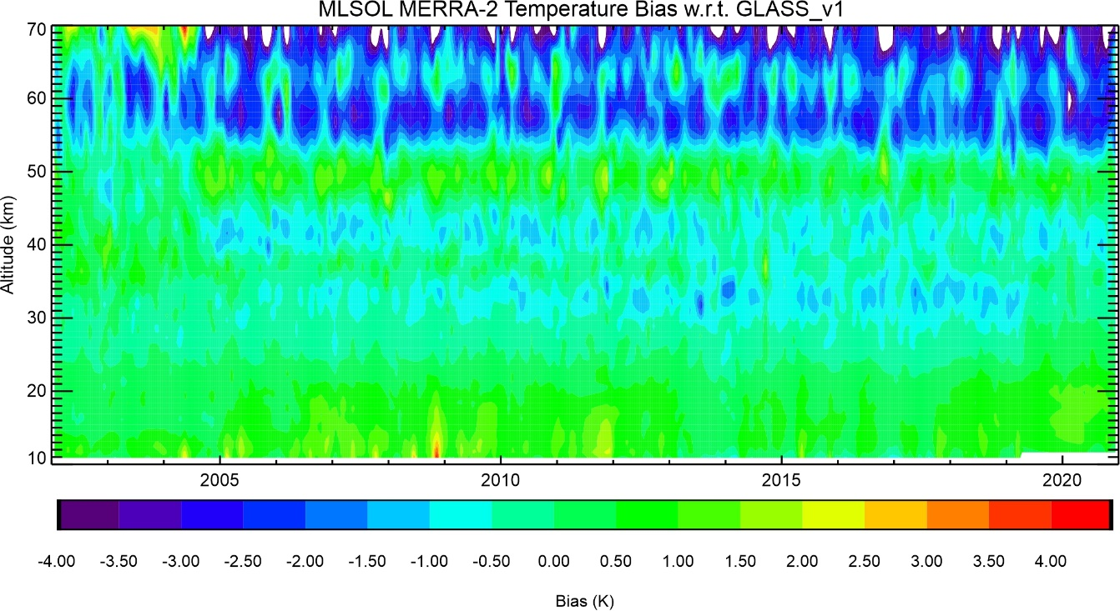
Using lidar to validate long-term consistency
SABER - Lidar
Lidar serves as transfer standard to identify discontinuities
MERRA2 - Lidar
Is MERRA2 driven by MLS Temp assimilation?

Slide 26
JPL-TMF Lidar Capabilities: Tropospheric Ozone
What species?
➔
1- Ozone DIAL (stratosphere): 12-50 km Prec. 0-20% Accur. 4%
➔
2- Ozone DIAL (troposphere): 0-20 km Prec. 0-20% Accur. 4%
➔
3- Temperature Rayleigh: 20-90 km Prec. 0-10 K Accur. 0.5 K
➔
4- Temperature vib.-Raman: 8-40 km Prec. 0-10 K Accur. 0.5 K
➔
5- Water vapor vib.-Raman: 0-20 km Prec. 0-20% Accur. 6%
➔
6- Clouds and aerosols: 0-50 km Prec. 1-20% Accur. 1-10%
Precision degrades with altitude and improves with integration time
Accuracy depends on altitude and species measured

Slide 27
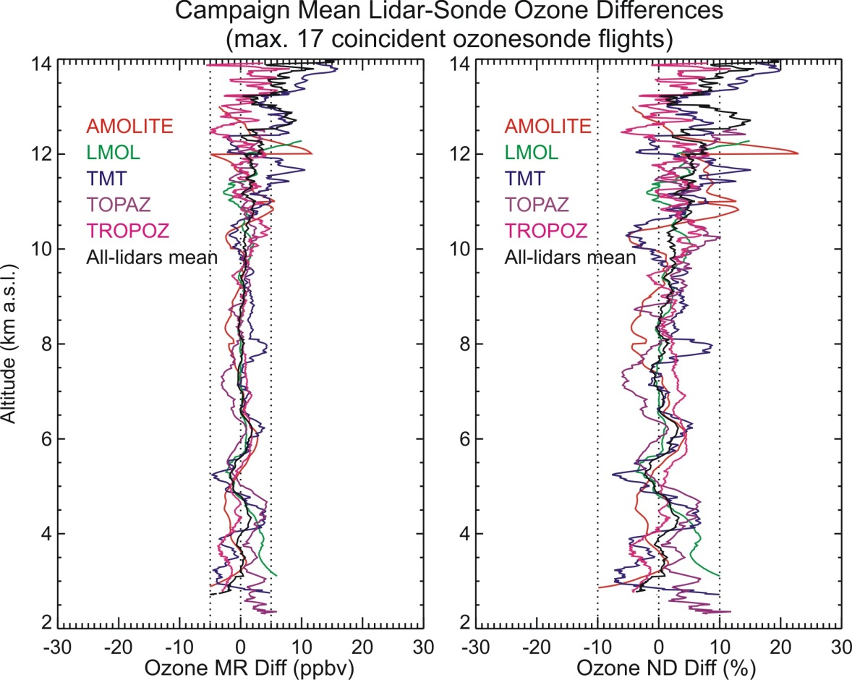
TMF Tropospheric Ozone DIAL Validation During SCOOP Campaign (August 2016)
4 visiting lidars during SCOOP campaign (TOLNet lidars)
All-lidar-mean bias with ozonesonde:
+0.1 ppbv (0.6%) RMS: 0.9 ppbv (2%)
All differences are within the ozonesonde and lidar combined uncertainties
➔TOLNet lidars form a mature, robust ground-based reference network
(Leblanc et al., 2018)

Slide 28
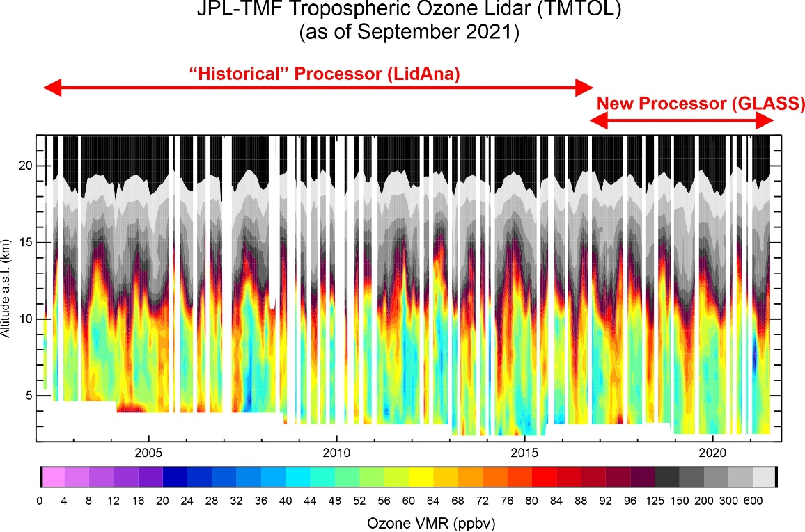
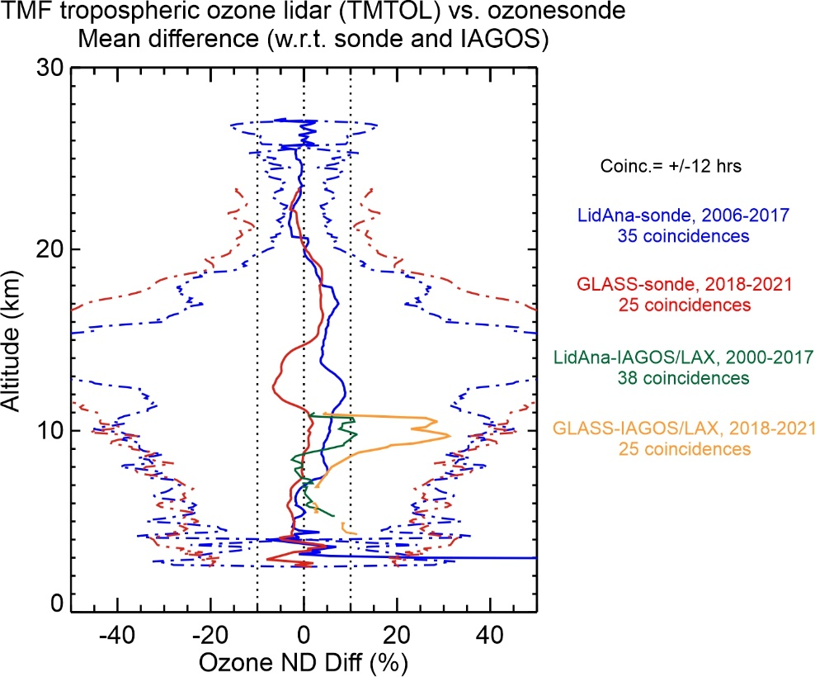
Tropospheric Ozone DIAL Validation contributions
Below: diff between lidar and others
High ozone variability in 8-15 km layer combined with different instrument representativeness lead to largest differences in UTLS

Slide 29
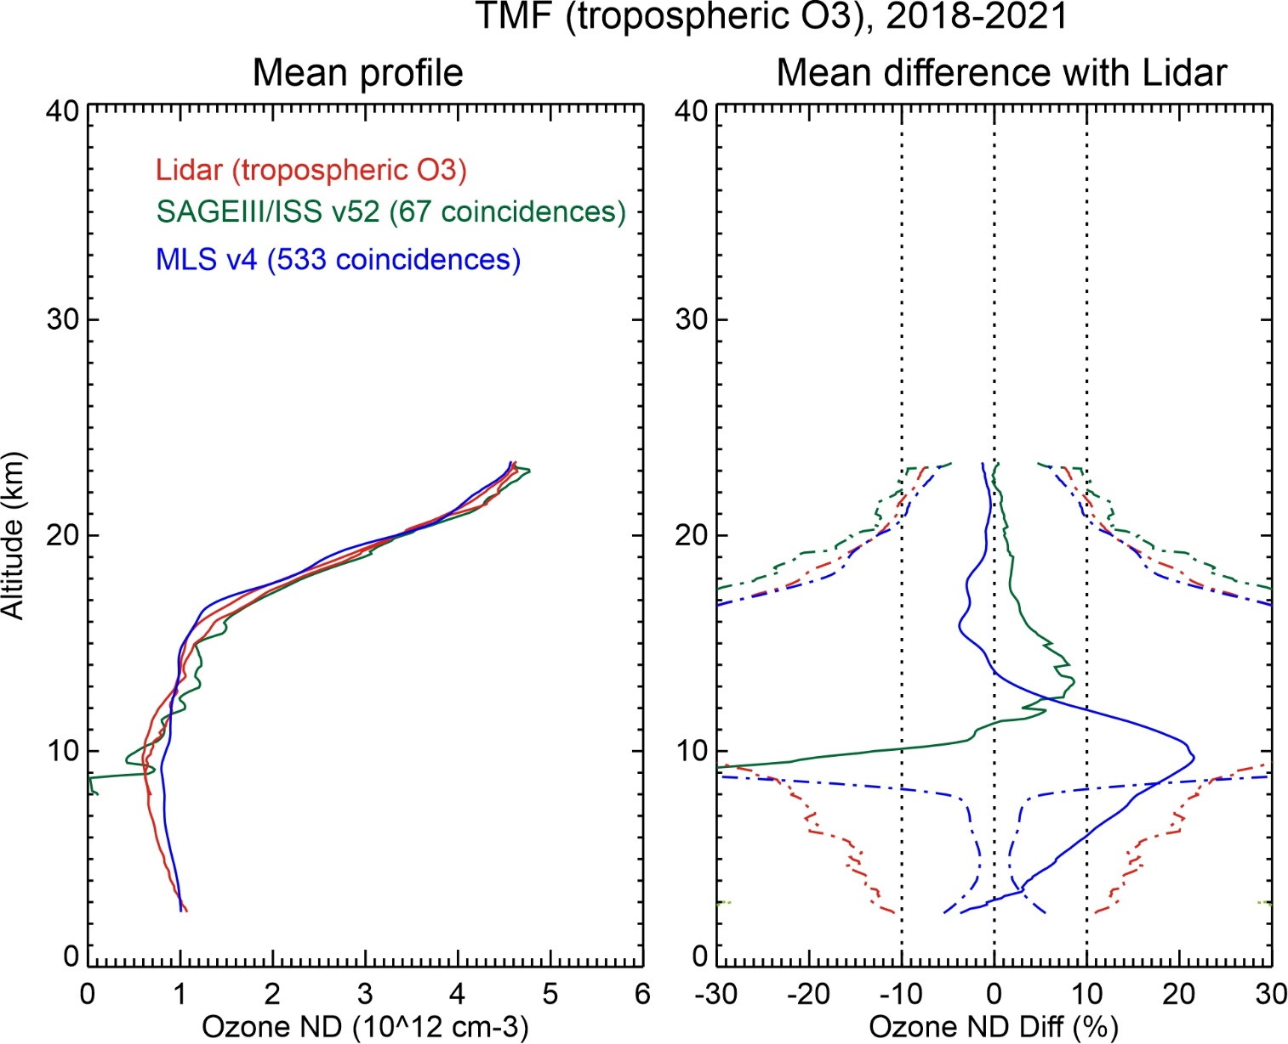
Tropospheric Ozone Lidar-satellite-sonde comparison (TMF)
SAGEIII/ISS v52 high bias 5% 13—16 km
MLS v4 low bias 3% 14-18 km
high bias 20% at 7-12 km
➔ Lower limit at TMF for - SAGEIII/ISS: approx. 10 km - MLS: approx. 13 km

Slide 30
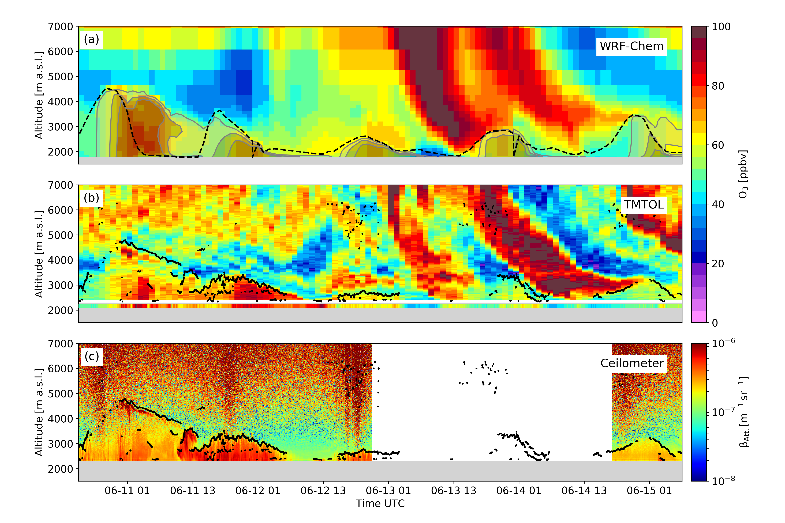
TMF Tropospheric Ozone vs. model Air Quality Monitoring (June 2020)
PBL ozone enhancement
on June 11-12
Followed by
Stratospheric ozone intrusions on June 13-14
➔ Lidar is best suited instrument for multi-day profiling and AQ monitoring
(Chouza et al., 2021)

Slide 31
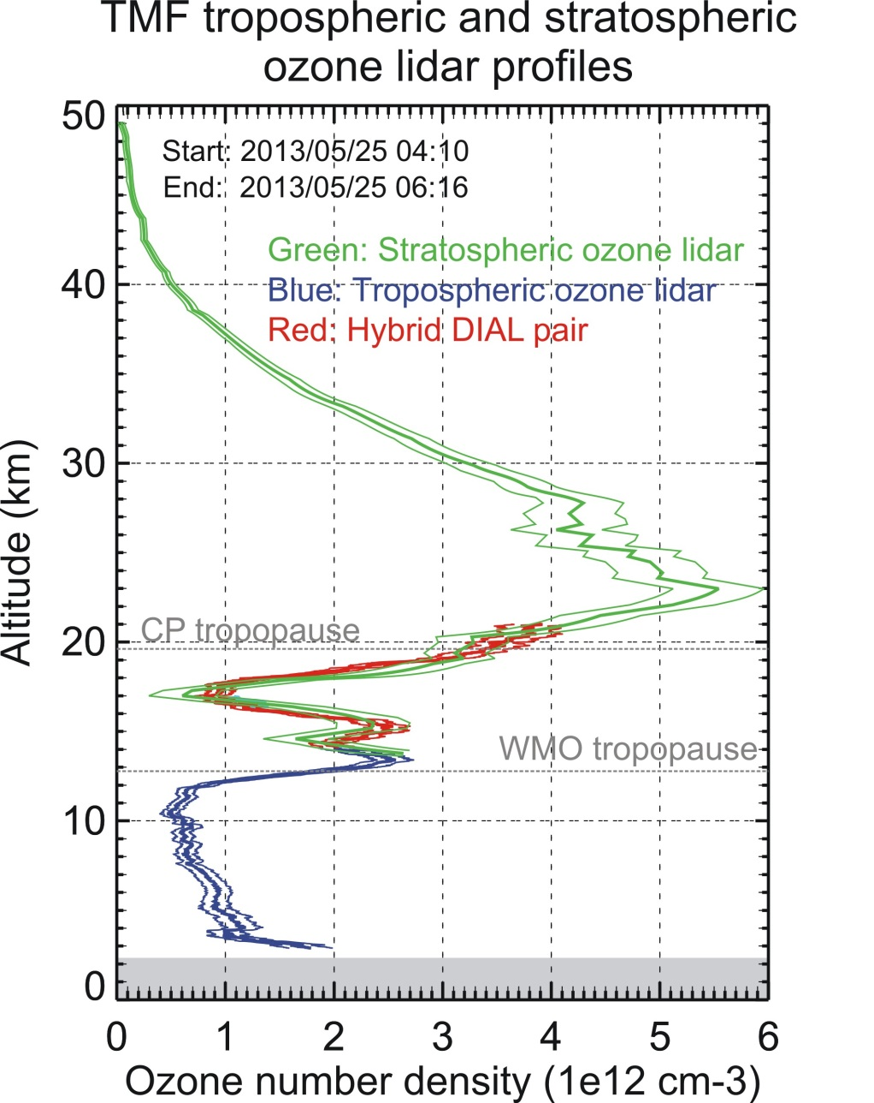
Combining strato. and tropo. O3 Lidars at TMF
Hybrid DIAL: Use 1 channel of tropo O₃ DIAL and 1 channel of strato O₃ DIAL
Green (15-50 km): Strato. O₃ DIAL
Red (15-22 km): “Hybrid” DIAL
Blue ( 3-15 km): Tropo. O₃ DIAL
➔ Hybrid DIAL: excellent technique for the upper troposphere and lower stratosphere
(McDermid et al., 2012)

Slide 32
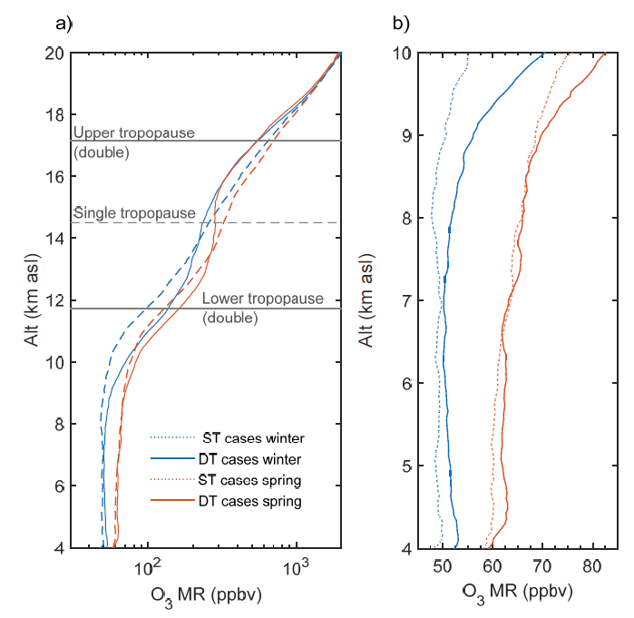
Ozone Long Range Transport and Intrusions within tropopause folds
Distinguishing air parcels within tropopause folds
Dash curves: 15-year climato. without tropopause folds Solid curves: 15-year climato. with tropopause folds
Low ozone in upper half of the fold (upper tropical tropo.)
High ozone in lower half of the fold (“middleworld”)
Ozone anomalies extend well below tropopause folds!
(Granados-Munoz and Leblanc, 2016)

Slide 33
Ozone variability in the UTLS before and after coordinate change
Geometric altitude
Potential temperature and PV
Reduced variability (now 30%-55%)
From SPARC Newsletter July 2020 (OCTAV-UTLS Activity)

Slide 34
JPL-TMF Lidar Capabilities
What species?
➔
1- Ozone DIAL (stratosphere): 12-50 km Prec. 0-20% Accur. 4%
➔
2- Ozone DIAL (troposphere): 0-20 km Prec. 0-20% Accur. 4%
➔
3- Temperature Rayleigh: 20-90 km Prec. 0-10 K Accur. 0.5 K
➔
4- Temperature vib.-Raman: 8-40 km Prec. 0-10 K Accur. 0.5 K
➔
5- Water vapor vib.-Raman: 0-20 km Prec. 0-20% Accur. 6%
➔
6- Clouds and aerosols: 0-50 km Prec. 1-20% Accur. 1-10%
Precision degrades with altitude and improves with integration time
Accuracy depends on altitude and species measured

Slide 35
Long-term Monitoring of Stratospheric Aerosol (JPL Lidar at Mauna Loa Observatory)
Top: Extinction coefficient
Bottom: Stratospheric Aerosol Optical Depth
2019/2020: 20-year high in stratospheric aerosol loading
Emergence of a new “chronic” source: Wildfires (through PyCb)

Slide 36
JPL-TMF Lidar Capabilities
What species?
➔
1- Ozone DIAL (stratosphere): 12-50 km Prec. 0-20% Accur. 4%
➔
2- Ozone DIAL (troposphere): 0-20 km Prec. 0-20% Accur. 4%
➔
3- Temperature Rayleigh: 20-90 km Prec. 0-10 K Accur. 0.5 K
➔
4- Temperature vib.-Raman: 8-40 km Prec. 0-10 K Accur. 0.5 K
➔
5- Water vapor vib.-Raman: 0-20 km Prec. 0-20% Accur. 6%
➔
6- Clouds and aerosols: 0-50 km Prec. 1-20% Accur. 1-10%
Precision degrades with altitude and improves with integration time
Accuracy depends on altitude and species measured

Slide 37
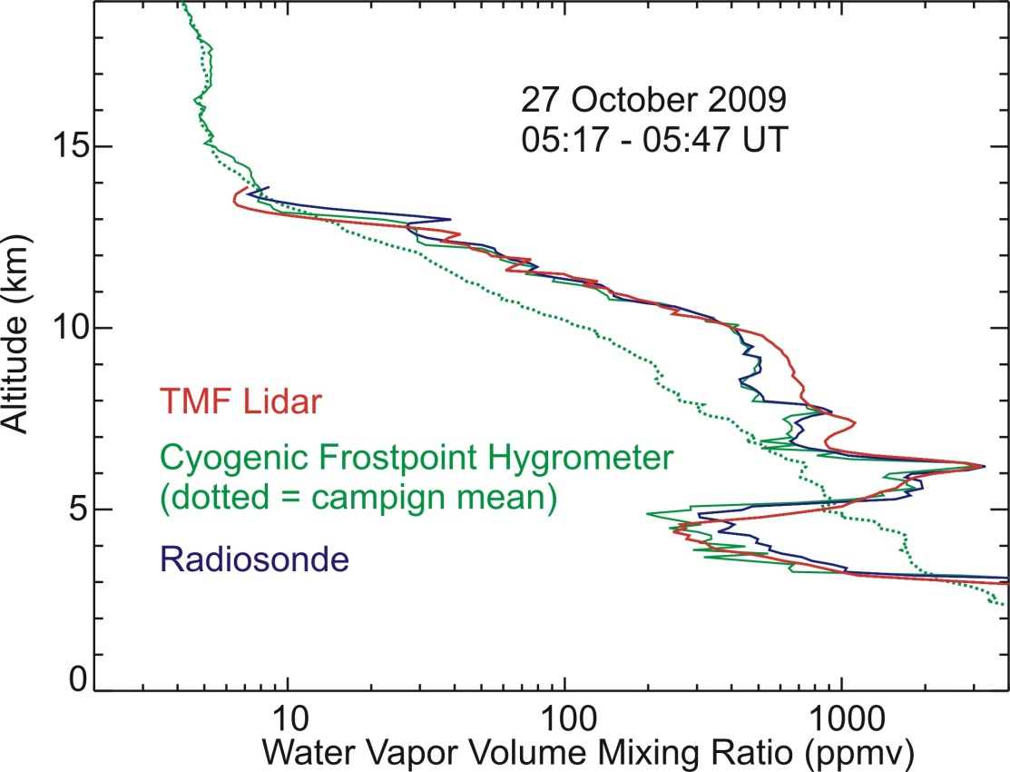
H₂O Raman Lidar Profile Example
Lidar validation during MOHAVE 2009 Campaign
Cryogenic Frost-point Hygrometer (green) is research-grade reference hygrometer for upper air (10-30 km)
30-min lidar profile reaches 14 km i.e., same as radiosonde
Very high variability at small vertical and temporal scales (e.g., 4-6 km)
(Leblanc et al., 2011)

Slide 38
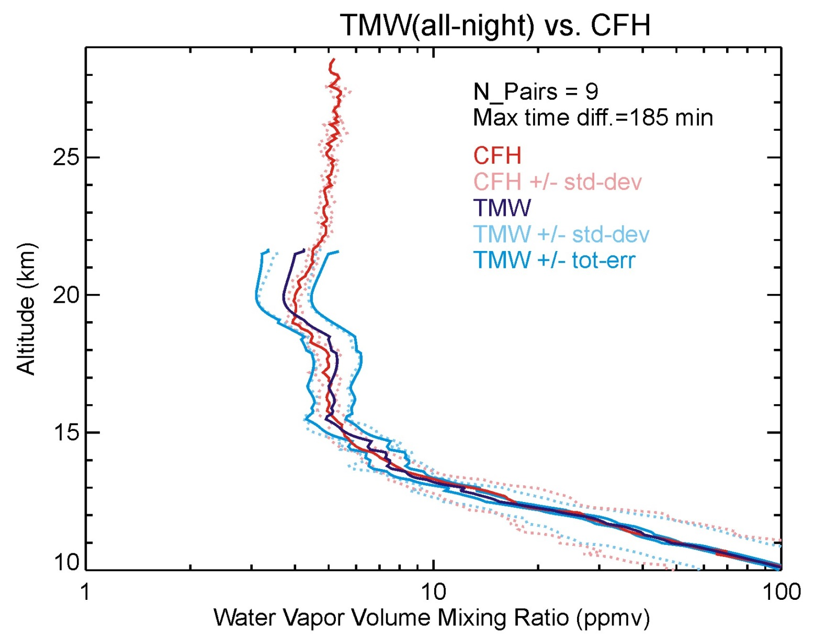
H₂O Raman Lidar for UTLS studies
TMF Raman lidar Optimized for UTLS measurements
Average 9 profiles MOHAVE 2009 campaign
Very challenging for H2O lidars to reach the LS
Good for UT (+/-5% diff. with Frost-Point)
➔ Long integration times required for LS
(Leblanc et al., 2012)

Slide 39
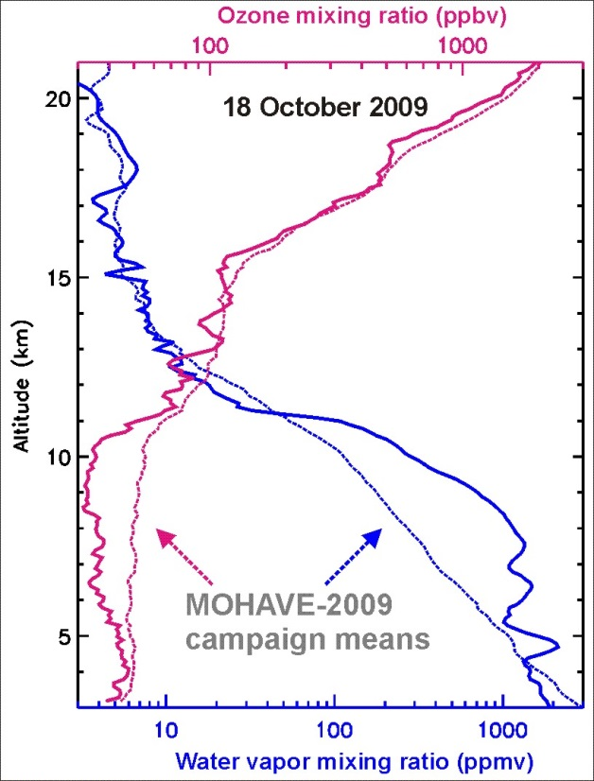
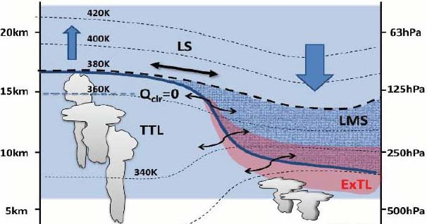
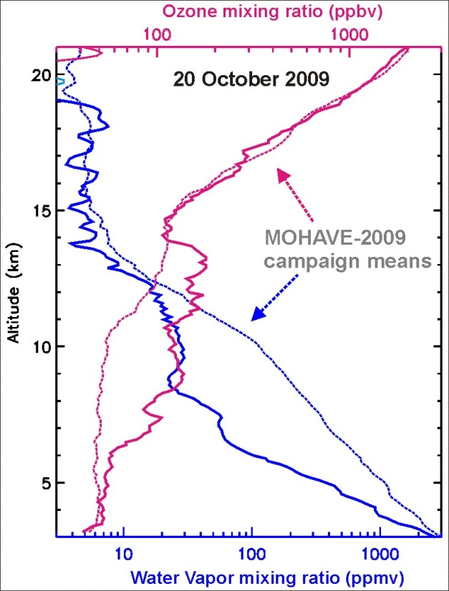
TMF Tropospheric Ozone and Water vapor
O₃ & H₂O lidar observations of a stratospheric intrusion during the MOHAVE 2009 Campaign
TMF
tropopause
Adapted from Hegglin, 2009
Sensing extratropical LMS
Sensing subtropical UT
Wet
O3-rich
O3-poor
Dry
TMF
EQ
34N
Pole

Slide 40
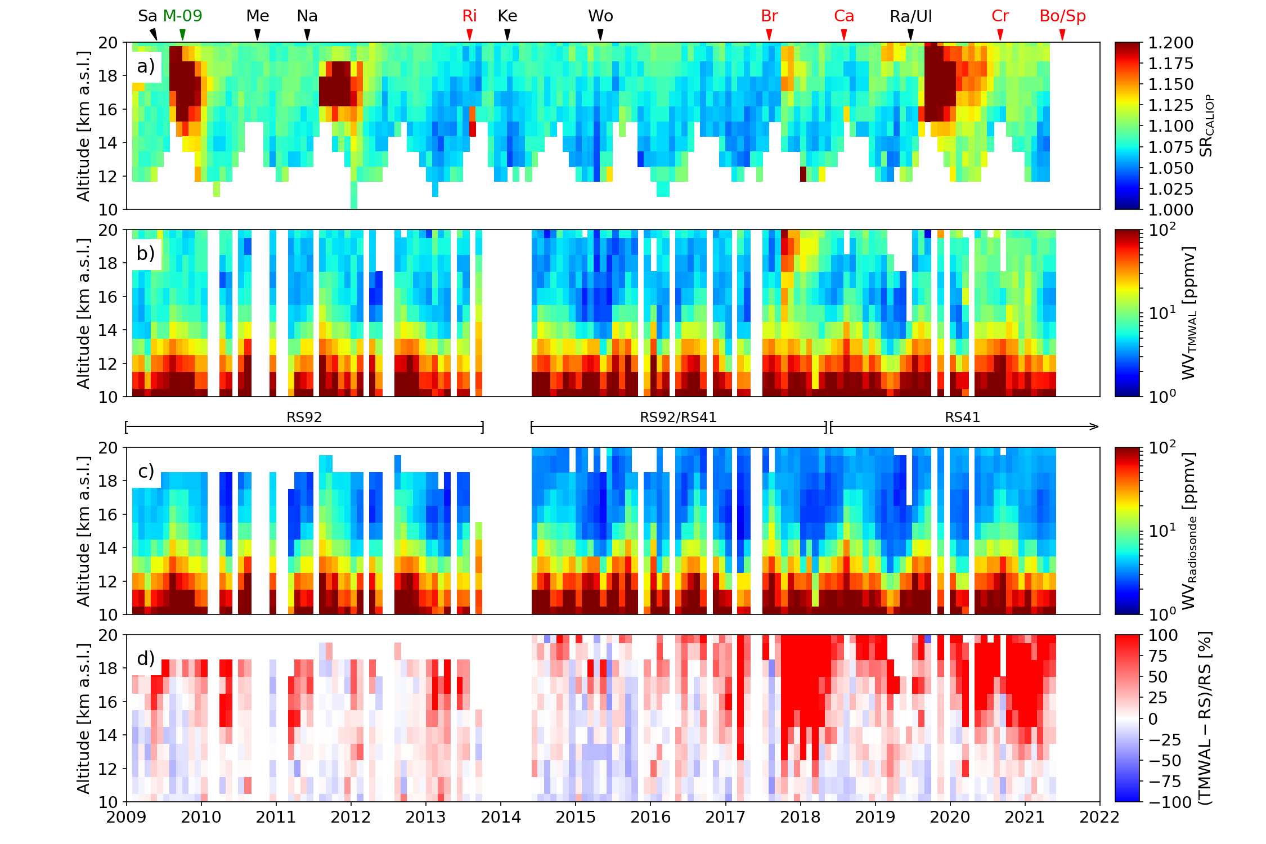
H₂O Raman Lidar for UTLS Long-Term Monitoring
Top panel: CALIOP aerosol scattering ratio
Third panel: H2O VMR from TMF radiosonde
Second panel: H2O VMR from TMF Raman lidar
Bottom panel: lidar-sonde difference
H2O high bias correlated
with biogenic aerosols,
not with volcanic aerosols
New “chronic” source: wildfires (through PyCb)
(Chouza et al., in prep. 2022)

Slide 41
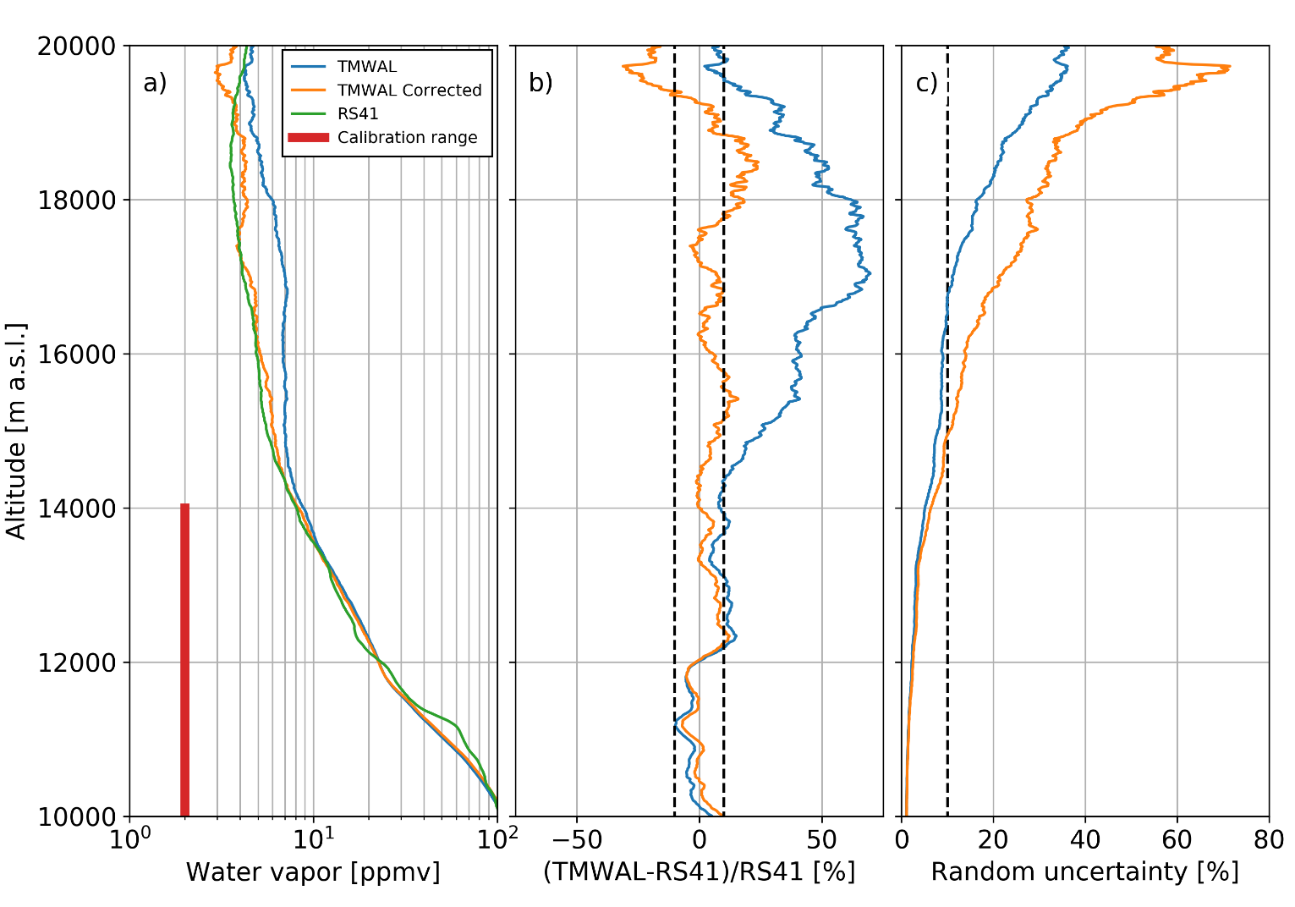
H₂O Raman Lidar in UV: Need aerosol fluorescence correction in the UTLS
Fluorescence contamination
by biogenic aerosols is a new reality
New correction technique developed at JPL-TMF
NDACC H2O Lidar long-term measurement strategy needs to be re-considered: Option 1: Apply (improved) fluorescence correction Option 2: Forget UV (355 nm), use 532 nm emission instead
(Chouza et al., in prep. 2022)

Slide 42
Future Activities of the JPL-TMF Lidar Group
Continue long-term monitoring by lidar: - Ozone, temperature, aerosol, and water vapor lidar measurements will continue - Shortage of satellite upper atmosphere observations is expected in near future ➔ continuation of ground-based measurements is essential to guarantee future monitoring of atmospheric composition without any gap
Design and build new mobile, autonomous tropospheric ozone lidar: - Use tropospheric ozone experience of the past 20 years and more recent automation experience to deploy and run ozone lidar on the field without attendance
Design and build new cloud/aerosol lidar capability: - Driven by 1) increase in wildfire activity and 2) climate science needs (Decadal Survey) - Aerosol capability needs multi-wavelength, including 532 nm ➔ new H2O Raman lidar - High lidar expertise within the TMF Lidar Group should be used to address those needs
THANK YOU
Visit the JPL-TMF Lidar Group website: https://lidar.jpl.nasa.gov/

