Slide 1
Science Team Meeting
NASA Langley Research Center
10/13/2022

Slide 2
Mission Operations
Jamie Nehrir
Mission Operations Manager

Slide 3
Outline
Mission Operation Overview
What Has Change in the Last Year
Future Work

Slide 4
Ops Overview
Mission Operations Goals
Commanding and downloading data on a weekly/daily basis
Maintaining the health and safety of the SAGE III payload
Daily engineering checks
Trending of engineering data and science metrics
Process and distribute SAGE III data
Process Ground Support Equipment (GSE) and Solid State Memory Card (SSMC) in near real-time (8-5 ET)
Processes 24 hours of SSMC data daily
Generates daily SCF files
Level 0 and ancillary data
Generates daily ESA/TASI Hexapod data files

Slide 5
Ops Team
SAGE III Payload Operations Center
Jamie Nehrir | Mission Operations Manager
Andrew Peterson | Ground System Manager
Greg Paxton | Ground Systems Lead
Samuel Porter | Deputy Mission Operations Manager
Robert Borchardt | Lead Technical Payload Engineer
Jonathan Hicks | Ground Systems Engineer
James Farmer | Ground Systems Engineer
Joshua McDonald | Payload Engineer
Caitlyn Stone | Payload Engineer
Donald Cleckner | Payload Engineer
Rick Farmer | Ground System Engineer
James Losey | Payload Engineer

Slide 6
SAGE III Operations
SAGE III celebrated its 5th birthday on board the International Space Station
ISS has been extended until 2030 and no other payload is projected to take over the SAGE III position (looking forward to supplying the Science team with many more years of data)
The SAGE III payload continues to operate as expected
SAGE has officially acquired over 50,000 occultation events!!

Slide 7
Phase-E Totals 7/1/2017 00:00 to 10/5/2022 09:00
Event Type | Total Planned | Total Acquired | Total % Acquired (vs. Planned)
Sunrise | 26739 | 24160 | 90.4%
Sunset | 26735 | 22802 | 85.3%
Moonrise | 3450 | 1390 | 40.3%
Moonset | 3904 | 2384 | 61.1%
All Occultation | 60828 | 50736 | 83.4%
Limb | 20130 | 19552 | 97.1%

Slide 8
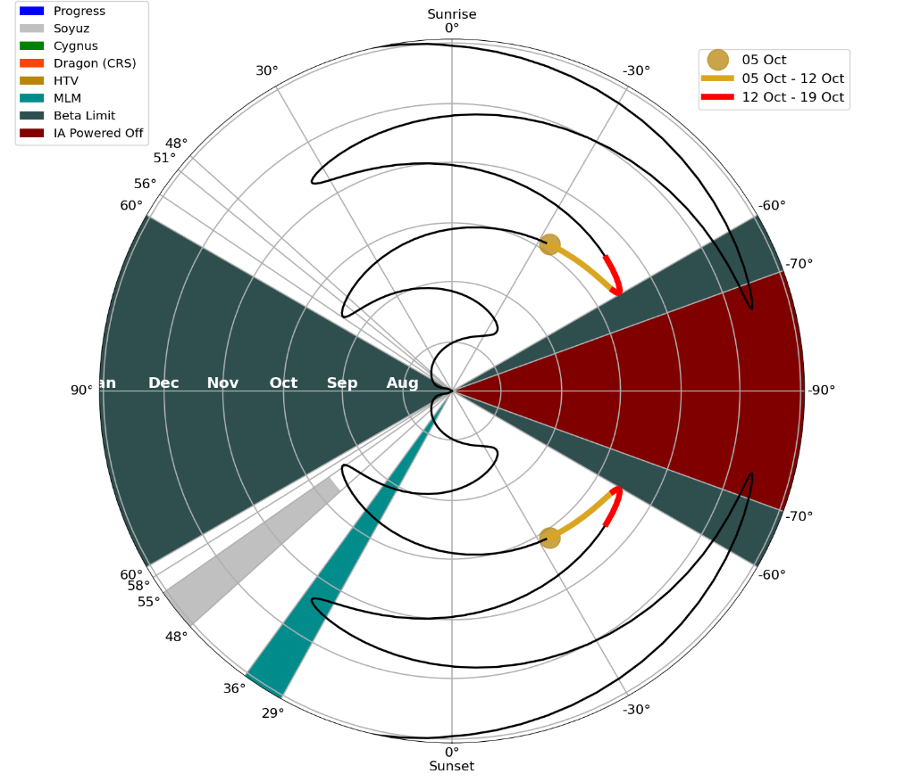
Analysis of Blockages for SAGE III
Now that MLM has been on board for over a year the SAGE III Operations team has a strong understanding of the expected blockages at different betas
The average amount of blockages has not changed with the addition of MLM
Note: previously we had blockages from Progress in this area

Slide 9
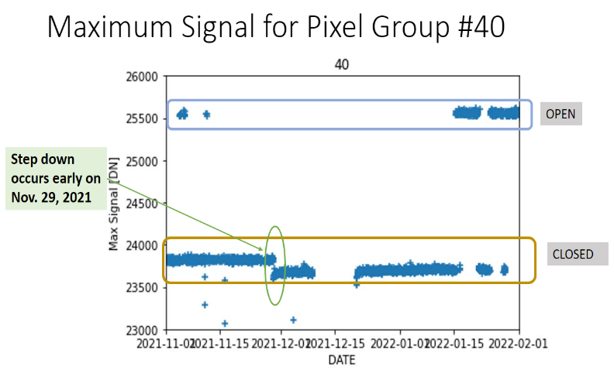
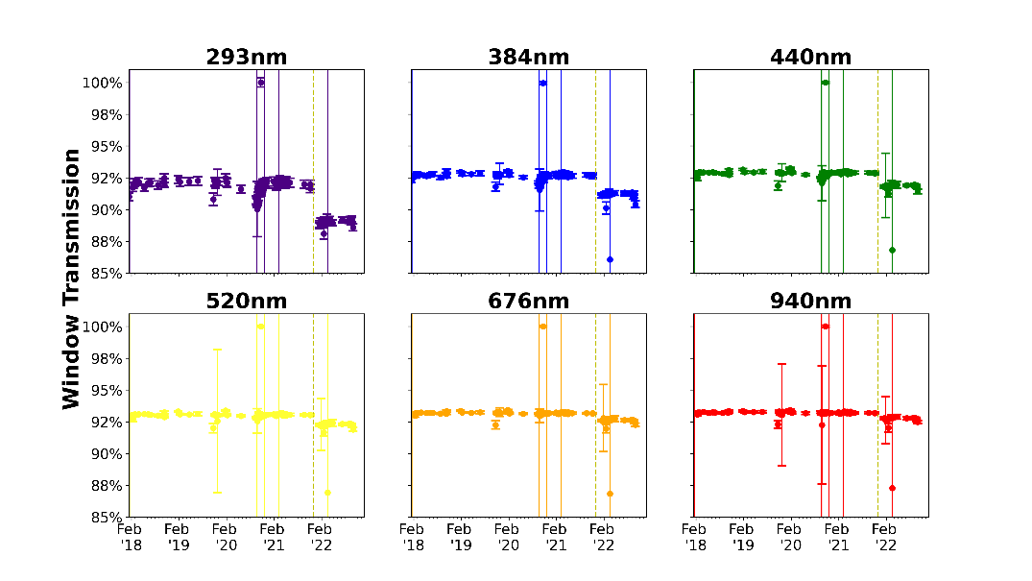
Window Transmission Anomaly
SAGE III observed a decrease in signal Transmission through the contamination window
Analysis of the contamination window transmission signal indicates an impulse contamination event on November 29, 2021. Previous contamination events seen in the transmission signal have slowly recovered as contamination has desorbed off the window. The November 29th contamination event was not seen by the CMP sensors and the transmission signal has not recovered after 11 months of collection of open/close window data.
Note: internal optics appear unaffected as the decrease in signal is only seen when the door is closed
Wavelength (nm) | Transmission Drop in %
293 | 2.6%
384 | 1.4%
440 | 0.97%
520 | 0.76%
676 | 0.58%
940 | 0.45%

Slide 10
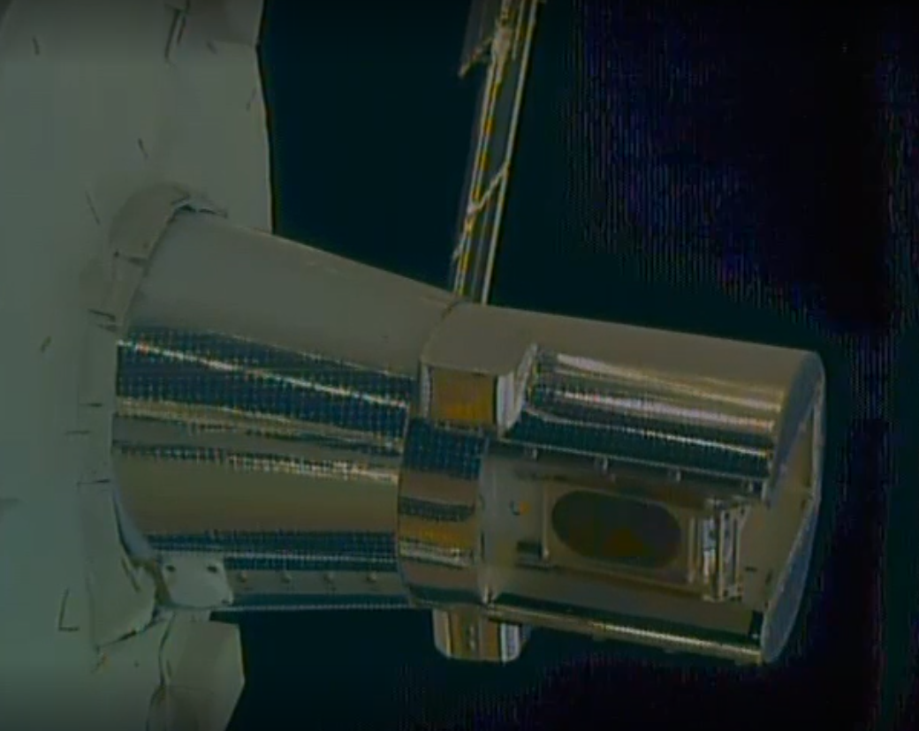
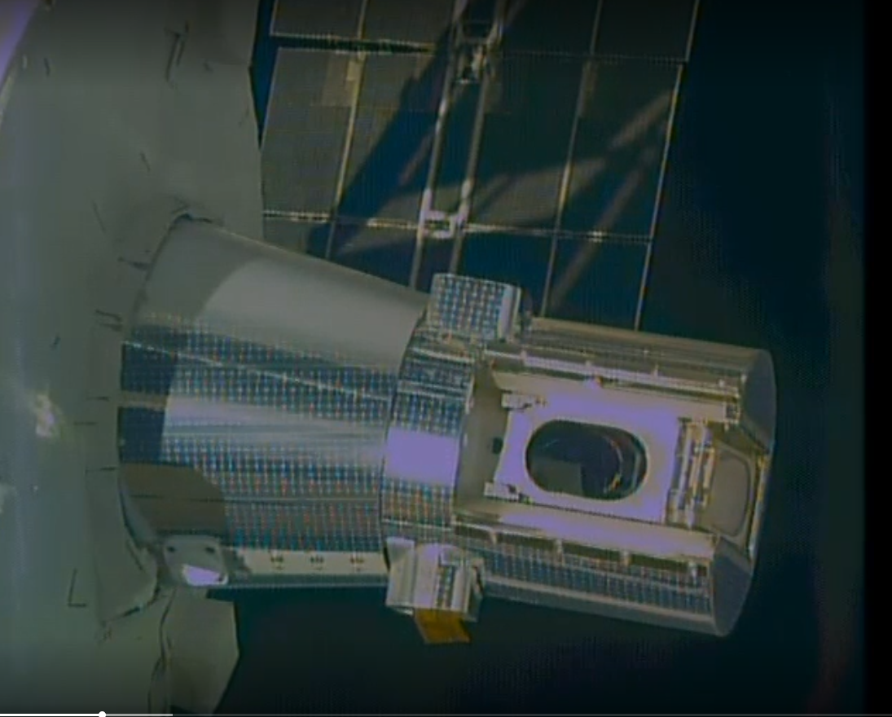
Window Transmission Anomaly
A Robotic Survey was conducted on Aug 23rd, 2022. An extensive review of the contamination window was done and there was no observed contamination or anomalies found on the window.
At this point the SAGE III team is treating this anomaly as a single event incident but will continue to monitor window transmission for the duration of the mission

Slide 11
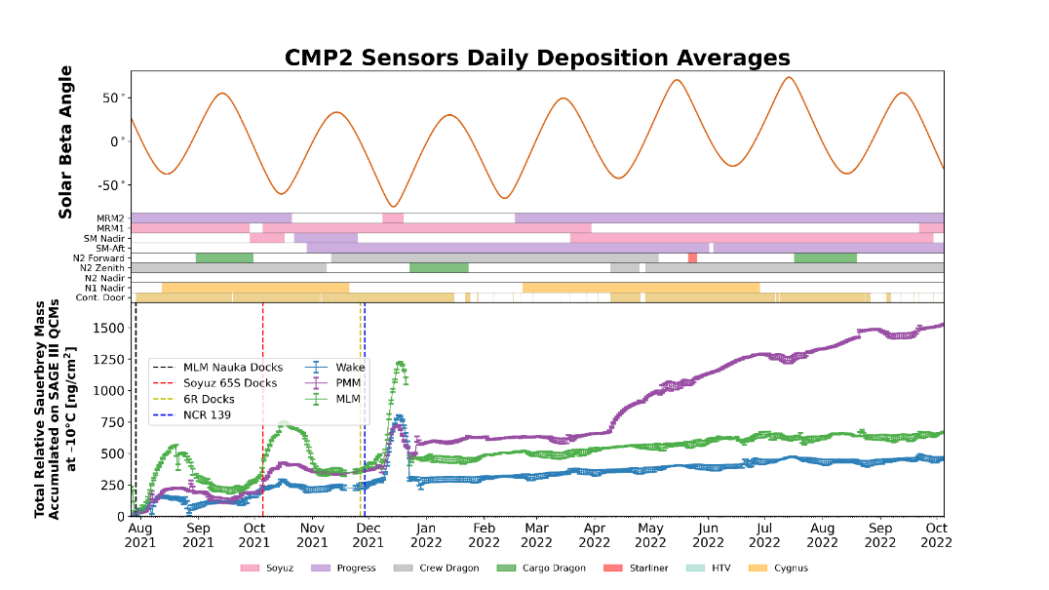
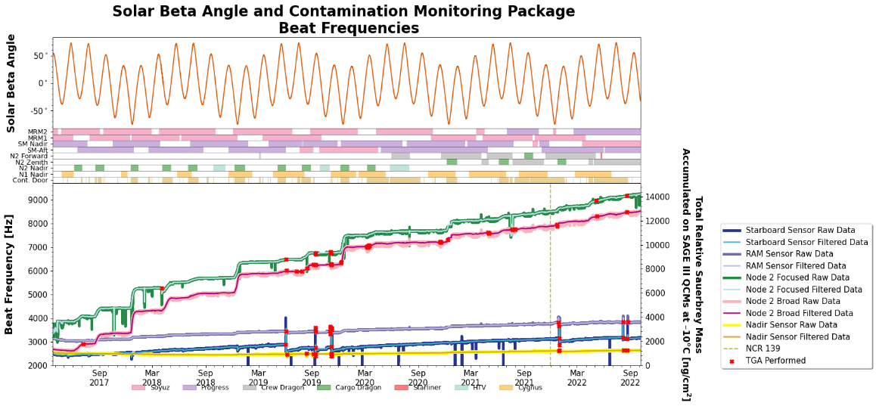
Contamination on ISS
Following the installation of MLM in July of 2021 and the increase in vehicle activity the SAGE III operations team has been closely monitoring the contamination levels on station
Arrival of MLM

Slide 12
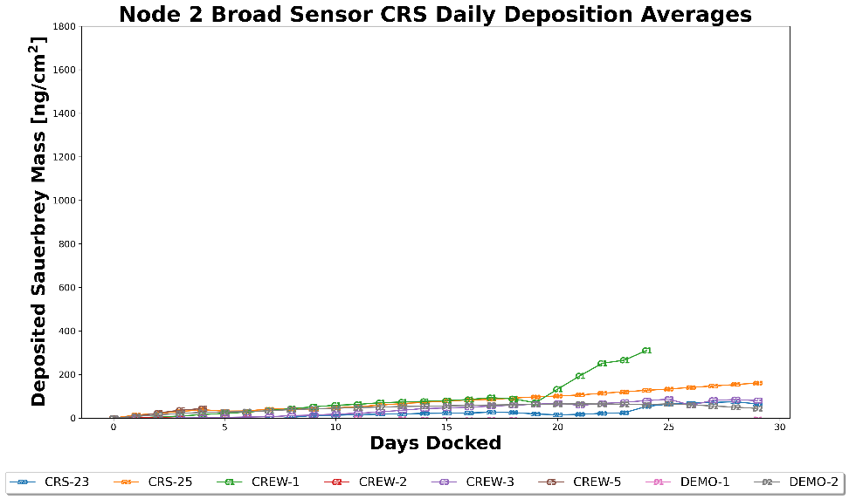
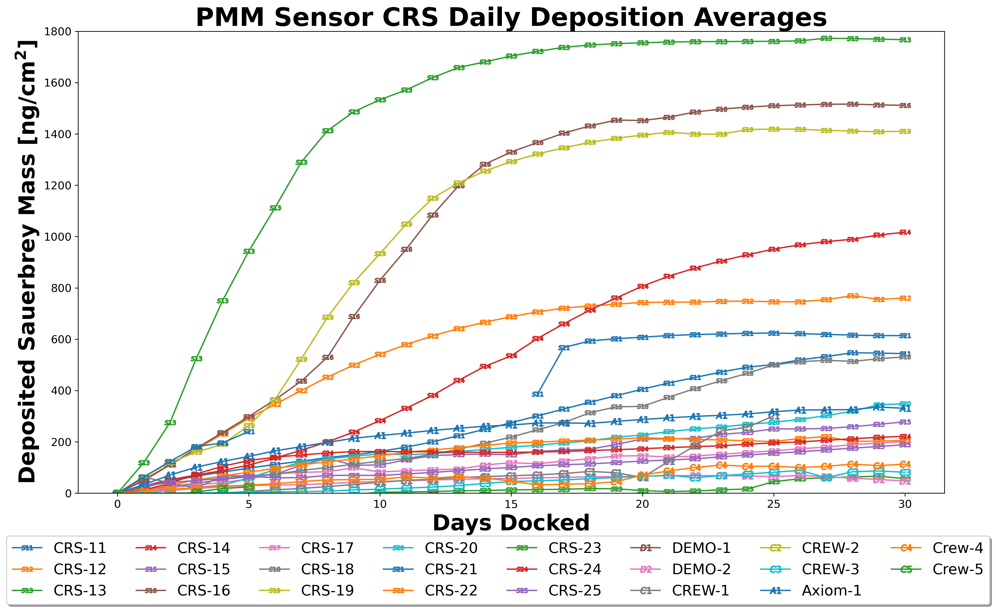
Contamination Cont.
Space X will start using a new paint and lubrication on the resupply vehicles starting Feb. 2023.
The SAGE III team will closely monitor the contamination levels while SpaceX is on station and will continue with the protocol of keeping the contamination window closed during the duration of the visit

Slide 13
Future Work
Update Instrument Assembly code to allow for automatic termination of Limb events.
This will allow for the execution of limbs at all pointing possibilities without exceeding thermal limits
Currently the operations team is executing limbs at solar noon to minimize any thermal exceedances on the elevation motor
As the payload ages thermal constraints will require the modification of limb durations. By having the automatic termination feature this will limit the amount of operator intervention if approaching thermal limits

Slide 14
Future Work Cont.
In 2024 ISS is proposing to start building a new module called Axiom. The first module will go up in 2024, followed by additional components in 2028 and 2030. Once the final portion of the Axiom module is added (the power hub) it will detach from the ISS and become in independent station.
When each component is added this could/will modify the yaw, pitch and roll of station.
SAGE III is actively working with the ISS to determine how these changes will affect SAGE III’s ability to point fully nadir.
Note: On July 2021 the SAGE III team uploaded new software that allows for additional pointing capabilities when station is outside the pointing capabilities of Hexapod.

Slide 15
Questions

