Slide 1
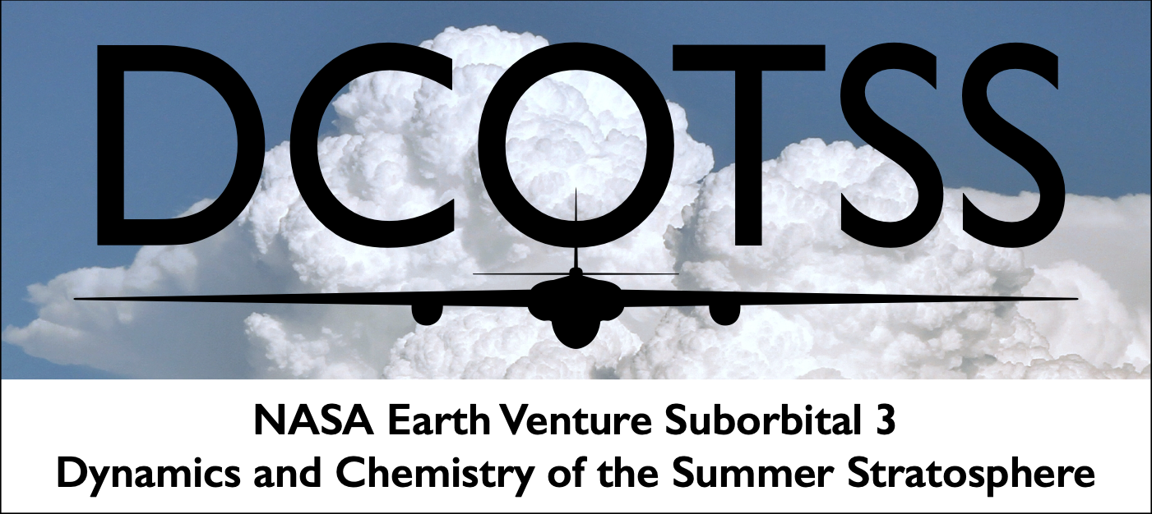

Dynamics and Chemistry of the
Summer Stratosphere (DCOTSS)
SAGE III/ISS Annual Meeting
Kristopher Bedka¹, Kenneth P. Bowman², Frank Keutsch³, Cameron Homeyer⁴
¹ NASA Langley Research Center, ² Texas A&M University, ³ Harvard University, ⁴ University of Oklahoma
NASA Langley Research Center, 2025-08-14

Slide 2
DCOTSS Summary
DCOTSS used the NASA ER-2 aircraft to measure the outflow from North American thunderstorms that overshoot into the overlying stratosphere (very rapid transport process)
Goal is to understand how overshooting storms affect the dynamics and composition of the stratosphere - including stratospheric ozone
Two deployments to Salina, KS (2021 & 2022) + flights from AFRC
Project was very successful at intercepting storm outflow (22/31 flights)
Notable results:
  order(s) of magnitude increase in data about overshooting storms
  water vapor signals dominate composition changes, driven by sublimated ice
  injected air is mixed into the global stratosphere
  did not observe conditions likely to cause rapid ozone destruction (cold + wet + high ozone + high chlorine)
  omnipresent volcanic aerosols in 2021 (but not 2022)
  all data in NASA ASDC archive - ongoing data analysis and modeling
Notes:
Close collaboration between dynamics and chemistry sides of the project
water signal comes from sublimated ice, rebounding from the collapsing overshooting

Slide 3
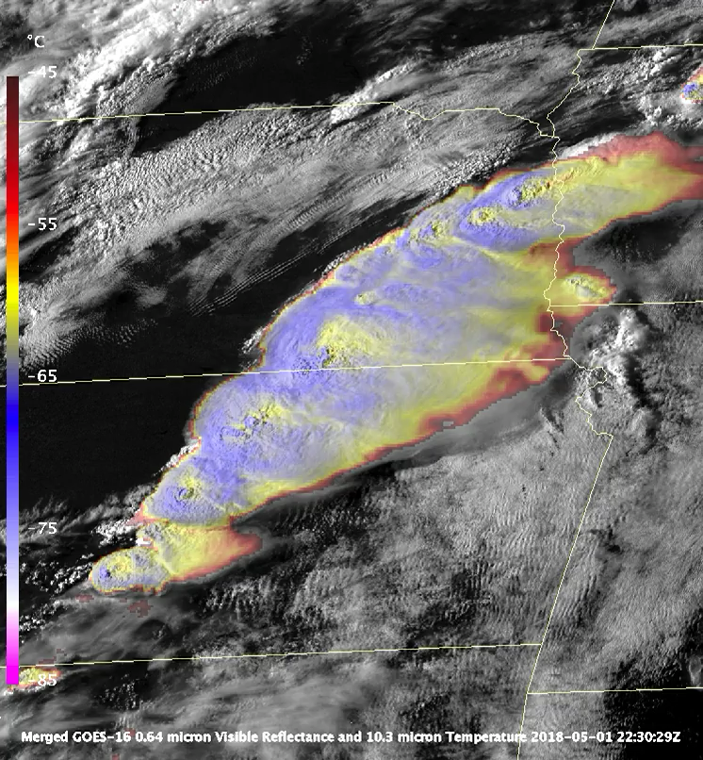
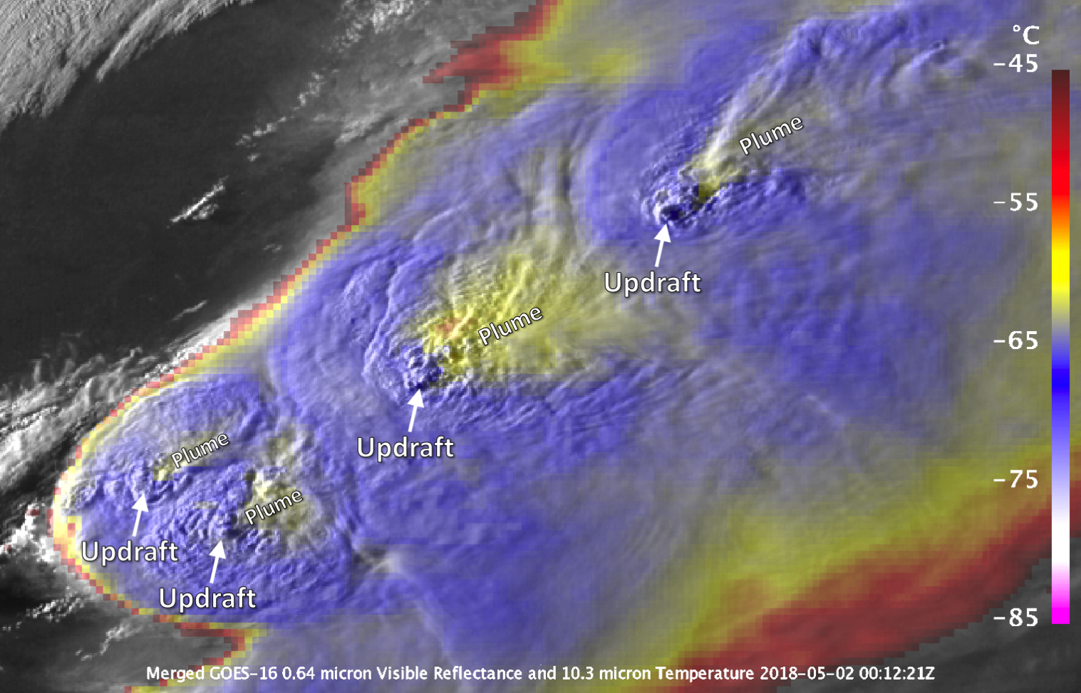
Overshooting Convective Storms over the Midwest U.S.
Notes:
2022-04-13
Overshooting convection
Anvil probably at tropopause
Updraft extending above tropopause
Cirrus plume downwind in stratosphere

Slide 4
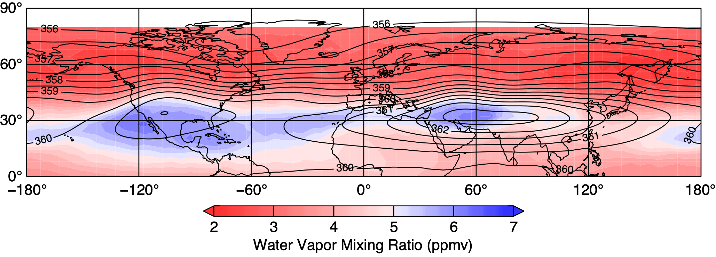
  Water Vapor in the Summer Stratosphere
North American
Monsoon Anticyclone
Asian
Monsoon Anticyclone
Notes:
Water vapor in the stratosphere is important for radiation and chemistry
NH summer lower stratosphere dominated by two humid regions over the monsoon areas
More water vapor over NA even though the Asian monsoon is larger
Water vapor and pollutants can be trapped in the interior of the anticyclones
Different process responsible for transport of water into the stratosphere in the two regions
Over North America overshooting convection is thought to be responsible for enhanced water vapor, supported by ACE-FTS heavy water isotope measurements. HDO condenses into liquid and ice
phases more readily than H2O, enrichment of 𝛿D provides evidence for transport of water into the stratosphere

Slide 5
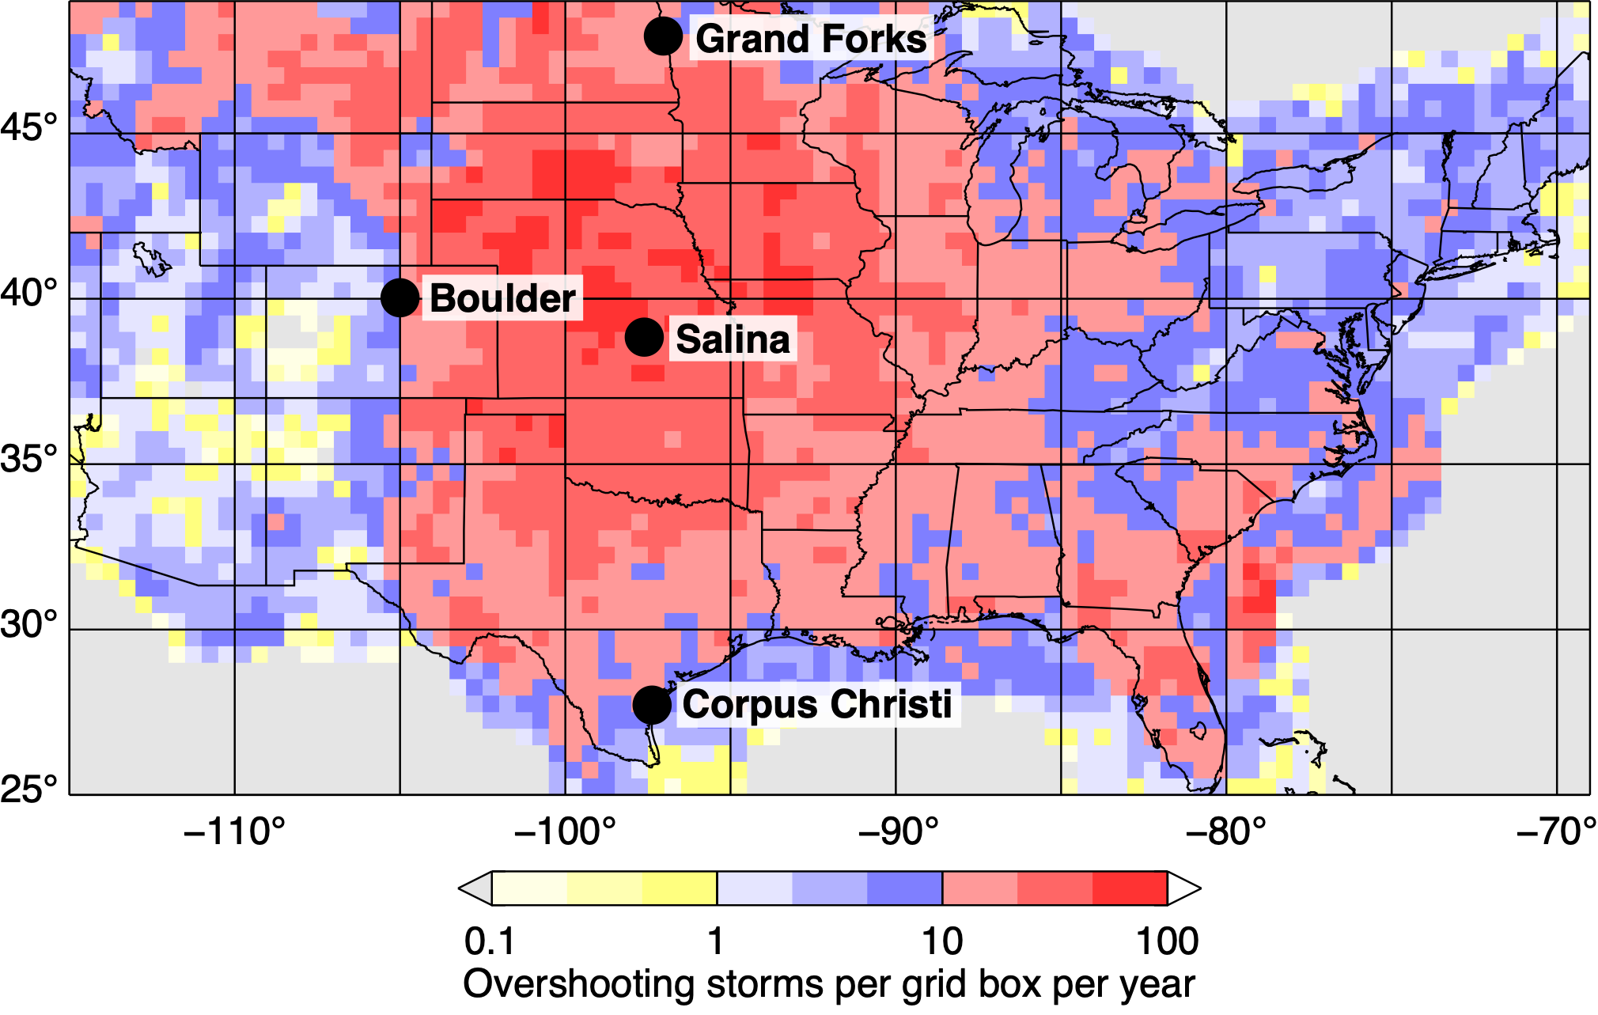
  Overshooting Events from NEXRAD Radar
50k to100k overshooting events per year
Notes:
Map shows occurrence of overshooting storms based on radar data
DCOTSS deployed to Salina, KS near the center of overshooting activity
Balloon launched from Corpus Christi, Boulder, and Grand Forks
Ozonesondes and radiosondes, Grand Forks, Corpus, Salina, for every DCOTSS flight day, with a few Frost Point Hygrometers
Boulder, all Frost Points and radiosondes
Jean Paul Vernier flew a few balloons with aerosol measurement capability

Slide 6
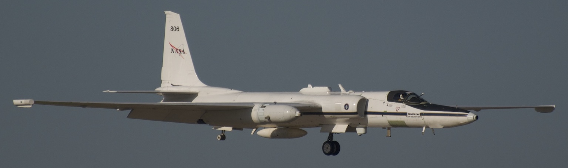
DCOTSS Project Summary
Goal
  Investigate how intense thunderstorms over the U.S. affect the stratosphere, including stratospheric ozone
Approach
  Use the NASA ER-2 to measure the composition of stratospheric outflow from overshooting storms
  Combine with satellite data and models to understand processes
  First mission specifically designed to study overshooting storms
ER-2 landing in Salina, KS during DCOTSS

Slide 7
Science Questions
Dynamics
  How much tropospheric air and water is transported into the stratosphere by overshooting convection?
  Which convective source regions impact the North American Monsoon Anticyclone (NAMA)?
  How long does convectively injected air stay in the NAMA?
  What dynamical mechanisms lead to injection of material into the stratosphere by convective storms?
Chemistry
  How much very-short-lived chlorine is present in the lower stratosphere over North America in summer?
  What chemical changes take place in the stratosphere due to convection in the NAMA?
  What are the composition and potential sources of aerosol in the lower stratosphere over North America?
  What will be the stratospheric chemical response to a volcanic eruption? (target of opportunity)
Notes:
Quantitative estimate of total injection (air and constituents)
Sierra Madre Occidental also contributes; radar not available, can use satellite
Large scale: NAMA behaves like a well-mixed leaky bucket
Small scale: mixing during lifecycle of overshooting pulses
Composition (gas & aerosol) of summer lower stratosphere not well characterized
Impact of injected air on stratospheric composition and chemistry

Slide 8
Project Design
Identify overshooting storms continuously in real-time using weather radar (NEXRAD) and satellites (GOES)
Forecast motion of storm outflow using the TRAJ3D trajectory model driven by operational weather forecasts
Design ER-2 flight plans to safely intercept storm outflow and to survey the NAMA circulation
Make in situ measurements of the composition of storm outflow and the surrounding environment using the ER-2
Model dynamics of injection process; chemical evolution of convective plume; and export to global circulation
Evaluate impact of convective injection over the N. America on the lower stratosphere at multiple scales
Notes:
The idea underlying DCOTSS is to intercept outflow, not storms
Requires continuous observations and trajectory forecasting

Slide 9
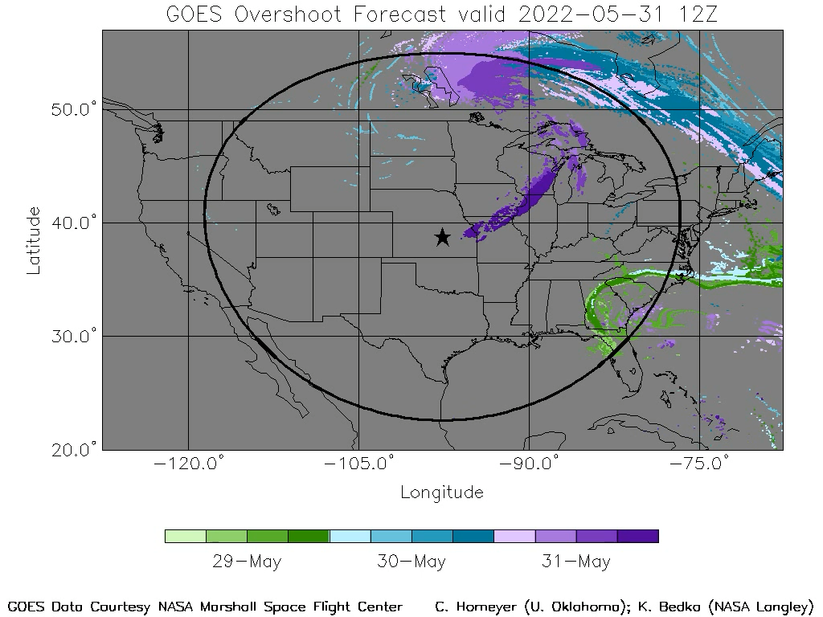
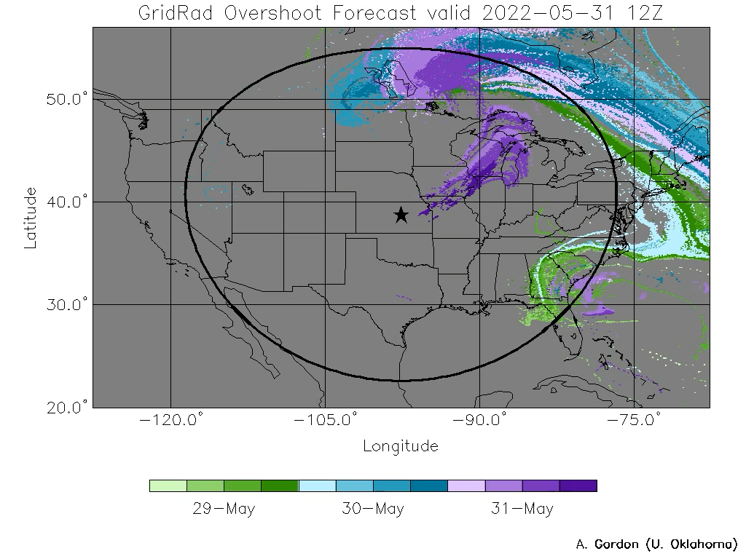
GOES and NEXRAD Overshooting Parcel Trajectories
GOES and NEXRAD overshooting cloud detections and height estimates from 10-min data products compiled hourly and used to initialize a forward trajectory model.
Trajectory model output were heavily utilized by Forecasting and Flight Planning Team, leading to a very high success rate with sampling convective outflow even days after the overshooting occurred
These data reveal the abundance of convectively-influenced stratospheric airmasses during
North American spring and summer

Slide 10
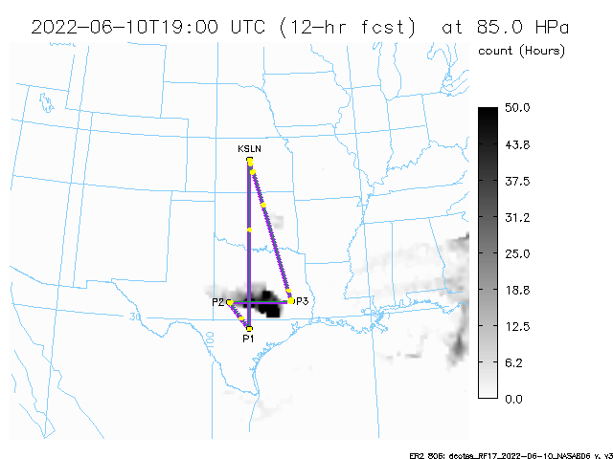
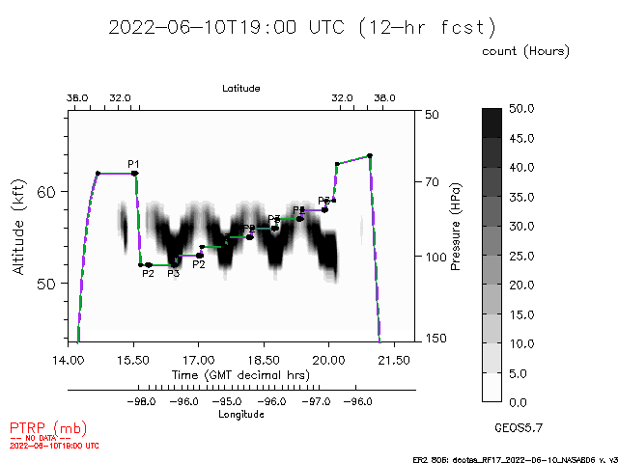
Example DCOTSS Overshooting Parcel
Trajectory Forecast and Flight Plan
Trajectory parcel density from overshooting at
85 hPa altitude at a hypothetical flight time
Parcel density cross-section
along a proposed flight track

Slide 11
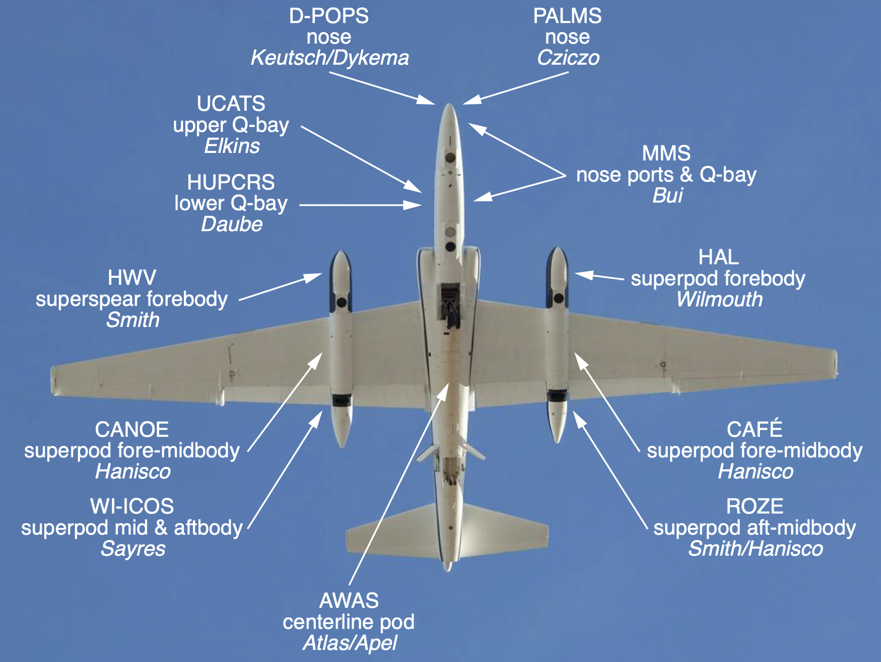
ER-2 Payload Configuration

Slide 12
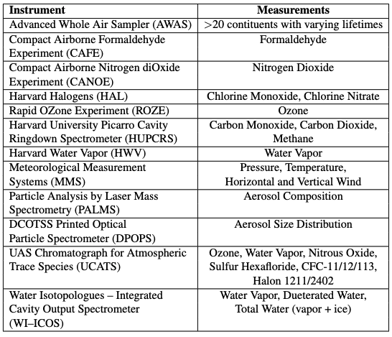
ER-2 Payload List
1 Hz: ROZE, HWV, MMS,
UCATS Water Vapor, CAFE, CANOE, DPOPS, PALMS
0.5 Hz: UCATS Ozone
0.1 Hz: HUPCRS, WI-ICOS
~0.03 Hz: HAL
~0.01 Hz: UCATS
Variable: AWAS

Slide 13
Project Changes
First deployment was scheduled to begin in Spring 2020, just as Covid closed everything down
Deployments were delayed by a year and reconfigured, in part to avoid scheduling conflicts with the ACCLIP mission
Spring 2021 vaccine rollout was just in time to allow deployments to proceed
Added ozone, water vapor, and aerosol balloon sondes for instrument calibration and stratospheric background (4 sites, NOAA + existing DCOTSS team)

Slide 14
Deployment Schedule
2021 | Length | Start Date | Flights
Integration & testing | 7 weeks | May 3 | 3
1 - Late summer deployment | 9 weeks | Jul 12 | 11 + 2
2022
Integration & testing | 4 weeks | Apr 4 | 1
2 - Early summer deployment | 9 weeks | May 9 | 12 + 2
Total |  |  | 31

Slide 15
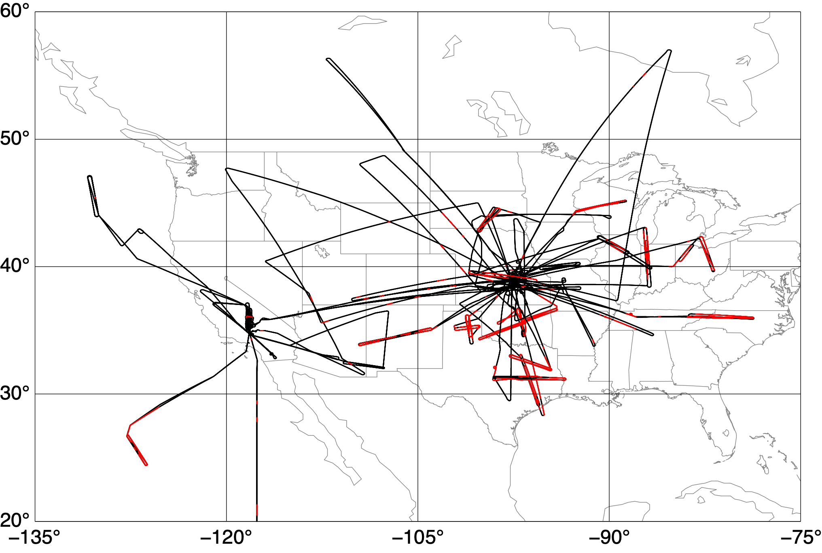
DCOTSS Flights (2021 and 2022)
Red indicates enhanced water vapor from convection
Notes:
Red segments are usually multiple transects at different altitudes

Slide 16
Flight Summary
Objective/observations | Number of flights
Total flights (16 + 15) | 31
Test flights (3 + 1) | 4
Transit flights (2 + 2) | 4
Stratospheric background | 31
Convective outflow | 22
Aged outflow | 18
Recent outflow | 11
Active outflow | 4
Sierra Madre outflow | 3
Sunrise & sunset chemistry | 2
Volcano/pyroCb (16 + 1) | 17
(2021 flights + 2022 flights)

Slide 17
Data Status
All final, quality-assured data are published, consisting of:
  Airborne data from all instruments aboard the ER-2
  Report data (mission reports, forecasting & flight planning)
  Balloon observations of ozone and water vapor
  ERA5 reanalysis & back trajectories along flight track
  Radar and satellite observations of tropopause-overshooting convection and forward trajectories
  Chemistry model output along flight track
Only incomplete item is high-resolution model output, which is still being generated

Slide 18
Science Highlights
Transport to stratosphere of water vs. tropospheric air
Chlorine and bromine from very-short-lived (VSL) species
Impacts of overshooting on stratospheric chemistry
Persistent stratospheric aerosol layer (possibly volcanic)
Aerosol composition
High-resolution modeling of overshooting storms

Slide 19
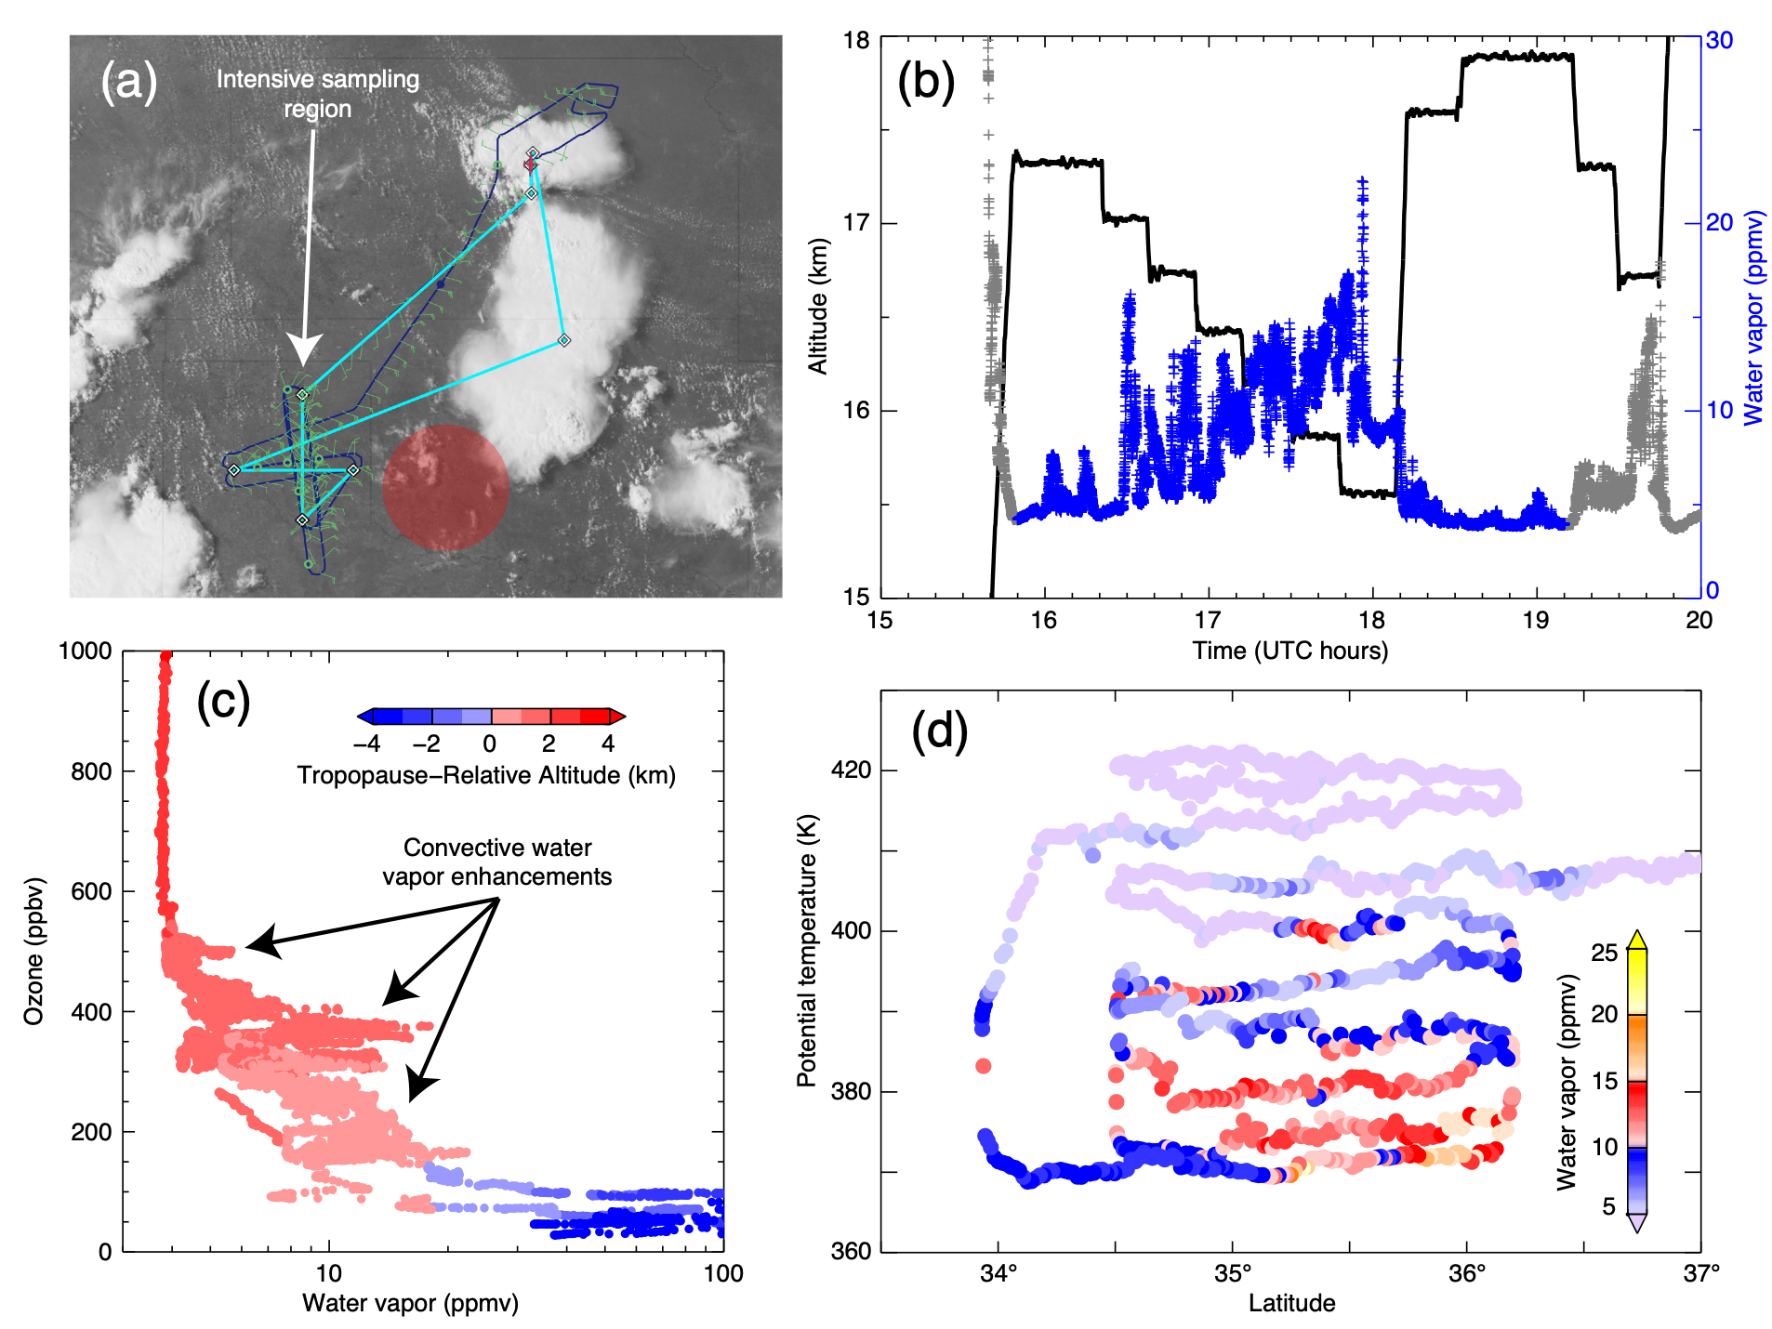
ER-2 Flight of 26 July 2021
Notes:
Satellite image is on the flight day - visible storms are not the ones we sampled
Overshooting storms occurred the day before in the area of the red circle
ER-2 transited from KS to TX and then made stacked transects through the forecasted outflow position
2x to 3x water enhancements from overshooting are visible, including at the highest level

Slide 20
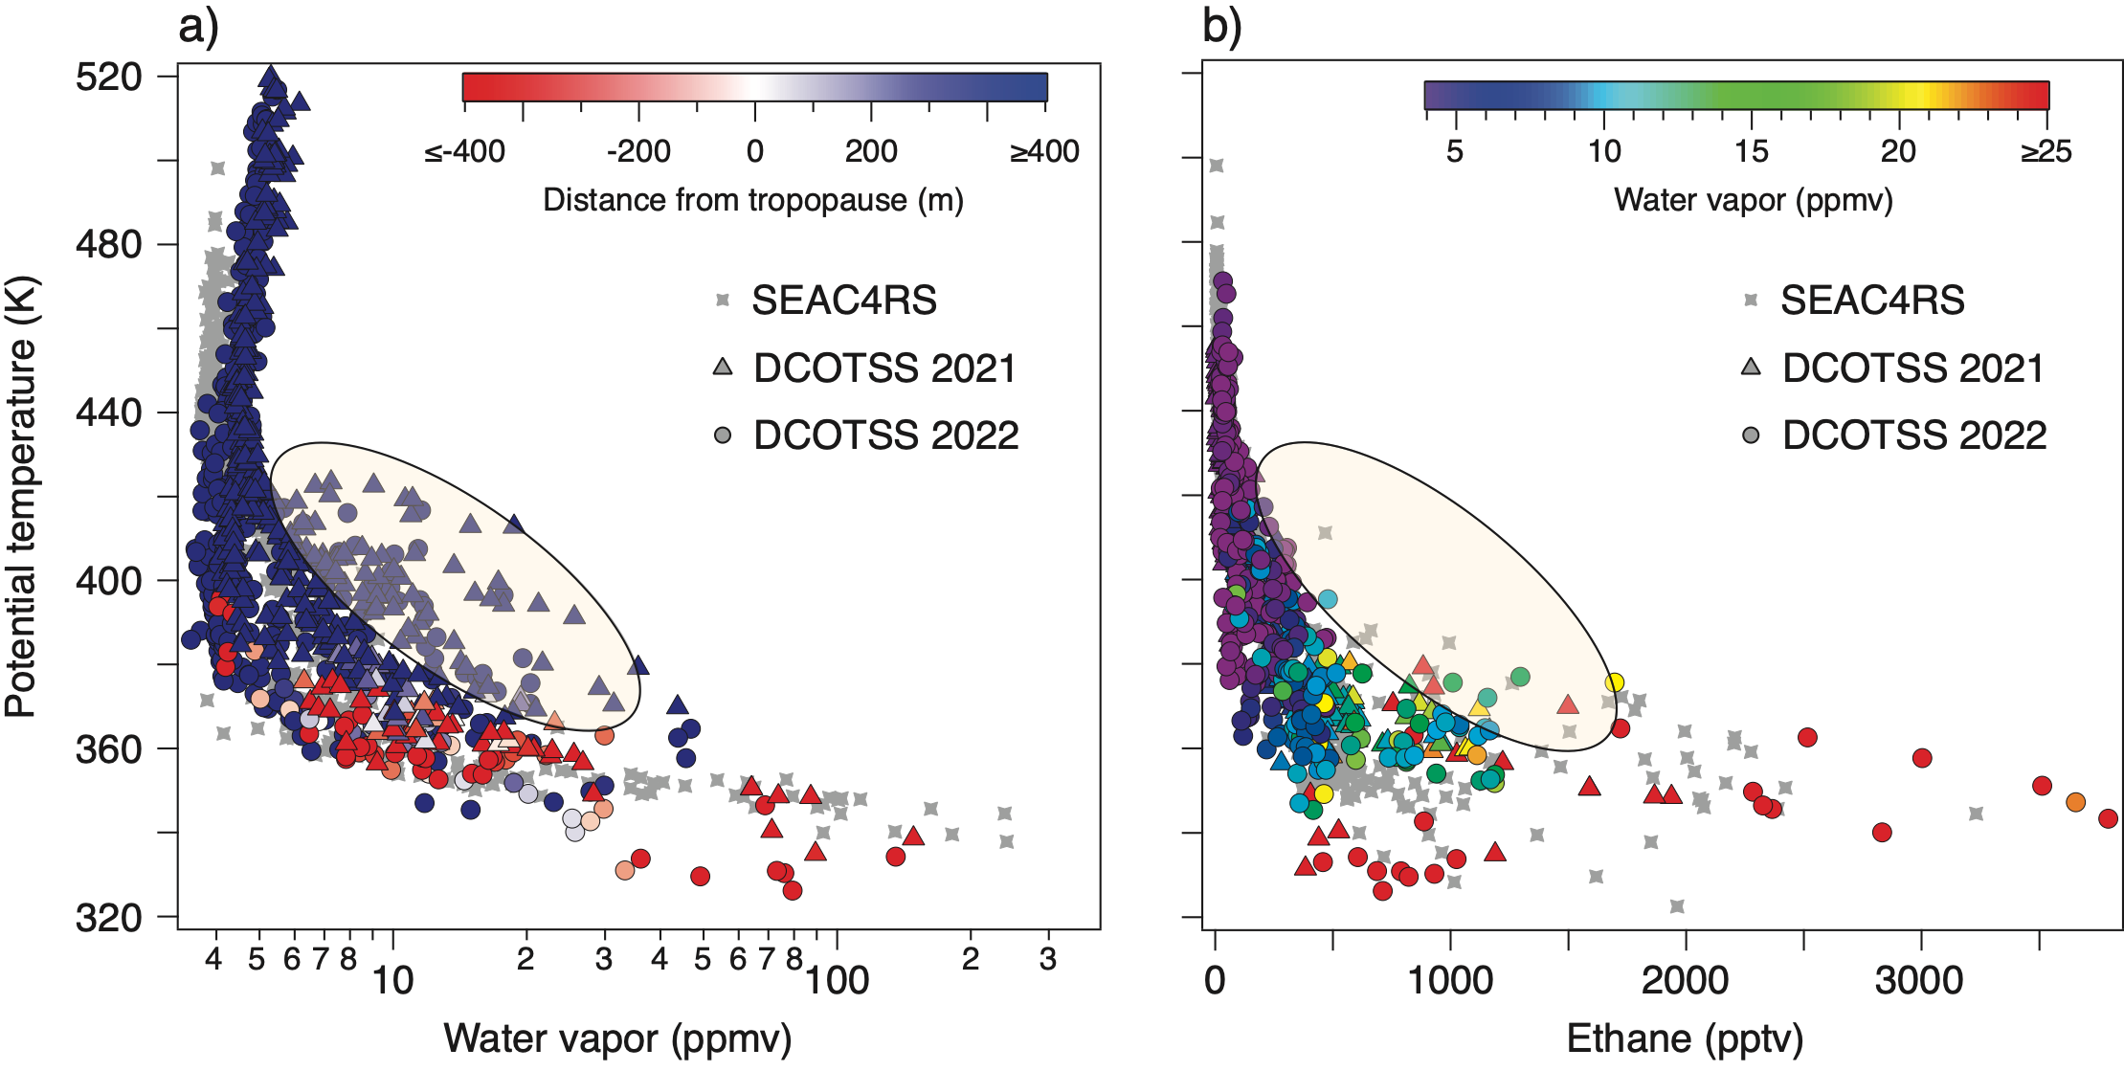
Transport of Water and Air
Samples at higher altitudes show enhanced water but less evidence of tropospheric air, indicating the importance of ice lofting
Notes:
Supported by formaldehyde, NO2, and water isotope measurements

Slide 21
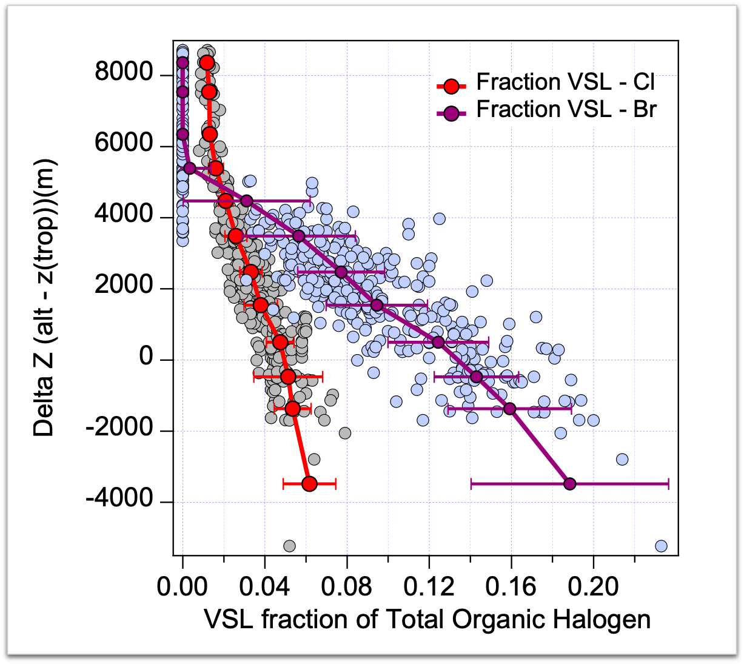
VSL Chlorine and Bromine from AWAS
Increase in VSL chlorine (~5% of total) compared to 2016 (WMO, 2018)
VSL bromine ~13% at the tropopause
VSL CL and Br detectable up to 4 km above the tropopause
Preliminary AWAS data from E. Atlas
Notes:
Very-short-lived (VSL) chlorine species, which are increasing in the troposphere, are generally unregulated because their short lifetimes reduce the potential impact on stratospheric ozone. Overshooting storms provide a mechanism for rapid transport of VSL species to the stratosphere. These data show that VSL chlorine species are increasing in the lower stratosphere.

Slide 22
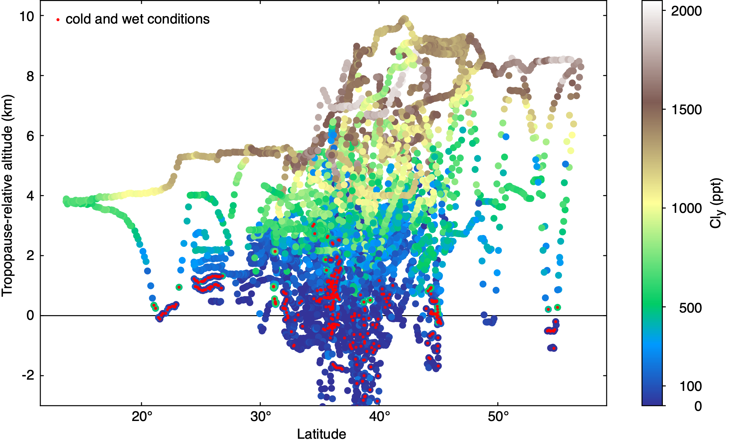
Potential Impacts of Convection on Ozone
Ozone destruction requires low temperatures, high water vapor,
high ozone, and high chlorine
Notes:
DCOTSS observed cold and wet conditions near the tropopause (blue + red dots), but in these locations both ozone and chlorine are small. At higher altitudes, where ozone and chlorine increase, temperatures also increase while water vapor decreases. DCOTSS did not observe locations with all of the ingredients necessary to trigger ozone destruction (cold, wet, high ozone, high chlorine).

Slide 23
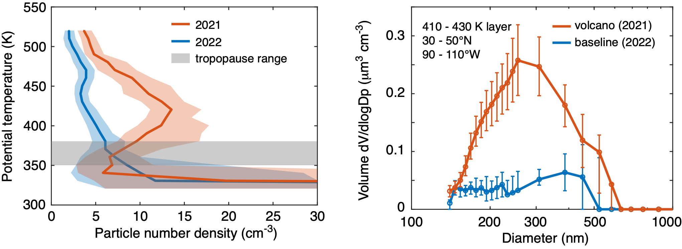
Volcanic Aerosol Layer in 2021
Notes:
DCOTSS observed ubiquitous volcanic aerosol particles in 2021. These are thought to be from the La Soufriere volcanic eruption.

Slide 24
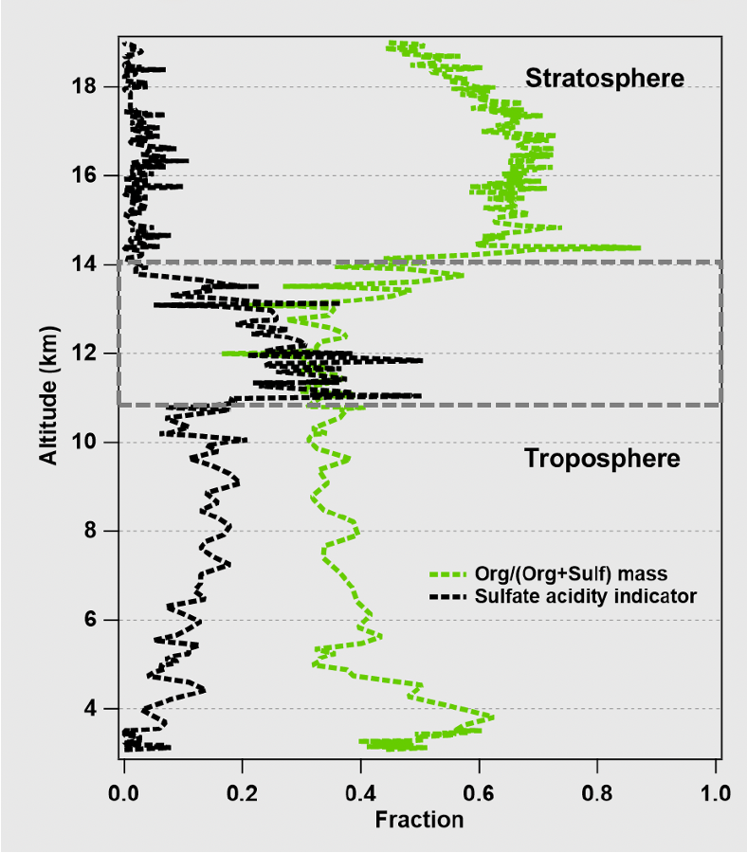
PALMS DCOTSS Aerosol Organic Mass Fraction and Acidity
Vertical profiles of sulfate acidity indicator, which is 195/(97+195) signal fraction, and mass fraction of organic material relative to sulfate for all non-refractory particles. m/z 195 is more intense for acidic particles.
From Shen et al. AGU Poster #A52Q-1221
No enhancement of particles in outflow of overshooting convection
high organic mass
fraction in
stratosphere
highest acidity
near tropopause
lower organic mass and
higher acidity in upper
troposphere
Notes:
No enhancement of particles in outflow of overshooting convection.

Slide 25
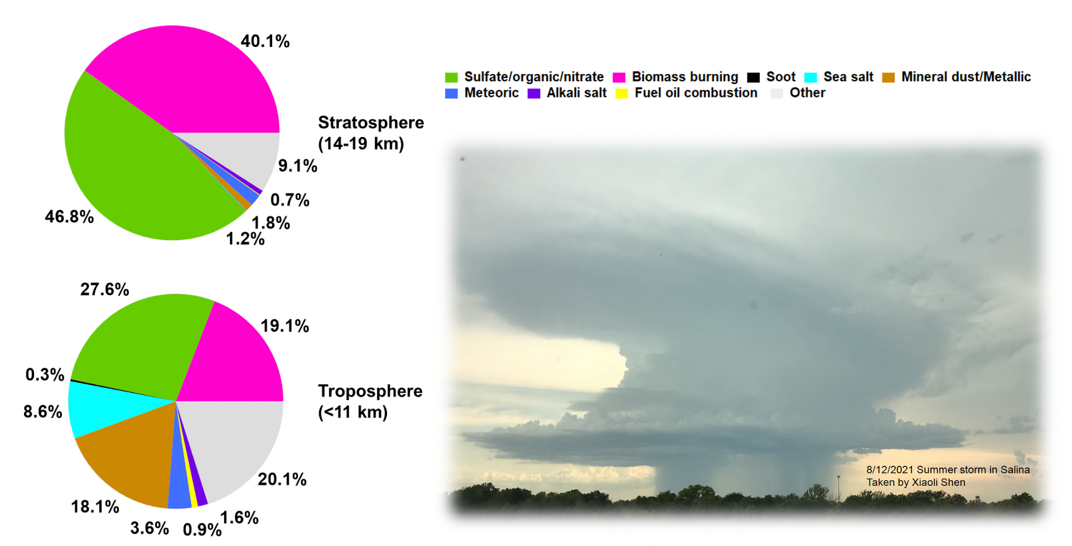
PALMS Aerosol Composition
Larger fraction of organic/biomass burning particles
than in troposphere
Notes:
Surprising result: Larger fraction of organic/biomass burning particles than in troposphere

Slide 26
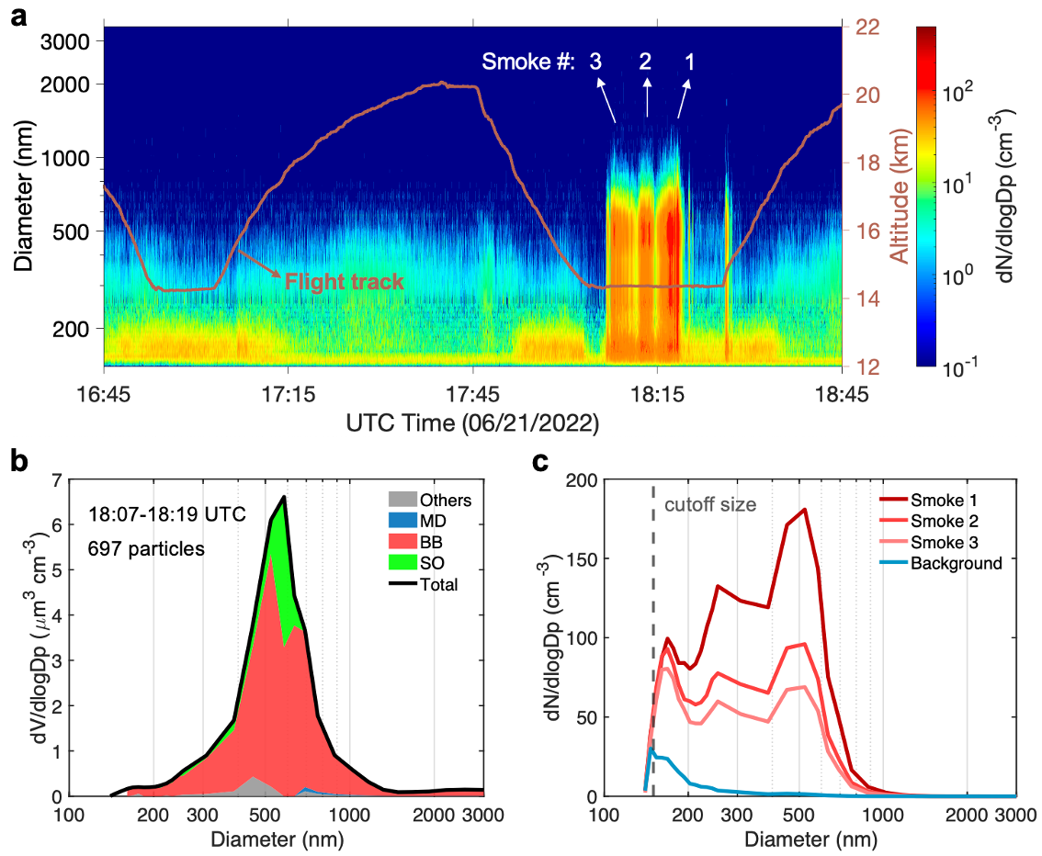
Large Biomass-Burning Particles Dominate New Mexico Wildfire Smoke Plume
Notes:
This smoke plume was immediately below the tropopause.

Slide 27
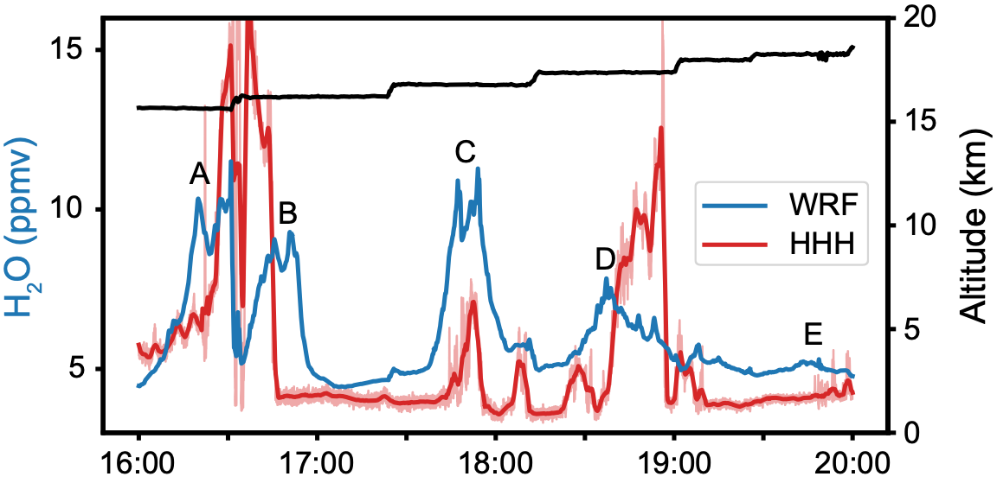
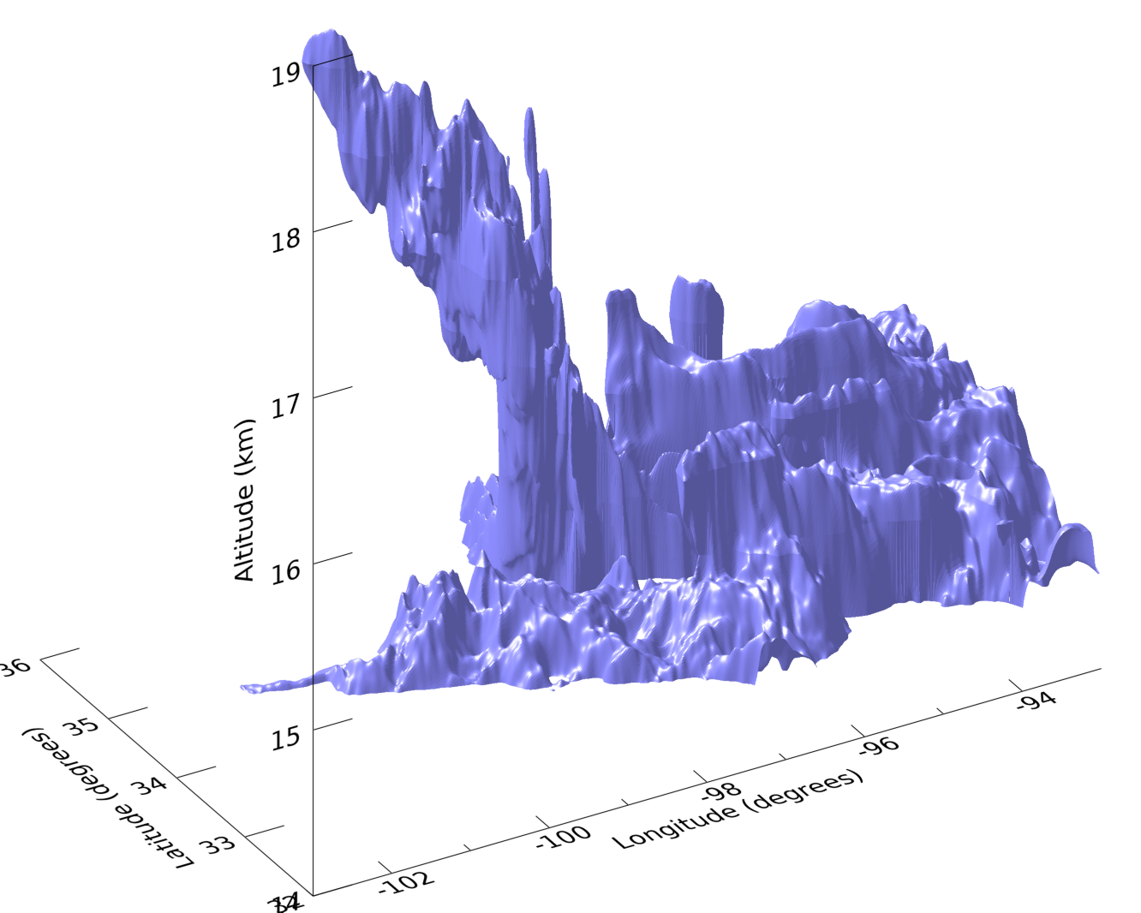

Overshooting Storm Simulations
Storm of 9 June 2022
ER-2
WRF
WRF model
1 km horizontal
250 m vertical
realistic initial and boundary conditions
12 ppm water vapor isosurface
Notes:
Models are showing good results simulated observed overshooting events.

Slide 28
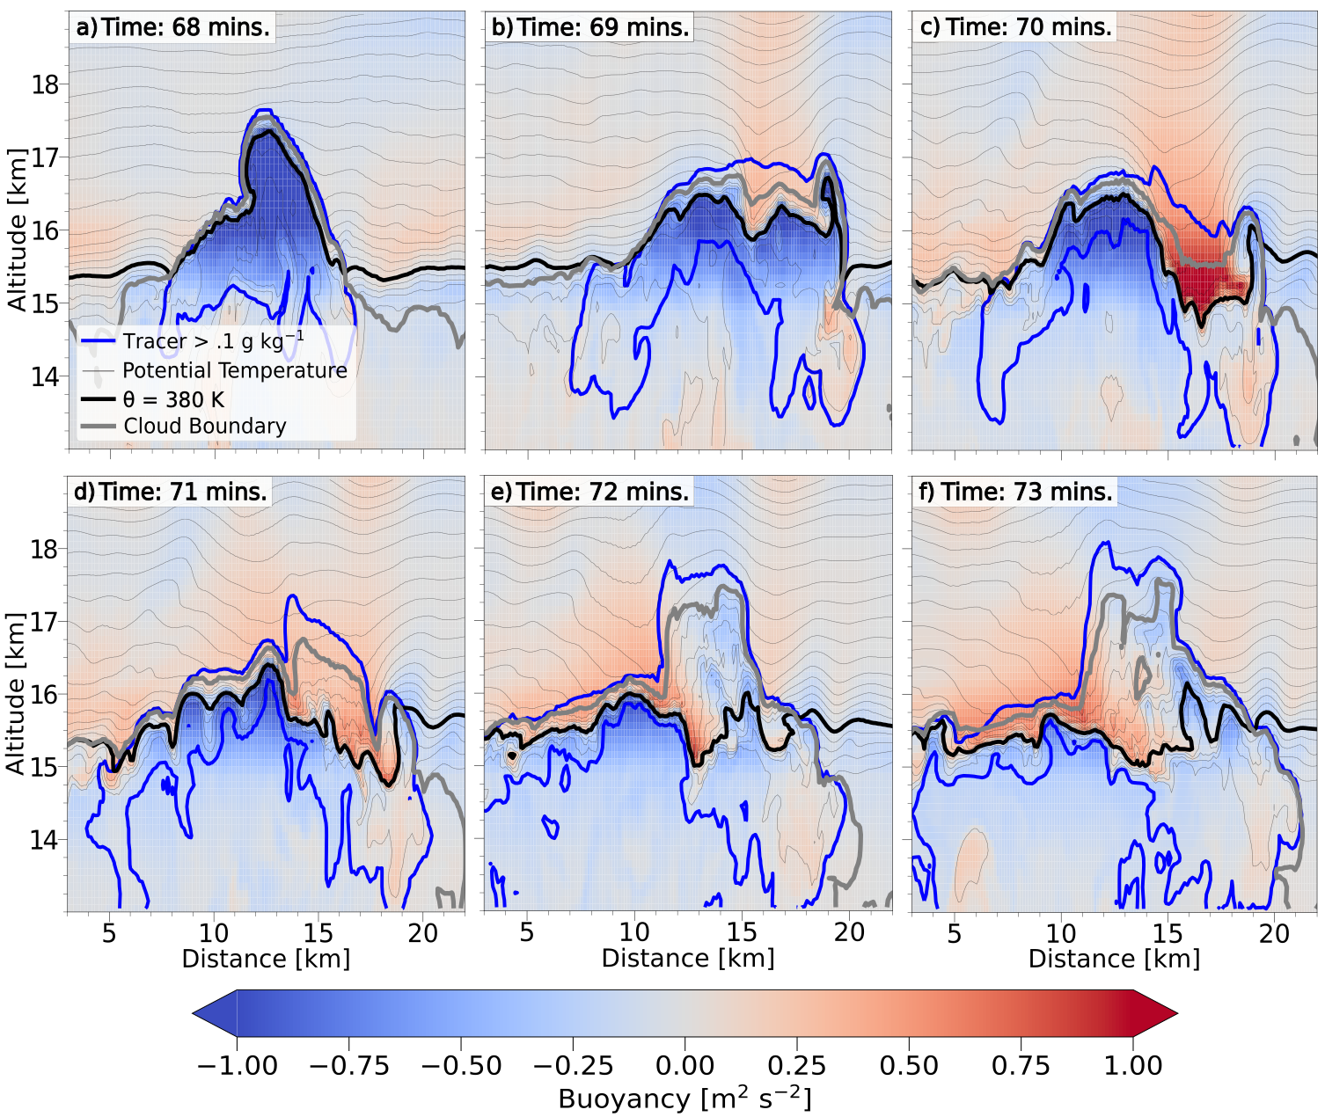
Overshooting Storm Simulations
CM1 model
100 m horizontal
100 m vertical
idealized initial and boundary conditions
Notes:
Very-high-resolution model simulations are revealing that most of the irreversible transport of water above to the stratosphere occurs when overshooting updrafts collapse and then rebound into the stratosphere.

Slide 29
Science Highlights
DCOTSS was very successful at forecasting and intercepting outflow from overshooting storms in the stratosphere (22/31 total flights, which includes test, transit, and survey flights)
Order(s) of magnitude increase in data about overshooting storms
Highest convective transport into the stratosphere ever observed (19+ km, 460 K, 1500 ppbv ozone)
Individual storms can inject kilotons of water into the stratosphere
Water vapor signals are stronger than other gases, indicating the importance of ice lofting in the overshooting storm tops
The confinement time within the NAMA circulation is ~10 days - export to global stratosphere
Omnipresent volcanic aerosols in 2021 (but not 2022)
Mixing occurs during the collapse of the overshooting updraft
Did not observe conditions likely to cause rapid ozone destruction (cold + wet + high ozone + high chlorine)

Slide 30
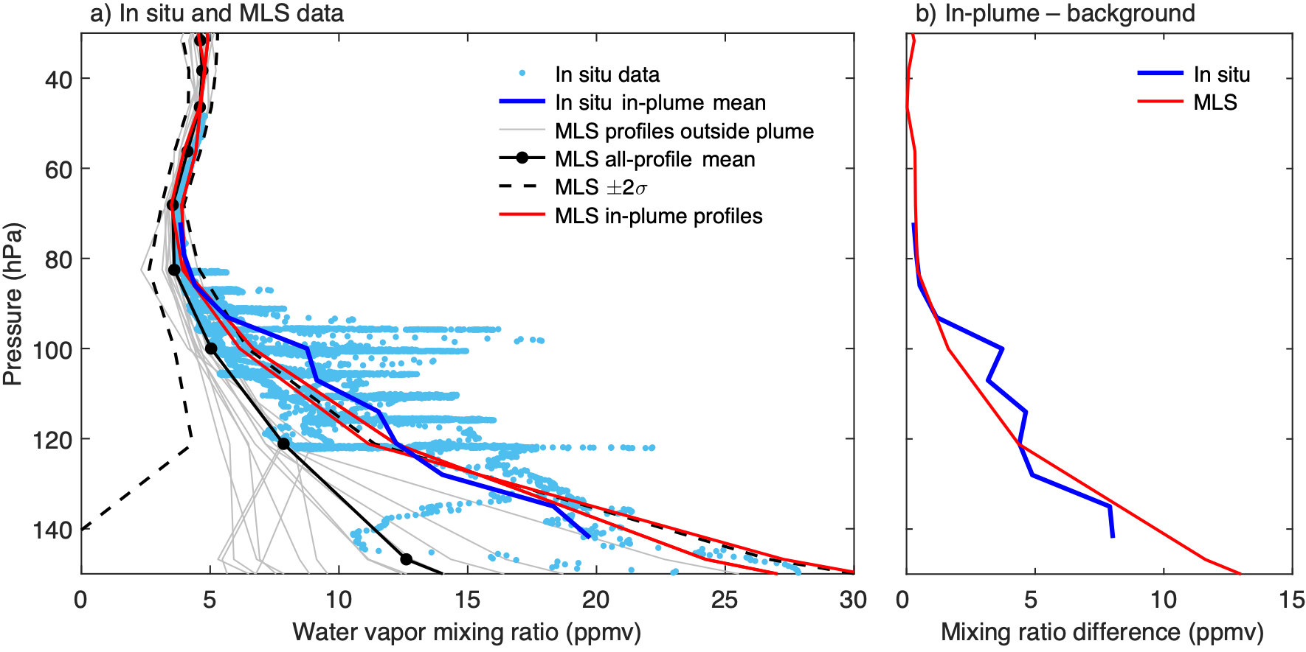
Data Products of Interest
High-frequency, high-resolution, gridded overshooting storm data for summers of 2021 and 2022 from NEXRAD and GOES
Forward trajectories from all identified overshooting storms provide good estimates of outflow plume evolution
In situ measurements (background and outflow plumes) of many stratospheric gases and particles
Notes:
MLS observed one large outflow plume that was also sampled by the ER-2 during DCOTSS. Graphs (from BAMS paper) show stratospheric water vapor enhancement from overshooting storms in MLS data.

Slide 31
DCOTSS Summary
All DCOTSS data are available from the NASA Atmospheric Science Data Center (ASDC) archive
Published research has addressed many aspects of DCOTSS science questions (see recently accepted BAMS paper and ESPO DCOTSS web site for publications list)
Modeling and data analysis are continuing in many areas
Thanks to everyone who made the mission a success: the DCOTSS science team, ER-2 team, ESPO staff, data management group, Salina airport management, and especially to NASA management for support that allowed the project to continue during the pandemic

Slide 32
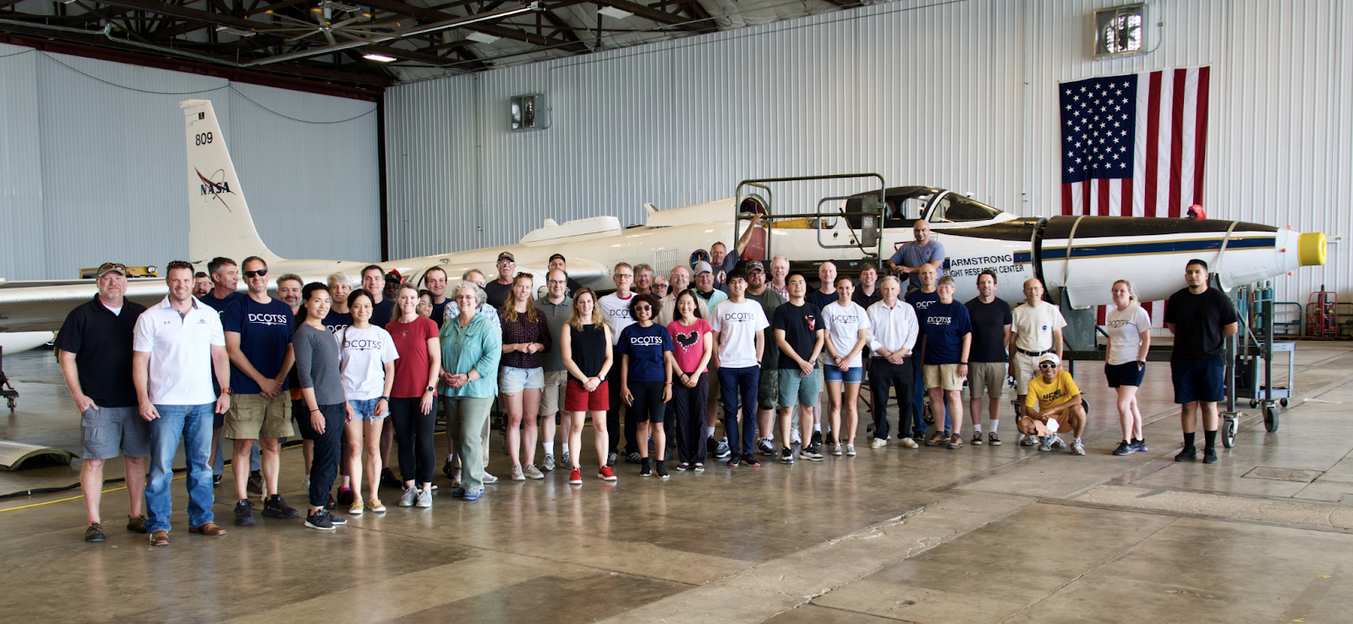
  Thank you!

