Slide 1


Inter-comparison study of stratospheric particle size distribution parameters derived from SAGE III/ISS extinction measurements
Nicholas Ernest ADNET Systems, Inc. & NASA Langley
Travis Knepp NASA Langley
Felix Wrana University of Greifswald

Slide 2
Knepp et al. (2024)
WRANA et al. (2021)
Wrana et al.
Utilizes 384, 448, 520, 755, 869, 1021 & 1543 nm (drops 601 & 676 nm).
Retrieval of mono-modal log-normal PSD parameter values.
All possible solutions within SAGE error envelope are weighted by a multivariate-normal PDF.
Median, percentiles for rₘ, σ, N, SAD, VD, effective radius.
Many data points due to many SAGE channels used.
High variance due to no smoothing.
Utilizes channels 449, 756 & 1544 nm
2-D lookup table of extinction-ratios to single, unique (rₘ, σ) for a monomodal log-normal PSD
rₘ, σ, N derived.
Smoothing of extinction profiles done before processing, consistent with SAGE 5.1 smoothing.
Less data points derived due to smaller LUT

Slide 3
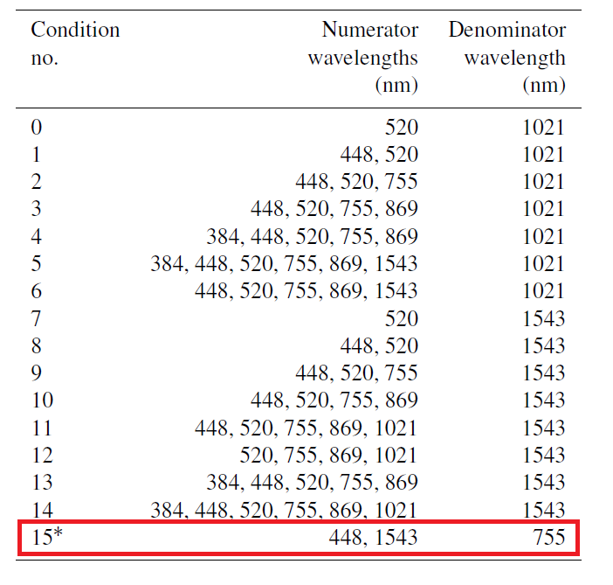
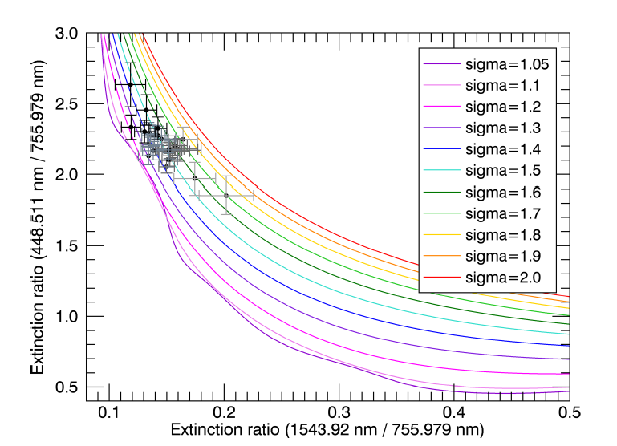
Knepp et al. (2024)
WRANA et al. (2021)

Slide 4
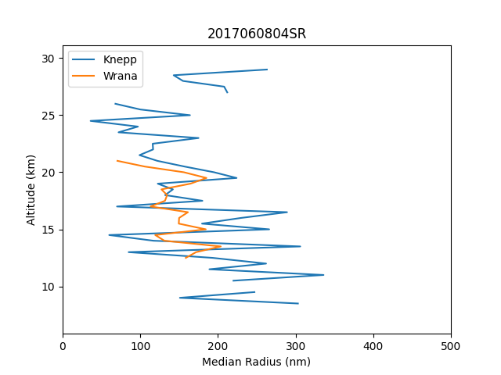
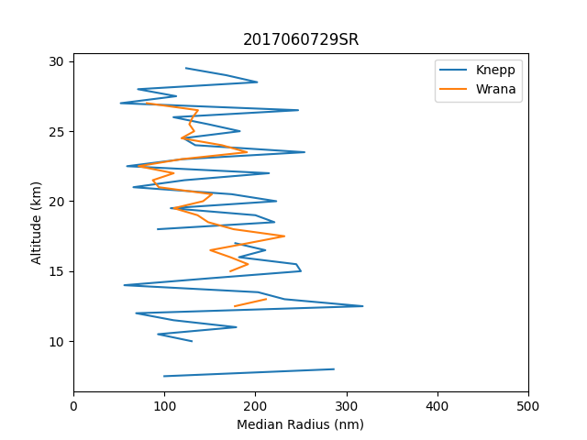

Slide 5
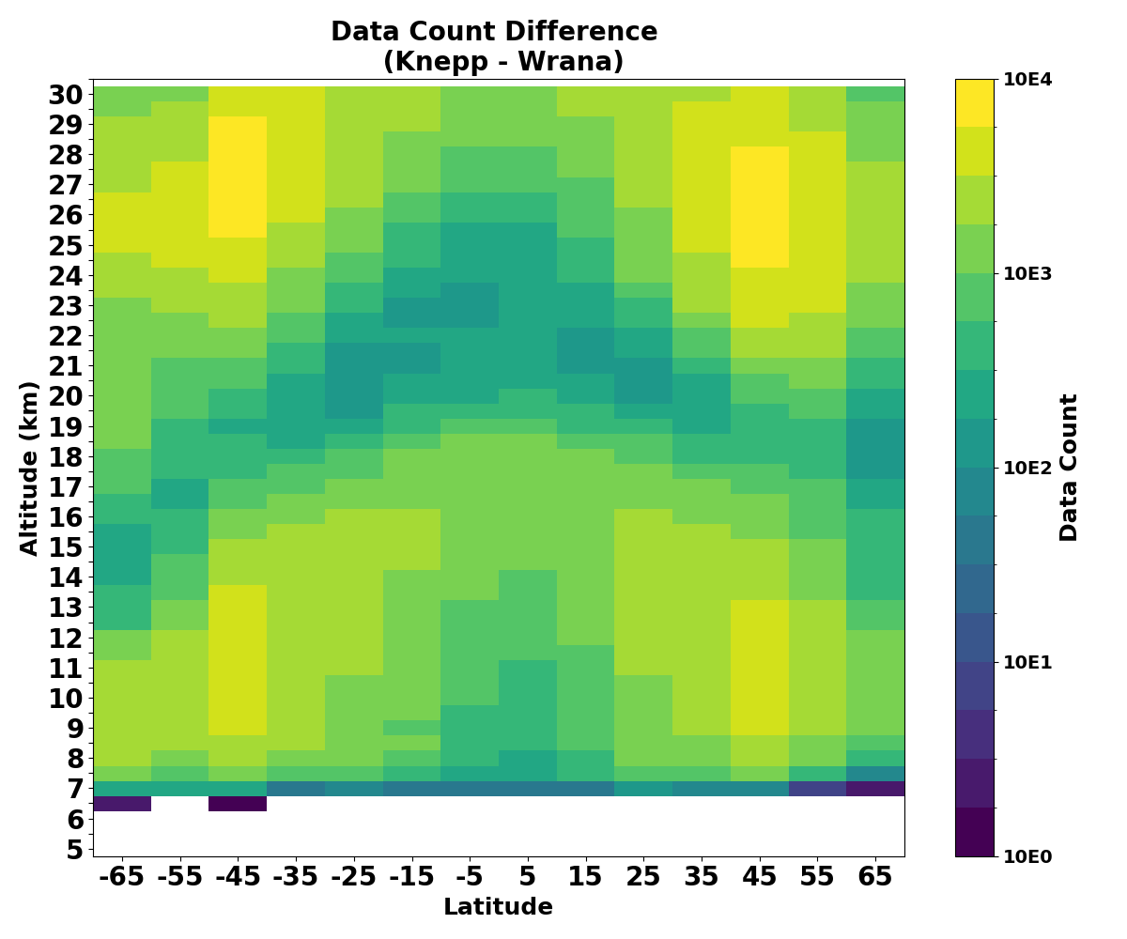

Slide 6
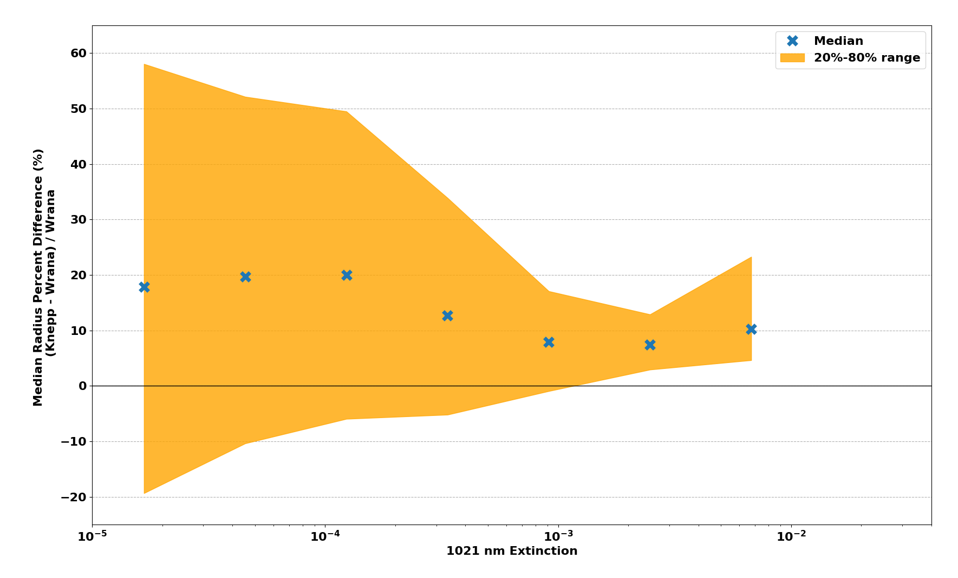

Slide 7
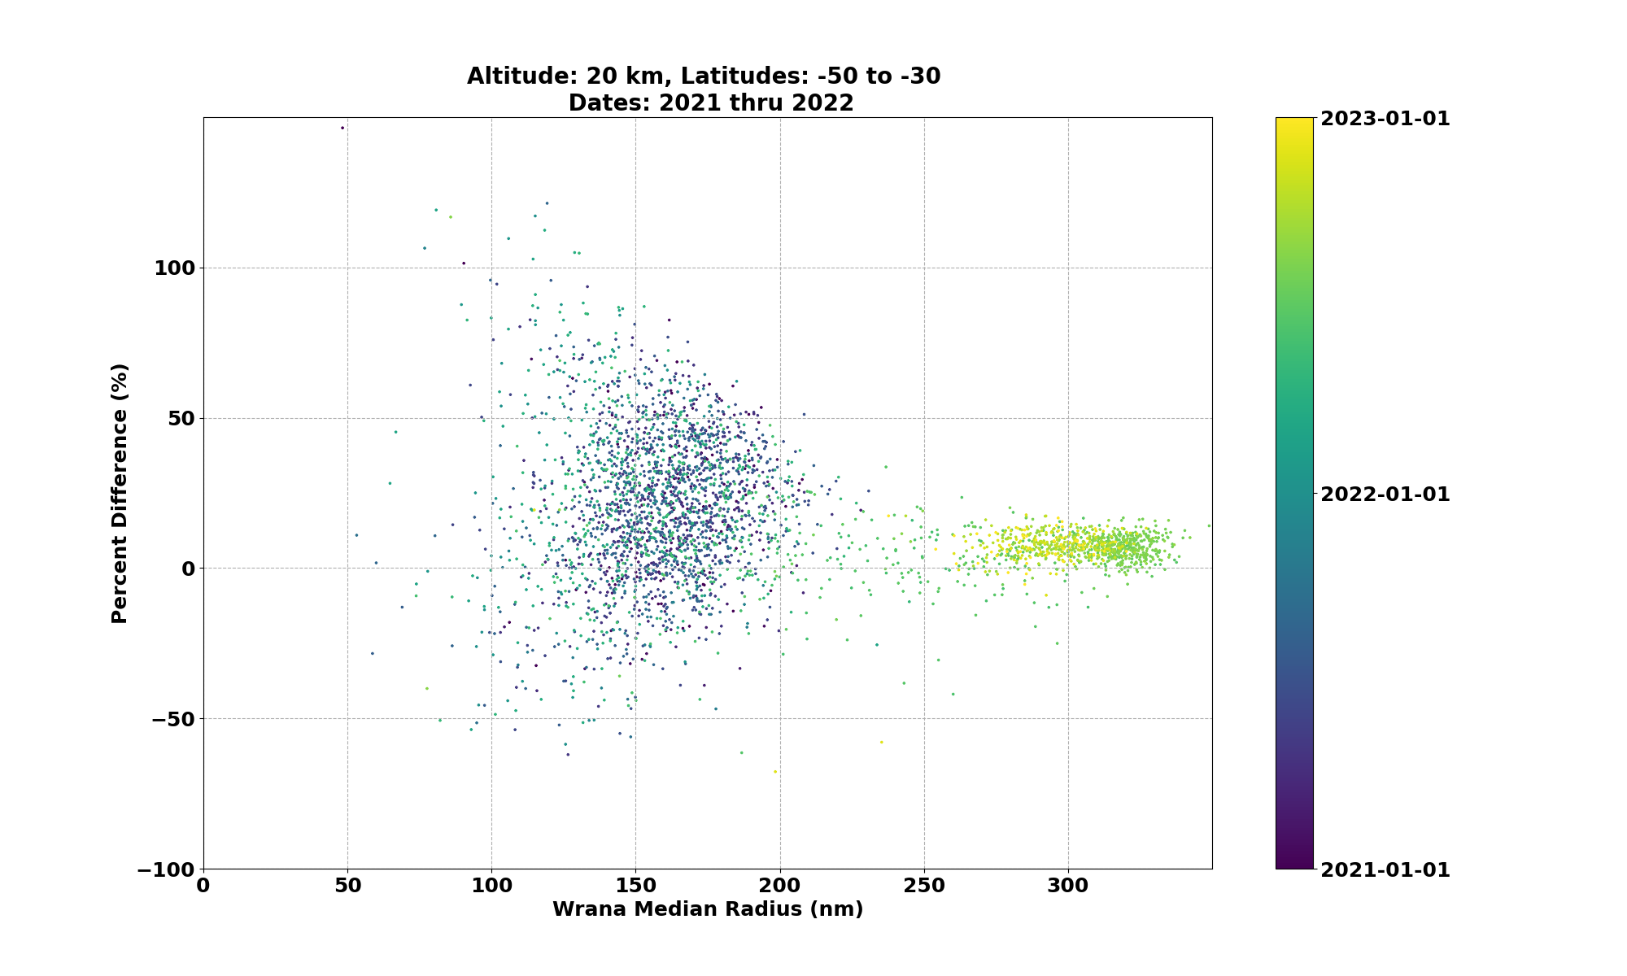

Slide 8
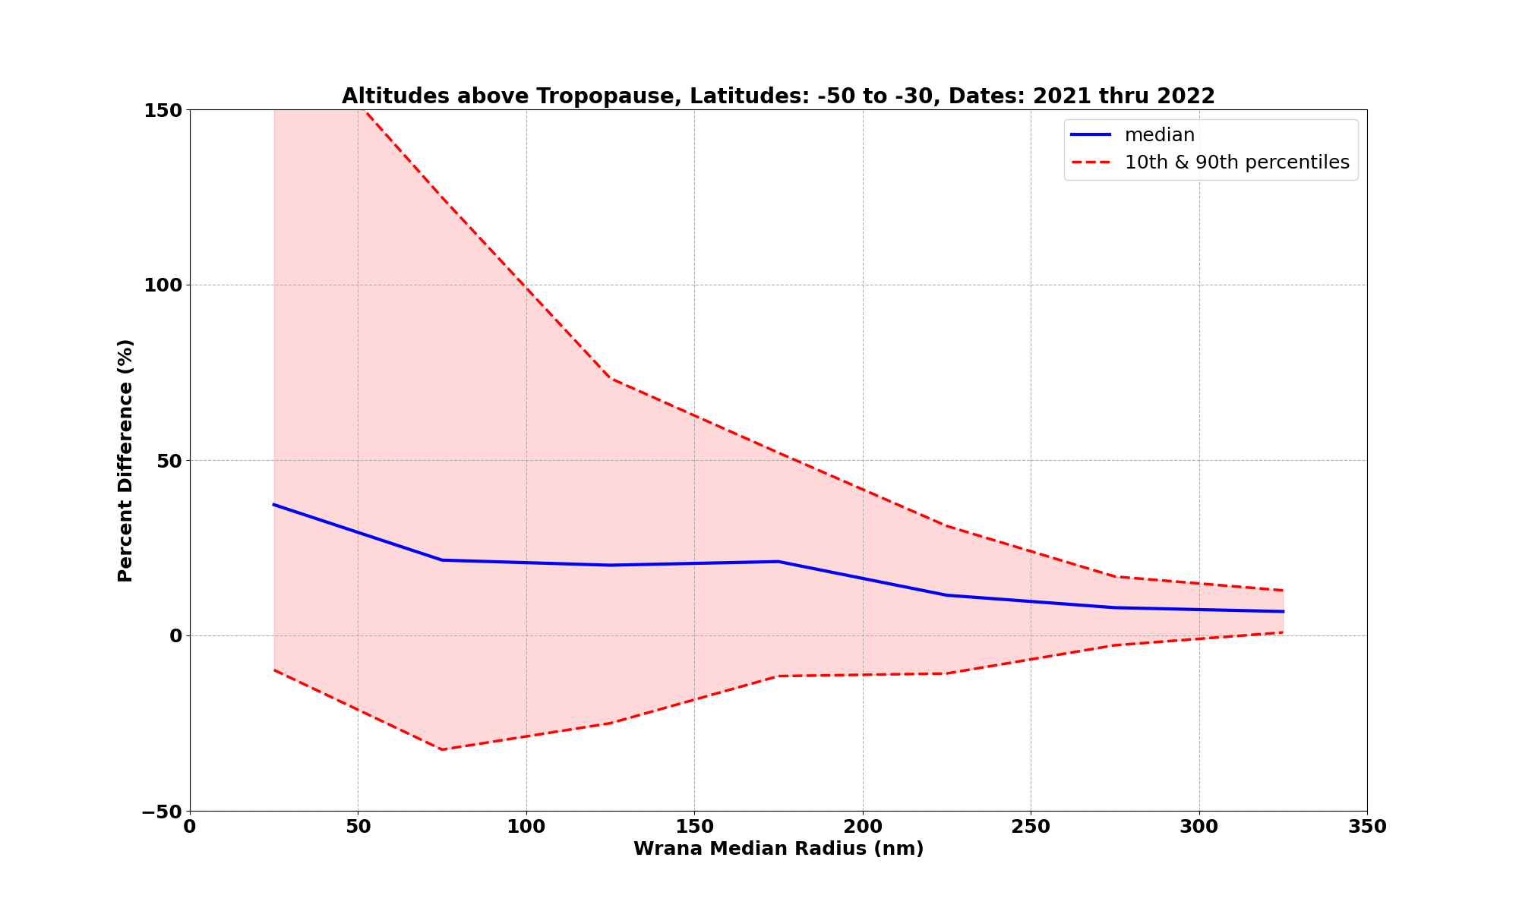

Slide 9
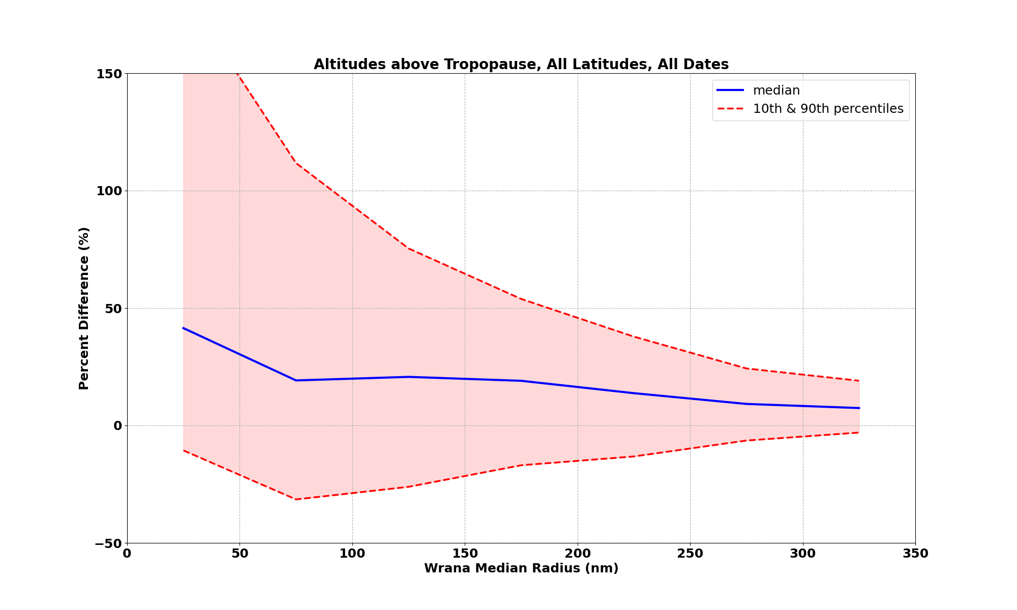

Slide 10
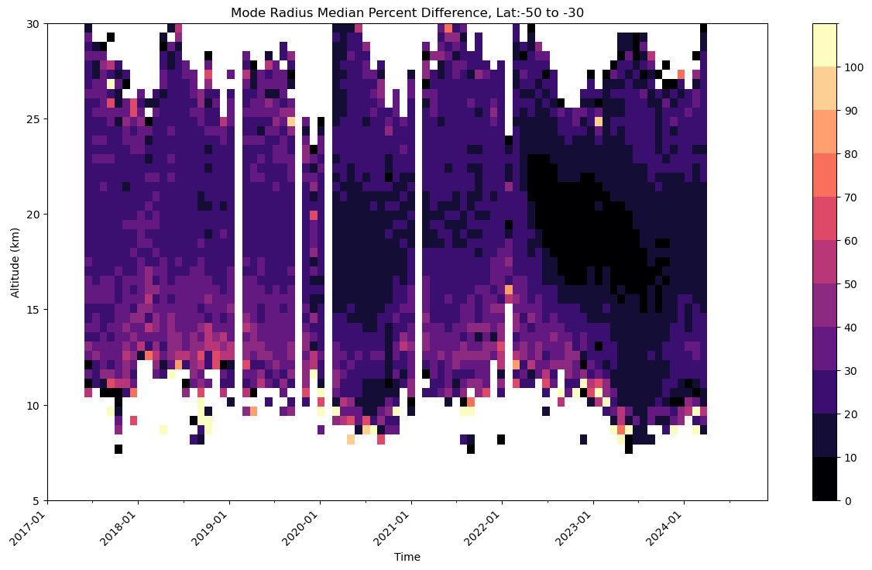
Median Radius, Median Percent Difference, Lats: 50 S to 30 S
(%)

Slide 11
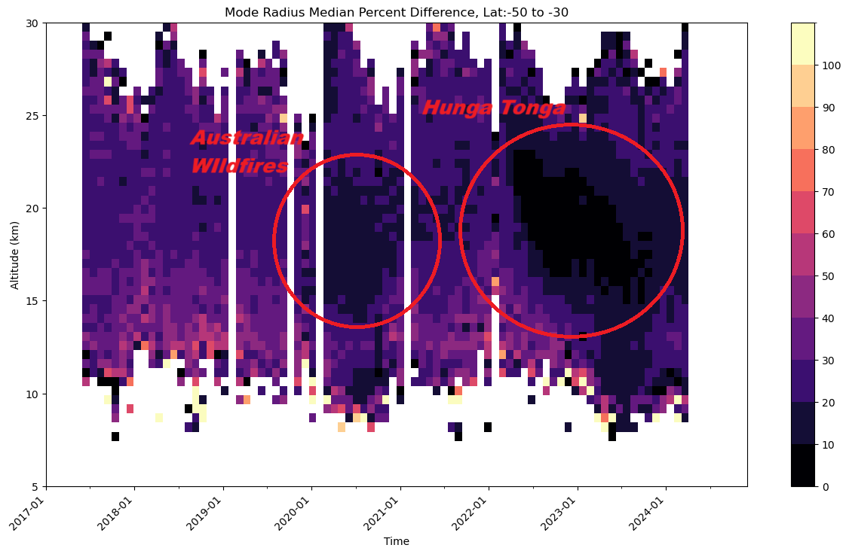
Median Radius, Median Percent Difference, Lats: 50 S to 30 S
(%)

Slide 12
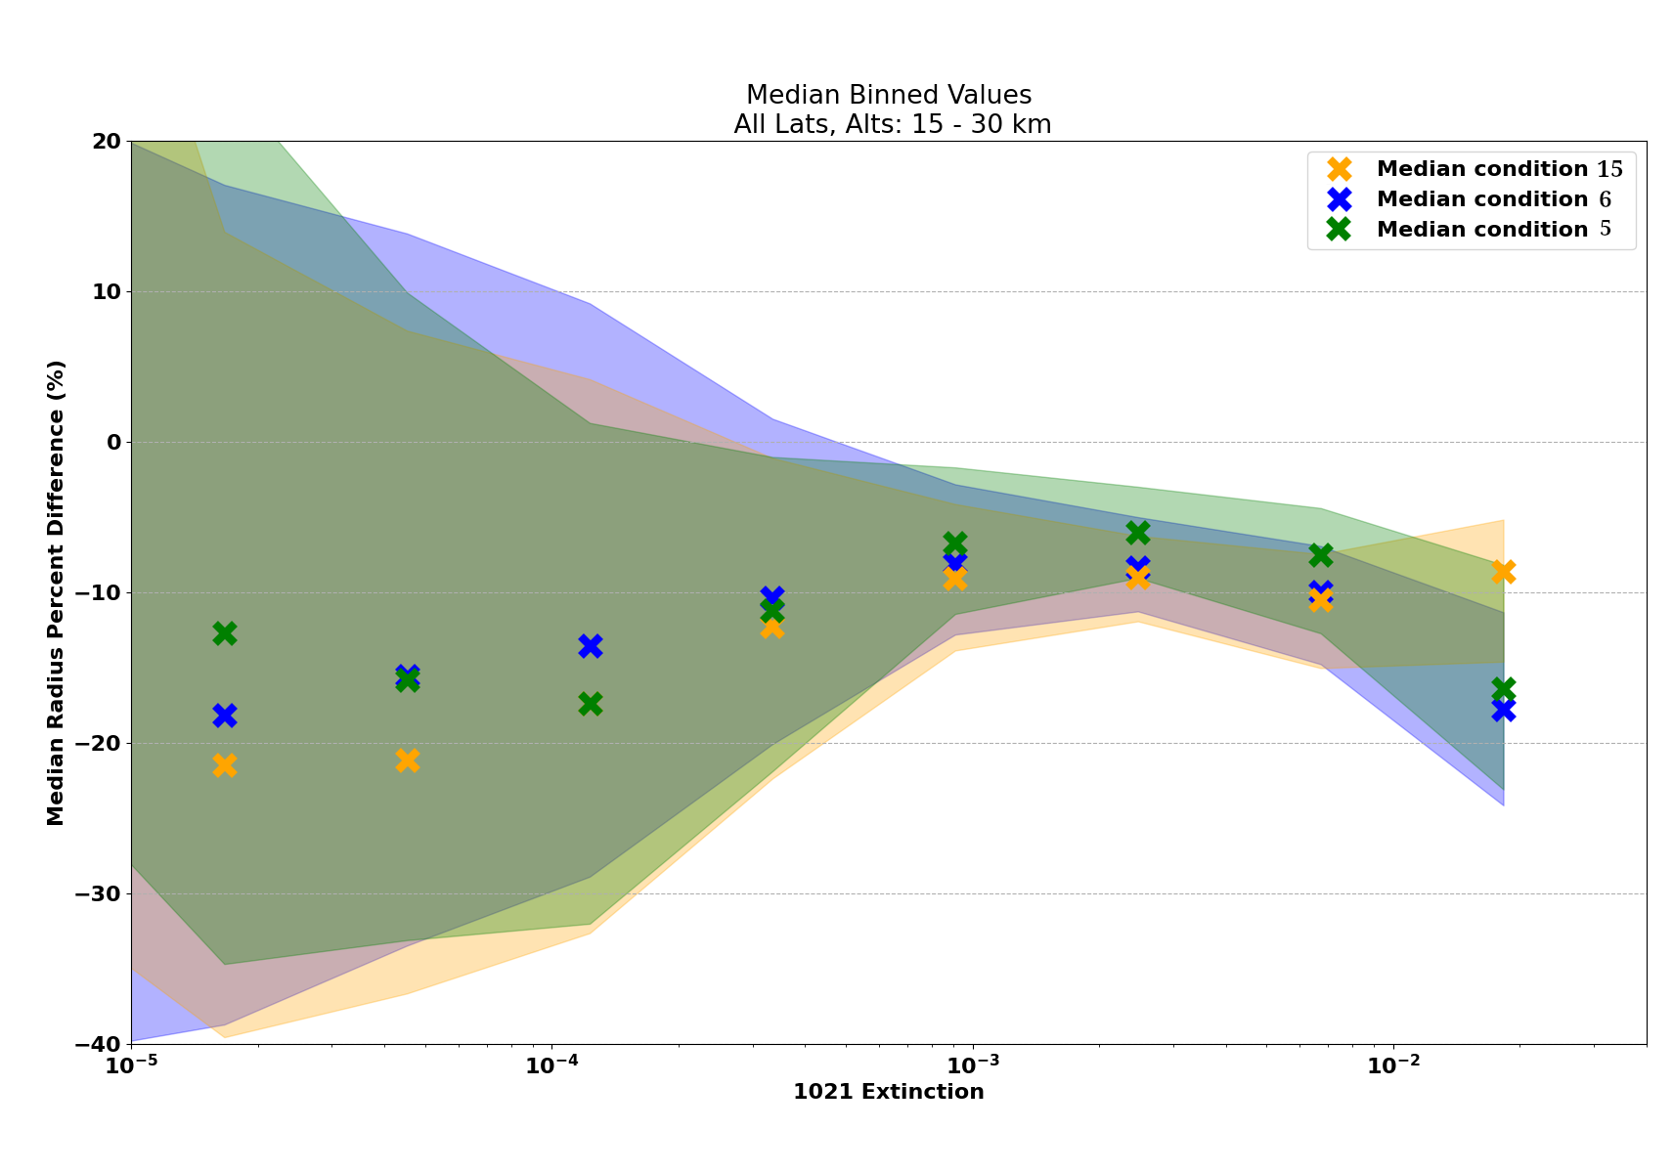
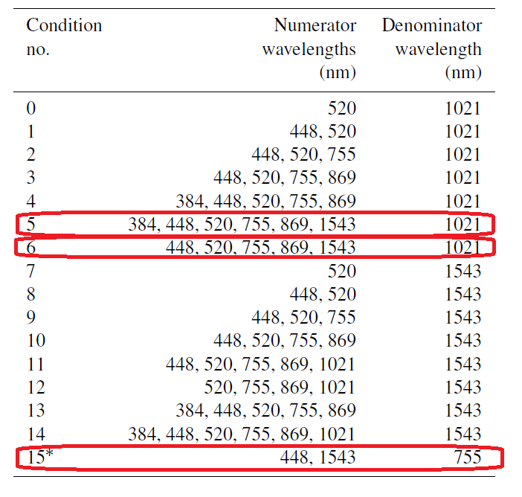
Knepp Solution Conditions

Slide 13
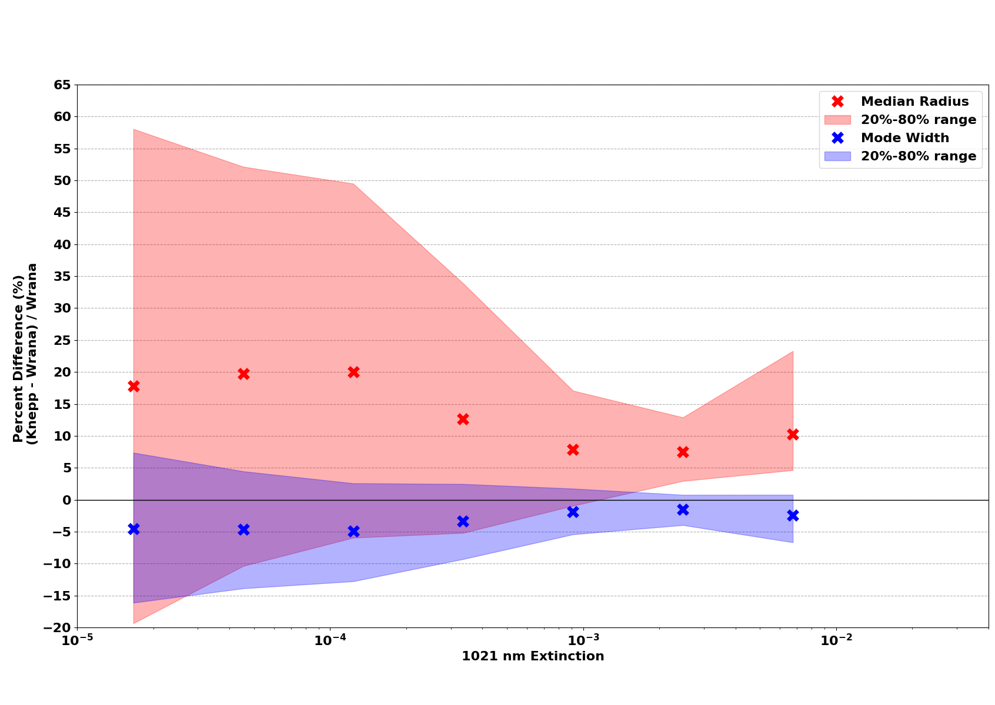
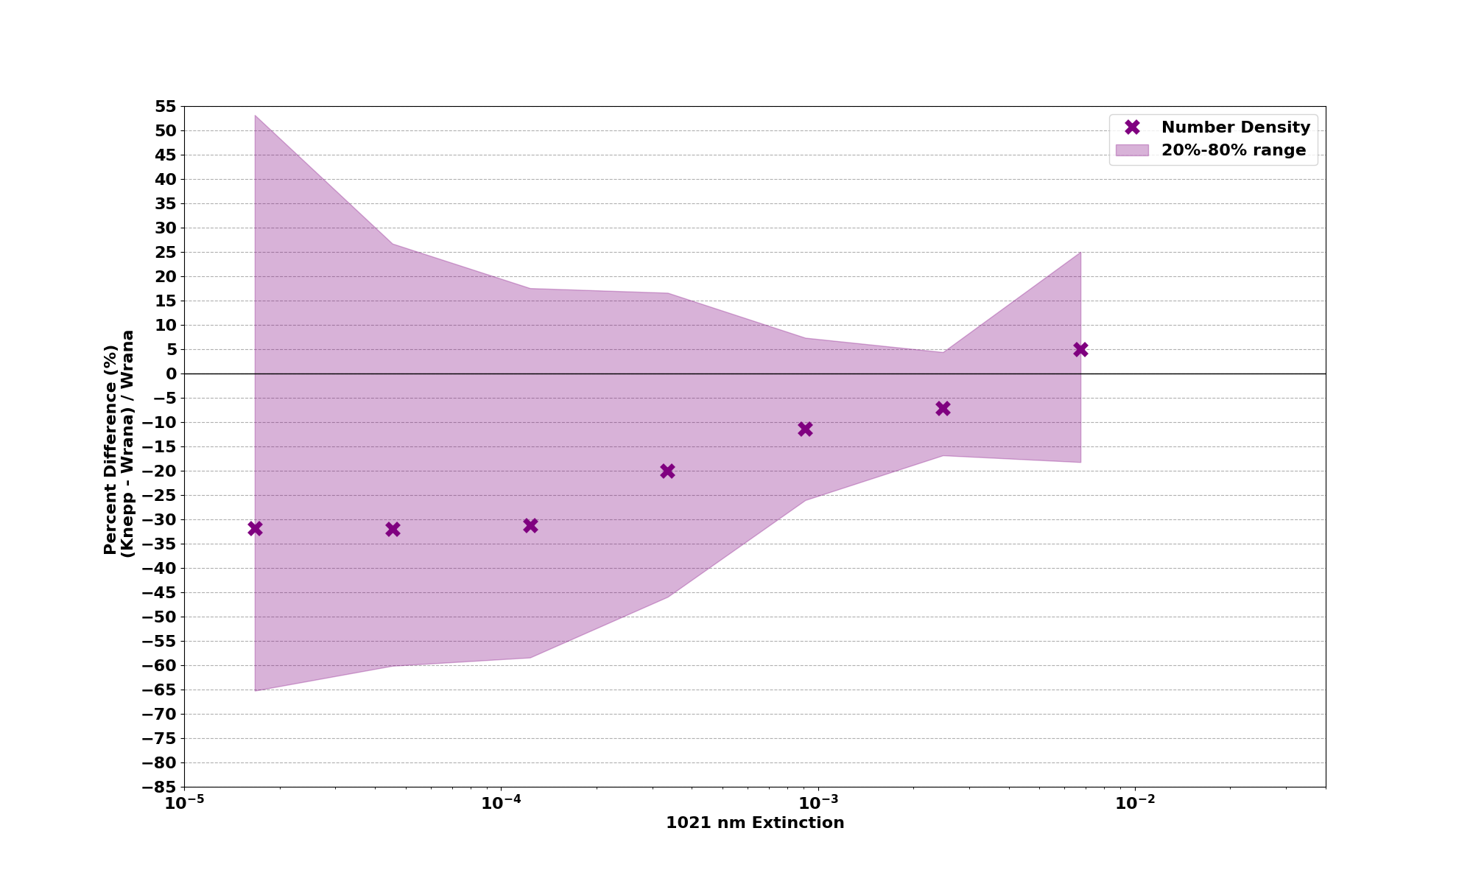
Overview – PSD Parameter Values

Slide 14
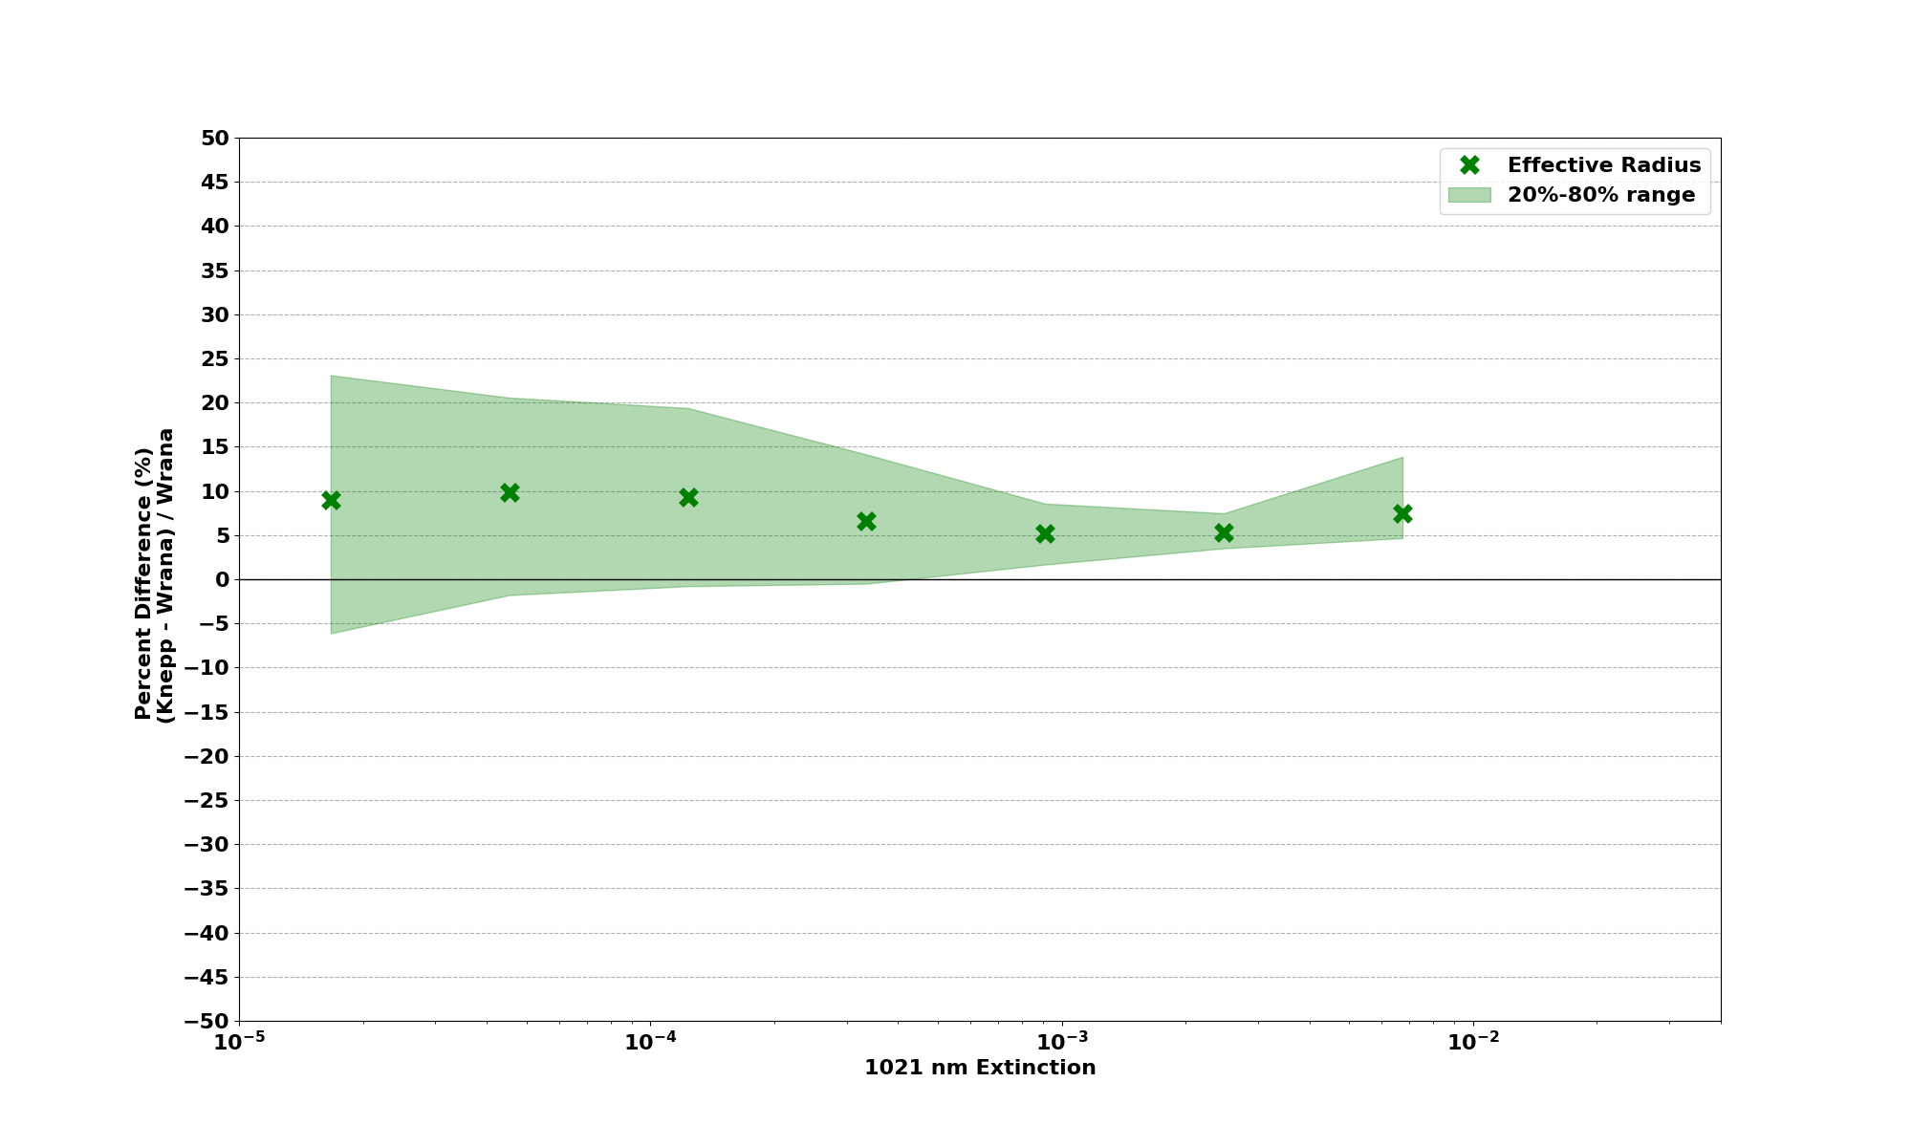
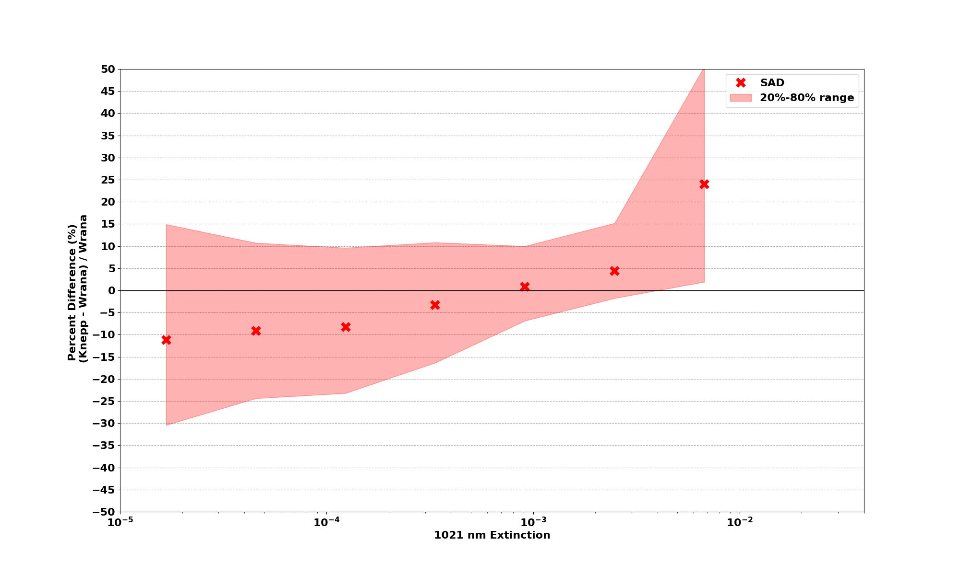
Overview – Derived Values

Slide 15
Effects of differences in methodologies
Wrana 3-pnt smoothing
Knepp channel conditions
Knepp uncertainty envelope
Refractive index differences

Slide 16
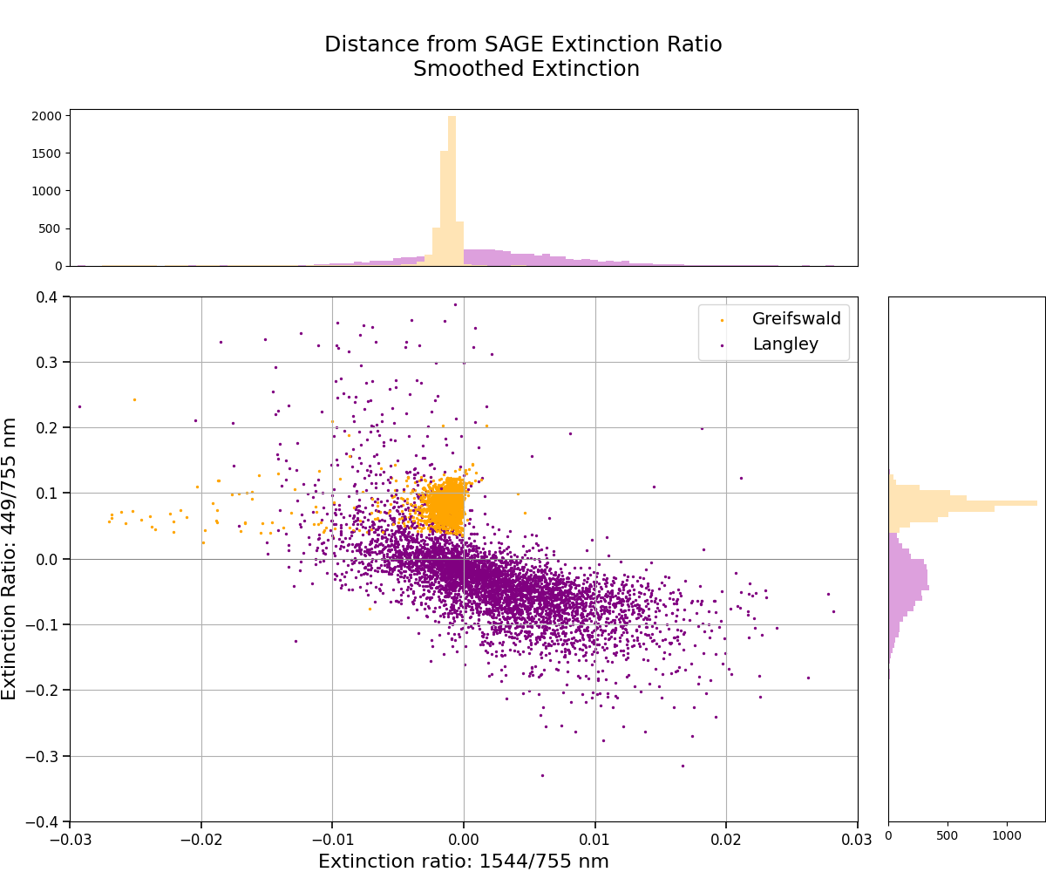

Slide 17
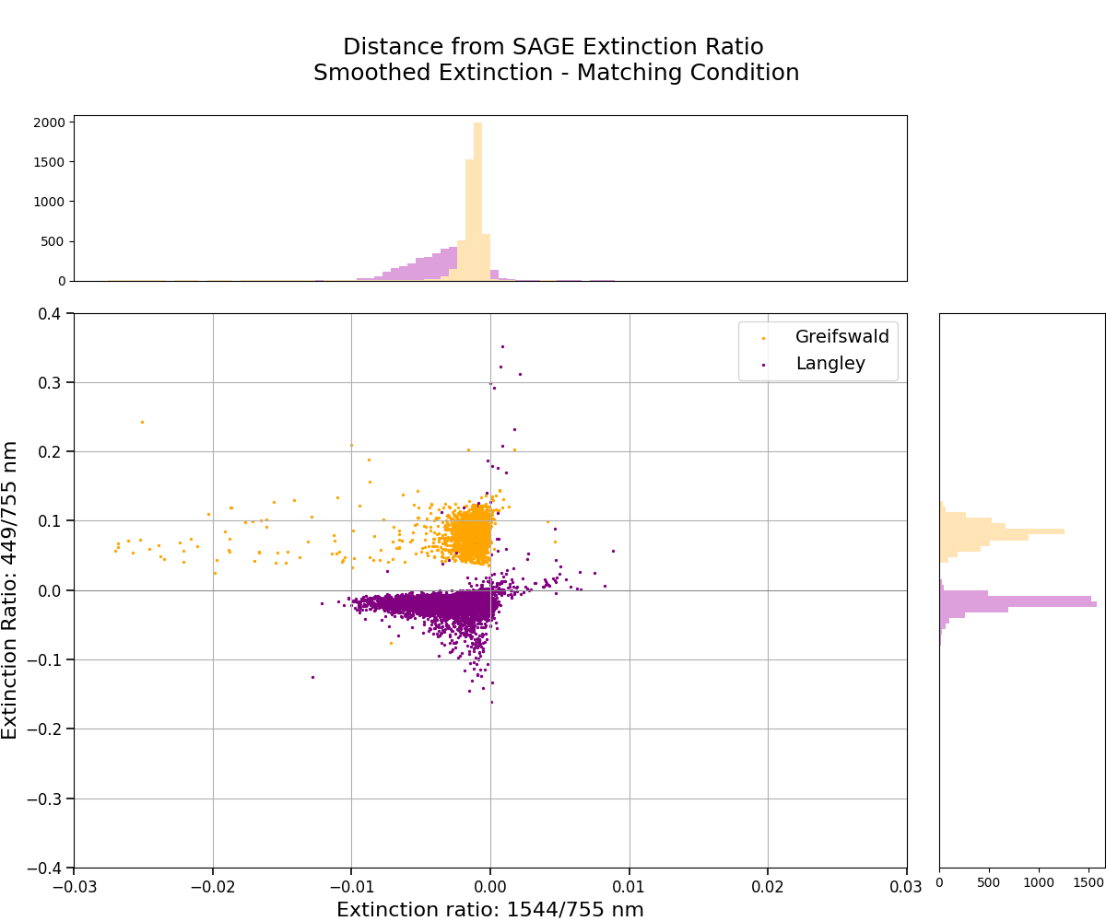

Slide 18
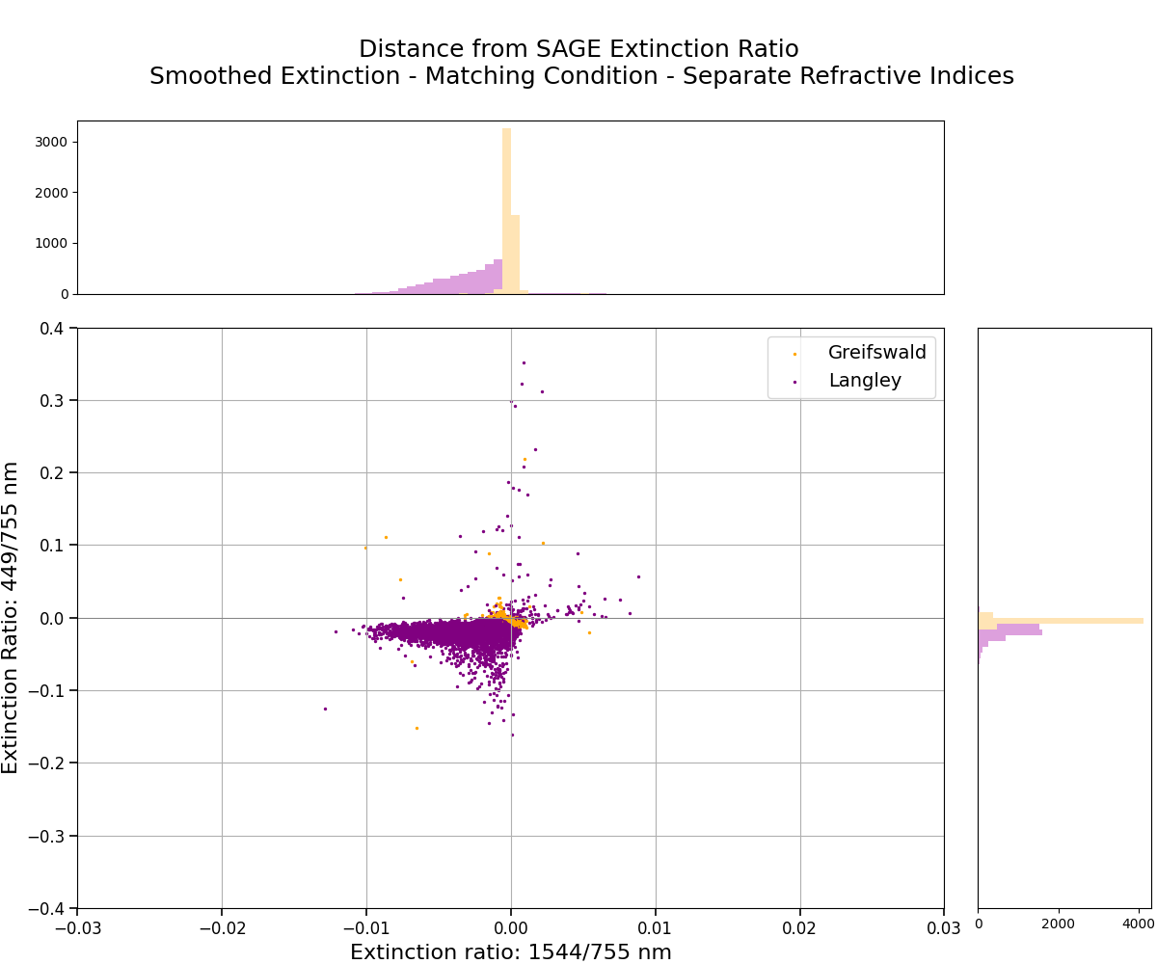

Slide 19
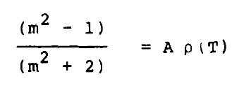
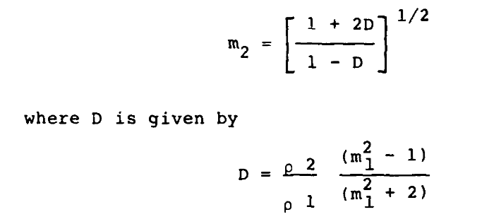
Wrana Index of Refraction Derivation
Lorentz-Lorenz from Hummel et al. (1988)

Slide 20
Future Work
SAGE III/ISS v 6.0 released, awaiting updates on PSD parameters
Updates on Knepp number density
Further clarification of algorithmic difference effects

Slide 21
References
Knepp, T. N., Kovilakam, M., Thomason, L., & Miller, S. J. (2024). Characterization of stratospheric particle size distribution uncertainties using SAGE II and SAGE III/ISS extinction spectra. Atmospheric Measurement Techniques, 17(7), 2025-2054.
Wrana, F., Von Savigny, C., Zalach, J., & Thomason, L. W. (2021). Retrieval of stratospheric aerosol size distribution parameters using satellite solar occultation measurements at three wavelengths. Atmospheric Measurement Techniques, 14(3), 2345-2357.
Wrana, F., Niemeier, U., Thomason, L. W., Wallis, S., & von Savigny, C. (2023). Stratospheric aerosol size reduction after volcanic eruptions. Atmospheric Chemistry and Physics, 23(17), 9725-9743.
Todt, M. A., Asher, E., Hall, E., Cullis, P., Jordan, A., Xiong, K., ... & Thornberry, T. (2023). Baseline Balloon Stratospheric Aerosol Profiles (B2SAP)—Systematic measurements of aerosol number density and size. Journal of Geophysical Research: Atmospheres, 128(12), e2022JD038041.
Hummel, J. R., Shettle, E. P., & Longtin, D. R. (1988). A new background stratospheric aerosol model for use in atmospheric radiation models (No. OMI298).

Slide 22
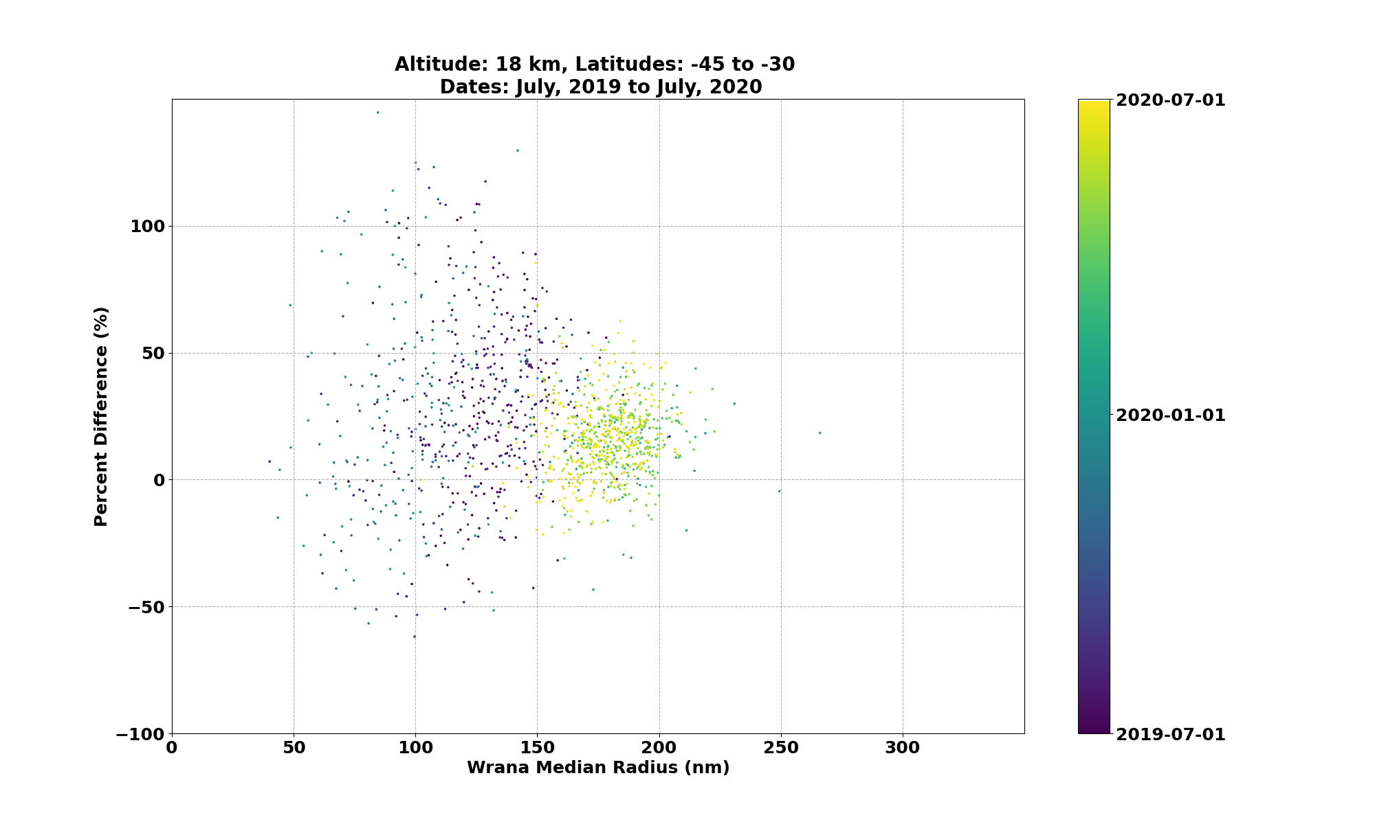

Slide 23
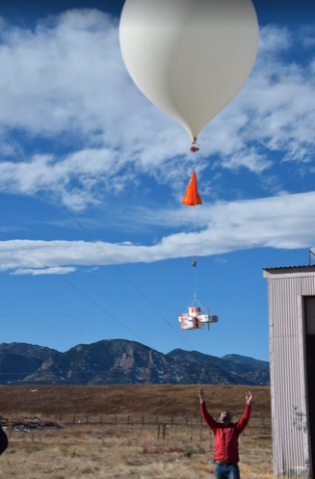
NOAA POPS Colorado Comparison
Latitude: 39.95, Longitude: -105.20
From March 2019, 1-2 times per month
Balloon-borne in situ measurements of particle size distribution
Very consistent values for aerosol background

Slide 24
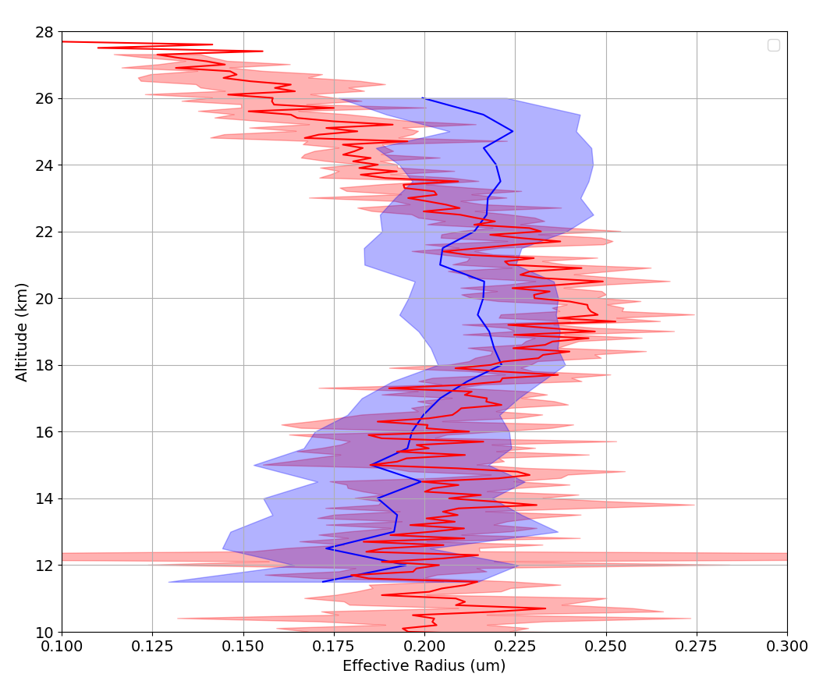
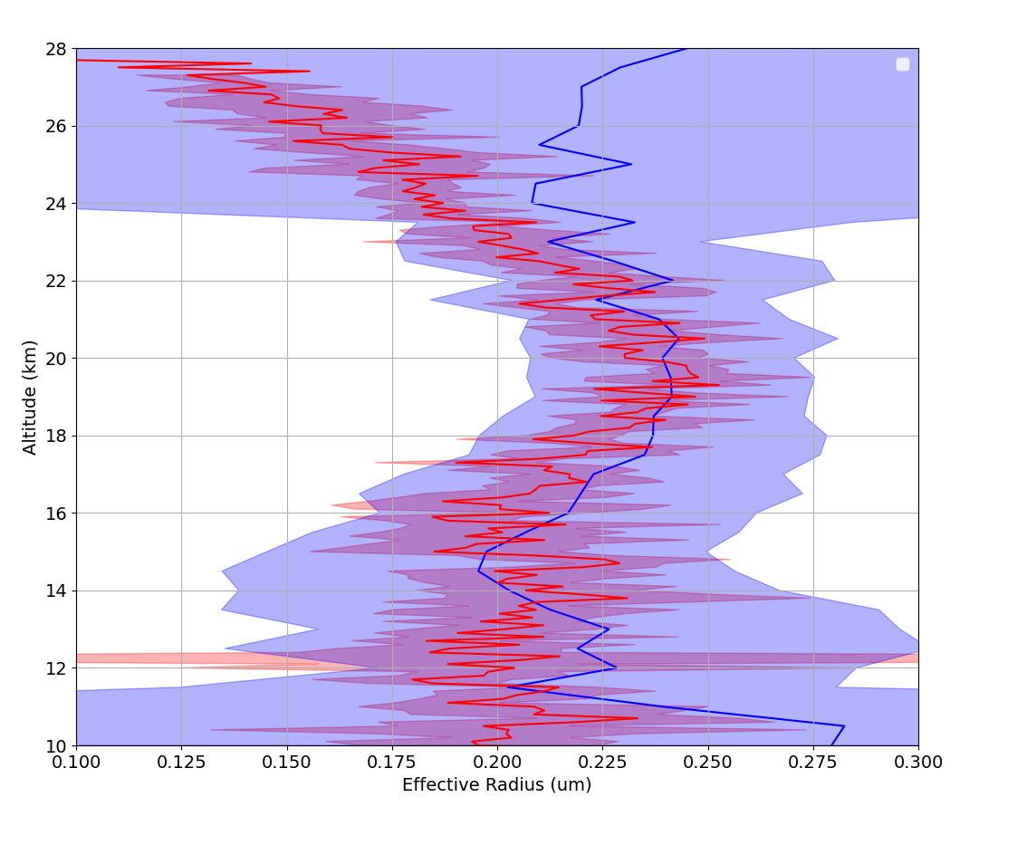
NOAA POPS Colorado
Wrana
Knepp

Slide 25
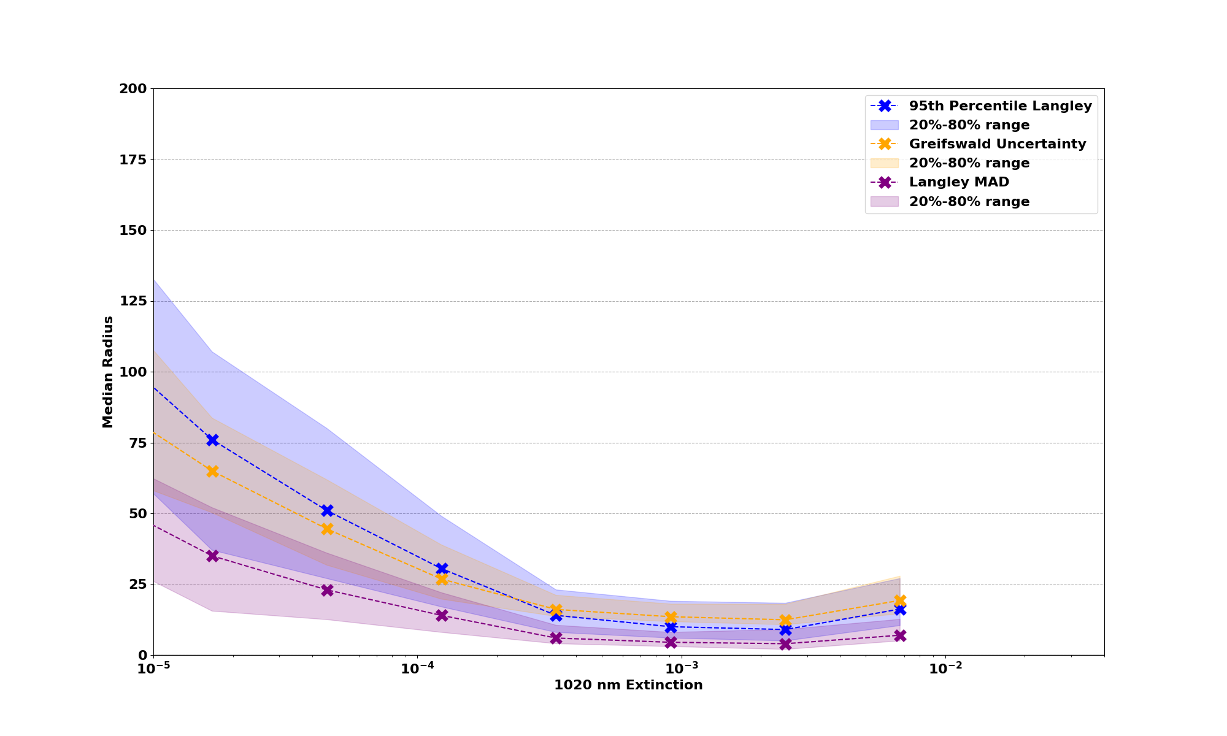

Slide 26
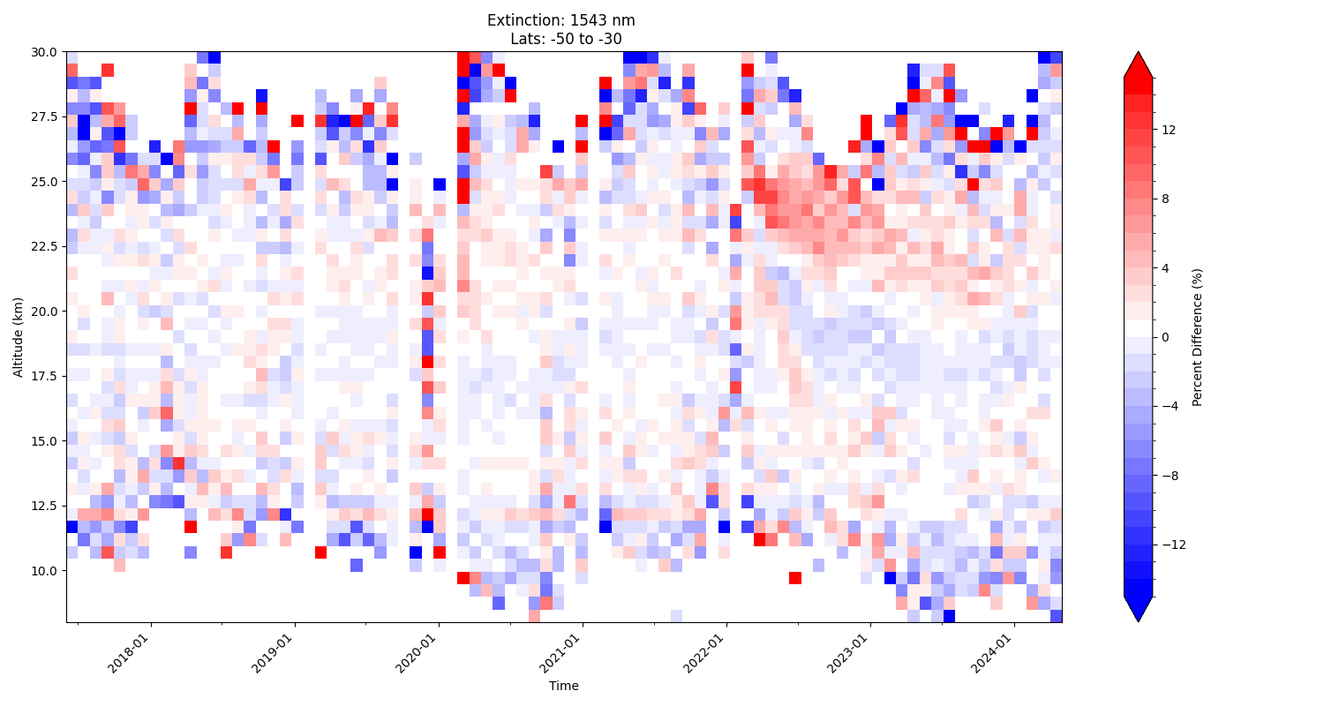

Slide 27
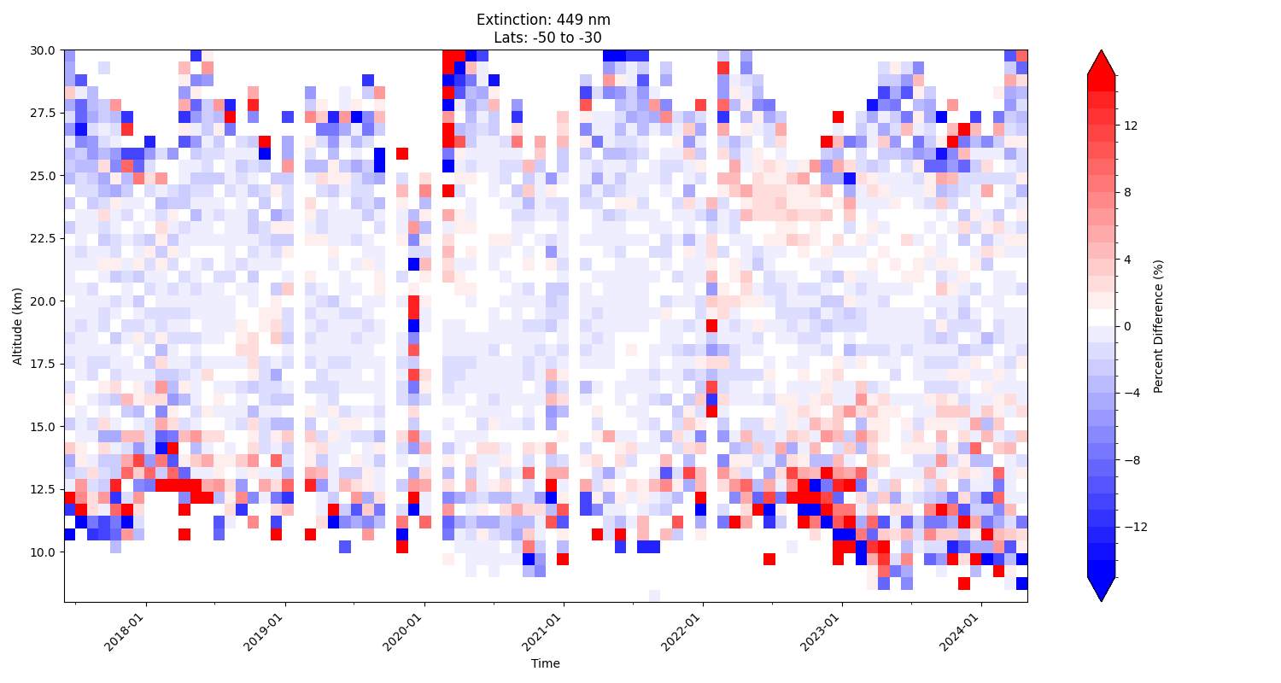

Slide 28
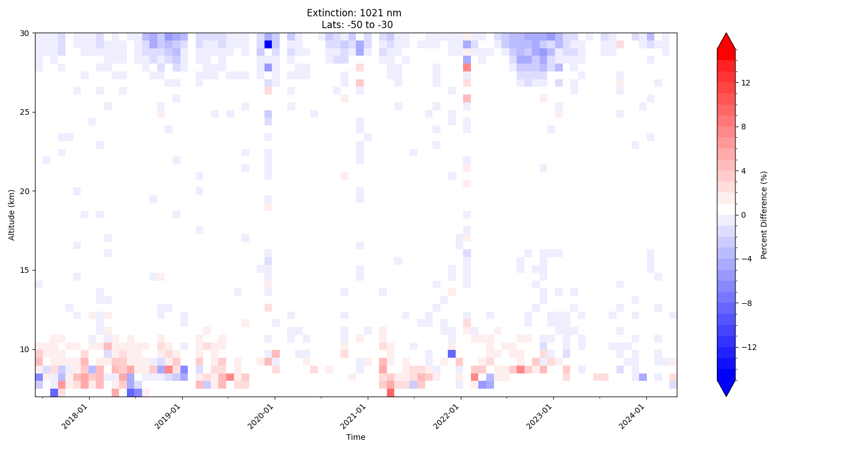

Slide 29
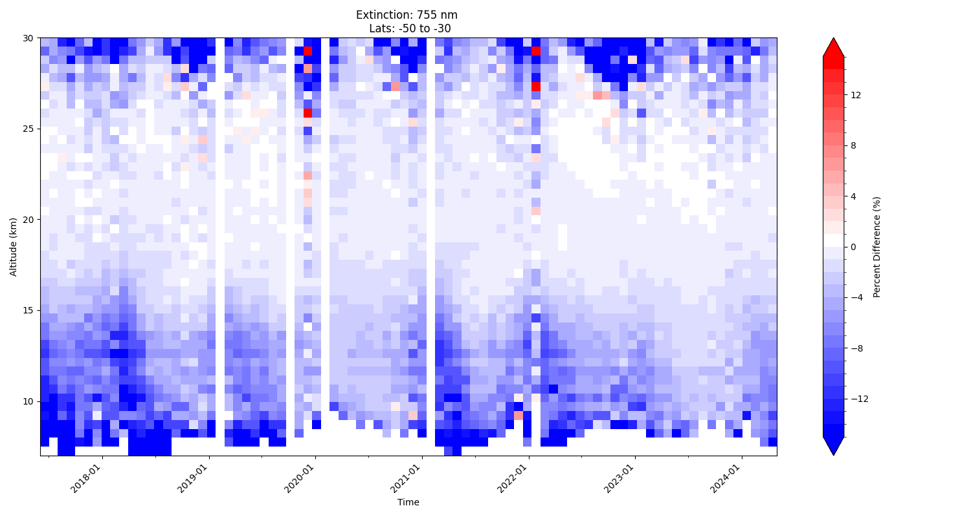

Slide 30
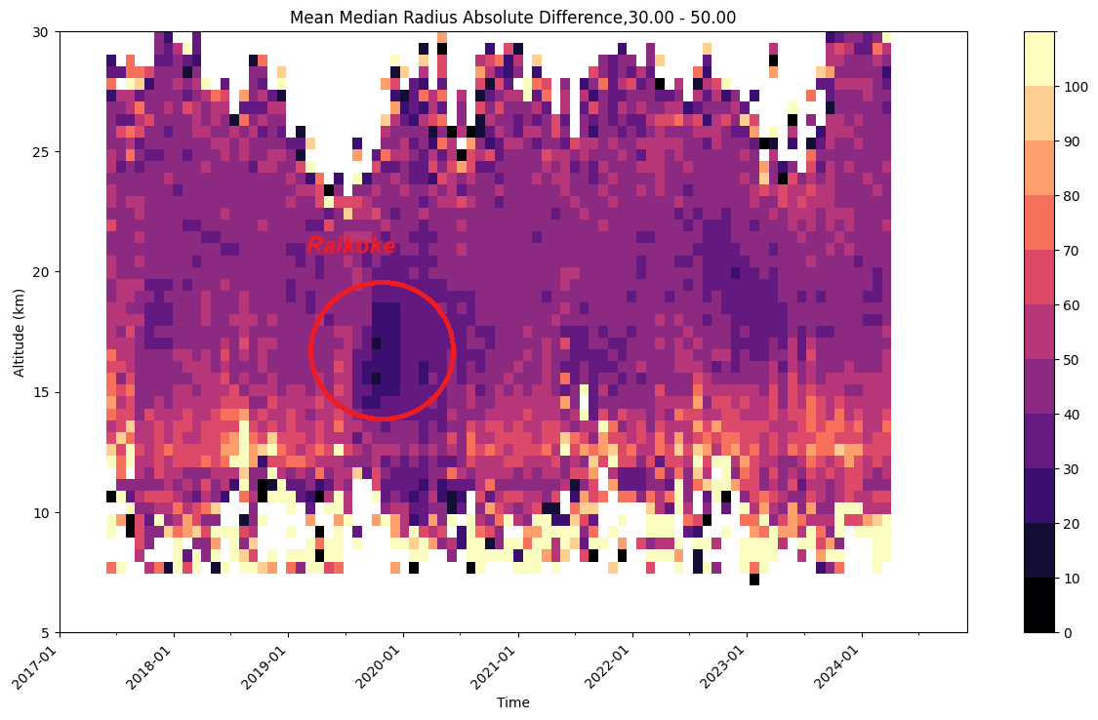
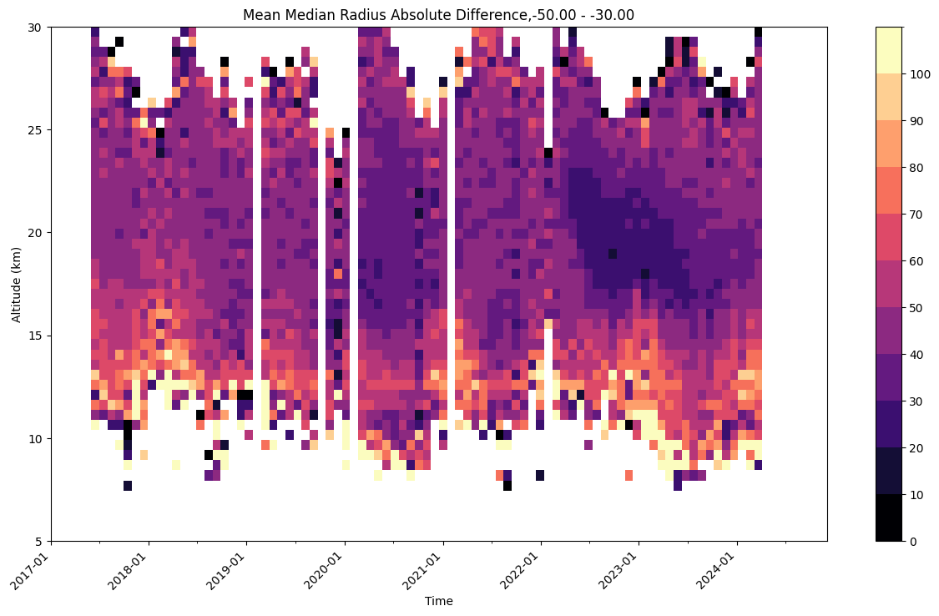
Median Radius, Median Absolute Difference, Lats: 50 S to 30 S
(nm)

Slide 31
Median Radius, Median Absolute Difference, Lats: 30 N to 50 N
(nm)

