Slide 1
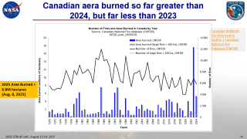
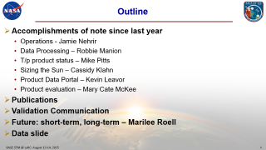
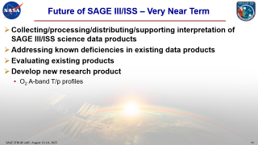
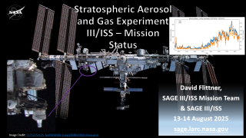
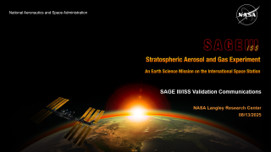
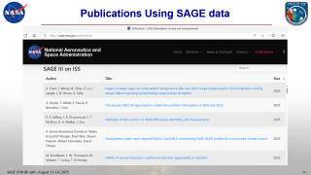
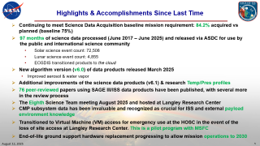
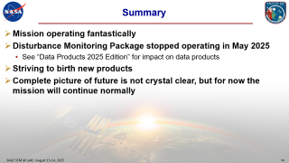

Slide 2
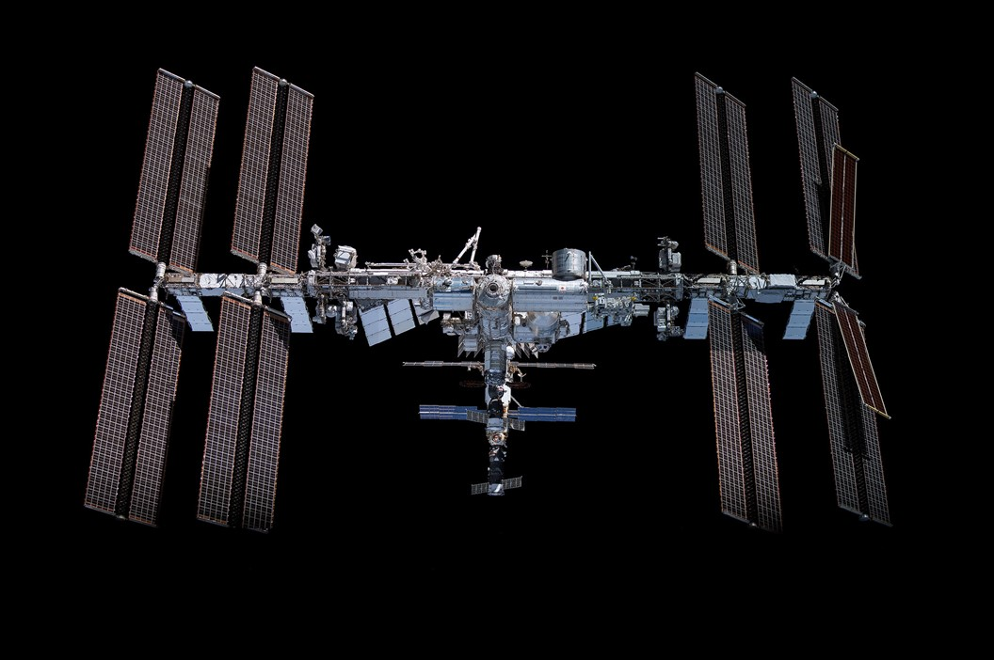

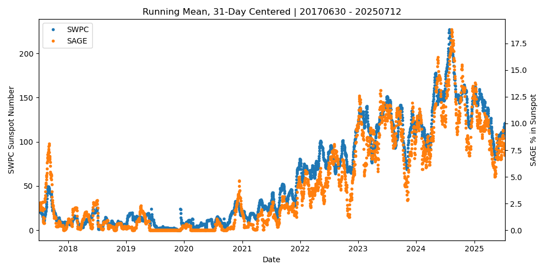
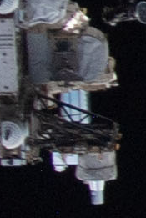
Stratospheric Aerosol and Gas Experiment III/ISS – Mission Status
David Flittner,
SAGE III/ISS Mission Team
& SAGE III/ISS
13-14 August 2025
sage.larc.nasa.gov
Image Credit: 51752252125_be036501b8_k.jpg (2048×1361) (nasa.gov)
Notes:
Observe the instrument in the Space Walk photo.

Slide 3
Outline
Accomplishments of note since last year
  Operations - Jamie Nehrir
  Data Processing – Robbie Manion
  T/p product status – Mike Pitts
  Sizing the Sun – Cassidy Klahn
  Product Data Portal – Kevin Leavor
  Product evaluation – Mary Cate McKee
Publications
Validation Communication
Future: short-term, long-term – Marilee Roell
Data slide

Slide 4
SAGE III/ISS STM 2025 - Thank You!
Thank you to Allison McMahon & Tracy May for planning, organizing and making it happen!
Thank you Jun Wang & Emma Knowland for crafting the meeting.
Thank you for taking the time to join the meeting and contributing to science advancements fueled by SAGE data and your curiosity.

Slide 5
Highlights & Accomplishments Since Last Time
Continuing to meet Science Data Acquisition baseline mission requirement: 84.2% acquired vs planned (baseline 75%)
97 months of science data processed (June 2017 – June 2025) and released via ASDC for use by the public and international science community
  Solar science event count: 72,508
  Lunar science event count: 4,855
  EOSDIS transitioned products to the cloud
New algorithm version (v6.0) of data products released March 2025
  Improved aerosol & water vapor
Additional improvements of the science data products (v6.1) & research Temp/Pres profiles
76 peer-reviewed papers using SAGE III/ISS data products have been published, with several more in the review process
The Eighth Science Team meeting August 2025 and hosted at Langley Research Center
CMP subsystem data has been invaluable and recognized as crucial for ISS and external payload environment knowledge
Transitioned to Virtual Machine (VM) access for emergency use at the HOSC in the event of the loss of site access at Langley Research Center. This is a pilot program with MSFC
End-of-life ground support hardware replacement progressing to allow mission operations to 2030

Slide 6
Interns
NASA Internship and Fellowship opportunities: NASA Intern
SAGE III/ISS has a vibrant & sought-after internship program
  3-5 interns during summer
Interns work on real tasks benefiting the SAGE III/ISS mission
Fantastic program teaching necessary skills/habits for successful science/engineering careers, e.g.:
  Python programing
  Configuration management (git)
  Self documenting code techniques
  Linux shells and scripting
Exceptional candidates should contact charles.a.hill@nasa.gov

Slide 7
SAGE III/ISS Mission Teams
Management – Marilee Roell, Dave Flittner, Sherry Beimler, Charles Hill
Operations – Jamie Nehrir, Sam Porter, Caitlyn Stone, Donald Cleckner, James Losey, Kenta Funada
Ground Systems – Greg Paxton, Andrew Peterson, Jim Farmer, Rick Farmer
Science – David Flittner, Charles Hill, Kevin Leavor, Mary Cate McKee, Mahesh Kovilakam, Travis Knepp, Mike Pitts
Science Processing – Rob Damadeo, Robbie Manion, Mike Heitz, Marsha Larosee
Validation - Kevin Leavor, Mary Cate McKee, Caitlyn Stone
Public Engagement – Allison McMahon
Web Development – Rick Farmer, Jim Farmer, Kevin Leavor
Emergencies – Shane Wolf, Tom Johnson

Slide 8
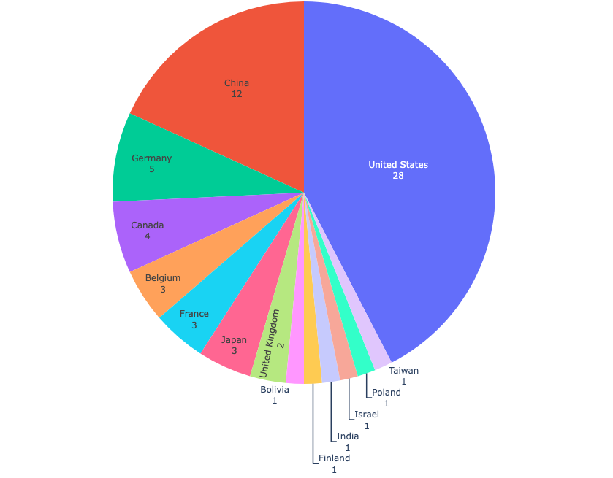
Who are the consumers
Unique Users by Country
China
United States
Statistics only for Direct Download
Courtesy of Cheyenne Land

Slide 9
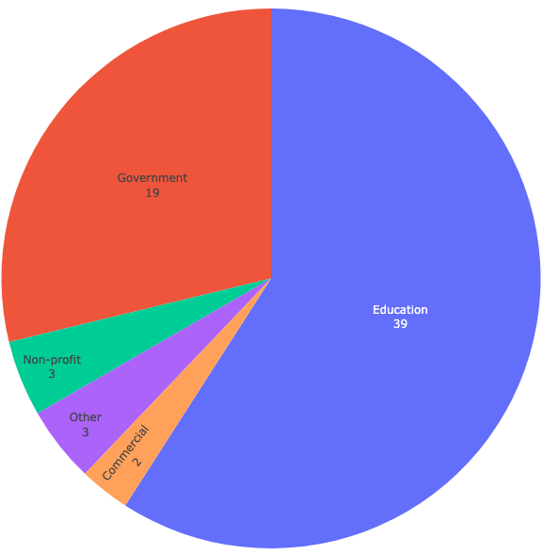
Unique User by Affiliation
Government
Education
Courtesy of Cheyenne Land

Slide 10
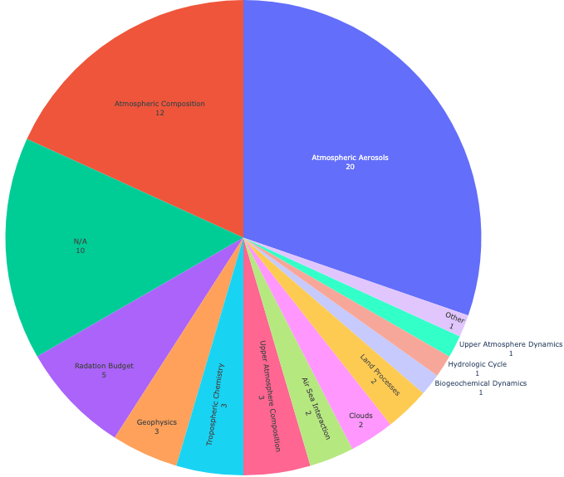
Unique User by Primary Study Area
Atmospheric Composition
Atmospheric Aerosols
Courtesy of Cheyenne Land

Slide 11
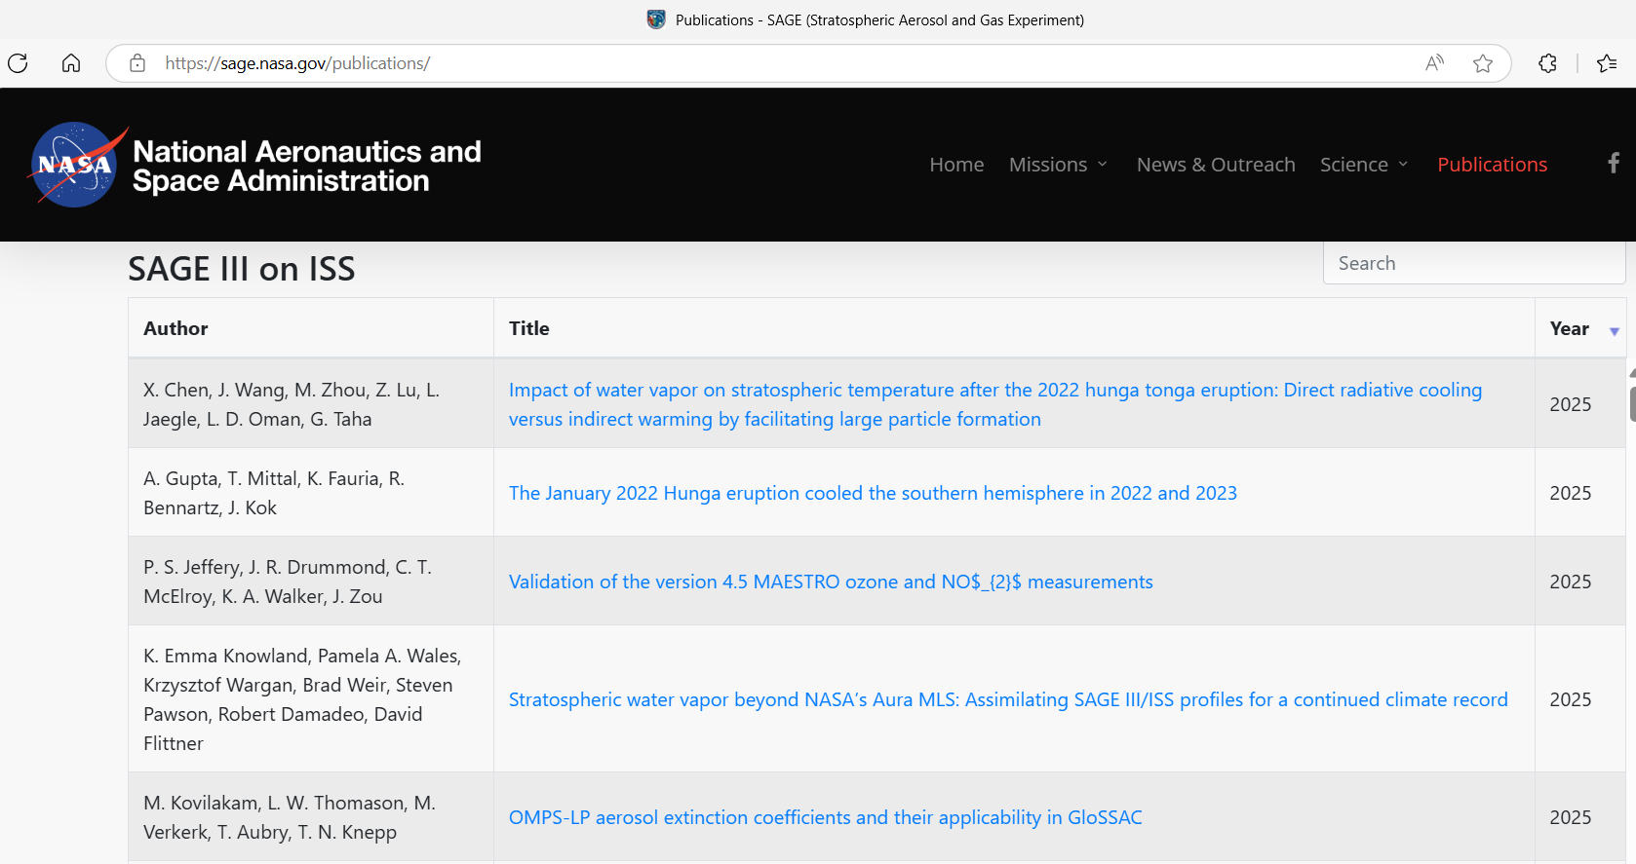
Publications Using SAGE data

Slide 12
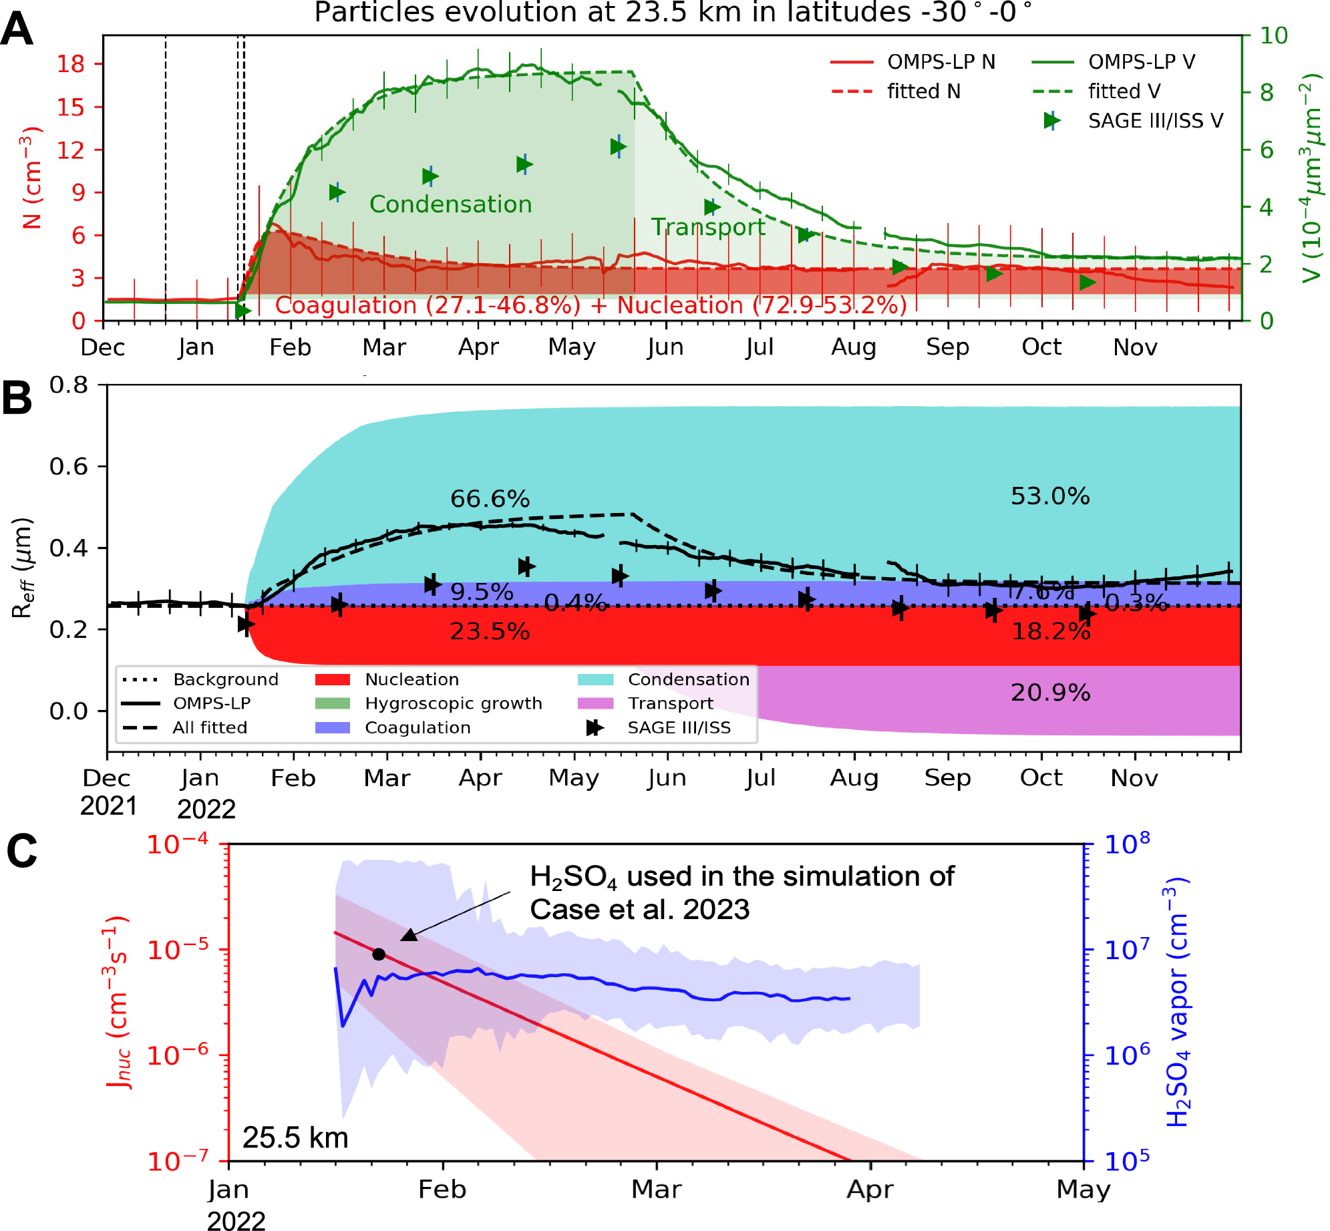
Chen et al.: Direct radiative cooling versus indirect warming by facilitating large particle formation
Used analytical expressions for aerosol evolution
Condensation and nucleation processes facilitated by abundant WV accounted for ~90% of the observed particle radius growth
Despite increased aerosol extinction due to particle growth, a cooling of up to −4 K was observed in the mid-stratosphere, persisting for over a year since February, with over 60% attributed to WV radiative cooling.
Conversely, in the lower stratosphere, ~50% of the observed 1–2 K warming was attributed to the radiative heating of large particles that formed in upper layers and settled down gravitationally.

Slide 13
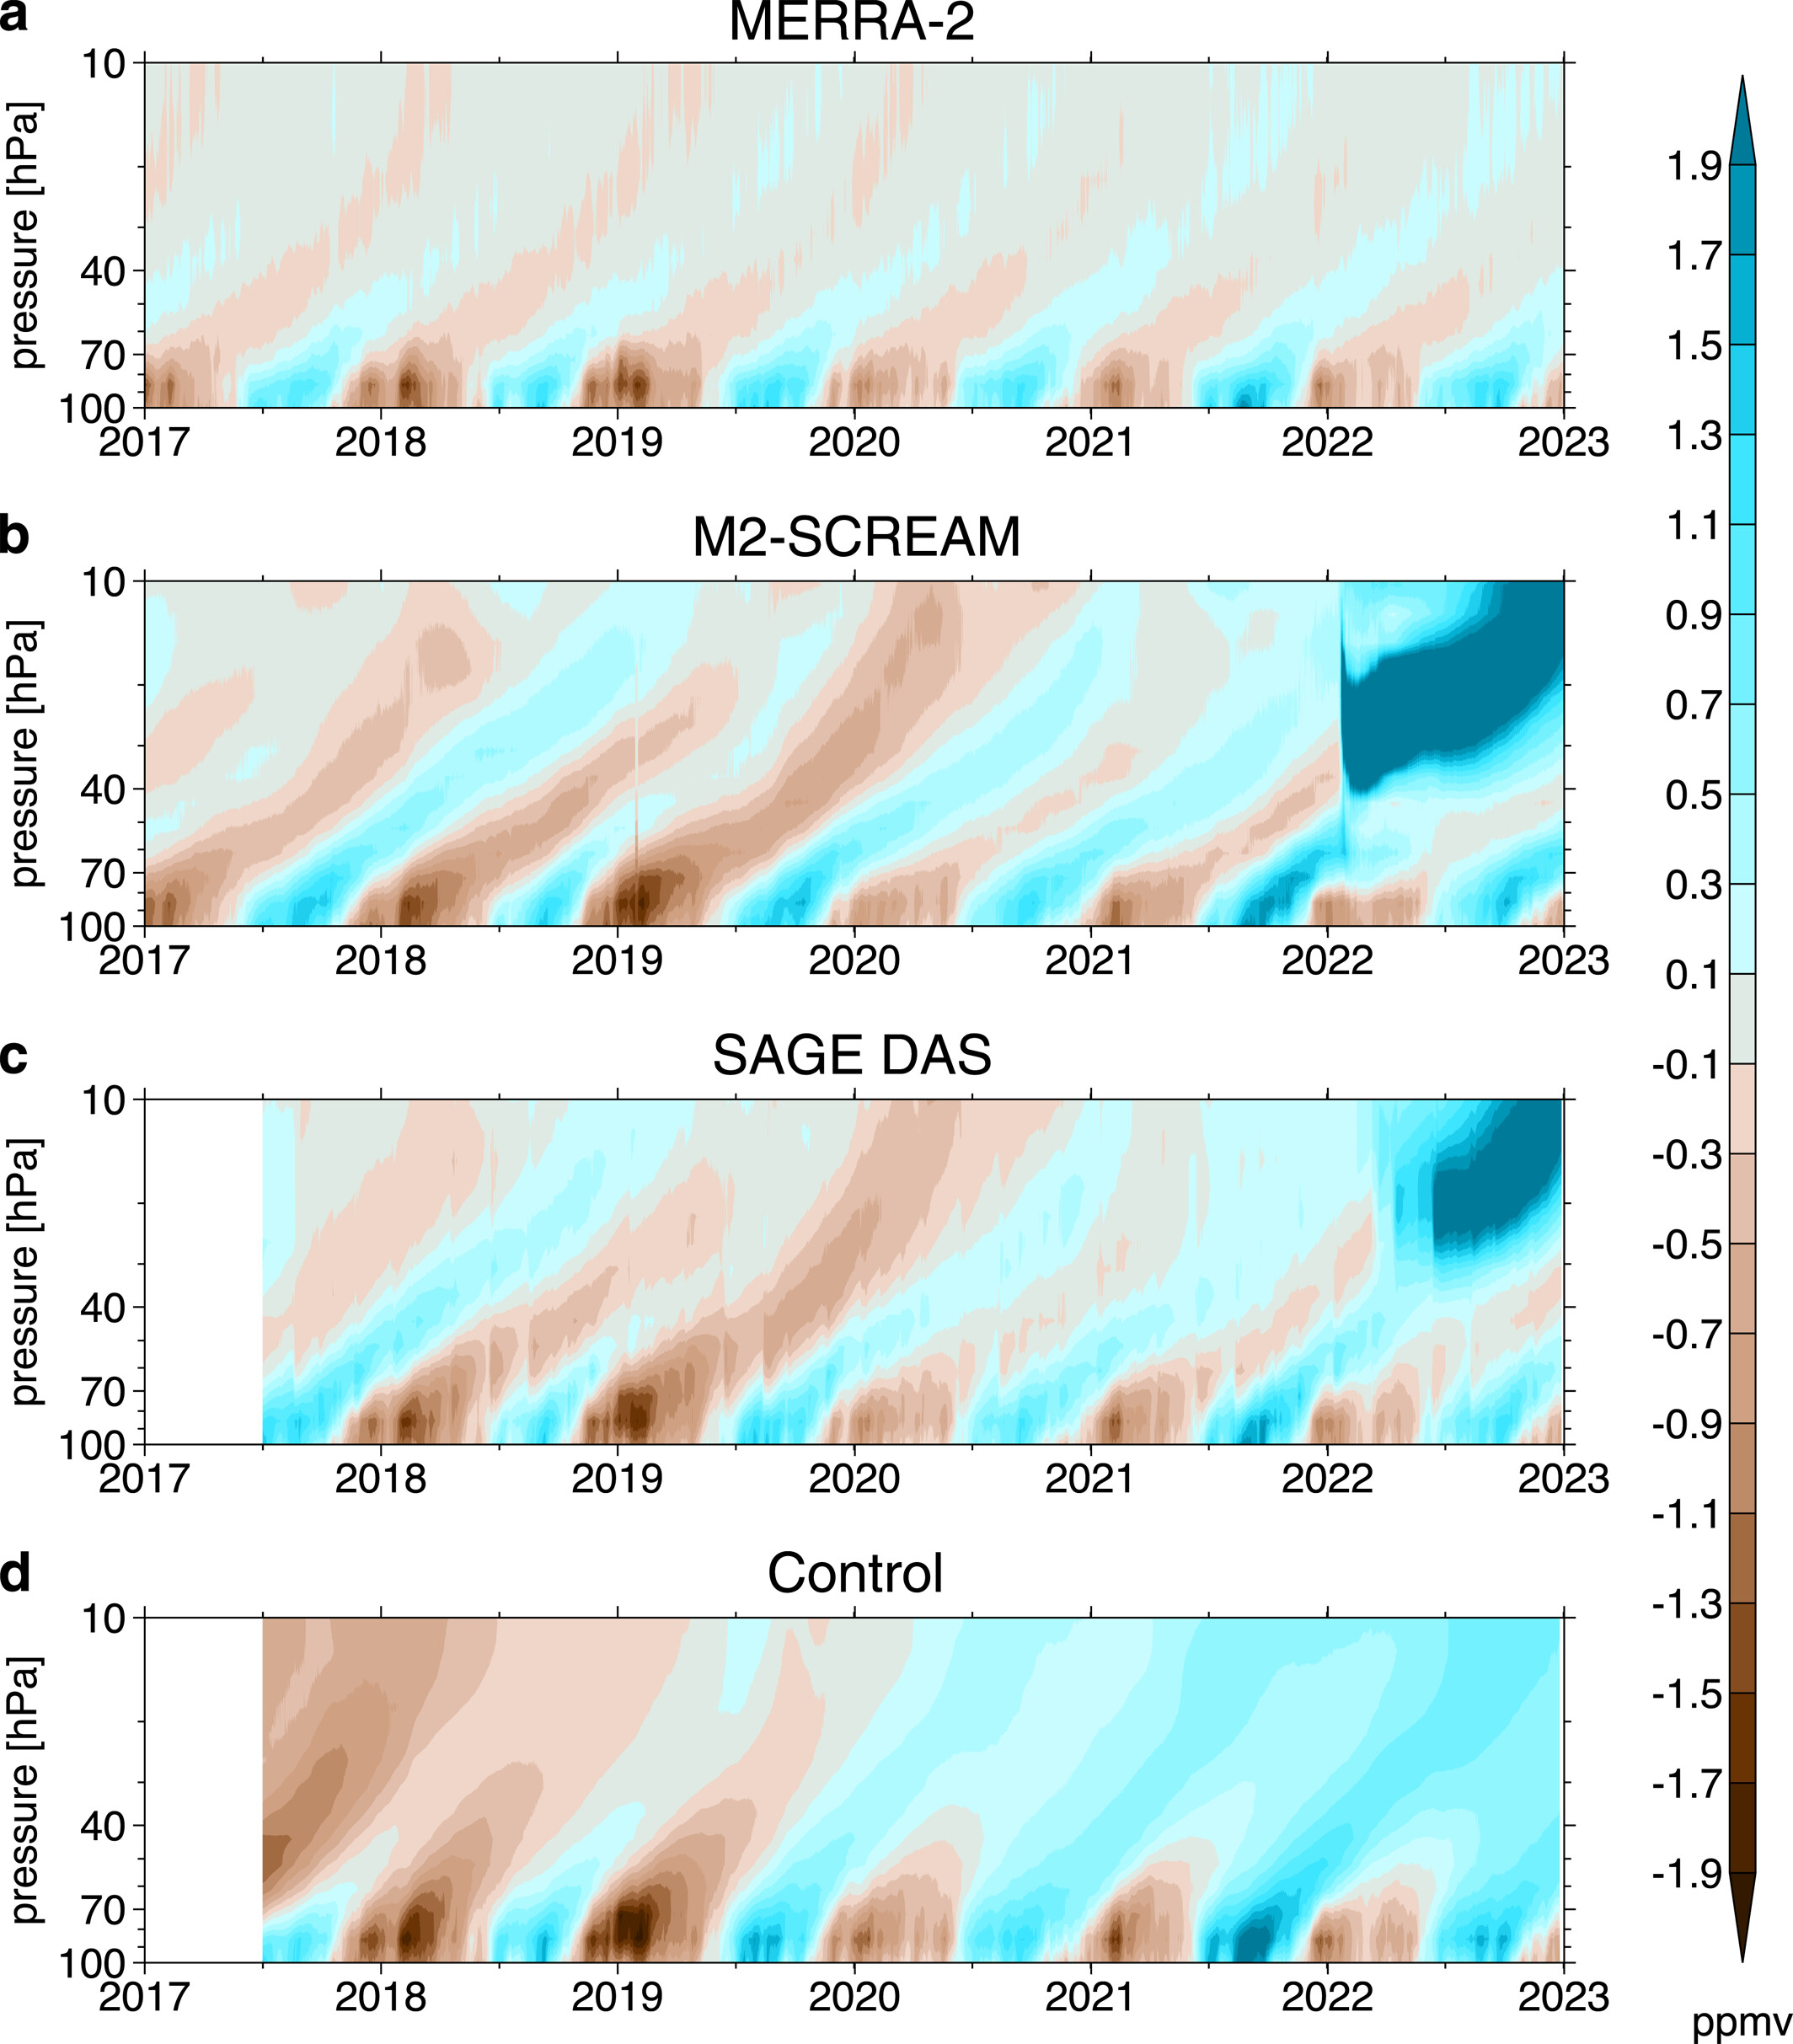
Knowland et al.: Assimilating SAGE III/ISS Profiles for a Continued Climate Record
Assimilation of SAGE III/ISS stratospheric water vapor (SWV) increases correlation to ACE-FTS by 17% versus when not assimilating SWV
Assimilated SAGE III/ISS SWV captures broad, subpolar features like the tropical tape recorder but struggles with capturing isolated events
SAGE III/ISS SWV profiles can continue the climate data record of Aura MLS, albeit with less coverage and fine-scale fidelity

Slide 14
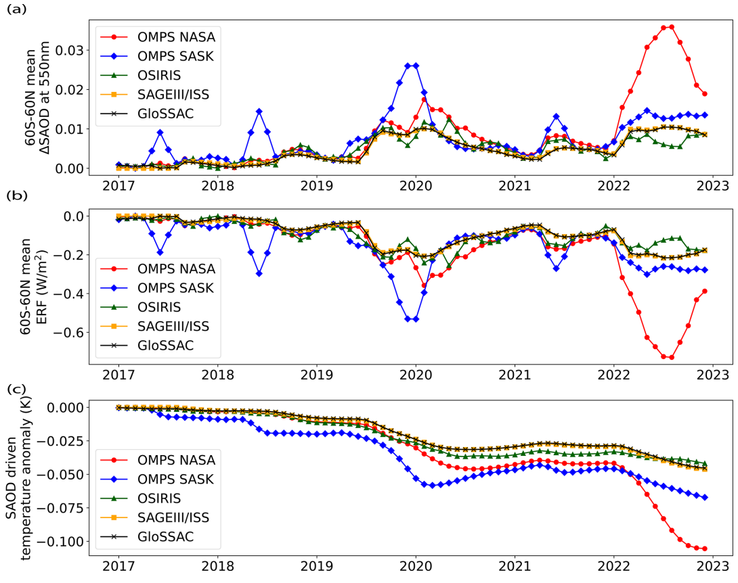
Kovilakam et al.: OMPS-LP aerosol extinction coefficients and their applicability in GloSSAC
Global Space-based Stratospheric Aerosol Climatology (GloSSAC) is essential for understanding climate impacts of stratospheric aerosols
  Major input for Coupled-Model Intercomparison Project (CMIP) 6 & 7
Future GloSSAC data sources are uncertain: CALIPSO decommissioned, OSIRIS near end of operations, SAGE III/ISS deorbited with ISS or prematurely shutdown
  Critical to evaluate suitability of incorporating other measurements, e.g. OMPS-LP
OMPS(NASA) exhibits a consistently high bias (>50 %) following large volcanic eruptions and pyrocumulonimbus plumes from intense wildfires, SAGE III/ISS between 40° S and 40° N.
Overestimation by OMPS(NASA) leads to an overestimation of the aerosol effective radiative forcing (ERF) and the associated model-simulated global surface temperature response by a factor of about 2.

Slide 15
SAGE III/ISS Validation Communications
NASA Langley Research Center
08/13/2025

Slide 16
Validation Efforts
The validation team has continued efforts to validate the SAGE III/ISS data product against in-situ & satellite measurements collected via a variety of sources
Ground-Based Measurements: Lidar & Sonde Data
  Actively participating NDACC, SHADOZ, and WOUDC stations
Satellite-Based Measurements
  Aura Microwave Limb Sounder (MLS)
  Atmospheric Chemistry Experiment Fourier Transform Spectrometer (ACE‐FTS)
  Ozone Mapping and Profiler Suite (OMPS) Limb Profiler (LP)

Slide 17
Interested in Participating in Validation Efforts?
Interested in participating in validation efforts but don’t have the time to dive into the website to plan for coincident events?
  The Validation Team can bring weekly updates directly to YOU
Each participating station or PI will receive weekly emails. Emails Include:
  Coincident measurements approximately 3 weeks out
    Ensure the accuracy of the SAGE III/ISS event predictions & allows stations to have advance planning for possible coincident measurements.
  Upcoming activities that may affect predictions & science data collection
The SAGE III/ISS Team is always looking to add to new participants

Slide 18
Contact Information
If you’re interested in receiving weekly emails and/or long-term predictions or have any questions comments, concern, feedback, etc., contact the SAGE III Validation Team at:
  larc-dl-sage-predictions@mail.nasa.gov
Please include the following for predictions:
  Station Name and Location (Lat. & Lon.)
  Email addresses of everyone to receive the predictions
  Duration of predictions you’d like to receive
    i.e: Short Term (3 Weeks) or Long Term (6 Months)

Slide 19
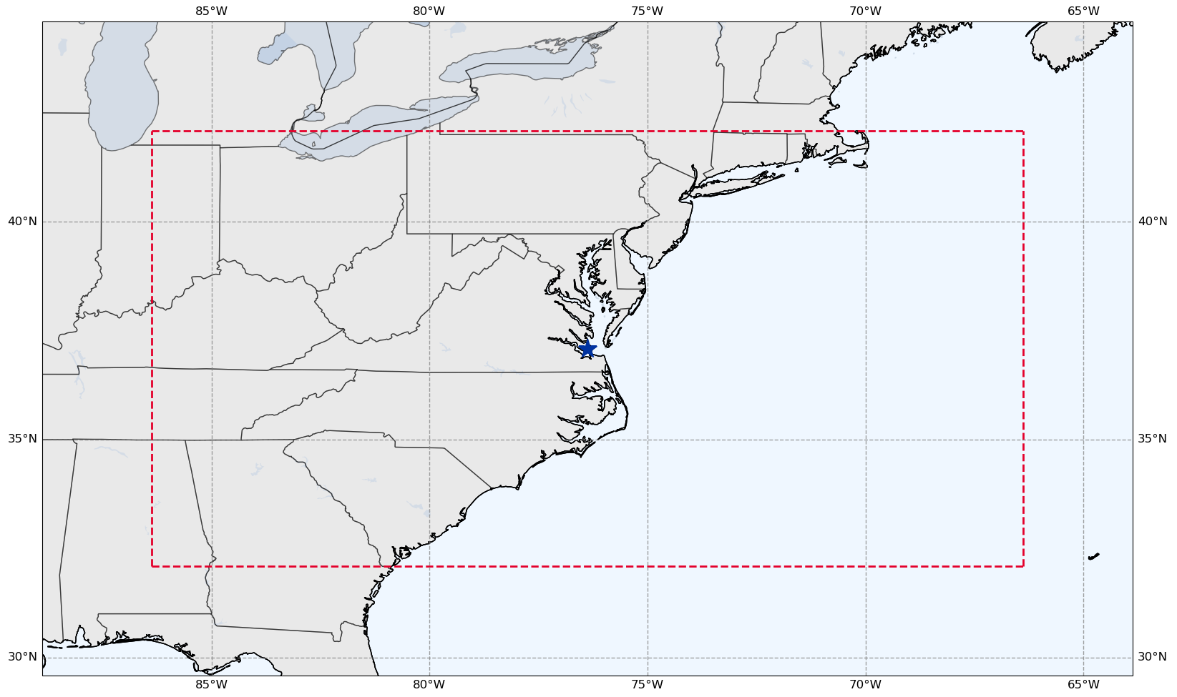

Validation Criteria
Species of Interest: Ozone, Water Vapor
  Plan to include Nitrogen Dioxide & Aerosol
Coincidence Criteria:
  ± 24 Hours
  ± 5 Deg Latitude
  ± 10 Deg Longitude
SAGE III/ISS Event Types:
  Solar Occultation
  Lunar Occultation
Langley Research Center
(37.09N, 76.38W)

Slide 20
SAGE III/ISS Predictions
SAGE III/ISS has a public facing website that allows users to input coordinates & timeframes to view any SAGE III/ISS events that match the selected criteria.
  https://science-data.larc.nasa.gov/sage-data/validation/
Prediction Website Curator: SAGE III/ISS Ground Systems
  Rick Farmer

Slide 21
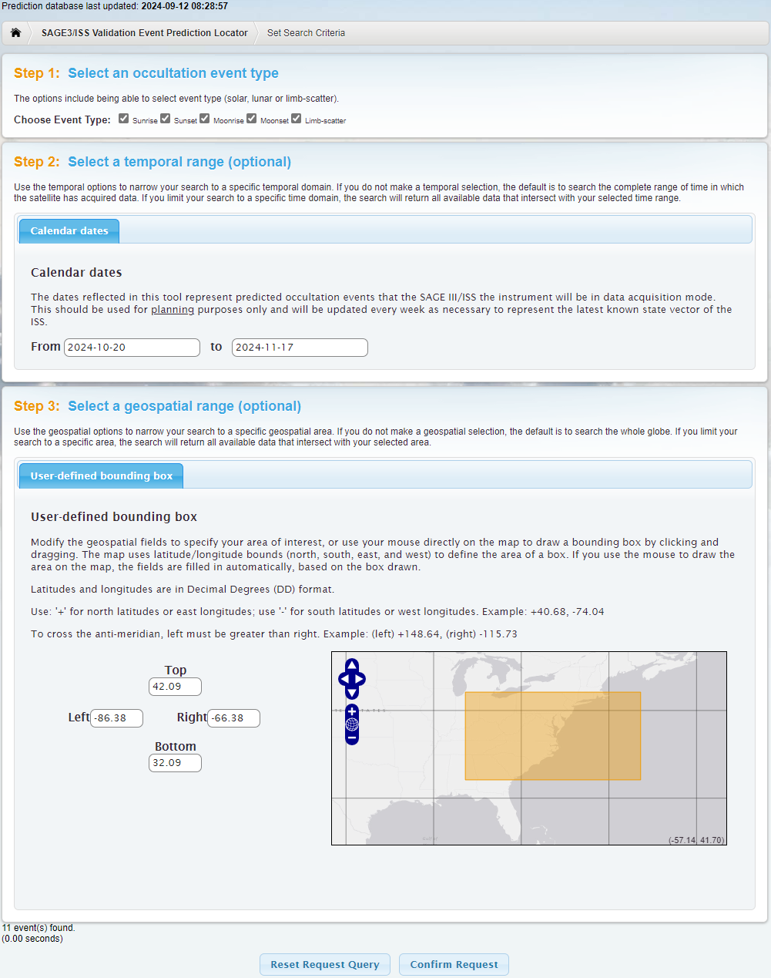
SAGE III/ISS Predictions
Choose Event Type(s)
  Sunrise, Sunset, Moonrise, Moonset, and/or Limb-Scatter
    Note: Limb-scatter events not shown in predictions
Select a Data Range
  2025-08-10 to 2025-09-07
Select an Area
  Top: 42.09 Bottom: 32.09
  Left: -86.36 Right: -66.68
Click “Confirm Request”

Slide 22
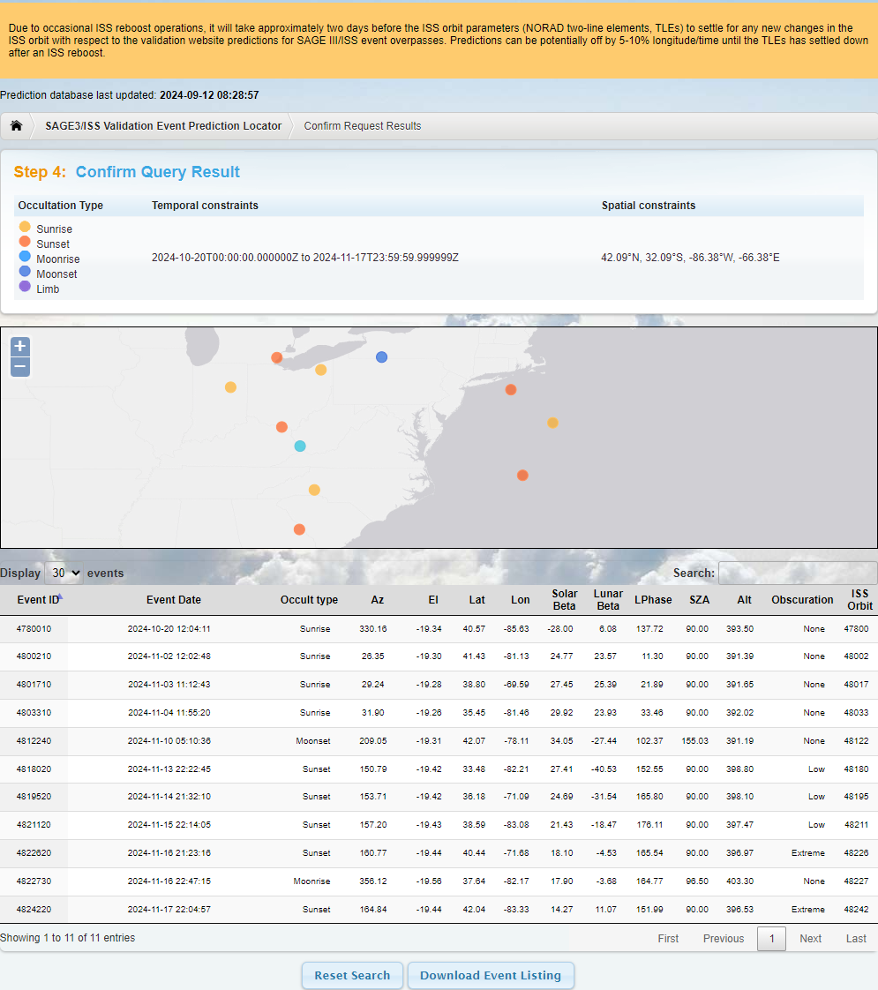
SAGE III/ISS Predictions
Reboost warning banner
Date prediction database was last updated
Occultation Type selected and user input Temporal & Spatial Constraints
Map of predicted events
Table of predicted events
  Includes additional information
Button to Download Events
  Downloads as a text file

Slide 23
Long Term Event Predictions
Long term predictions are available on the Validation website and via email to interested stations & PIs
Long term predictions are useful for long term planning but come with the caveat that the events are likely to shift in time & location
Predictions are approximately 6 months out but are not guaranteed
  Highly variable in both time & space due to activities in the coming months that can affect predictions

Slide 24
Activities that Affect Predictions
ISS Re/Deboosts
  Needed periodically for altitude maintenance
  Predictions may be slightly skewed in time & location until ISS TLEs have settled
    Typically takes 2-4 days for TLEs to settle out following re/deboosts
  Detailed in weekly emails and noted on the prediction website via warning banner
Blockages
  Visiting Vehicles, Modules, or Solar Panels can obstruct the view of SAGE III/ISS
  Blockage levels are: None, Low, Medium, High, & Extreme
    High & Extreme levels of blockages may still acquire but are not guaranteed
Station Activities & Maneuvers
  May sometimes miss events for scheduled activities & large attitude changes
  Activities & maneuvers that affect events are detailed in weekly emails

Slide 25
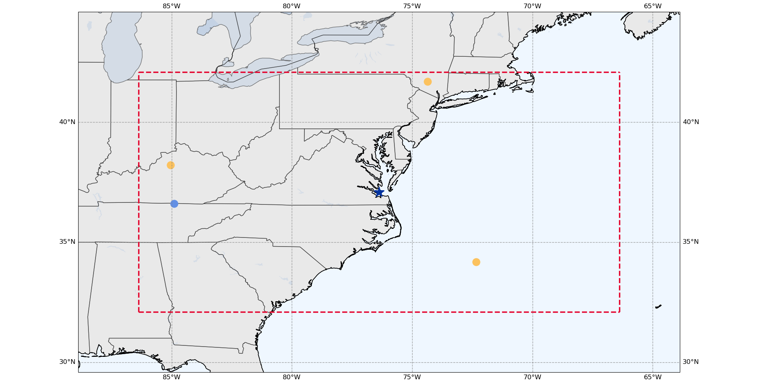
Predicted Events Before Reboosts
Aug. 10 – Sep. 07, 2025
Moonset
01 Sep 2025 04:28:21
(36.61, -84.89)
Prediction File Generated: 2025-06-11
● Sunrise ● Sunset ● Moonrise ● Moonset

Slide 26
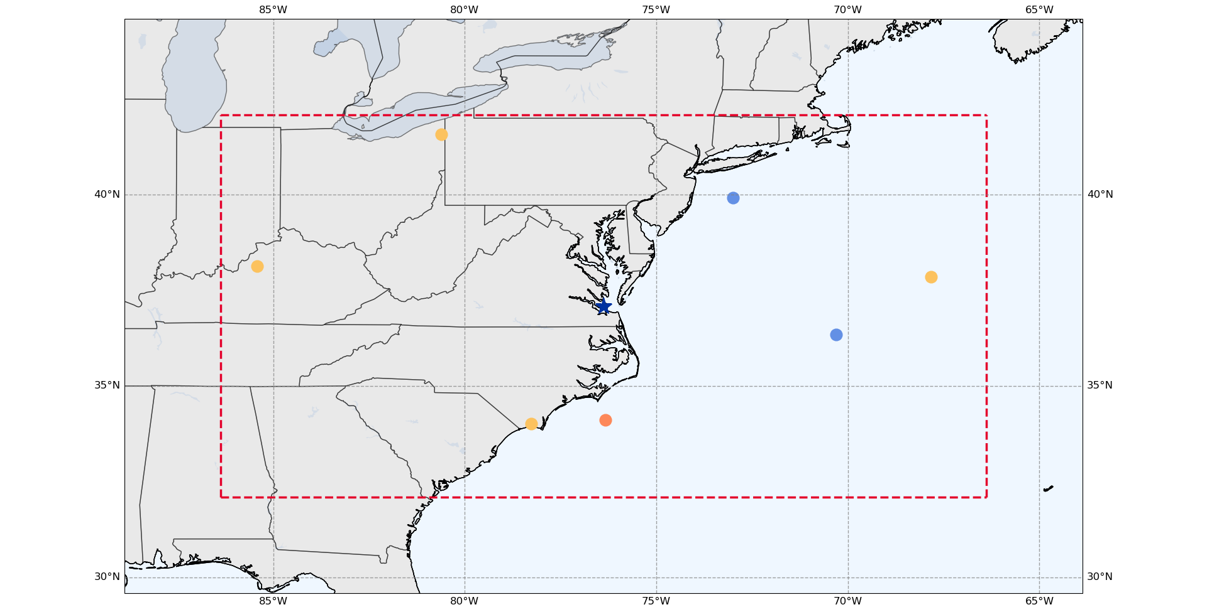
Predicted Events After Reboosts
Aug. 10 – Sep. 07, 2025
Moonset
02 Sep 2025 04:16:56
(39.92, -73.00)
Moonset
01 Sep 2025 03:29:06
(36.35, -70.31)
Prediction File Generated: 2025-07-23
● Sunrise ● Sunset ● Moonrise ● Moonset

Slide 27
Backup Slides

Slide 28
Downloaded Events Text File
# List generated: Thu Sep 12 05:26:20 2024
# Mission Name: SAGE3ISS
# Occultation type(s): [Sunrise][Sunset][Moonrise][Moonset][Limb]
# Temporal constraints: 2024-10-20T00:00:00.000000Z,2024-11-17T23:59:59.999999Z
# Spatial constraints: 42.09&deg;N, 32.09&deg;S,-66.38&deg;E,-86.38&deg;W
Event ID | Cycle ID | Event date | Event type | Azimuth | Elevation | Latitude | Longitude | Solar Beta Angle | Lunar Beta Angle | Lunar Phase | Solar Zenith Angle | Altitude | ISS Orbit | Obscuration | Notes
4780010 |  | 2024-10-20 12:04:11 | Sunrise | 330.1581 | -19.34374 | 40.56586 | -85.63167 | -28.00407 | 6.07685 | 137.725 | 89.99754 | 393.4992 | 47800 | None | N/A
4800210 |  | 2024-11-02 12:02:48 | Sunrise | 26.35157 | -19.30104 | 41.43395 | -81.13433 | 24.76801 | 23.56879 | 11.298 | 89.99753 | 391.3877 | 48002 | None | N/A
4801710 |  | 2024-11-03 11:12:43 | Sunrise | 29.23517 | -19.28232 | 38.79577 | -69.58694 | 27.45259 | 25.38956 | 21.887 | 89.99753 | 391.6451 | 48017 | None | N/A
4803310 |  | 2024-11-04 11:55:20 | Sunrise | 31.89774 | -19.26053 | 35.45394 | -81.46194 | 29.92374 | 23.92535 | 33.456 | 89.99753 | 392.016 | 48033 | None | N/A
4812240 |  | 2024-11-10 05:10:36 | Moonset | 209.046 | -19.30755 | 42.06685 | -78.10965 | 34.05468 | -27.44401 | 102.368 | 155.02544 | 391.1856 | 48122 | None | N/A
4818020 |  | 2024-11-13 22:22:45 | Sunset | 150.7857 | -19.41657 | 33.48341 | -82.20781 | 27.4075 | -40.53225 | 152.551 | 89.99753 | 398.8035 | 48180 | Low | N/A
4819520 |  | 2024-11-14 21:32:10 | Sunset | 153.7122 | -19.42354 | 36.17918 | -71.0896 | 24.68764 | -31.53777 | 165.804 | 89.99753 | 398.1036 | 48195 | Low | N/A
4821120 |  | 2024-11-15 22:14:05 | Sunset | 157.2015 | -19.43021 | 38.58645 | -83.08376 | 21.43343 | -18.47171 | 176.11 | 89.99753 | 397.4712 | 48211 | Low | N/A
4822620 |  | 2024-11-16 21:23:16 | Sunset | 160.769 | -19.43544 | 40.44382 | -71.6752 | 18.09574 | -4.53122 | 165.54 | 89.99753 | 396.9739 | 48226 | Extreme | N/A
4822730 |  | 2024-11-16 22:47:15 | Moonrise | 356.1224 | -19.56033 | 37.63534 | -82.17452 | 17.90372 | -3.67578 | 164.774 | 96.49689 | 403.3034 | 48227 | None | N/A
4824220 |  | 2024-11-17 22:04:57 | Sunset | 164.8437 | -19.43981 | 42.04152 | -83.32846 | 14.27323 | 11.07221 | 151.991 | 89.99752 | 396.5321 | 48242 | Extreme | N/A

Slide 29
Weekly Email Content Breakdown
(Sent Jun. 25, 2025)
Attached is a list of predictions for future SAGE III/ISS events near your station. This list contains 10 possible overpass events over the next 3 months.
One new activity added to the list for this week.
Upcoming activities of note: In the first week of July, there’s a Progress 90P undocking on July 1st (GMT 182) and a set of maneuvers with large attitude associated with a Progress 92P docking on July 5th (GMT 186); Currently, only the first of the two maneuvers is scheduled on July 4th (GMT 185). Later in July, we have another 91P Reboost scheduled for the 16th (GMT 197); there are no large attitude changes associated with this reboost activity.
For the 90P Undocking on GMT 182, we’ll have science taking disabled from around 1445 to 2245. For the maneuvers associated with the 92P docking on GMT 186, I currently do not have concrete times we’ll have science taking disabled, but this should be from sometime around mid-afternoon on GMT 186 until ISS returns to a nominal attitude, potentially around July 13th (GMT 194) or 14th (GMT 195).
Following the 91P Reboost, prediction times and locations can potentially be off until orbital parameters have settled out.
I’ve gone ahead removed any potentially affected events from this week’s prediction file.
Please let us know if you have any questions.
Number of Coincident Events and Duration of Search Window
  Blue: Number of Events
  Yellow: Duration of Search Window
Upcoming Activities
Activity Effects on Predictions

Slide 30
Prediction File for LaRC
PREDICTED SAGE III/ISS OVERPASS EVENTS RUN 2025-07-23 12:20:34.284026+00:00; Bounding Box +/-(lat/lon) = 5.00/10.00
SAGE EVENT PREDICTION FILE USED: <path\to\prediction\file>\AllEvents_SUT_20250723_20260119.csv
STATION = LaRC has 13 possible overpass events.
The table below may have less based on ISS activities.
Search window covers 12.0 weeks into the future from 2025-07-23 12:20:34.284026+00:00 .
DATE TIME (UTC) | Latitude [deg] | Longitude [deg] | EVENT TYPE | Obscuration Likelihood | Notes
28 Jul 2025 00:41:30 | 41.79 | -80.86 | Sunset | None | N/A
28 Jul 2025 23:55:01 | 38.43 | -71.52 | Sunset | None | N/A
30 Jul 2025 00:41:31 | 34.54 | -85.45 | Sunset | None | N/A
17 Aug 2025 10:40:32 | 34.02 | -78.27 | Sunrise | None | N/A
18 Aug 2025 09:54:01 | 37.85 | -67.83 | Sunrise | None | N/A
19 Aug 2025 10:40:17 | 41.58 | -80.61 | Sunrise | None | N/A
01 Sep 2025 03:29:06 | 36.35 | -70.31 | Moonset | None | N/A
02 Sep 2025 04:16:56 | 39.92 | -73.00 | Moonset | None | N/A
07 Sep 2025 11:21:12 | 38.13 | -85.43 | Sunrise | None | N/A
07 Sep 2025 23:18:33 | 34.11 | -76.33 | Sunset | Extreme | N/A
27 Sep 2025 23:04:32 | 40.54 | -80.18 | Sunset | None | N/A
28 Sep 2025 22:17:20 | 37.17 | -68.55 | Sunset | None | N/A
29 Sep 2025 23:03:07 | 33.04 | -80.08 | Sunset | None | N/A
Date/Time File was Generated (UTC)
Prediction File Used
  Start Date & End Date of prediction file
Number of Possible Coincident Events
Duration of Search Window
  Number of Weeks & Search Window Start Date (UTC)
Table of Predicted Events
  Predicted Start Date & Time
  Lat. & Lon.
  Event Type
  Possibility of Obstructions (Blockages)

Slide 31
Predictions Before and After Reboosts for LaRC
Aug. 10 – Sep. 07, 2025
Before Reboosts
Prediction File Generated Jun. 11, 2025
After Reboosts
Prediction File Generated Jul. 23, 2025
Datetime (UTC) | Lat. | Lon. | Event Type | Obscuration Likelihood
17 Aug 2025 10:16:40 | 34.17 | -72.35 | Sunrise | None
18 Aug 2025 11:02:21 | 38.22 | -85.04 | Sunrise | None
19 Aug 2025 10:15:05 | 41.7 | -74.36 | Sunrise | None
01 Sep 2025 04:28:21 | 36.61 | -84.89 | Moonset | None
Datetime | Lat. | Lon. | Event Type | Obscuration Likelihood
17 Aug 2025 10:40:32 | 34.02 | -78.27 | Sunrise | None
18 Aug 2025 09:54:01 | 37.85 | -67.83 | Sunrise | None
19 Aug 2025 10:40:17 | 41.58 | -80.61 | Sunrise | None
01 Sep 2025 03:29:06 | 36.35 | -70.31 | Moonset | None
02 Sep 2025 04:16:56 | 39.92 | -73 | Moonset | None
In the time since the earlier prediction file was generated, two reboot activities have occurred.

Slide 32
Reboost Schedule
Jan. 2025 – Mid Aug. 2025
2025/01/11 – 89P Reboost
2025/02/01 – 89P Reboost
2025/02/20 – 89P Reboost
2025/03/17 – 91P Reboost
2025/04/02 – 91P Reboost
2025/04/23 – 91P Reboost
2025/04/30 – PDAM Aft Progress*
2025/06/19 – 91P Reboost
2025/07/16 – 91P Reboost
2025/08/14 – 91P Reboost
Note: Depending on the magnitude of a Potential Debris Avoidance Maneuver, or PDAM, it can affect predictions in a similar manner as a reboost activity.

Slide 33
Future of SAGE III/ISS – Very Near Term
Collecting/processing/distributing/supporting interpretation of SAGE III/ISS science data products
Addressing known deficiencies in existing data products
Evaluating existing products
Develop new research product
  O₂ A-band T/p profiles

Slide 34
SAGE III on ISS
Mission Planning under ESD guidance
Marilee Roell, Science Manager
Dave Flittner, Project Scientist
Jamie Nehrir, Mission Ops Manager
Robert Damadeo, Algorithm Lead
NASA Langley Research Center
August 13, 2025

Slide 35
Update
Communication from Office of International and Interagency Relations (OIIR) and Karen St. Germain to ESA on June 2
The Fiscal Year (FY) 2026 U.S. President’s Budget Request (PBR) (technical supplement) was released on May 30. The budget decreases overall funding for NASA Earth Science, and specifically, the PBR technical supplement does not request funding for SAGE III and calls for its closeout in FY26. The SAGE III mission has provided a plan for closeout.
Although the FY26 appropriations is not yet known, NASA, in parallel, is looking for ways to extend the mission life with little or no funding.
In the past, NASA has been successful in developing approaches to partnerships that leverage public and private investments to achieve NASA mission goals.
One path NASA is pursuing is to seek interest from one or more entities to carry out operations of the instrument or to sponsor the operation of the instrument.
NASA is soliciting initial interest in partnerships for SAGE III and two other International Space Station (ISS) instruments using an ISS NASA Research Announcement (NRA) Step 1, a non-binding information-gathering tool: https://sam.gov/workspace/contract/opp/b6885c0350dd4d799c36f6429fc18805/view
If funding allows and the instrument continues to operate the way it is currently, SAGE III could operate until the end of ISS operations in approximately 2030.

Slide 36
FY2026 President’s Budget Request Guidance per FY2027 Program Resources Guidance
This FY2027 PRG submission responds to the following guidance:
SAGE III (857865)
  The FY2026 President’s Budget Request Guidance Letter was received Friday June 20 requesting a plan (budget, schedule, and activities necessary to meet NASA safety requirements) for closeout of the SAGE III mission over a 90 day period to begin no earlier than Nov 17, 2025. SAGE III mission managers are compiling the plan for delivery to the Executive Program Manager by July 18, 2025.
  Policy plans and directives (NASA Policy Directive (NPD) 8010.3B (Notification of Intent to Decommission or Terminate Operating Space Systems and Terminate Missions) and NASA Earth Science Data Preservation Content Specification 423-SPEC-001 will be used for closeout guidance.
  Please identify any risks and impacts associated with the rapid closeout timeline including workforce, contractual, technical, or data requirements with mitigation measures and associated costs. This plan will help ESD formulate a strategy to most effectively utilize the limited funds available to safely and responsibly close out the missions.
  Each budget submission should include a breakout between Mission Operations (MO) & Data Analysis (DA).

Slide 37
Activities for closeout (1/2)
Accelerated Phase-F plan
Payload orderly shutdown
  Final Instrument and Optical Characterization operations (if not completed prior to KDP-F)
    Boresight; Mirror Cal; Extended Spectral Cal; CTE; Visual survey (ISS action); TGAs on CMPs
  Final report on Payload characterization completed and archived (ASDC and/or Sharepoint)
  Final science data collection approximately 3 weeks before mission closeout schedule (Disable SEM)
  Hexapod commanded to the zero position (No ability to lock mechanism)
  Scanhead commanded to stow, and window commanded close and locked (scanhead can not be locked)
  Power off Payload. (ISS supplies Survival Heater power) (~t-21days)
Ground Support Hardware and software decommissioning
  After payload power off, generate final telemetry trending package for closeout (~t-21days)
  Generate a copy of ALL SAGE Databases for archival (Raw and Derived databases)
    Make an image of SPOC Utils operating system
    Copy InControl from CC7 and make an image of CC7 operating system
  Project documentation archival activities (SharePoint, GitHub, FSSB for flight software)

Slide 38
Activities for closeout (2/2)
Accelerated Phase-F plan
Science Data finalization and archival
  Algorithm development complete/frozen after KDP-F (~t-3 months)
  Review/build/test final algorithm production code
  Reprocess all SAGE III science data with final algorithm build (~t-2 months)
  Collect and receive the last collected science data events (~t-3weeks)
  Receive MERRA2 products for processing (~t-1 week)
  Complete transfer of final science data product to the ASDC along with the Data Product User Guide and Processing Manual
Documentation and contract/agreement finalized/closeout
  Decommissioning Review (DR) upon receipt of the mission termination letter
  KDP-F Review (ESD lead) will be held prior to the 90-day closeout process start
  Disposal Readiness Review (DRR) (LaRC lead) will be held within ~60 days of mission closeout
  Finalize Algorithms documentation (Product Manual and peer-reviewed pub-TBD)
  Complete Post-Flight Reports (NCRs) and GitHub open items
  Activities (ICD updates) associated with the removal or disposal of the instrument is covered by the ISS Program (disposal-in-place)
  Flight Operations Handbook updates and closeout
  Closeout with ESA/TASI on Hexapod agreement (return of hardware)
  Complete Final Mission Report (document Lessons Learned and success metrics)

Slide 39
Schedule Milestones for Closeout
DR – Decommissioning Review
KDP – Key Decision Point (Phase F start)
DRR – Disposal Readiness Review
ICD – Interface Control Document
ISS – International Space Station
SEM – Science Event Manager
GSE – Ground Support Equipment
Closeout (3 months) using FY25 funds
KDP-F
Final ICD mods
Final
Mission
Report
90 days
Power OFF
DR
DRR
Turn over to ISS
Disposal
Algorithm Frozen
T-80days
Reprocessing data
T-67days
Last Science Collected
T-21days
Final Product
Delivery T-1day
90 days
Power OFF
GSE hardware handover
Disable SEM
Manual Downlink
Final Telemetry
Trending Package
Generation
Assumptions:
1) ISS will have the action of disposal of the payload.
2) Any updates or mods needed in the ICD for disposal of the payload
will have signatures prior to the DRR.
3) Full staffing to allow documents and activities closeout prior to and during the
90-day closeout period.
4) Final Mission Report and lab hardware delivery/disposition is outside the 90-day timeframe (TBD).
Database closeout
Copy of databases
& Image of
Operating Systems
complete

Slide 40
Summary
If SAGE is turned off prematurely science casualties are (backup slides):
  The US will NOT capably fulfill mandate to Montreal Protocol as the OMPS instrument CANNOT be solely relied upon to assess stratospheric ozone trends
  Calibrated 40+ year, accurate record of aerosol extinction will END
  NASA will have NO instruments measuring stratospheric water vapor
CMP subsystem data recognized crucial for ISS external environment knowledge
During the 90-day closeout period, assume full complement of personnel to allow for documents completion and lab closeout activities
The notional earliest date for closeout kickoff (November 17th) has been extended to the right to a TBD date
The ISS has indicated that survival heater power can be supplied to SAGE III in the event of cancellation allowing for reactivation if the funding environment changes
Waiting on Congressional appropriations for FY26 funding amount (possible CR)
Until official direction to closeout the SAGE III mission, the SAGE III mission continues to operate as a fully funded mission collecting stratospheric data

Slide 41
Backup

Slide 42
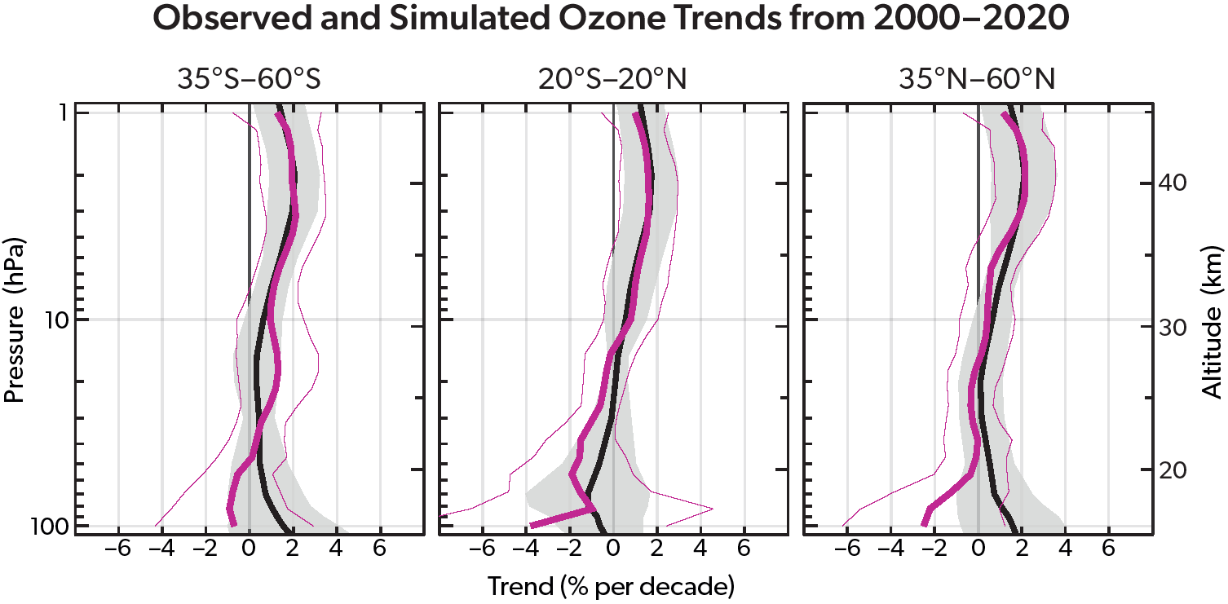
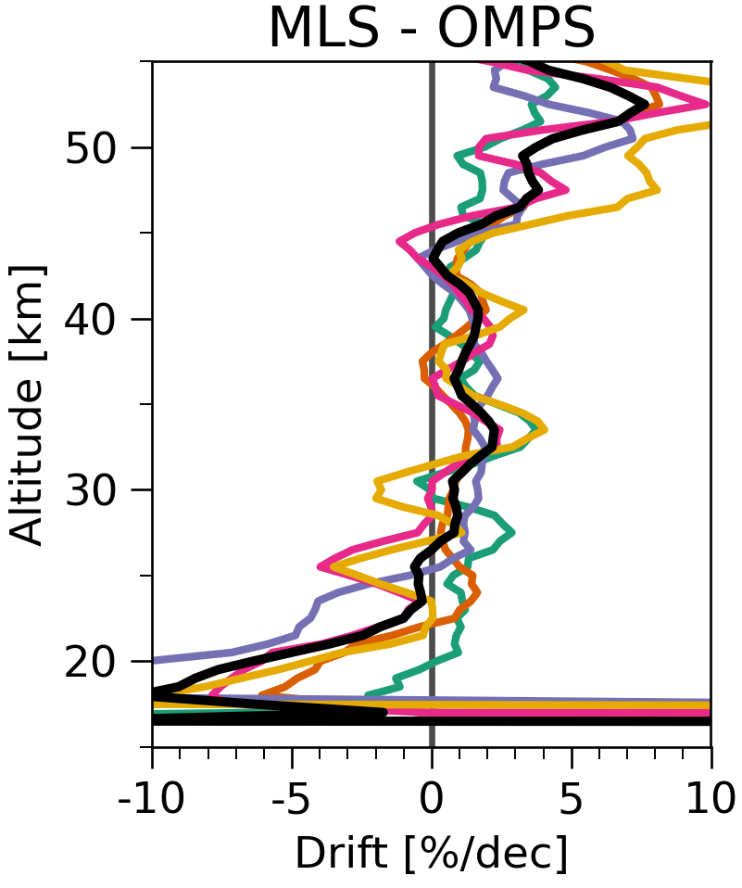
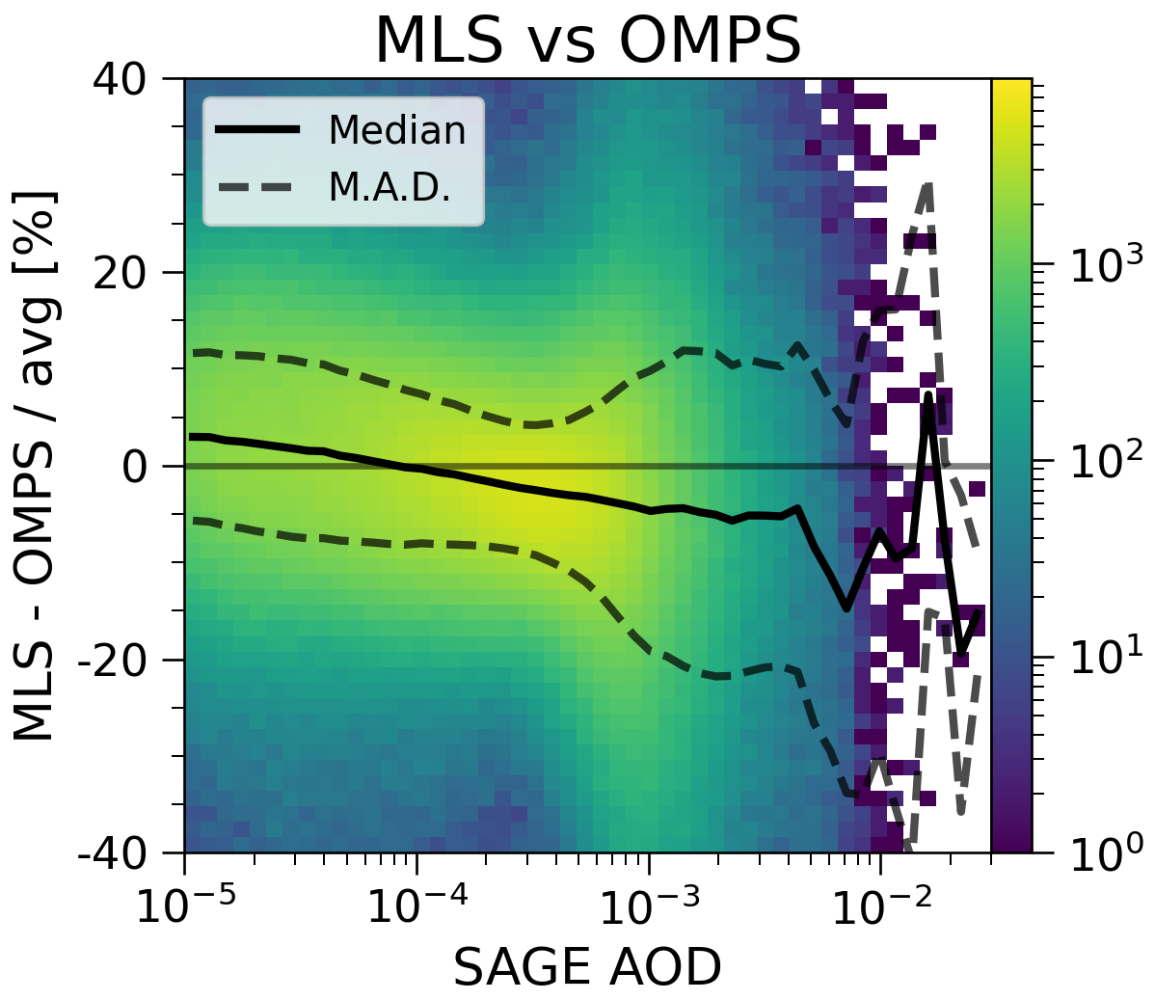
Ozone
The long-term evolution of the ozone layer is
far from a solved problem. Trends in the
lower stratosphere are still negative,
uncertainties are large, and models cannot
fully predict the changes. [1]
These assessments are possible only through
multi-instrument records that are carefully
intercalibrated against a reference standard,
such as a stable occultation instrument.
There will soon be a critical loss of available data
records. The Program of Record (OMPS) lacks the
stability to carry on the record on its own. [2]
At a minimum, a high-density sampler with low
precision and stability should be combined with
a calibration-quality measurement to ensure the
combined data record can be trusted.
Notes:
[1] World Meteorological Organization (WMO), Scientific Assessment of Ozone Depletion: 2022, GAW Report No. 278, 509 pp., WMO, Geneva, 2022.
Top figure shows the measured (pink) and modeled (black) long-term trends of ozone as a function of pressure/altitude in three wide latitude bands. While the upper stratosphere (which previously had the largest relative decreases) shows clear signs of recovery, the lower stratosphere (which is where the bulk of the ozone column resides) shows signs of a continual decrease. While this is expected in the tropics, resulting from accelerating circulation patterns as a resulting of increasing/decreasing tropospheric/stratospheric temperatures, it is unexpected at mid-latitudes, revealing how we still do not yet fully understand all of the mechanisms involved. Additionally, uncertainties in the lower stratosphere are large, conveying the continued need for precise and stable long-term measurements.
[2] McKee et al., “An Assessment of Satellite Ozone Instrument Data Quality and Stability”, in prep.
Bottom left figure shows the drift between OMPS and MLS over the SAGE III/ISS mission period. While drifts are within a few %/decade, there is a clear problem in the lower stratosphere. Bottom right figure shows the bias between OMPS and MLS as a function of aerosol (from SAGE III/ISS) indicating a clear sensitivity of OMPS ozone to aerosol loading. Note that a similar analysis with SAGE data shows no apparent drifts or aerosol sensitivity. Given the asymmetric aerosol loading over the analysis time frame, it is possible the OMPS drift versus MLS is caused by this sensitivity of retrieved ozone to aerosol loading.

Slide 43
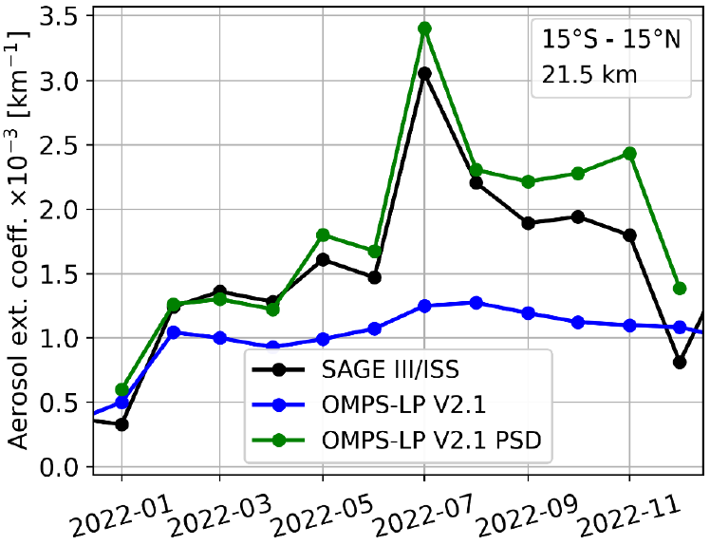
Aerosol
Aerosol extinction data are critical for
modeling and to assess the impacts of
volcanic eruptions and wildfires, but it
is a derived (not measured) parameter
for all but occultation instruments.
SAGE measurements anchor the record,
and showed a nearly 40% bias in recent
measurements from other sensors. [1]
GloSSAC climatology (>40 years) is heavily used,
but SAGE will soon be the only source of data*
OMPS data quality is currently insufficient for inclusion [2]
Problem stems from inadequate assumptions about
particle size properties
SAGE can provide this data to incorporate into OMPS
retrievals and significantly reduce biases [3]
SAGE data will be invaluable to calibrate future aerosol
instruments: ALTIUS (ESA), ALI (CSA), LUCE (ESA)
Notes:
[1] Kovilakam et al., “The Global Space-based Stratospheric Aerosol Climatology (version~2.0):~1979--2018”, Earth Sys. Sci. Data, 2020.
Top figure shows different versions of GloSSAC. Earlier versions (v1 [red & blue]) had no way to calibrate records after the end of SAGE II. Introduction of SAGE III/ISS data revealed biases in those records (v2 [green]).
* GloSSAC uses SAGE II (occultation [1984-2005]), OSIRIS (limb scatter [2001-present]), CALIPSO (lidar backscatter [2006-2023]), and SAGE III/ISS (occultation [2017-present]). OSIRIS is expected to cease operations soon due to age and degrading orbit.
[2] Kovilakam et al., “OMPS-LP aerosol extinction coefficients and their applicability in GloSSAC”, Atmos. Chem. Phys., 2025.
Limb scatter instruments such as OSIRIS and OMPS must make assumptions about the aerosol size parameters for their retrieval algorithms. The static assumption assumes background conditions, leading to larger biases for perturbed events with greater aerosol loading.
[3] Rozanov et al., “Accounting for the aerosol particle size distribution in the retrieval of stratospheric aerosol extinction coefficients from OMPS-LP measurements”, presented at the 13th Atmospheric Limb Workshop, 2025.
Bottom figure shows the impact of using derived particle size distribution (PSD) estimates on the OMPS retrieval. Black shows SAGE III/ISS measured extinction data, blue shows OMPS-LP derived extinction data, and green shows OMPS-LP derived extinction data modifying the PSD assumptions in the retrieval using values derived from SAGE measurements.

Slide 44
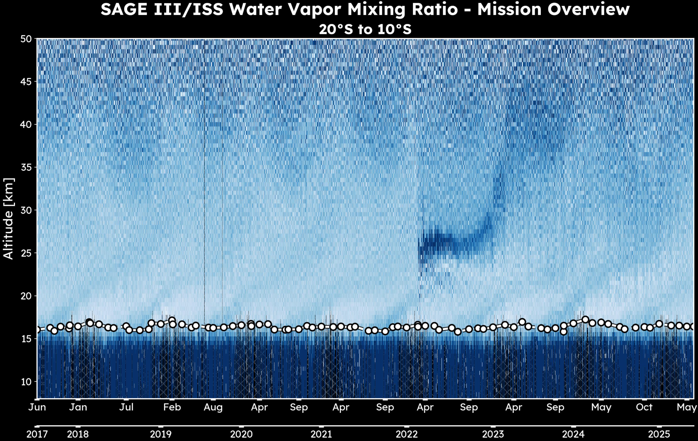
Water Vapor
Water vapor is critical to the energy balance of the
atmosphere and its variability is an indicator of
chemistry, stratospheric circulation, and
strat/trop exchange.
While long-term changes are still an area of study,
the Hunga eruption also showed the impact of
large perturbations on the stratosphere. [1]
There are very few instruments measuring
stratospheric water vapor and SAGE is the only
one under 20 years old to bridge the gap to
expected future instruments (e.g., SHO [CSA]).
Studies have shown the sparser sampling will still be
sufficient for incorporation into models after Aura MLS
is decommissioned. [2]
Notes:
[1] Millán et al., “The Evolution of the Hunga hydration in a moistening stratosphere”, Geophys. Res. Lett., 2024
[2] Knowland et al., “Stratospheric water vapor beyond NASA's Aura MLS: Assimilating SAGE III/ISS profiles for a continued climate record”, Geophys. Res. Lett., 2025.
Bottom figure shows stratospheric water vapor anomalies from reanalysis runs under different conditions: (a) Standard reanalysis, (b) Ingestion of MLS data, (c) Ingestion of SAGE III/ISS data.

Slide 45
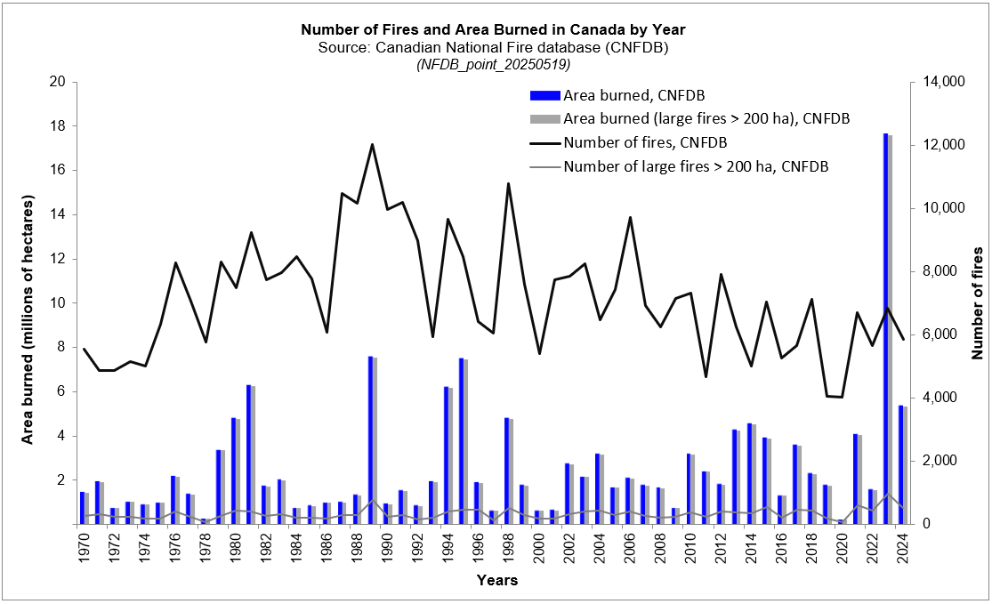
Canadian aera burned so far greater than 2024, but far less than 2023
Canadian Wildland Fire Information System | Canadian National Fire Database (CNFDB)
2025 Area Burned = 6.8M hectares (Aug. 8, 2025)
Notes:
Terms and Conditions - Natural Resources Canada

Slide 46
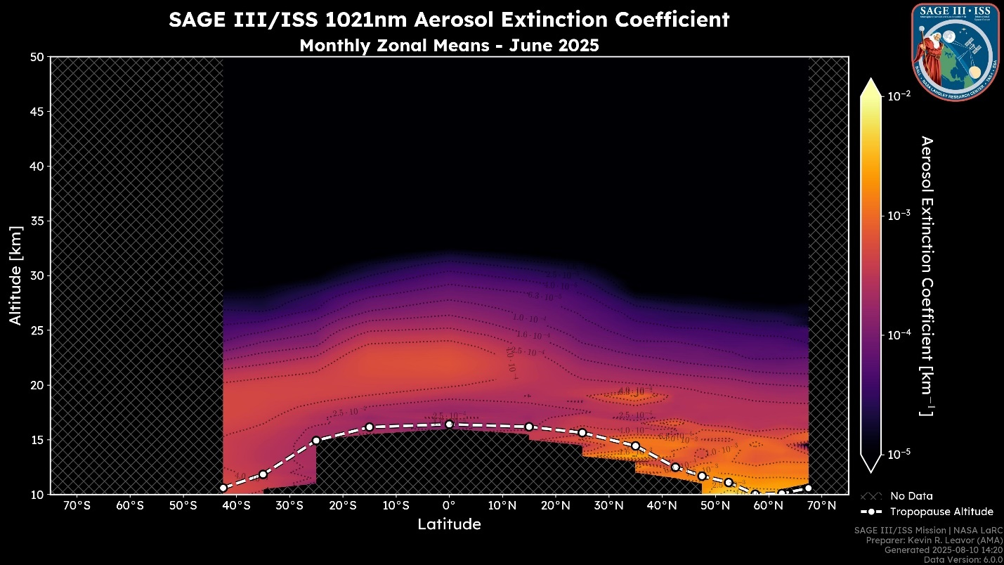

Slide 47
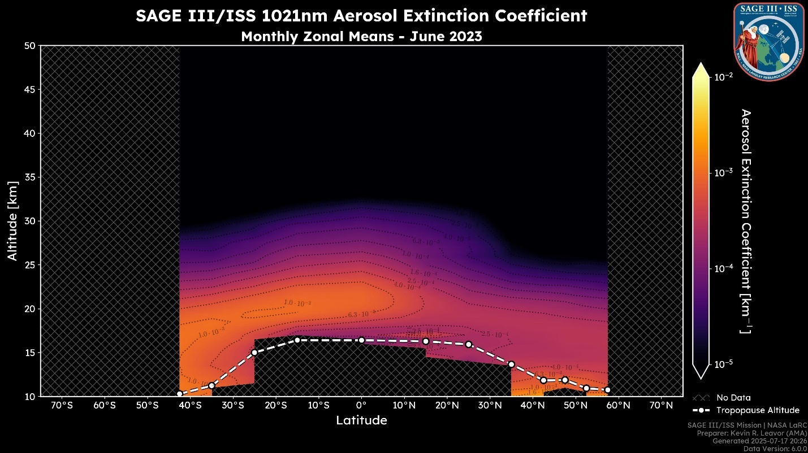
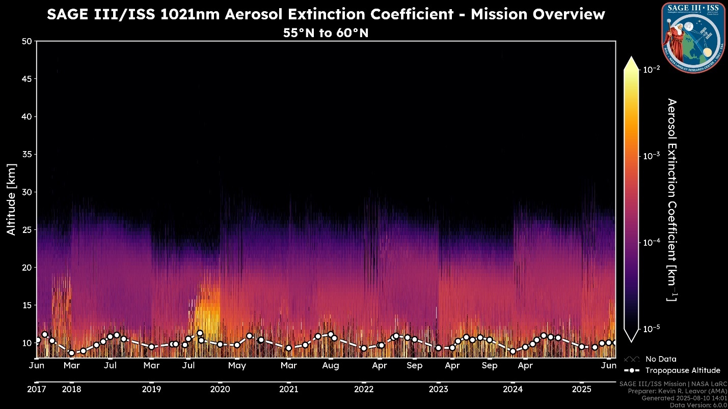
2025 vs 2023

Slide 48
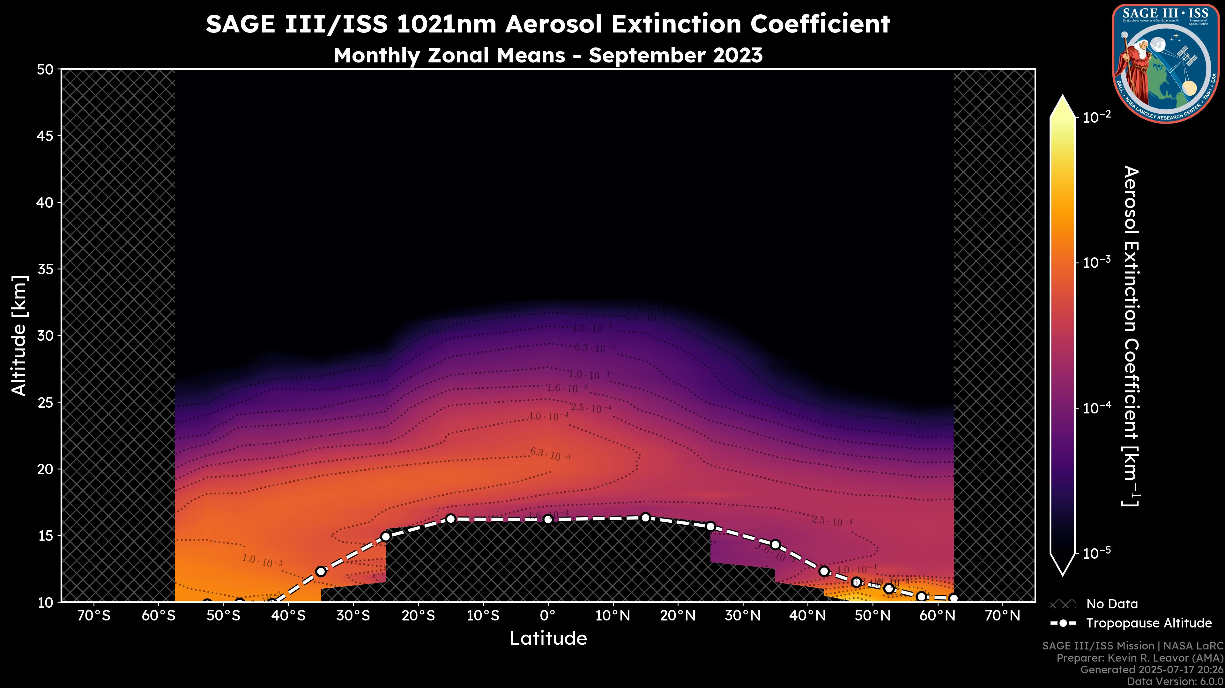

Slide 49
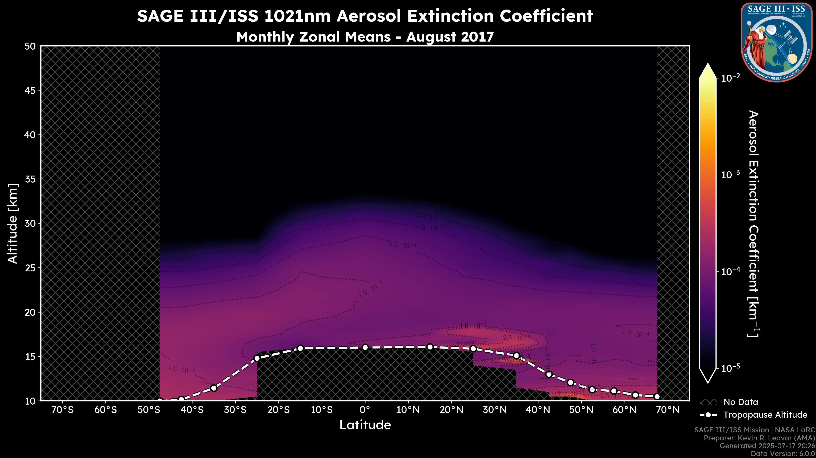

Slide 50
Summary
Mission operating fantastically
Disturbance Monitoring Package stopped operating in May 2025
  See “Data Products 2025 Edition” for impact on data products
Striving to birth new products
Complete picture of future is not crystal clear, but for now the mission will continue normally

