Slide 1
The Role of SAGE III/ISS and other Global Space-based Aerosol Measurements in Advancing and Sustaining GloSSAC
PI: Mahesh Kovilakam¹
Collaborators: Larry Thomason², Travis Knepp³, Adam Bourassa⁴, and Landon Reiger⁴
¹ADNET Systems Inc
² NASA, Retired
³ NASA Langley Research Center
⁴ University of Saskatchewan

Slide 2
Background
Global Space-based Stratospheric Aerosol Climatology (GloSSAC) was first created in 2018 (Thomason et al., 2018) to support the climate modeling community for the Coupled Model Intercomparison Project Phase 6 (CMIP6).
GloSSAC is a monthly zonal average aerosol climatology that currently provides stratospheric aerosol extinction and optical depth at 525 and 1020 nm at 5-degree latitude and 0.5 km altitude bin resolutions.
Stratospheric Aerosol Gas Experiment (SAGE) series of measurements are integral part of GloSSAC data
GloSSAC is publicly available via ASDC (https://asdc.larc.nasa.gov/project/GloSSAC). GloSSAC version 2.23 is the latest version, providing zonally averaged monthly data from 1979- 2024.
The Science Directorate at NASA's Langley Research Center: External Peer Review

Slide 3
Users of GloSSAC
GloSSAC is widely used in climate modeling and observational studies.
GloSSAC is now designated as the primary stratospheric aerosol dataset for satellite era in the upcoming CMIP7 project (https://zenodo.org/records/15556388), underscoring its scientific significance. GloSSAC will be utilized as the observational dataset for both driving climate model simulations and independent evaluation of interactive stratospheric aerosol model.
Publications and citations
Journal publications since 2018
GloSSAC version 1.0 published in Earth System Science Data (ESSD) in 2018
GloSSAC version 2.0 published in ESSD in 2020
GloSSAC version 2.2 published in Atmospheric Measurement Techniques (AMT) in 2023
Citations: over 300 citations combined
The Science Directorate at NASA's Langley Research Center: External Peer Review

Slide 4
Current Status of GloSSAC
The current utilization of SAGE III/ISS, OSIRIS, and CALIPSO for GloSSAC is affected by the conclusion of CALIPSO mission as of August 1, 2023, and the declining coverage of OSIRIS.
It is important to continue and maintain GloSSAC product as modeling community relies on this observational dataset.
Ozone Mapping and Profiler Suite Limb Profiler (OMPS-LP) is a potential candidate to replace OSIRIS or CALIPSO in the near future.
Two different products of OMPS are publicly available (OMPS(NASA) and OMPS(SASK))
A recent study has shown that OMPS(NASA) is overestimating extinction coefficient by a factor of two below the peak of the aerosol layer following Tonga Eruption in January 2022 (Bourassa et al., 2023).
Therefore, it is critical to evaluate OMPS products before considering its incorporation into GloSSAC.

Slide 5
Proposed Tasks
Evaluate OMPS(NASA)/OMPS(SASK) products and perform comparisons/validations against available space-based and potential in-situ measurements.
Explore the possibility of improving the OMPS(SASK) extinction retrieval by integrating SAGE III/ISS particle size distribution into OMPS(SASK) retrieval algorithm.
Evaluate the improved product using comparisons with SAGE III/ISS
Expand the GloSSAC record by incorporating additional optical parameters, including surface area density and effective radius.
Incorporate OMPS extinction coefficients into GloSSAC with additional optical parameters.
✓

Slide 6
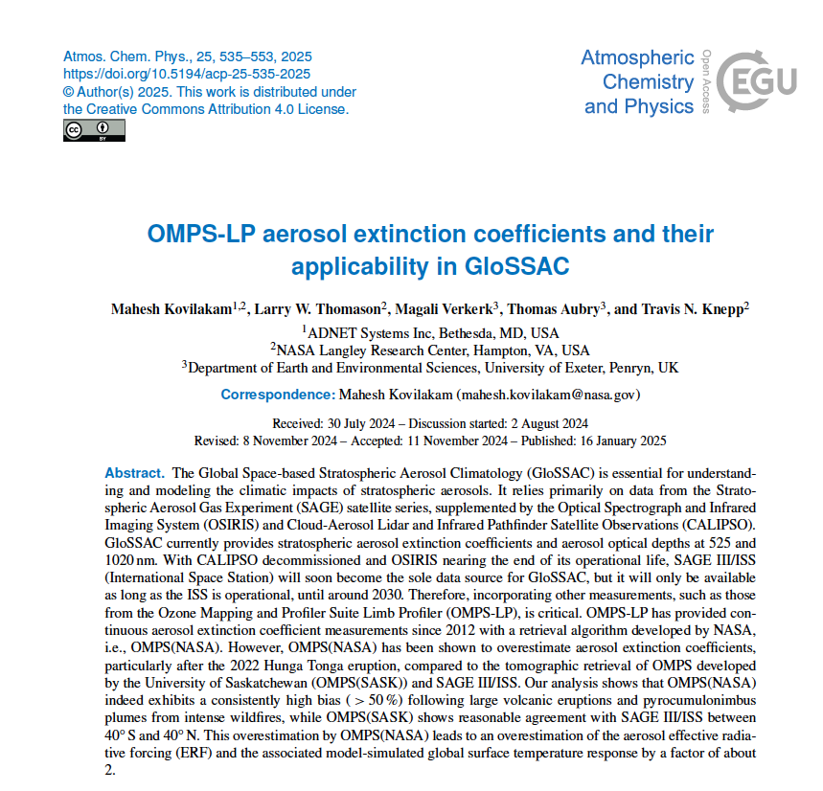

Slide 7
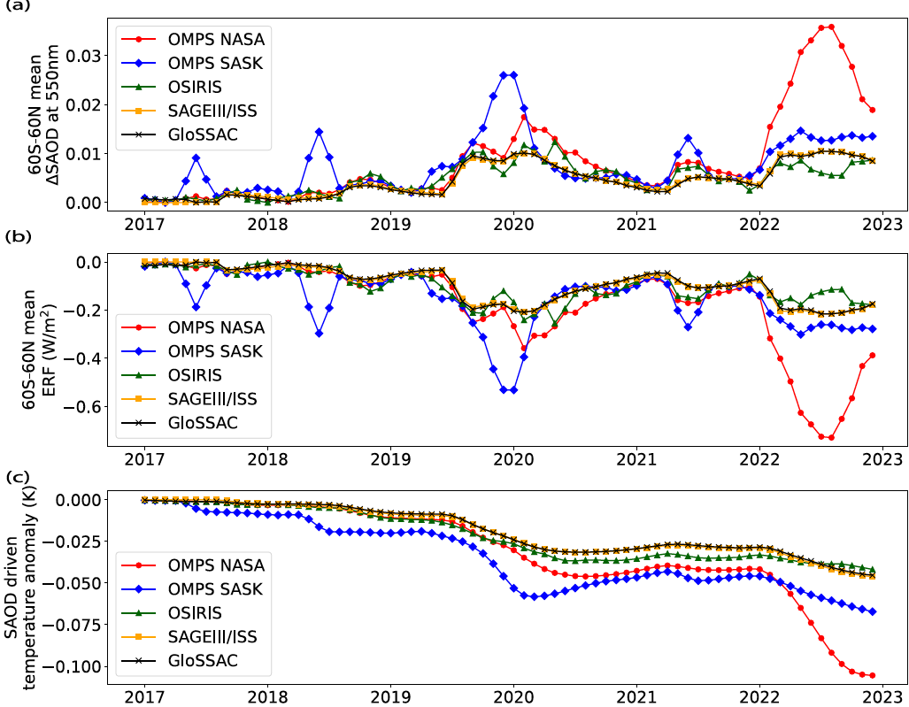
Findings
OMPS(NASA) product exhibits a high bias (exceeding 50%), particularly in the aftermath of perturbed events and in the GloSSAC context, the bias exceeds the allowable differences between the instruments(+/- 20%). This overestimation by OMPS(NASA) leads to an overestimation of the aerosol effective radiative forcing and the associated model-simulated global surface temperature response by about a factor of two.
Currently all OMPS extinction products have deficiencies and are showing significant differences relative to occultation measurements, following perturbed events. A revised version of OMPS (NASA) product is recently released.
Future tasks include exploring the possibility of improving the OMPS extinction retrieval by integrating SAGE III/ISS particle size distribution into OMPS retrieval algorithm.

Slide 8
Proposed Tasks
Evaluate OMPS(NASA)/OMPS(SASK) products and perform comparisons/validations against available space-based and potential in-situ measurements.
Explore the possibility of improving the OMPS(SASK) extinction retrieval by integrating SAGE III/ISS particle size distribution into OMPS(SASK) retrieval algorithm.
✓
This work is currently in progress in collaboration with University of Saskatchewan

Slide 9
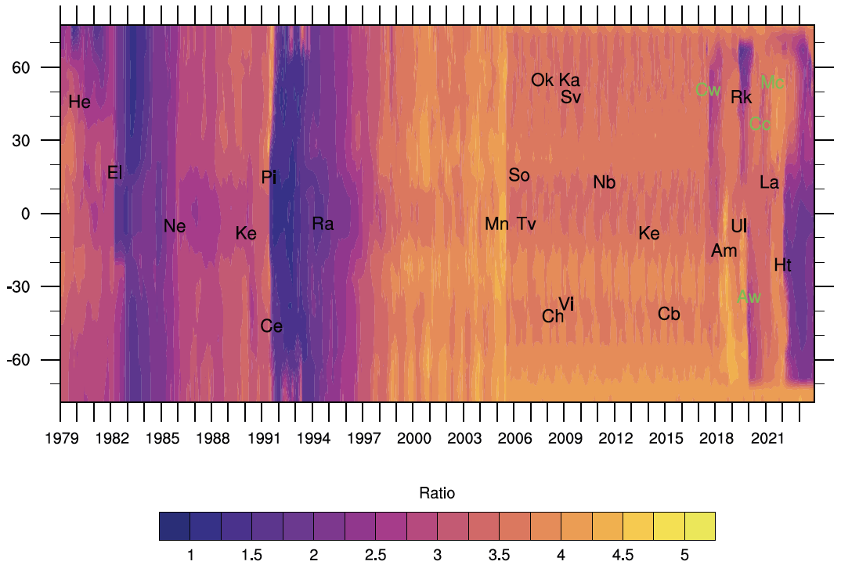
Single Wavelength Problem
Stratospheric Aerosol Optical Depth Ratio (525/1020 nm)
OSIRIS+CALIPSO period
Major volcanic eruptions (black) and wild fire events (green) with abbreviated two-letter code with their respective latitude and time of occurrence that are listed here. The event names shown are St. Helens (He), El Chichon (El), Nevado del Ruiz (Ne), Kelut (Ke), Pinatubo (Pi), Cerro Hudson (Ce), Rabaul (Ra), Manam (Mn), Soufrière Hills (So), Tavurvur (Tv), Chaiten (Ch), Victoria (Vi), Okmok (Ok), Kasatochi (Ka), Sarychev (Sv), Nabro (Nb), Kelut (Ke), Calbuco (Cb), Canadian wildfire (Cw), Ambae (Am), Raikoke (Rk), Ulawun (Ul), Australian wildfire (Aw), California Creek Fire (Cc), La Soufrière (La), McKay Creek fire (Mc) and Hunga Tonga (Ht).
Notes:
Latitude versus time dependence of stratospheric aerosol optical depth (SAOD) ratio. Major volcanic eruptions (black) and wild fire events (green) with abbreviated two-letter code with their respective latitude and time of occurrence that are listed here. The event names shown are St. Helens (He), El Chichon (El), Nevado del Ruiz (Ne), Kelut (Ke), Pinatubo (Pi), Cerro Hudson (Ce), Rabaul (Ra), Manam (Mn), Soufrière Hills (So), Tavurvur (Tv), Chaiten (Ch), Victoria (Vi), Okmok (Ok), Kasatochi (Ka), Sarychev (Sv), Nabro (Nb), Kelut (Ke), Calbuco (Cb), Canadian wildfire (Cw), Ambae (Am), Raikoke (Rk), Ulawun (Ul), Australian wildfire (Aw), California Creek Fire (Cc), La Soufrière (La), McKay Creek fire (Mc) and Hunga Tonga (Ht).

Slide 10
Predictability of changes in stratospheric Aerosol
This work builds on the study by Thomason et al. (2021), which describes the relationship between extinction coefficients (521 and 1022 nm) and extinction ratios following volcanic events. We identified seven perturbed events between June 2017 and December 2024.
For each event, a 10-degree latitude band centered on the event’s location is selected. To identify the peak perturbation, we used a 6 months window (3 months before and 6 months after the event). The perturbed month is chosen as the one where the 1020 nm extinction coefficient (k₁₀₂₀) reaches its peak.

Slide 11
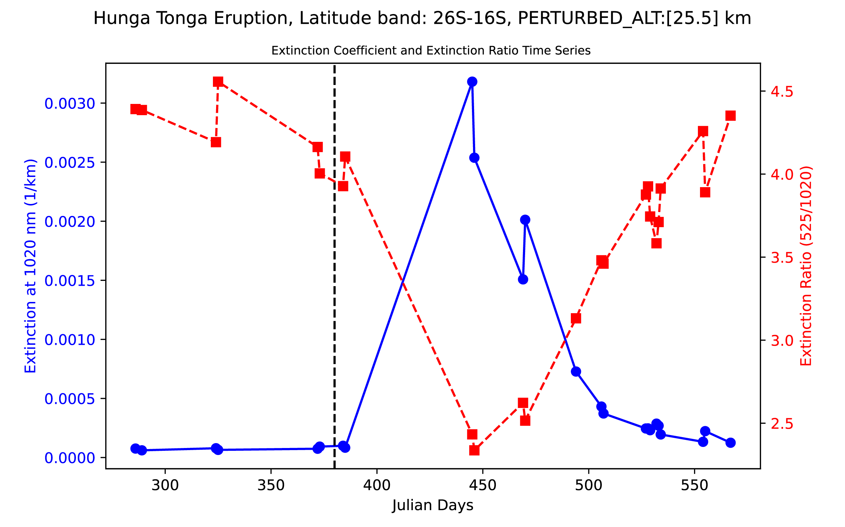
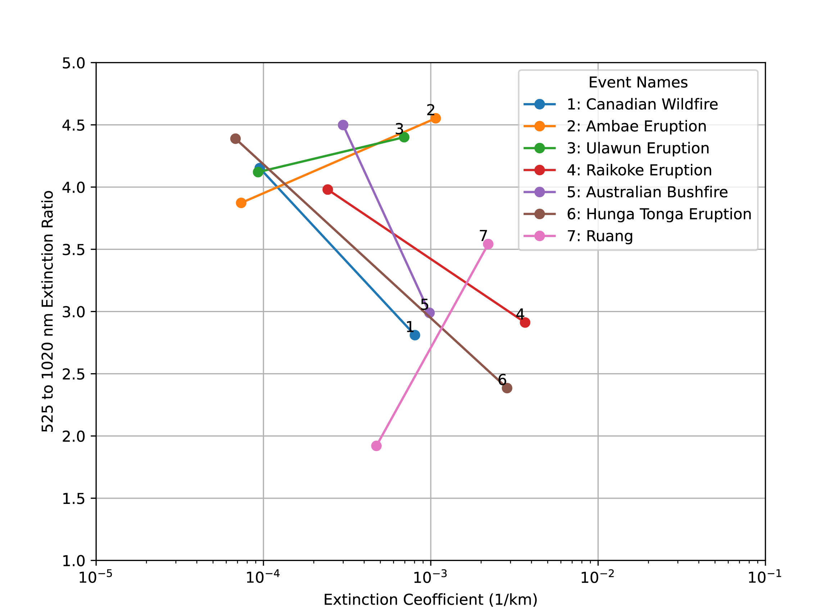
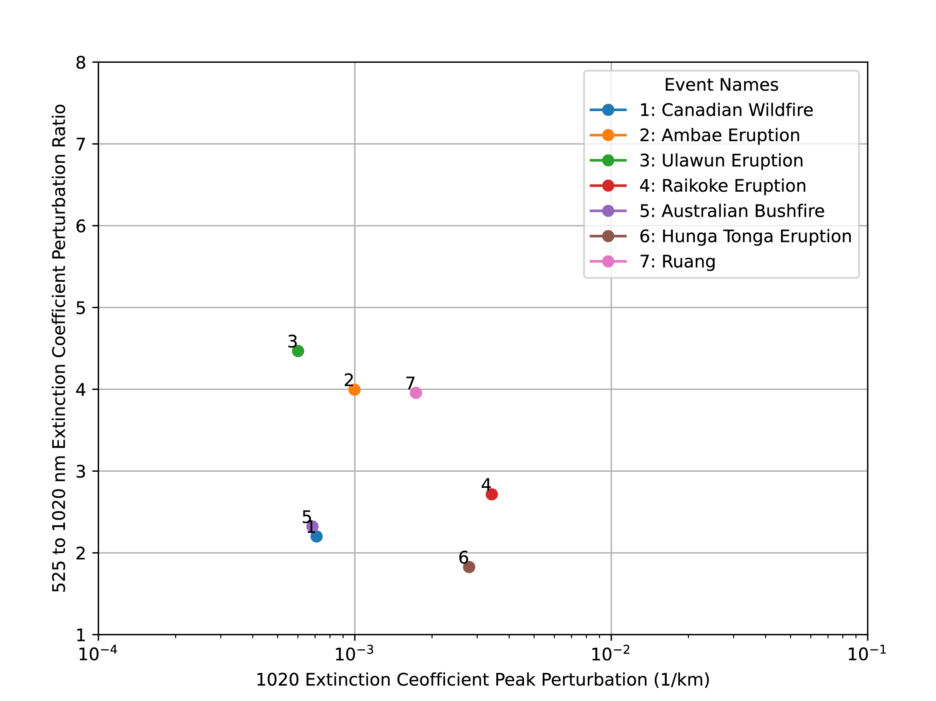
Perturbed extinction coefficient is defined as 𝛿k_{λ} = k_{λ}(after)- k_{λ}(before)
Perturbation ratio (𝛿_{ratio} = 𝛿k₅₂₅/𝛿₁₀₂₀)

Slide 12
Predicting Extinction Coefficient at 525 nm
August 2017 is used as a representative background period.
Perturbed extinction coefficient profiles (𝛿k_{λ} = k_{λ}(after)- k_{λ}(background)) at 1020 nm are computed by subtracting the background profile (August 2017) from the perturbed month’s profiles.
Perturbed extinction coefficient at 525 nm (𝛿k₅₂₅) is estimated by multiplying the 1020 nm perturbed extinction (𝛿k₁₀₂₀) coefficient by the perturbation ratio (𝛿_{ratio}).
525 nm extinction coefficient is predicted by adding the perturbed 525 nm extinction to the background 525 nm extinction coefficient (k₅₂₅(predicted)= 𝛿k₅₂₅ + k₅₂₅(background)).

Slide 13
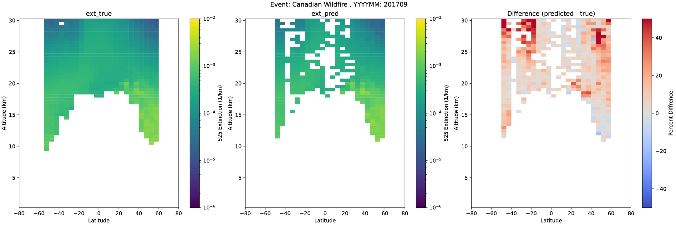
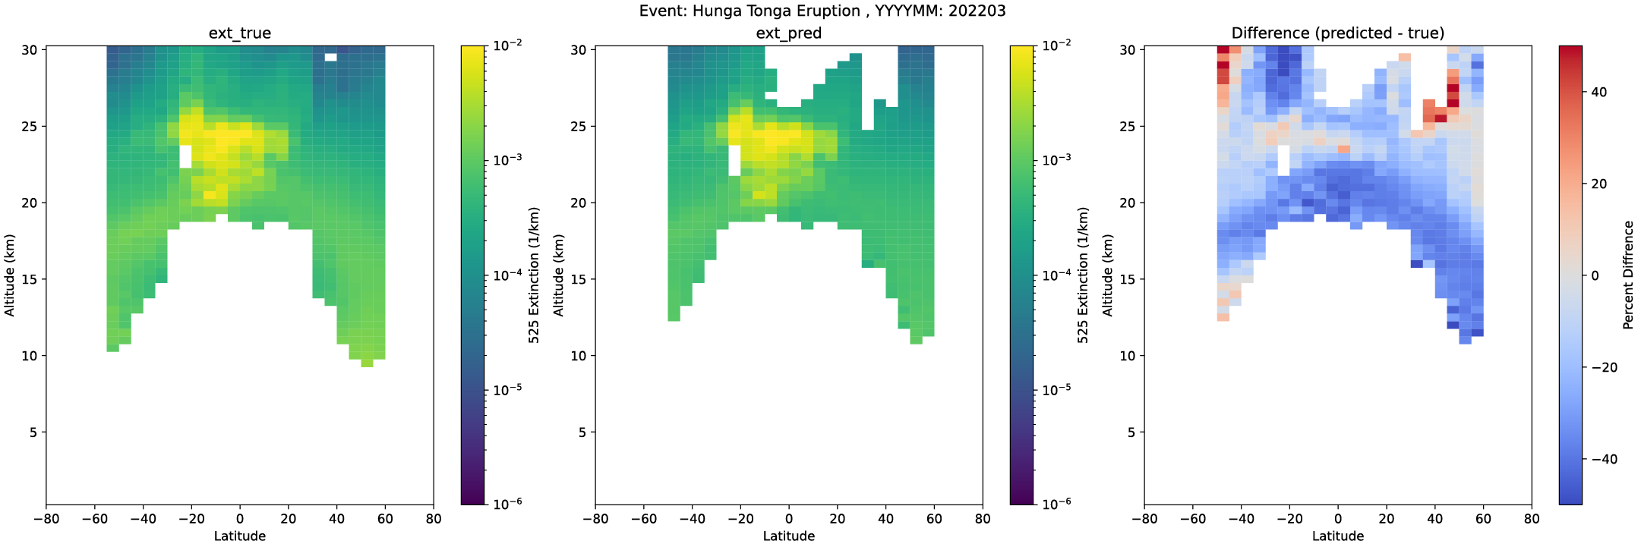
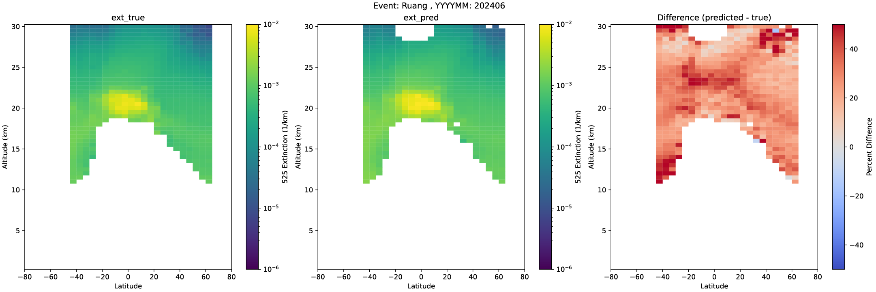
Fixed 𝛿_{ratio}

Slide 14
ML Approach
Implemented HistGradientBoosting (HGB) regressor to predict 𝛿k₅₂₅ and k₅₂₅
Initial attempts to establish a relationship between between 𝛿₁₀₂₀ (input) and 𝛿_{ratio} (target) were unsuccessful. Therefore , used 𝛿₁₀₂₀ as input and 𝛿k₅₂₅ as target .
Training Dataset:
data spanning July 2017 - December 2024
Vertical range: Tropopause+1 km to 25 km altitude
Split: 80% training / 20% testing (Model 1)
Alternative approach by categorizing events (Model 2)
k₅₂₅ (predicted) = k₅₂₅(background)+ 𝛿k₅₂₅.

Slide 15
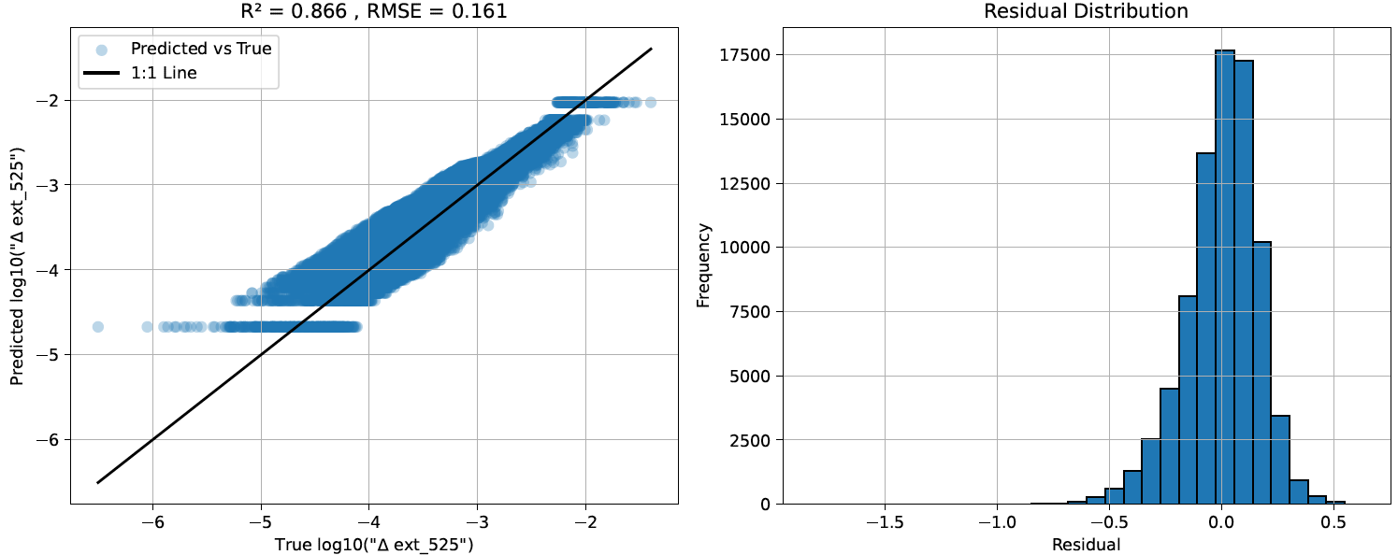
Model 1 (Data between 201709 and 202412)
Notes:
Residual is computed as the difference between true test values and predicted values

Slide 16
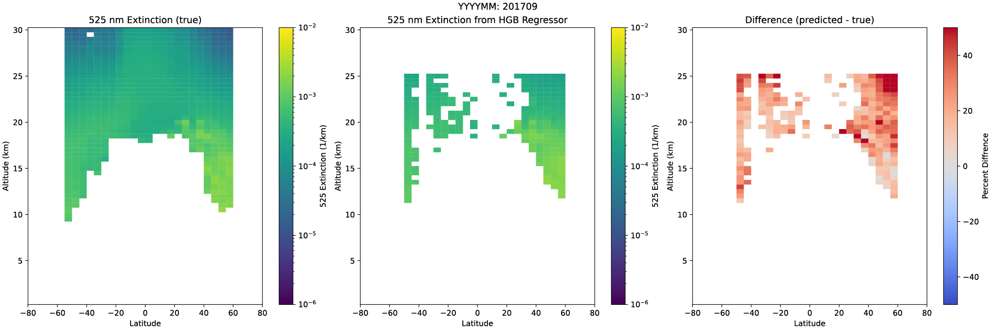
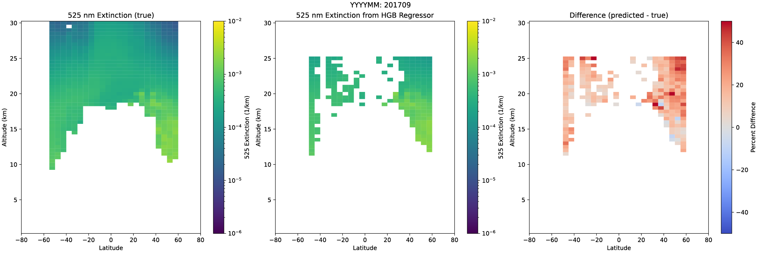
Fixed 𝛿_{ratio}
Model 1
Model 2

Slide 17
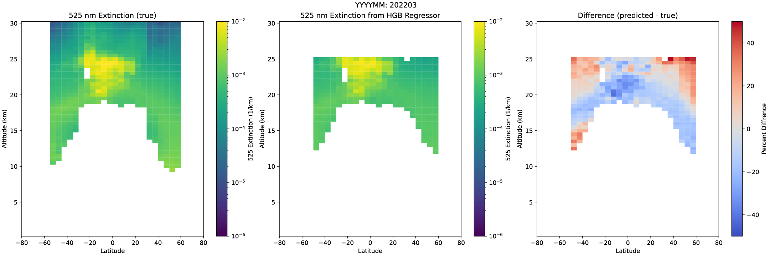
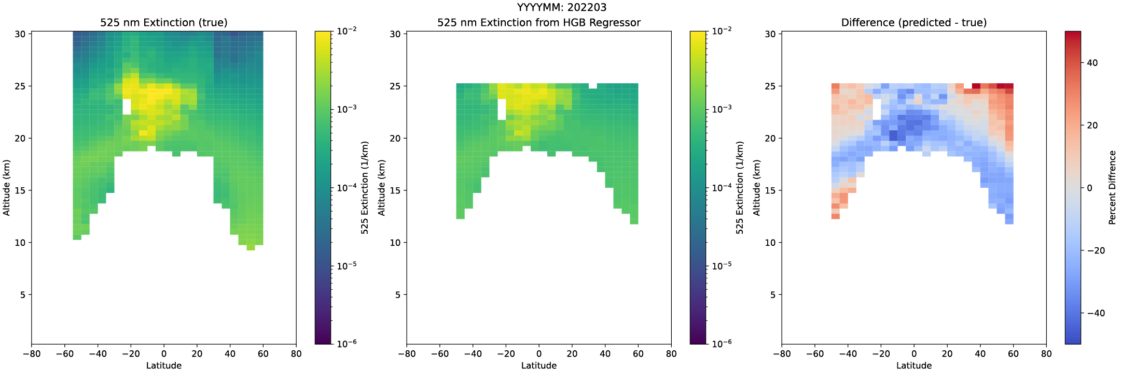
Fixed 𝛿_{ratio}
Model 1
Model 2

Slide 18
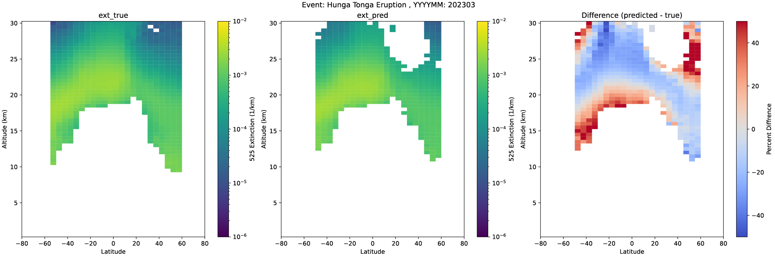
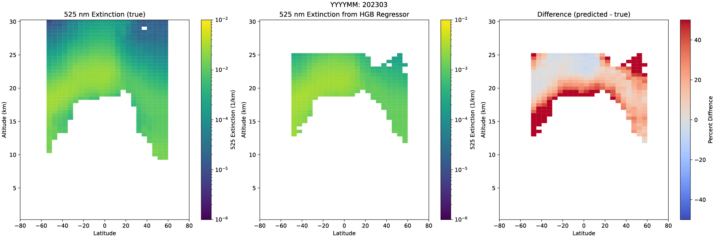
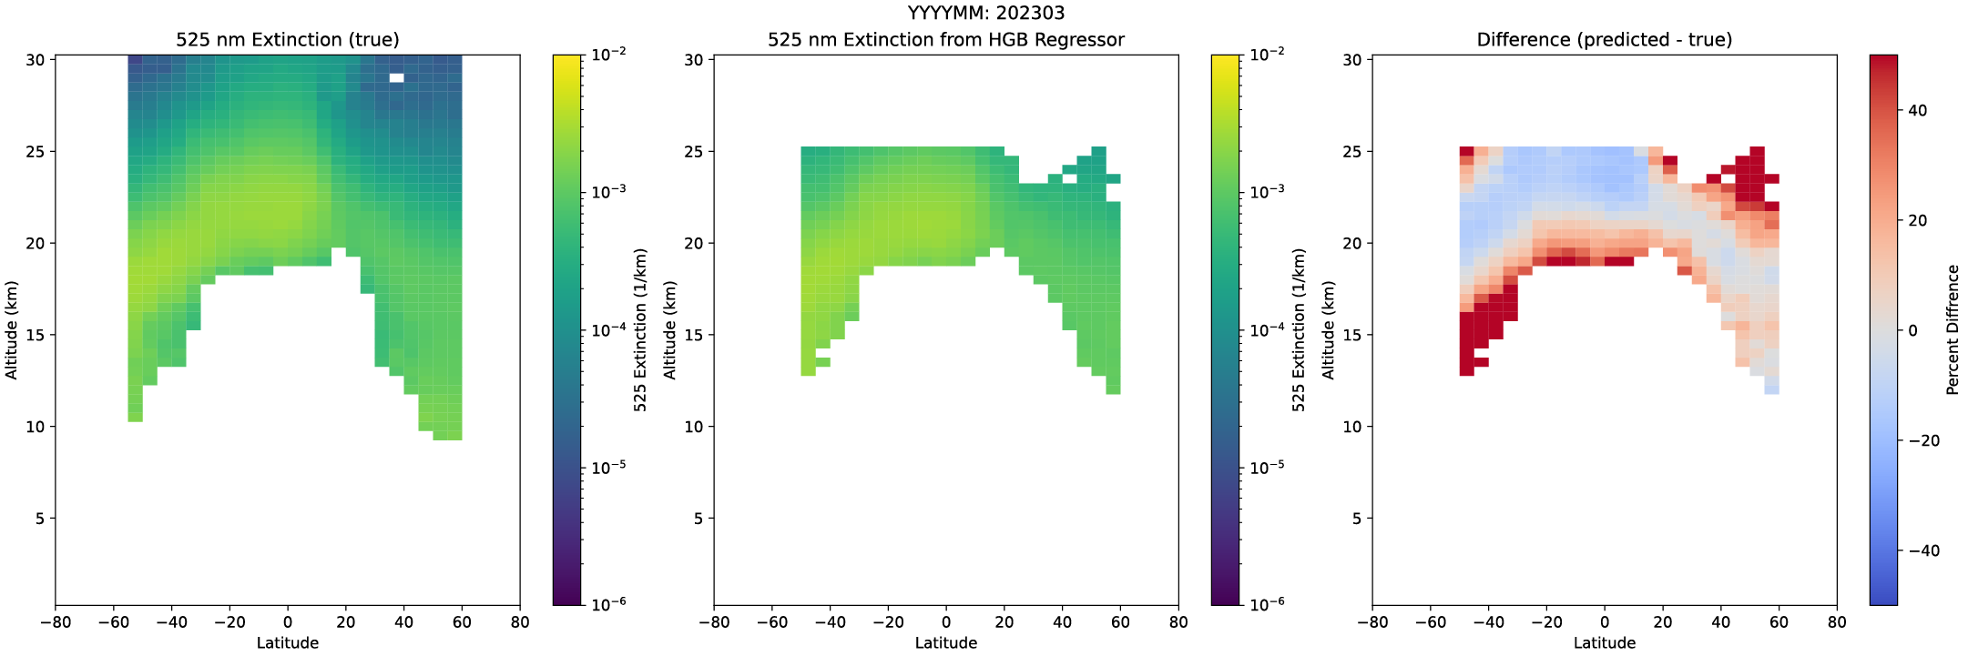
Fixed 𝛿_{ratio}
Model 1
Model 2

Slide 19
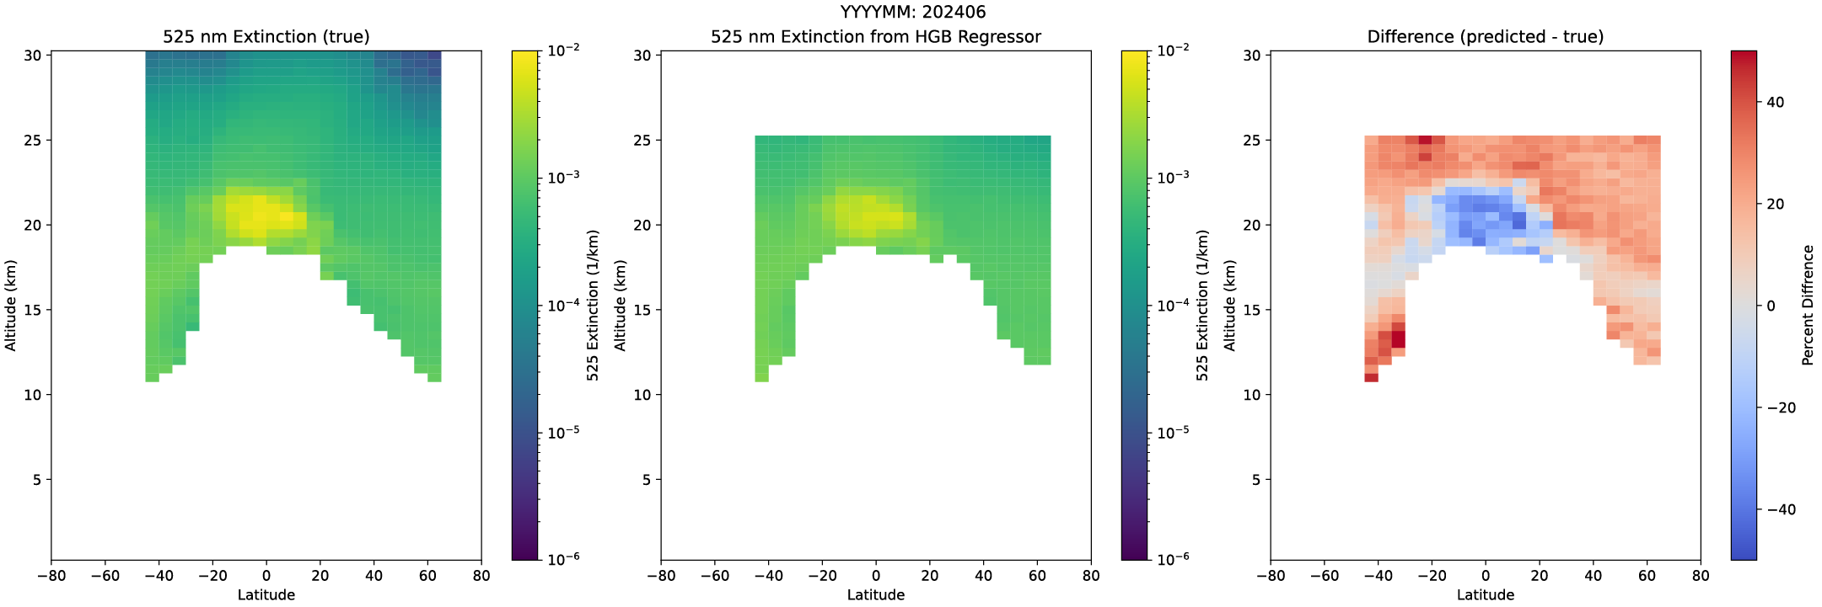
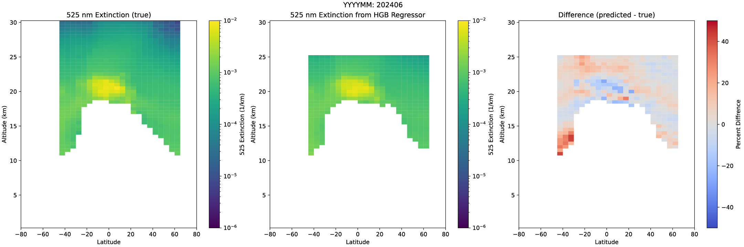
Fixed 𝛿_{ratio}
Model 1
Model 2

Slide 20
Work in progress
The results from the ML approach show promise, but there are limitations due to the differing behaviors of each event. Implementing this for the 2005-2017 period is challenging, as only a single wavelength extinction coefficient is available from OSIRIS/CALIOP.
While SAGE III/ISS multi-wavelength measurements allow for present-day validation of the fixed 𝛿_{ratio} and ML approach, the single wavelength limitation during 2005-2017 creates validation challenges.
We have about 4 years of overlap between SAGE II and OSIRIS between 2001 and 2005. While OSIRIS data is available only at 750 nm, it needs to be converted to 1020 nm.
While the current HGB regressor can only establish relationship between 𝛿k₅₂₅ from 𝛿k₁₀₂₀ , future work will compare the current HGB regressor with alternative approaches to evaluate whether different models can improve the prediction of 𝛿_{ratio} from 𝛿k₁₀₂₀ across varying events, latitudes, and altitudes.

Slide 21
Summary
We followed Thomason et al., 2021 method to study the predictability of k₅₂₅ from k₁₀₂₀ using different approaches with SAGE III/ISS measurements
The event-based fixed 𝛿_{ratio} for predicting the 525 nm extinction coefficient (k₅₂₅) works but has limitations.
Machine Learning (ML) approaches were tested, but attempts to establish a relationship between 𝛿₁₀₂₀ (input) and 𝛿_{ratio} (target) were unsuccessful. A revised approach is tested to predict 𝛿₁₀₂₀ as input and 𝛿k₅₂₅ as the target
Although the results from the ML approach show promise, limitations persist due to the variability of each event.
While ML methods may help reconstruct missing wavelengths, results may not be robust due to the absence of direct measurements during key periods.
Given the increasing frequency of fires and volcanic events, accurate measurements of stratospheric aerosol are critical. Solar occultation measurements are particularly valuable as they provide reliable multi-wavelength extinction coefficients.
With growing interest in solar radiation modification (SRM) and Stratospheric Aerosol Injection (SAI) as potential climate interventions, a multi-instrument approach combining solar occultation and limb-scatter measurements would be ideal for global monitoring of stratospheric aerosols.

Slide 22
Backup Slides

Slide 23
Monthly Zonal averaged Extinction Coefficient
Tonga Eruption

Slide 24
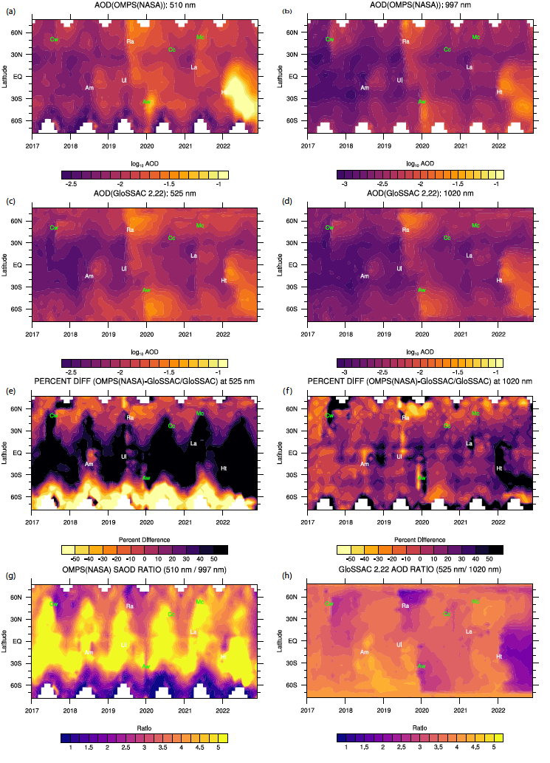

Slide 26
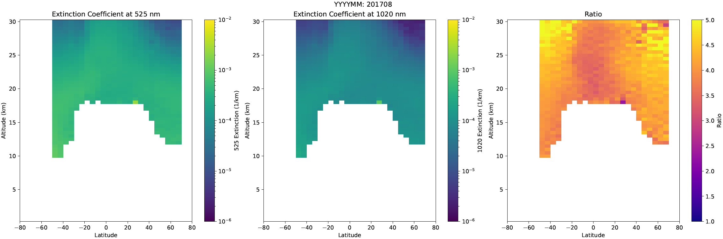

Slide 27
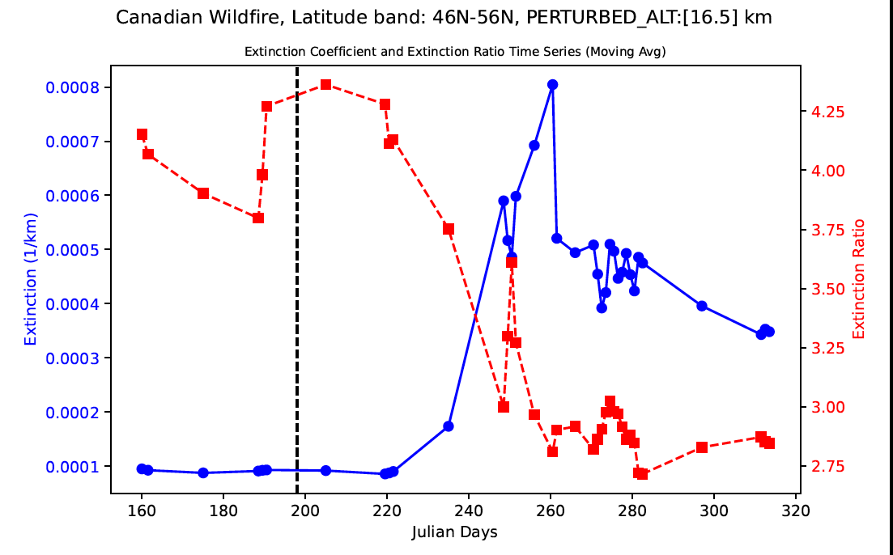

Slide 28
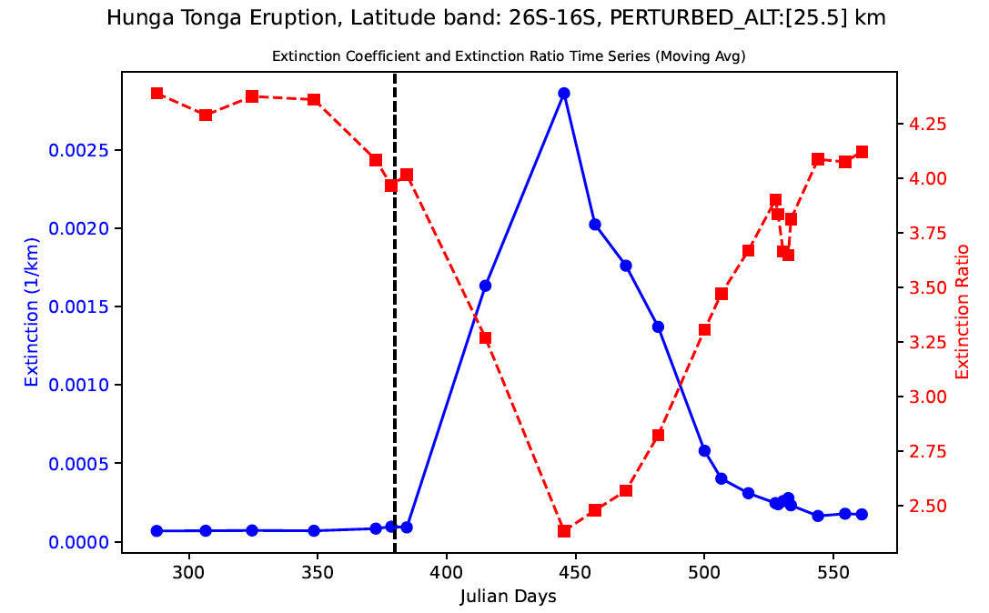

Slide 29
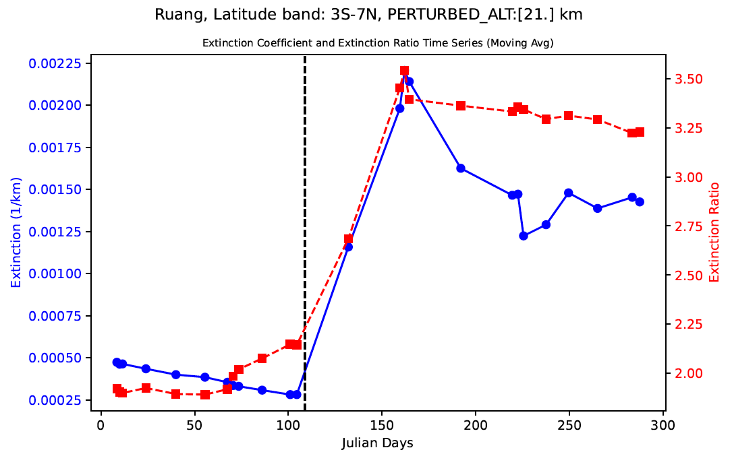

Slide 30
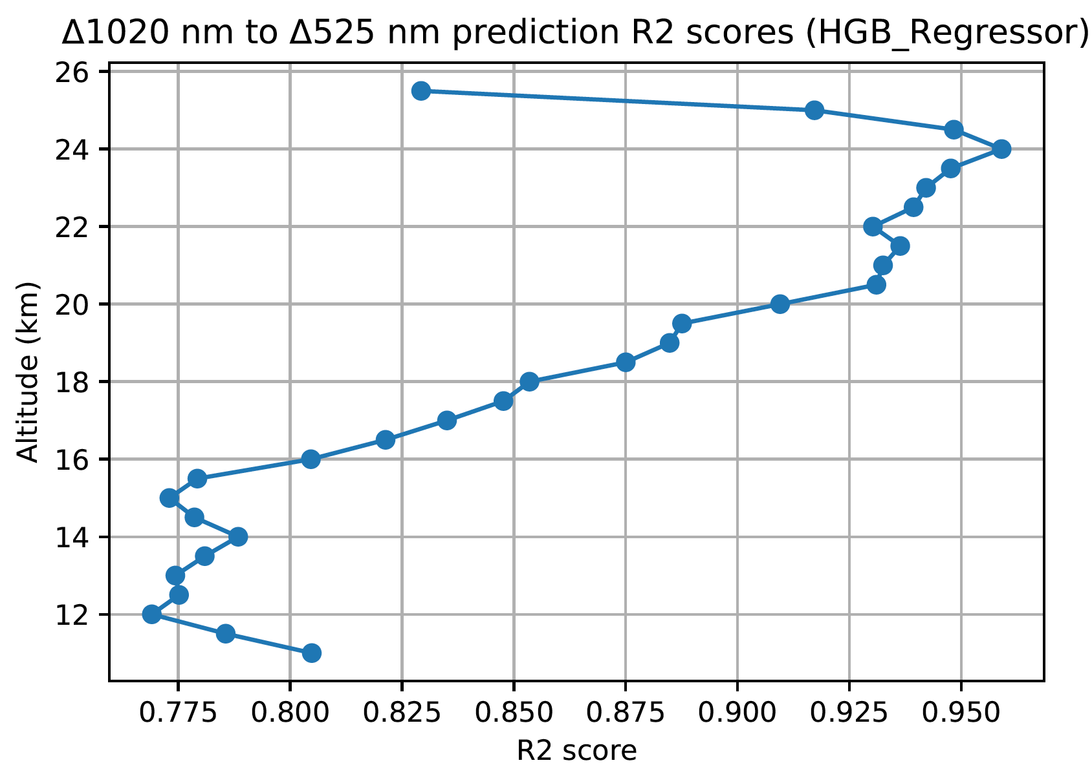

Slide 31
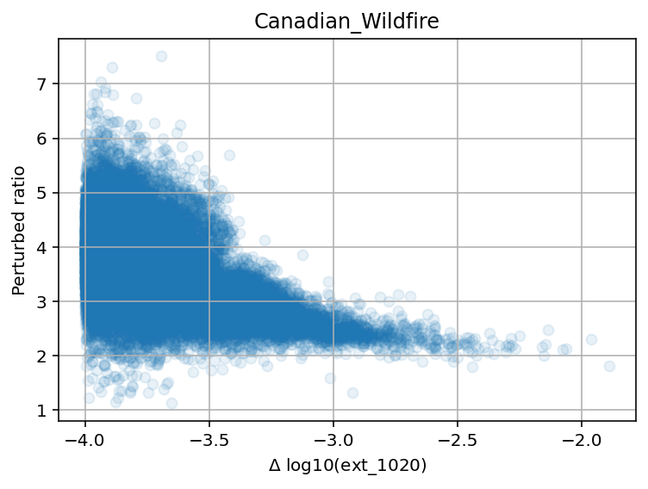

Slide 32
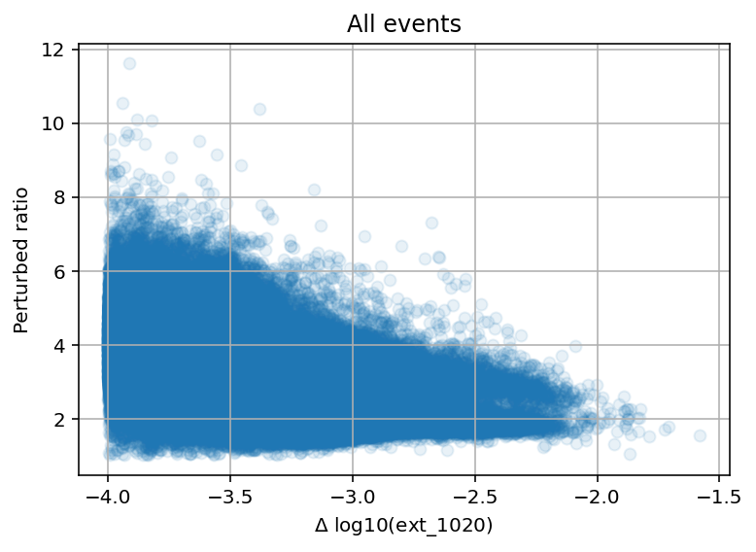

Slide 33
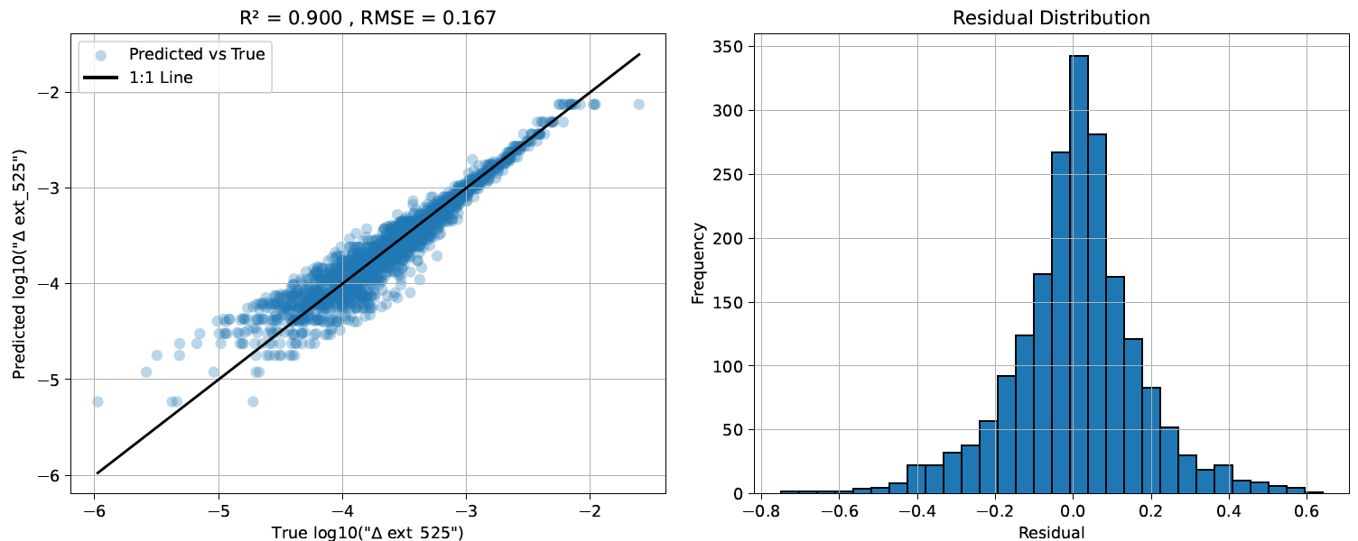
Model 2 Canadian Wildfire (201709-201803)

Slide 34
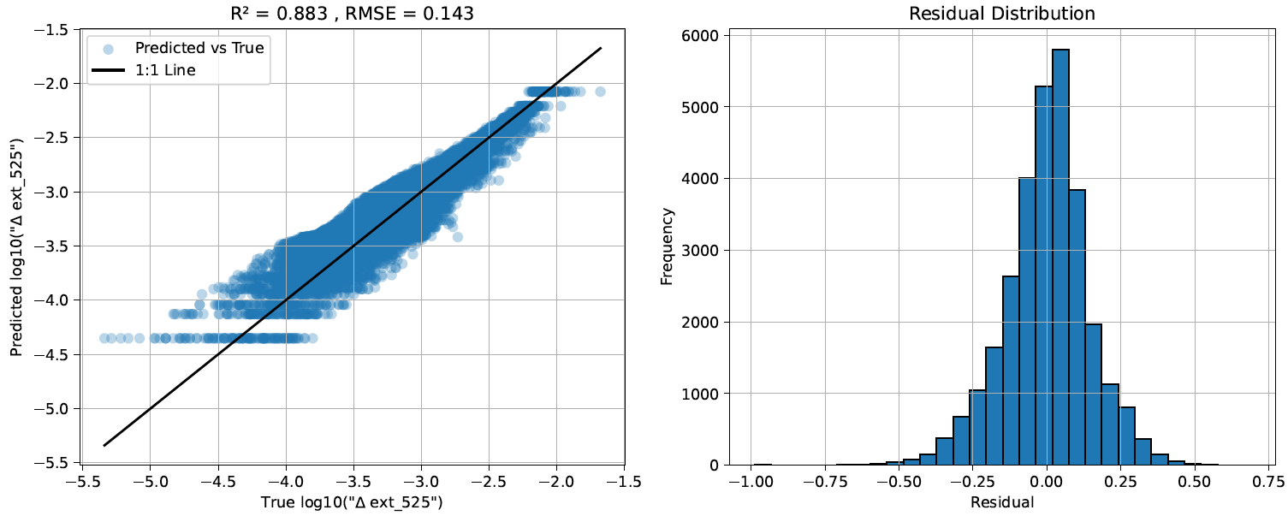
Model 2 Tonga Eruption (202203-202405)

Slide 35
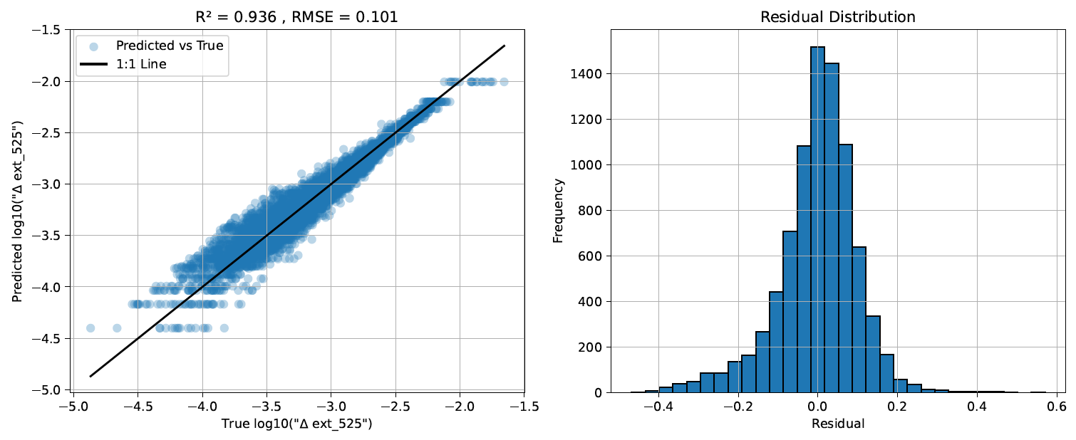
Model 2 Ruang Eruption (202406-202501)

Slide 36
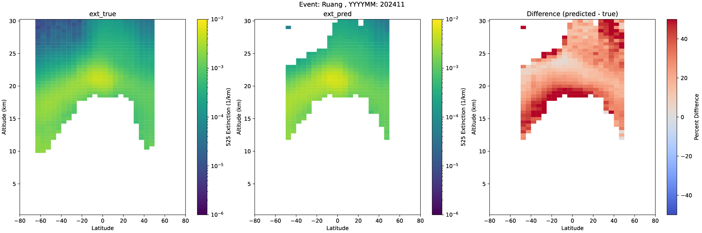
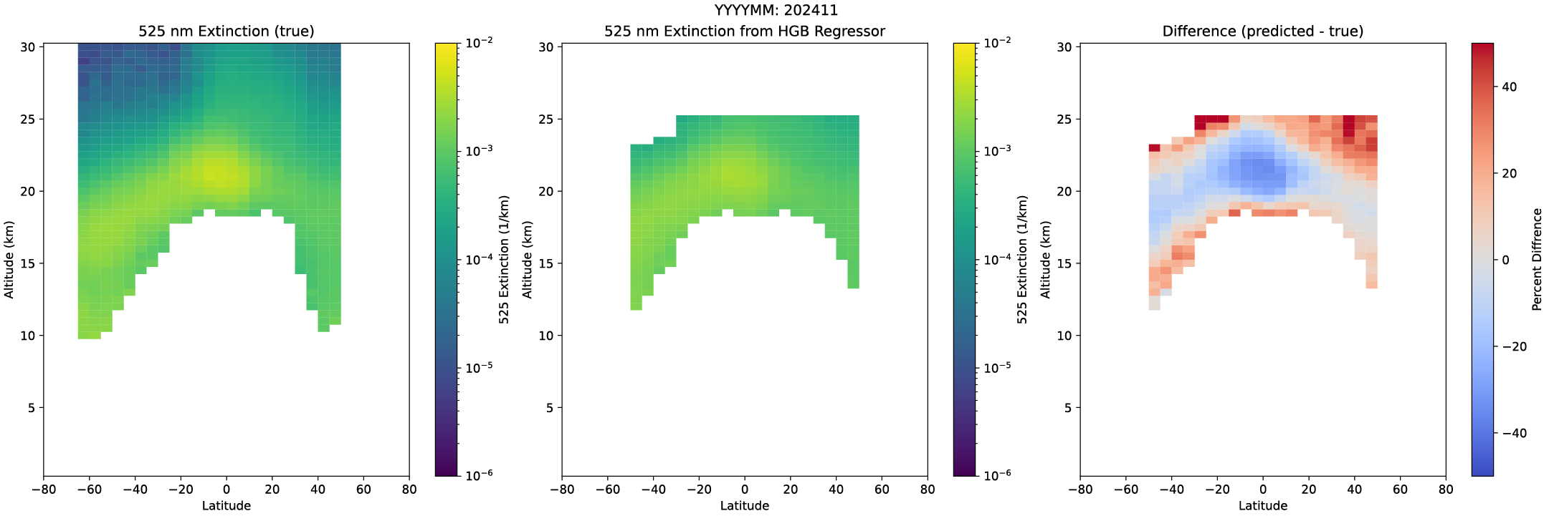
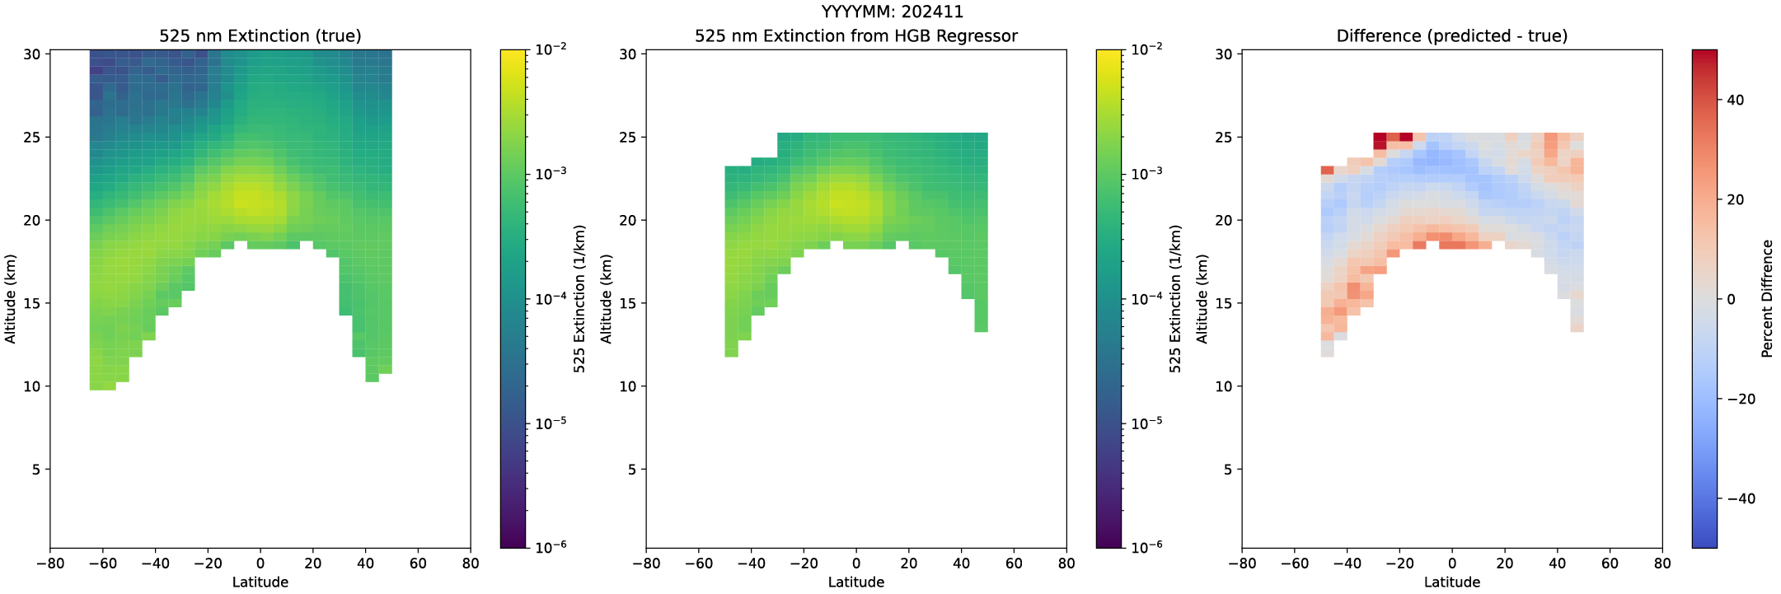
Fixed 𝛿_{ratio}
Model 1
Model 2

Slide 37
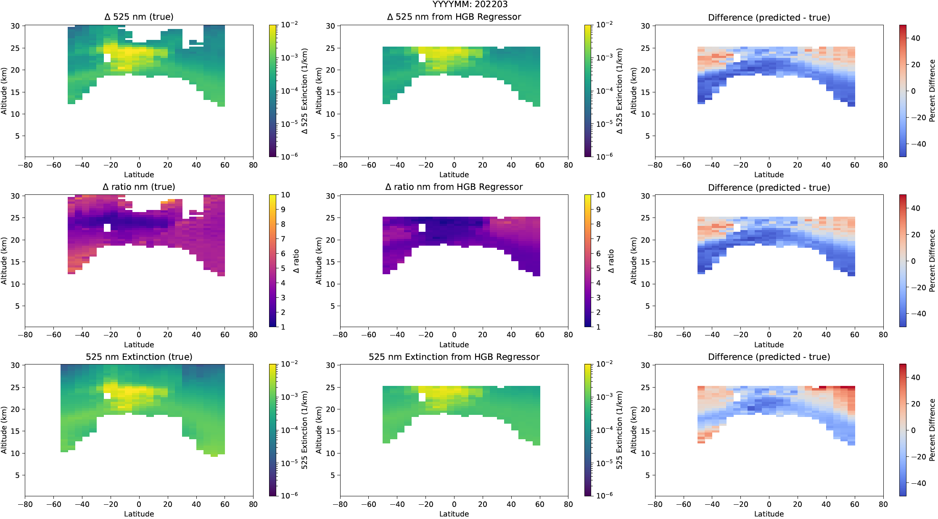

Slide 38
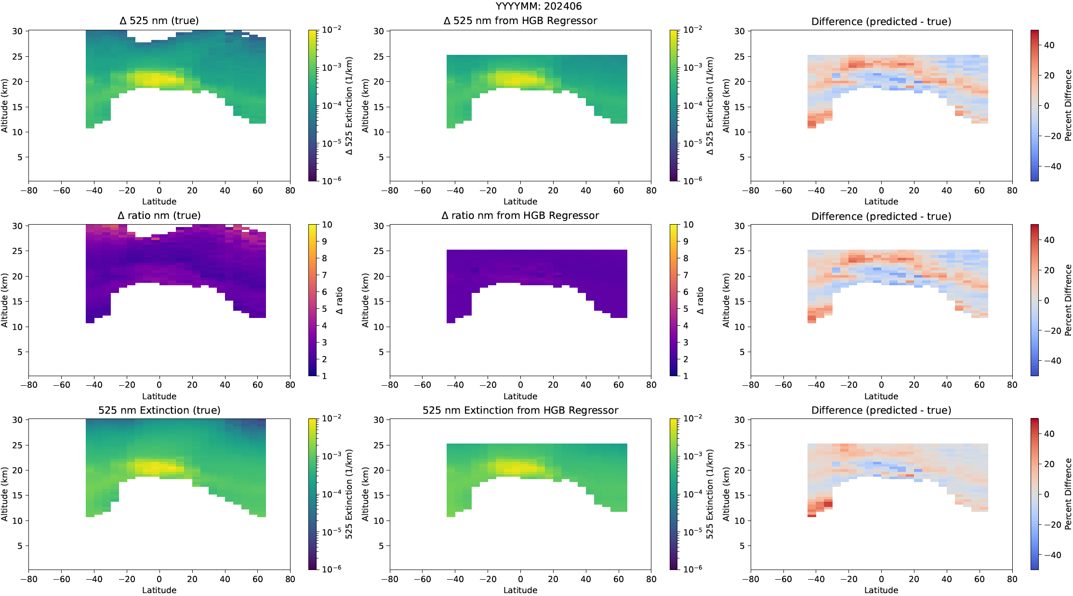

Slide 39
References
Bourassa, A. E., Zawada, D.J., Rieger, L.A., Warnock, T.W., Toohey, M., Degenstein, D.A.: Tomographic retrievals of Hunga Tonga-Hunga Ha’apai volcanic aerosol, Geophysical Research Letters, vol. 50, no.3, p. e2022GL101978, 2023. e2022GL101978 2022GL101978
Kovilakam, M., Thomason, L. W., Verkerk, M., Aubry, T., and Knepp, T. N.: OMPS-LP aerosol extinction coefficients and their applicability in GloSSAC, Atmos. Chem. Phys., 25, 535–553, https://doi.org/10.5194/acp-25-535-2025, 2025.
Thomason, L. W., Kovilakam, M., Schmidt, A., von Savigny, C., Knepp, T., and Rieger, L.: Evidence for the predictability of changes in the stratospheric aerosol size following volcanic eruptions of diverse magnitudes using space-based instruments, Atmos. Chem. Phys., 21, 1143–1158, https://doi.org/10.5194/acp-21-1143-2021, 2021.
The Science Directorate at NASA's Langley Research Center: External Peer Review

