Slide 1
The SAGE III/ISS Quicklook Website
Updates for 2025 Edition
Kevin R. Leavor
SAGE III/ISS Lead Data Scientist

Slide 2
Overview
The Quicklook (and Expedited) Website(s)
Your Website Team
Managing the Website, but not your Expectations
2025 Updates
  What launched after Last STM
  What else went live
  What’s coming
What’s Next?

Slide 3
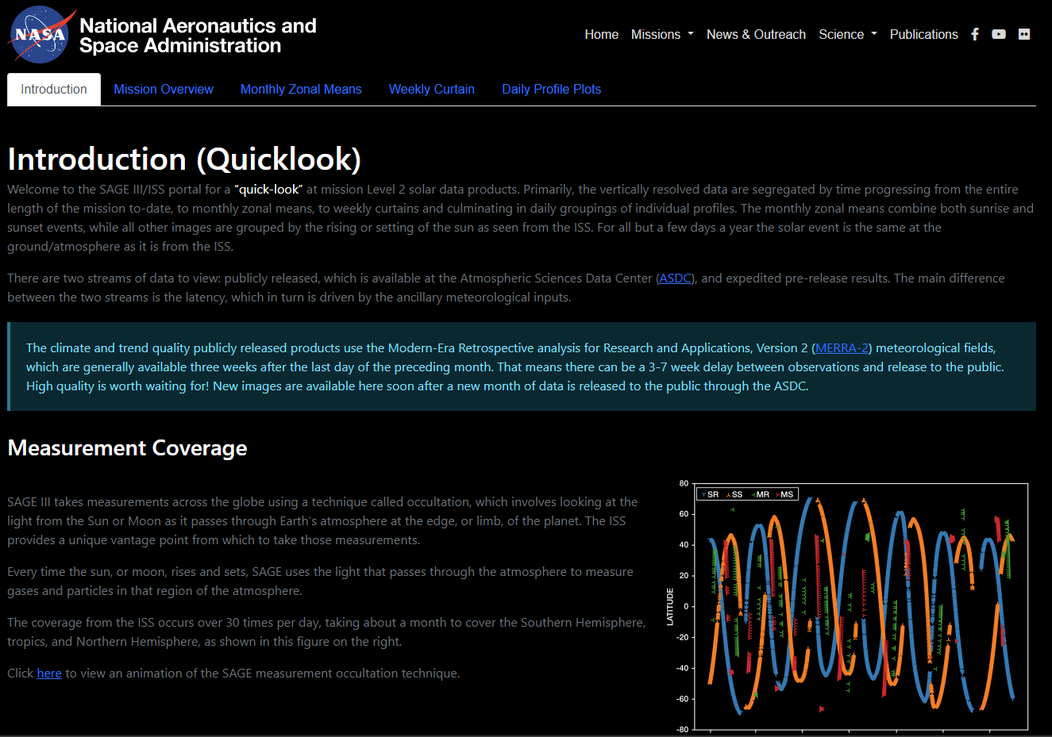
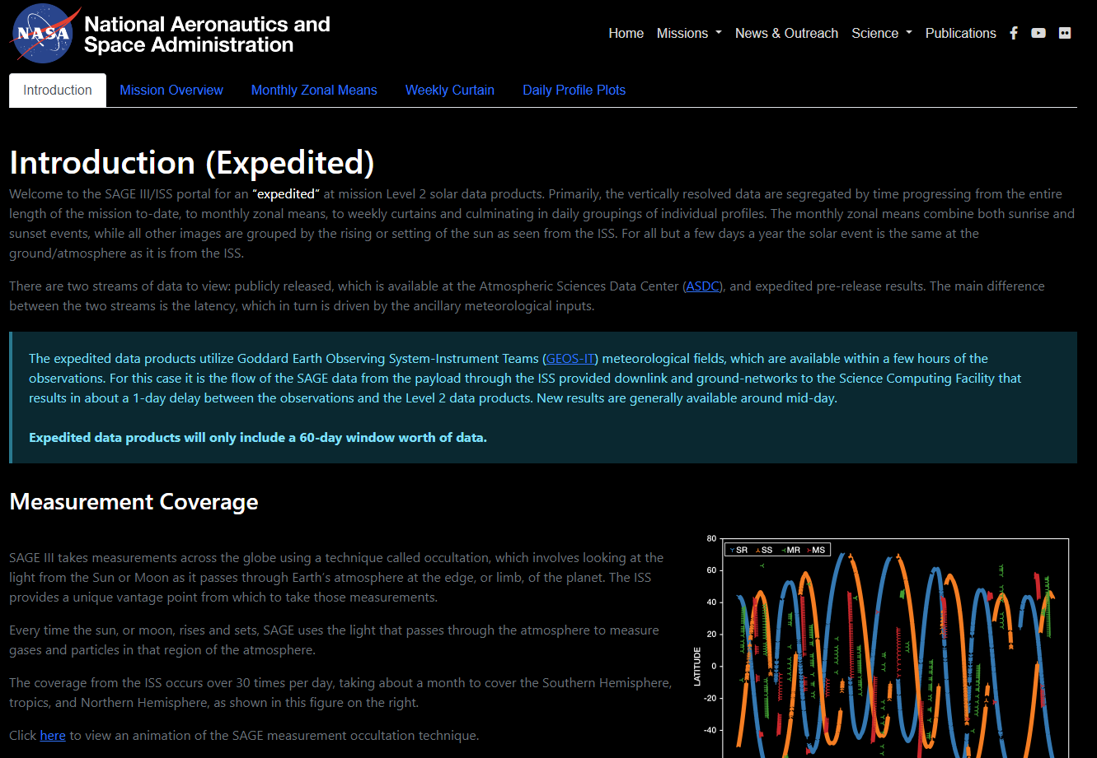
The Quicklook Website
Quicklook – Release Product Version
https://sage.nasa.gov/sageiii-iss/browse_images/quicklook/
Expedited – Pre-Release internal product using GEOS
https://sage.nasa.gov/sageiii-iss/browse_images/expedited/

Slide 4

The Quicklook Website
But I only remember base URLs!
https://sage.nasa.gov

Slide 5
Your Website Team
Science Content
Kevin Leavor
  Processing, Management
Mary Cate McKee
  Ground validation
David Flittner
  Science objectives, content review
Marilee Roell
  Science management, content review
Web Content and Support
Rick Farmer
  Web development, backend
Greg Paxton
  Ground systems management, process review
Caitlyn Stone
  Operations, Partner communication

Slide 6
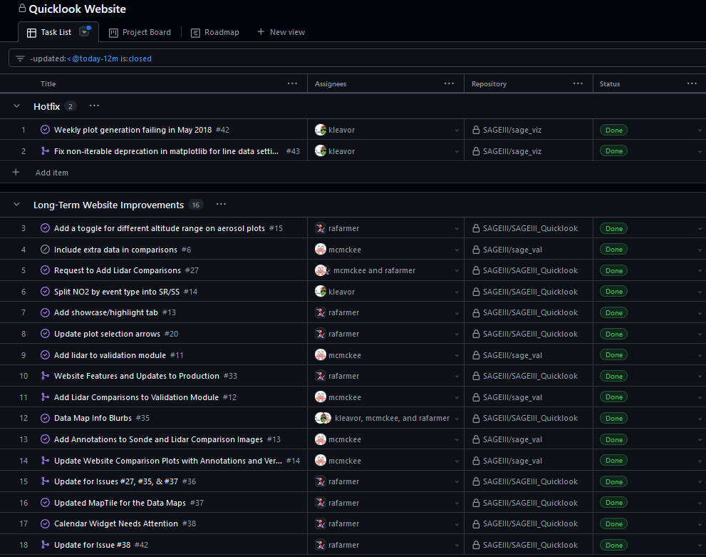
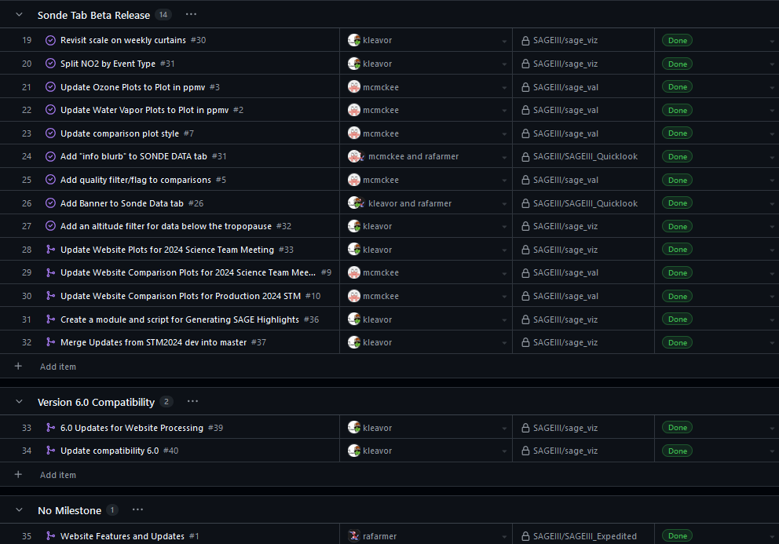
2025 Updates: A Busy Year

Slide 7
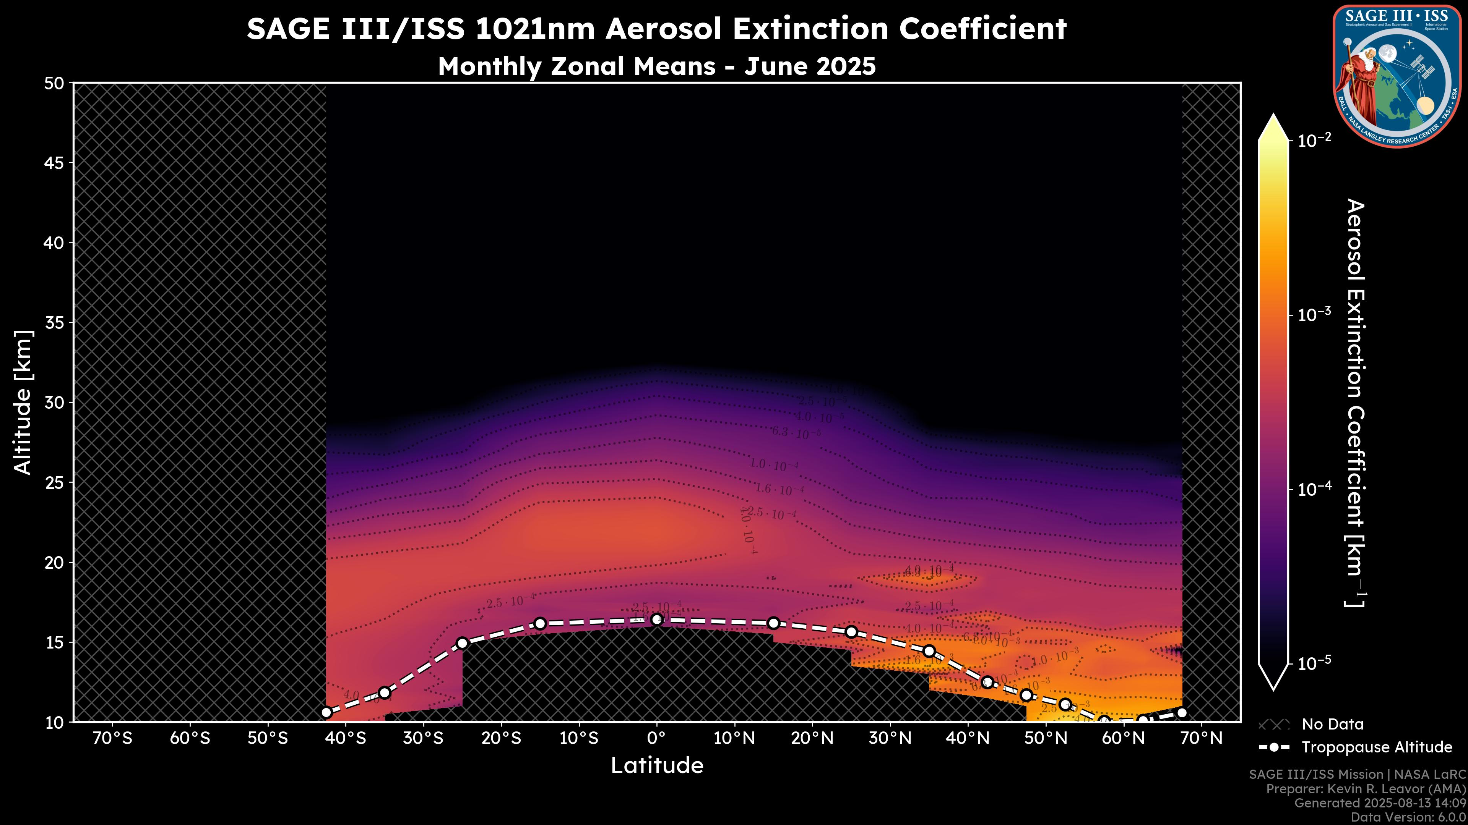
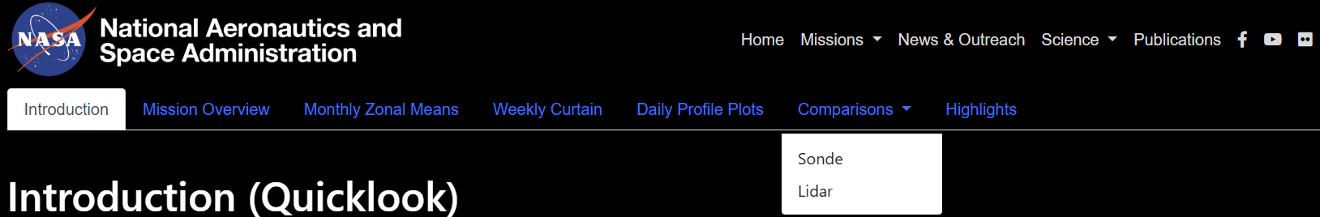
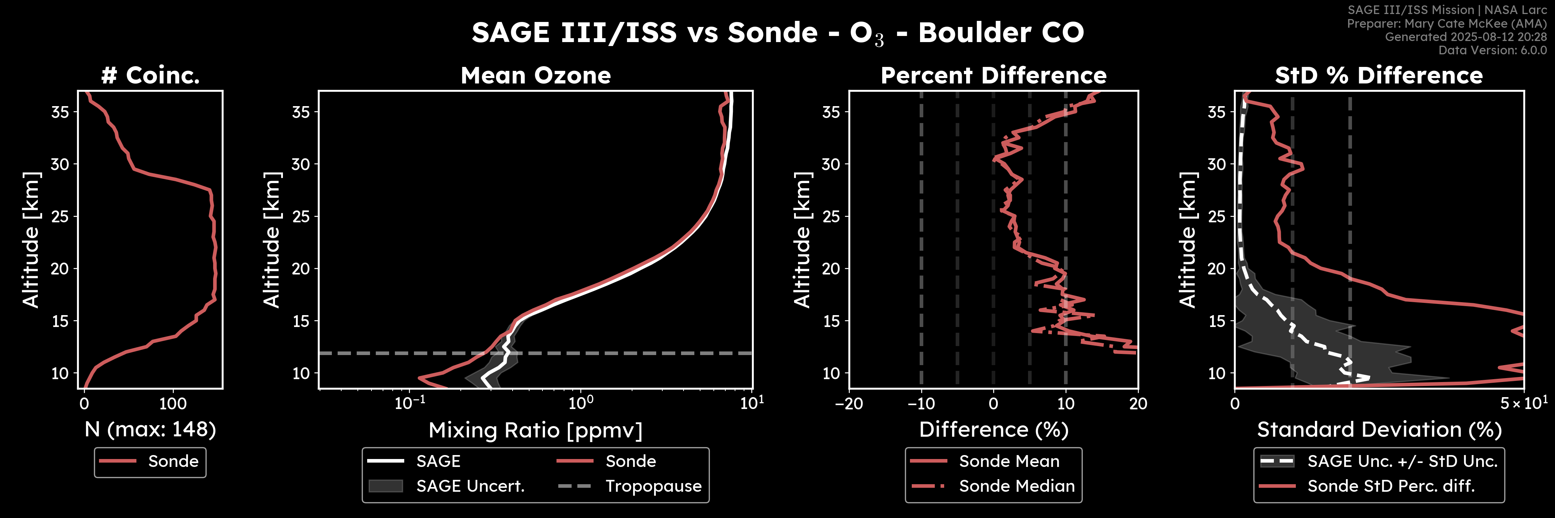
2025 Updates
What we launched after last year (as promised!)
  Sonde Comparison
  Diurnal Separation of NO₂
  Event Highlights (currently has Hunga Tonga)
  Tropopause Filtering in MZM plots

Slide 8
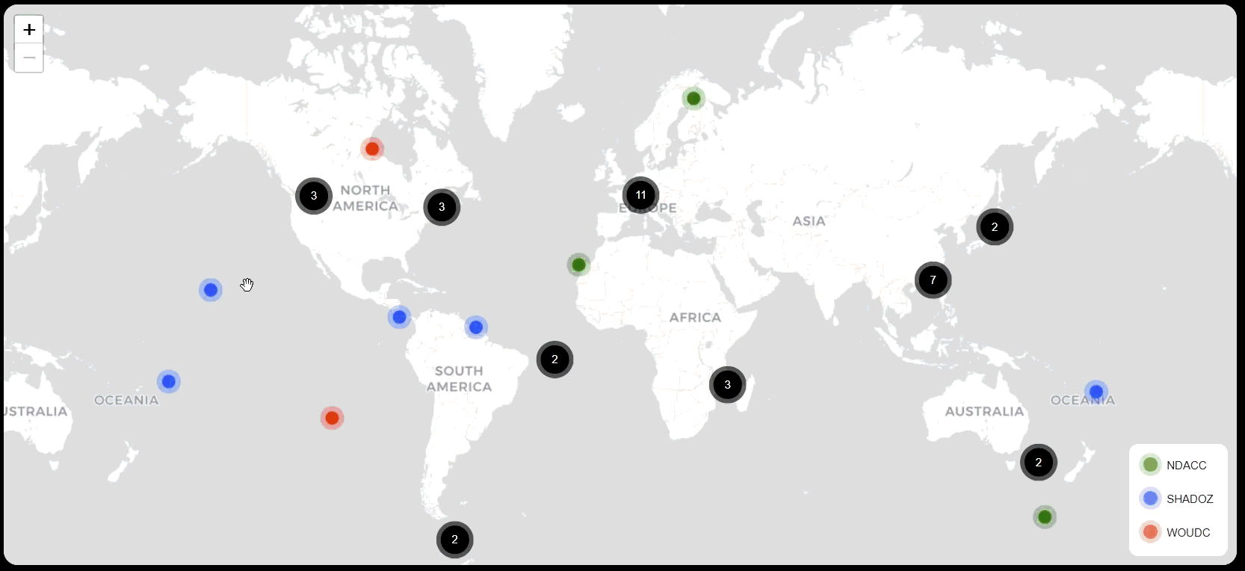
2025 Updates
What went live since
  New Comparisons map interface (Thanks Rick!)

Slide 9
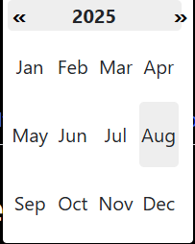
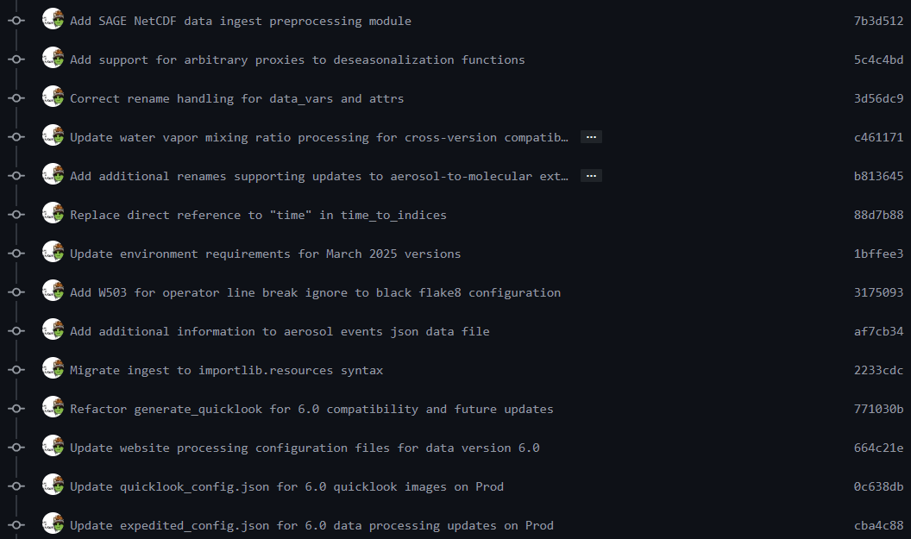
2025 Updates
What went live since
  Calendar Widget Bug Fix (Thanks Rick!)
  Version 6.0 Compatibility (Live in July)
    Update for compatibility with Python 3.12
    Adopted Scientific Python SPEC 0 for future maintenance
    Completely new ingest backend compatible across product versions
    Hotfix for an edge case related to a Matplotlib deprecation

Slide 10
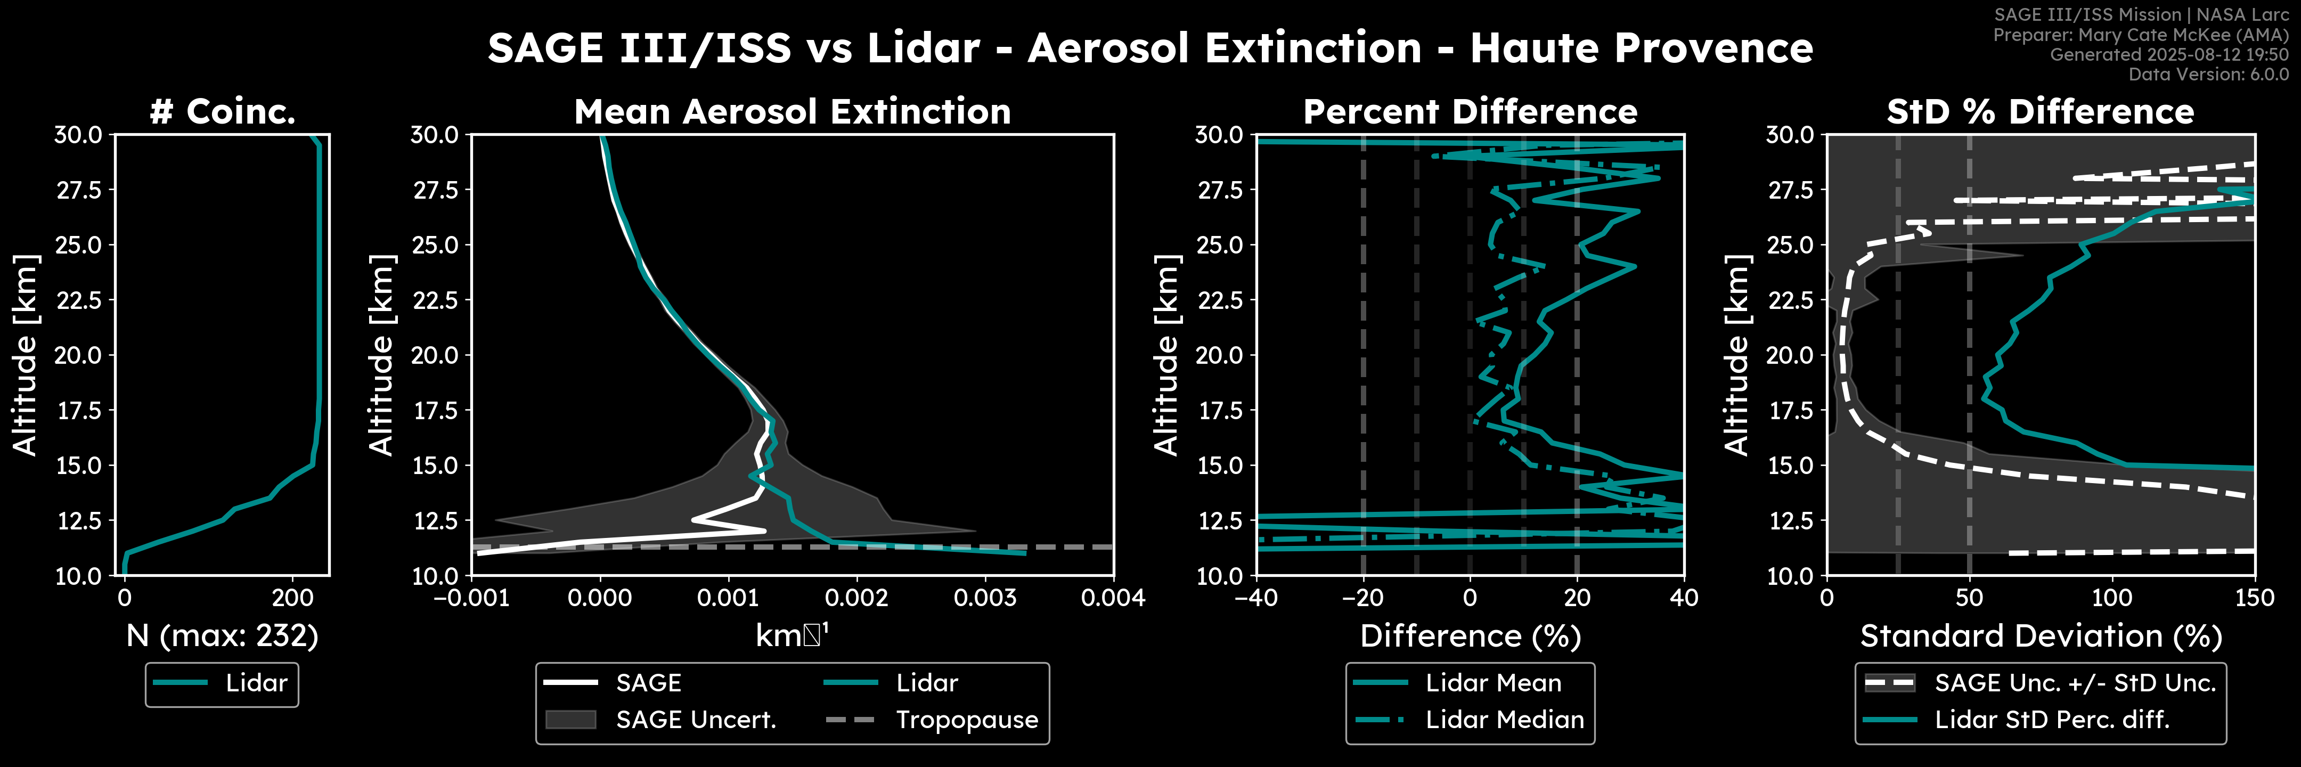
2025 Updates: What’s Coming
Aerosol Lidar Comparisons (Thanks Mary Cate!)

Slide 11
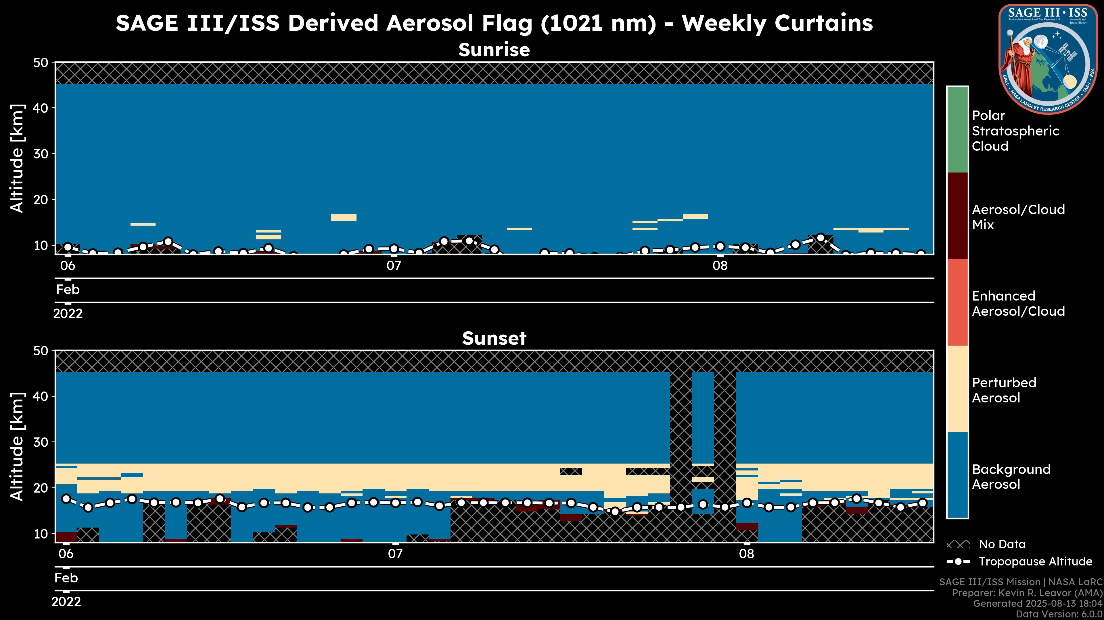
2025 Updates: What’s Coming
6.0 Aerosol Parameter Plots – Aerosol Flags

Slide 12
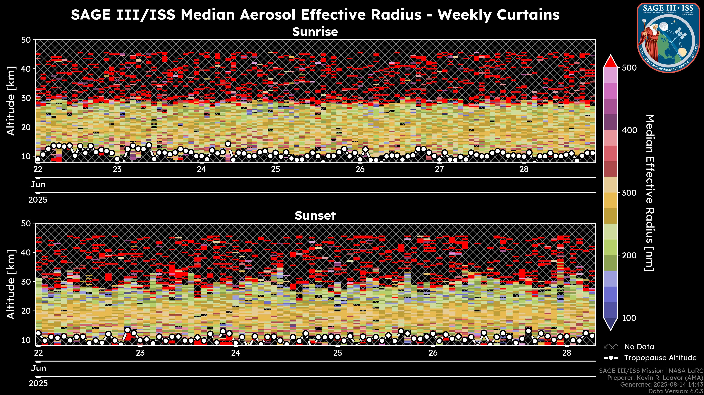
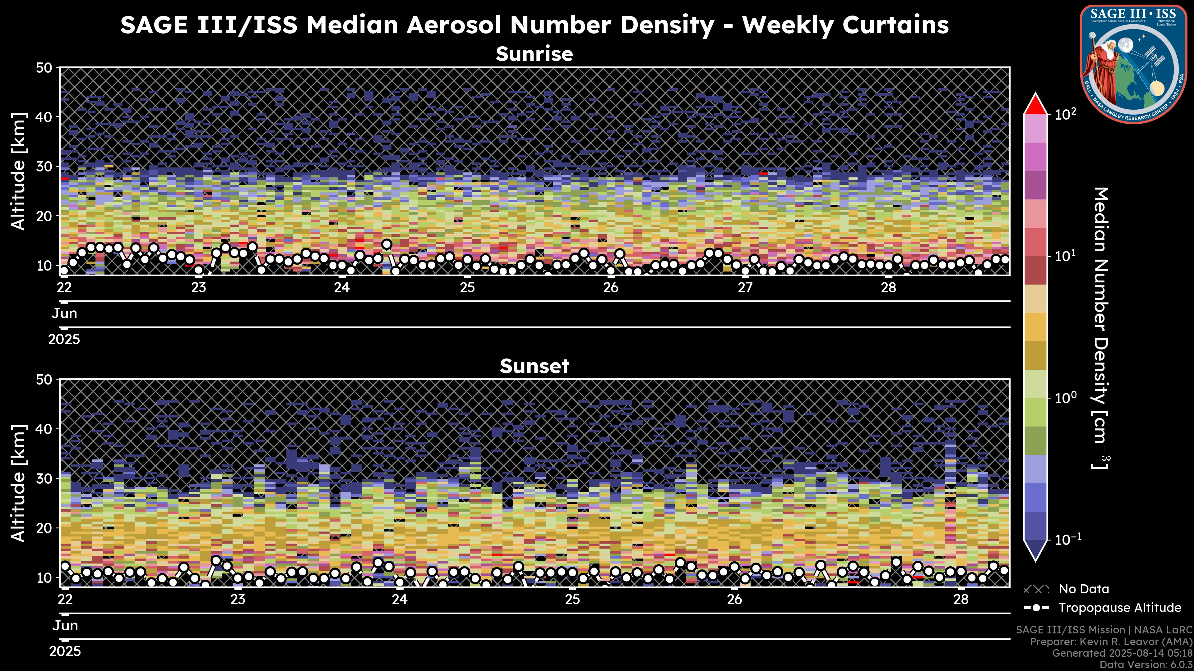
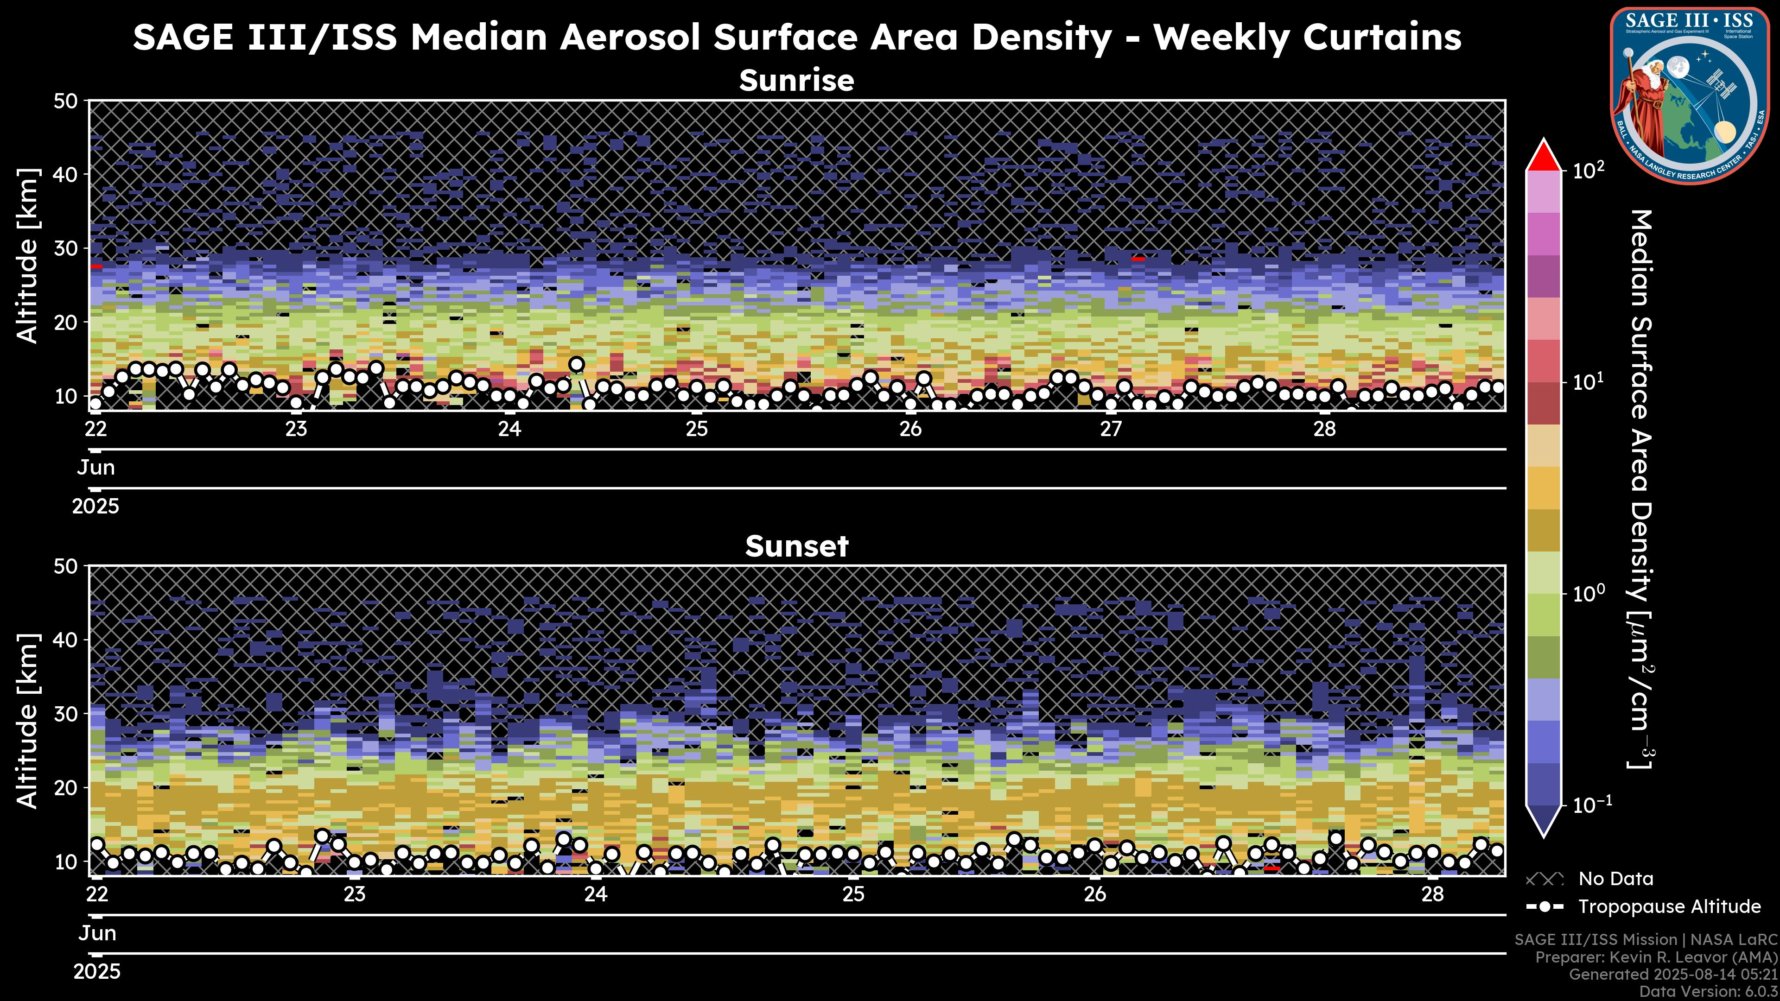

2025 Updates: What’s Coming
6.0 Aerosol Parameter Plots – Particle Size Distribution

Slide 13


Still More to Come
Line Plot Visualization Improvements (Thanks Lars!)
Additional highlights
Hover content on maps
Homogenized data comparisons
Suggestions from YOUR FEEDBACK!
Current plans for updates are through EOY
Quicklook
Expedited

