Slide 1
Update on SAGE III/ISS temperature and pressure research products
Michael Pitts¹, Robert Manion², Robert Damadeo¹, David Flittner¹, Mary Cate McKee³
¹NASA Langley Research Center, Hampton, Virginia
²Adnet Systems, Inc., Hampton, Virginia
³Analytical Mechanics Associates, Hampton, Virginia
14 August 2025

Slide 2
Outline
Brief overview of T/p retrieval algorithm
Assessment of forward model
Correlative comparisons
Potential sources of uncertainty
Summary and ongoing work

Slide 3
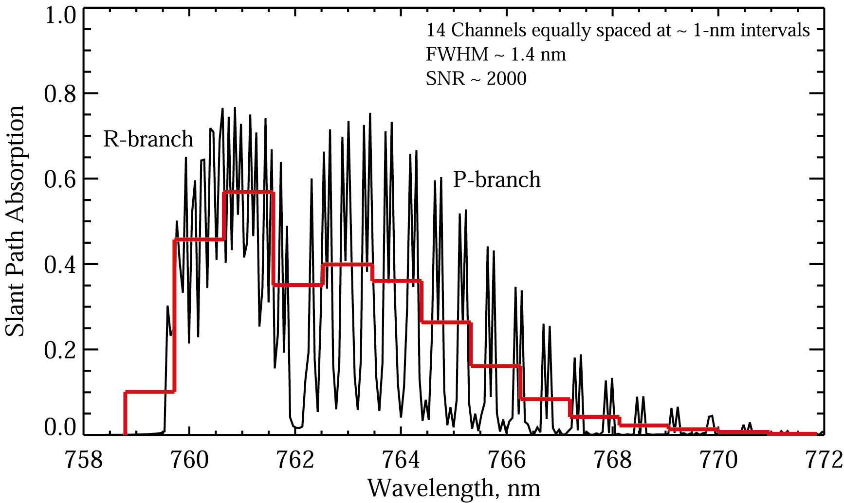
Strategy for Temperature/Pressure Retrievals
Iterative approach required due to non-linear nature of problem
Uses non-linear least squares fitting routine (Levenberg-Marquardt)
Simultaneously fits measured A-band spectra from all 14 channels and 90 tangent altitudes
Includes O₂ absorption, Rayleigh scattering, aerosol extinction, and O₃ absorption components, plus wavelength and PSF adjustments
Implemented at the SCF
Solves for successive adjustments to trial T,p profiles by minimizing residuals between measured and modeled absorption
Includes non-rigid hydrostatic constraint
14 Channels at ~ 1-nm intervals
FWHM ~ 1.4 nm
SNR ~ 1500
A-band contains ~290 individual absorption lines with the distinctive R-branch and P-branch structure. Broad features are still visible at SAGE III resolution (red line)

Slide 4
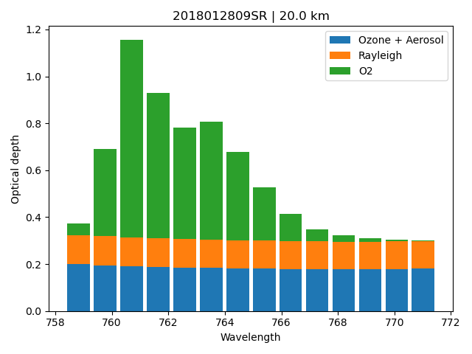
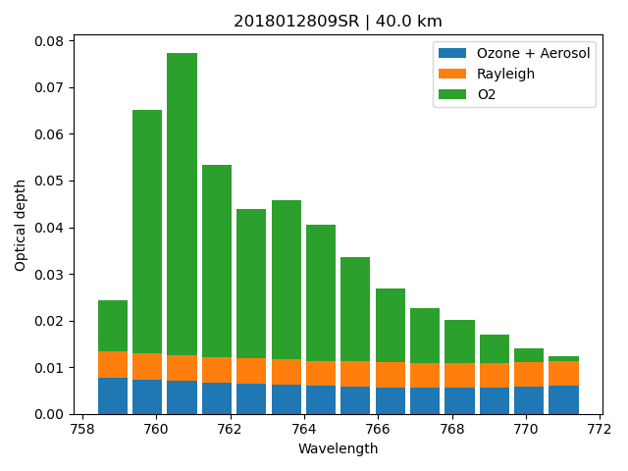
Forward Model Elements
Forward model simulates SAGE III/ISS LOS transmission measurements in 14 O₂ A-band channels using LBL radiative transfer calculations
Inputs:
Initial guess T/p profiles
Pathlength matrix
O₂ Spectroscopic parameters (HITRAN 2020)
Initial guess aerosol (linear fit: slope + intercept)
Initial guess ozone (cross sections + ozone number density)
Initial wavelength map
Initial PSF widths
Outputs
LOS transmission (O₂ + Rayleigh + aerosol + O₃)

Slide 5
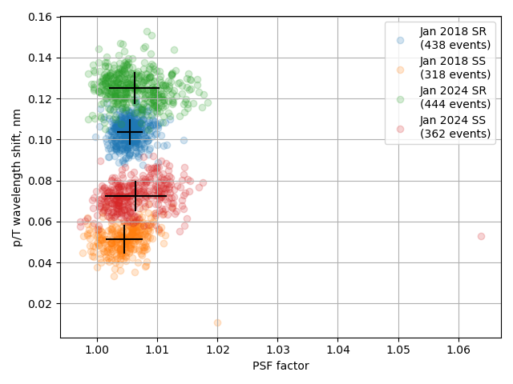
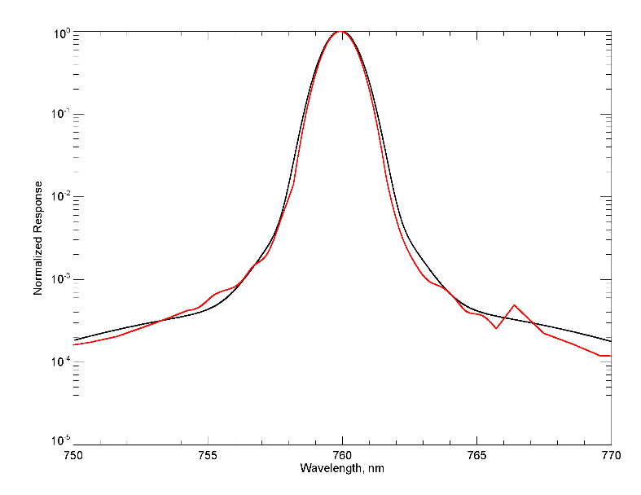
Retrieved Wavelength and PSF Width Adjustments to Best fit Measured Spectra
Drift of wavelength shift with time may be related to general warming of instrument/ spectrometer as thermal systems have aged
Systematic differences between SR & SS may be related to Doppler shift from spacecraft motion
Only slight adjustment to PSF widths
SR change
2018-2024
Instrument PSF
Prelaunch NIST
Model with Gaussians
SS change
2018-2024

Slide 6
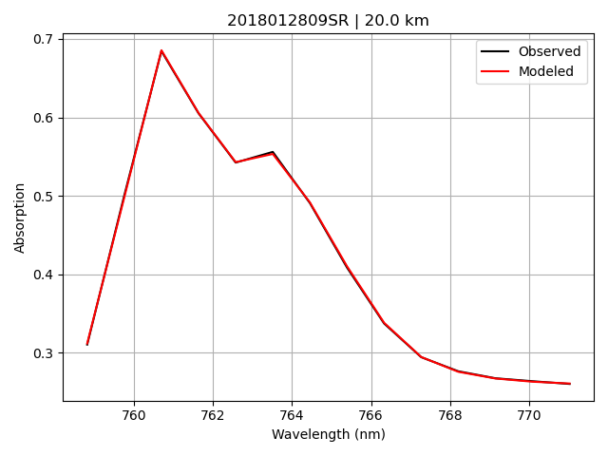
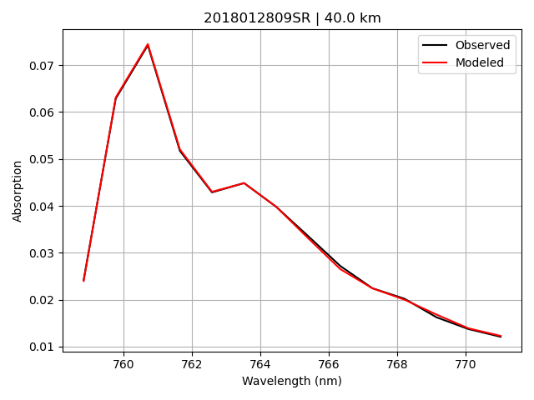
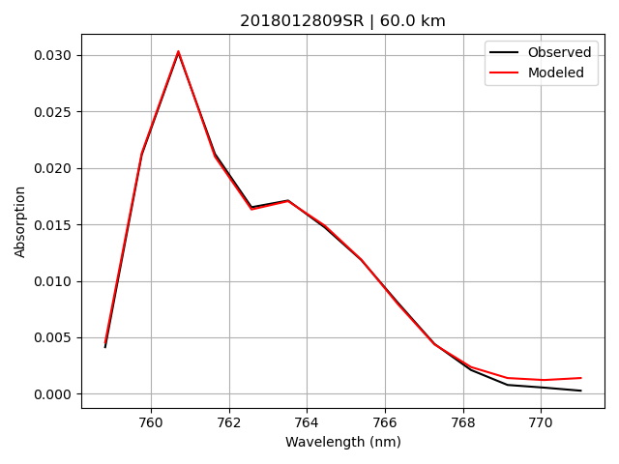
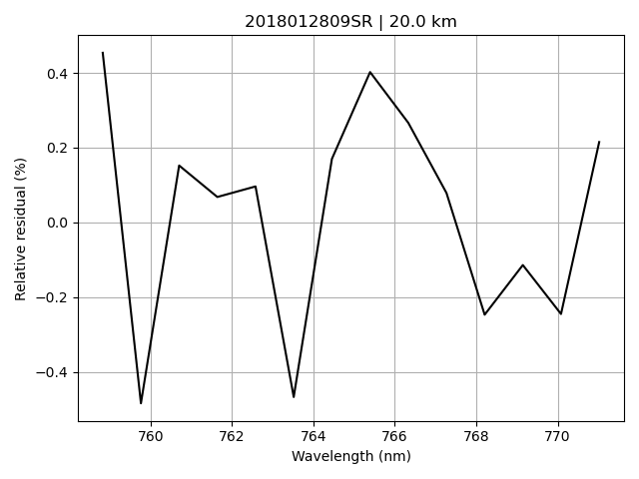
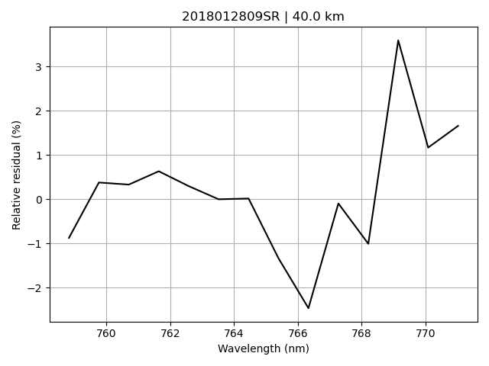
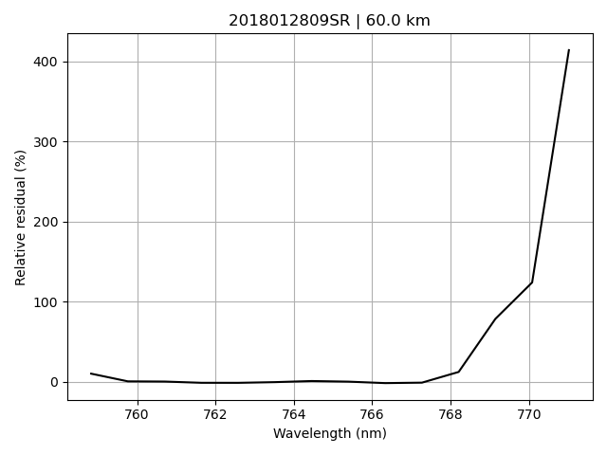
Forward Model Fitting LOS Total (O₂ + Rayleigh + aerosol + O₃) Extinction Spectra

Slide 7
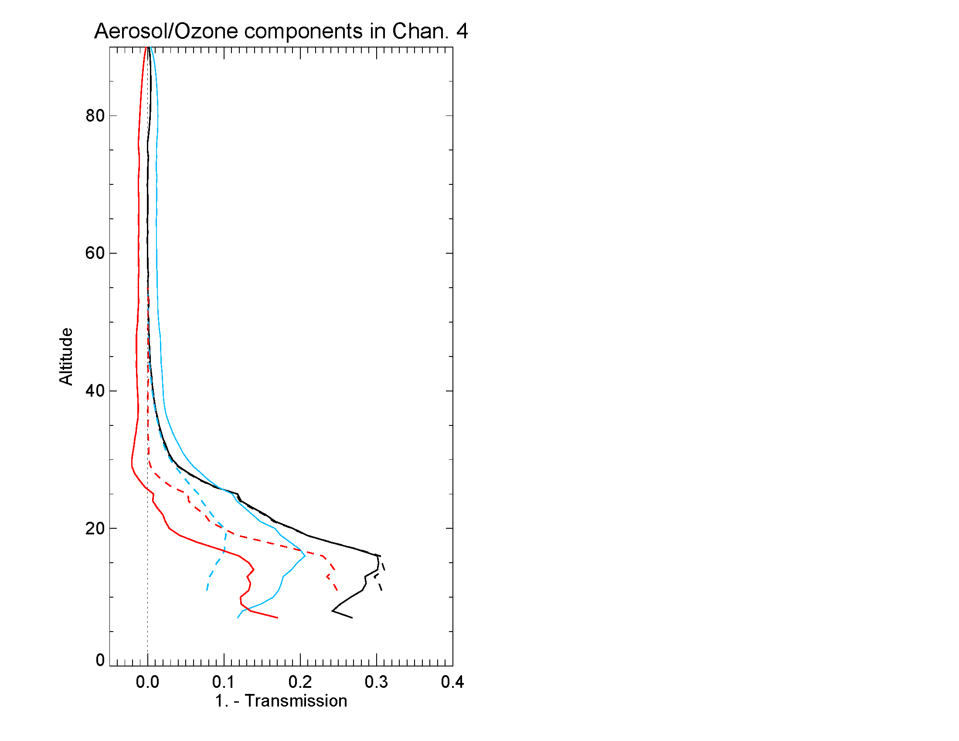
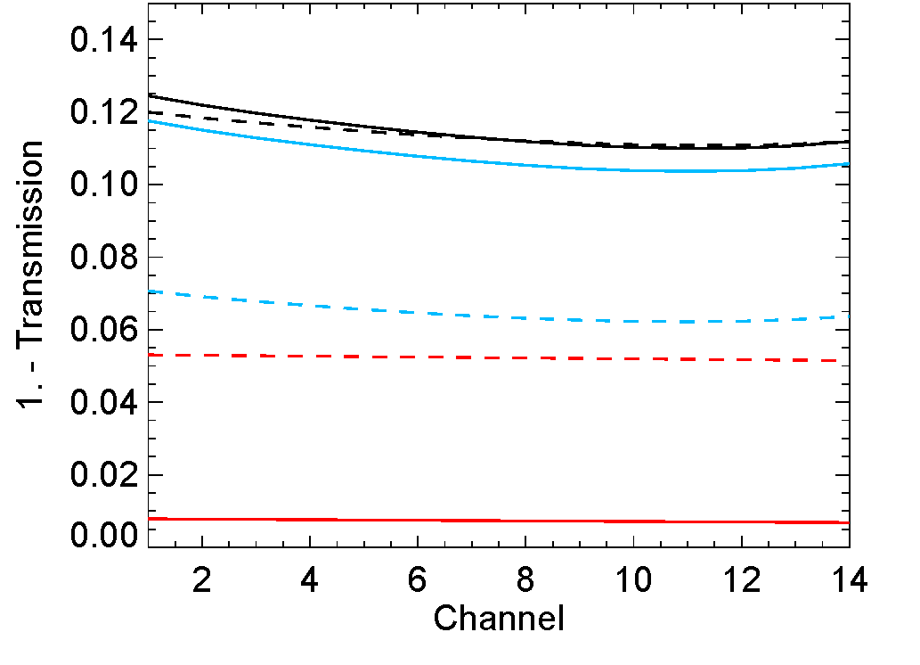
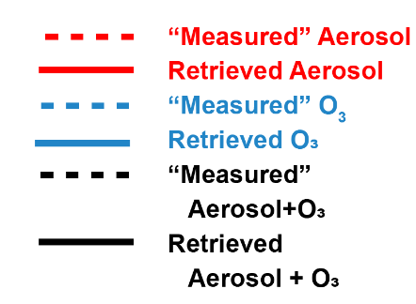
Aerosol & O₃ Component Fitting
Aerosol/O₃ Component Profiles
Aerosol/O₃ Component Spectra
25 km
SR Event January 2018
Channel 4 ~ 762 nm
“Measured” aerosol and O₃ components interpolated from aerosol channels and AO3 ozone product
Combined retrieved aerosol + O₃ components agree well with “Measured” values with slight slope difference
Retrieval has difficulty separating aerosol & O₃ contributions
Possible cross talk between aerosol/O₃ fitting and O₂-Rayleigh fitting
O₃
Aerosol

Slide 8
Correlative Comparisons MERRA-2 & Aura MLS (2024)

Slide 9
Correlative Comparisons SABER & ACE (2024)

Slide 10
Correlative Comparisons (2024) ALL
Preliminary Assessment
Systematic warm bias 20-40 km & upper mesosphere
Too cold at tropopause and stratopause

Slide 11
O₂ A-band Spectroscopy Uncertainty
Line intensities
Modeled line shape
Currently using standard Voigt profile (VP)
More advanced line shapes are likely more accurate, e.g.
Speed dependent Voigt profile (SDVP)
Speed dependent Nelkin-Ghatak profile (SDNGP)
Recent lab measurements differ in magnitude and spectral shape from previous HITRAN compilations
E. M. Adkins et al., An accurate determination of O₂ A-band line intensities through experiment and theory, JQSRT, 2025.
D.A. Long et al., The effects of advanced spectral line shapes on carbon dioxide retrievals, JQSRT, 2021.

Slide 12
Summary and Ongoing Work
Retrieval algorithm including wavelength and PSF width adjustments implemented at SCF
Wavelength adjustments of ~0.05 nm for SS and ~0.09 for SR with systematic drift over mission possibly due instrument/spectrometer warming as thermal systems age
PSF widths slightly larger than baseline
Forward model assessment
Modeled LOS extinction spectra accurately fit measured spectra (typically < few percent except in weak channels at high altitudes)
Combined aerosol + ozone components match well with “measured” values
Correlative comparisons
SAGE III/ISS temperature profiles capture fundamental features of atmospheric thermal structure, but warm bias in stratosphere (20-40 km) and above ~ 70 km
Ongoing Work:
Continue refining forward model parameters (e.g., spectroscopy and instrument response)
Expand correlative comparisons to include full mission time period & additional instruments (e.g. ground-based lidars)
T/p research products anticipated to be included in final data product release

