Slide 1
SAGE III/ISS Ozone as a Validation Tool
Mary Cate McKee
SAGE III/ISS Data Scientist
Robert Damadeo, David Flittner, Kevin Leavor

Slide 2
Outline
Methods
Ozone Bias relative to SAGE
Ozone Drift Relative to SAGE
By latitude
By instrument
Aerosol Sensitivity in Ozone
Pre-SAGE and Pre-HTHH Drift
Conclusions
Notes:
- Now that SAGE has 8 years of data, it is appropriate to assess the stability of our data record, and today I’m going to be looking at ozone stability.

Slide 3
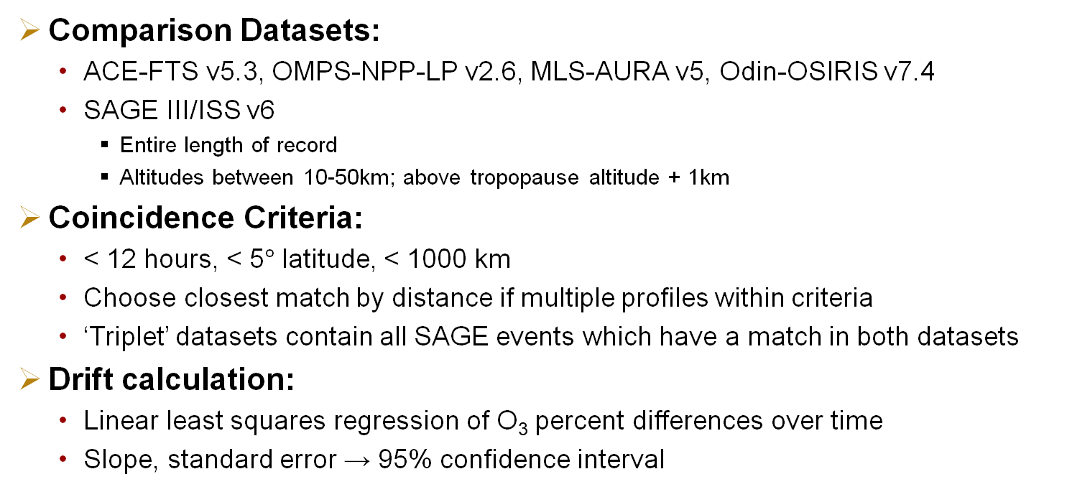
Methods
Comparison Datasets:
ACE-FTS v5.3, OMPS-NPP-LP v2.6, MLS-AURA v5, Odin-OSIRIS v7.4
SAGE III/ISS v6
Entire length of record
Altitudes between 10-50km; above tropopause altitude + 1km
Coincidence Criteria:
< 12 hours, < 5$°$ latitude, < 1000 km
Choose closest match by distance if multiple profiles within criteria
‘Triplet’ datasets contain all SAGE events which have a match in both datasets
Drift calculation:
Linear least squares regression of O₃ percent differences over time
Slope, standard error → 95% confidence interval

Slide 4
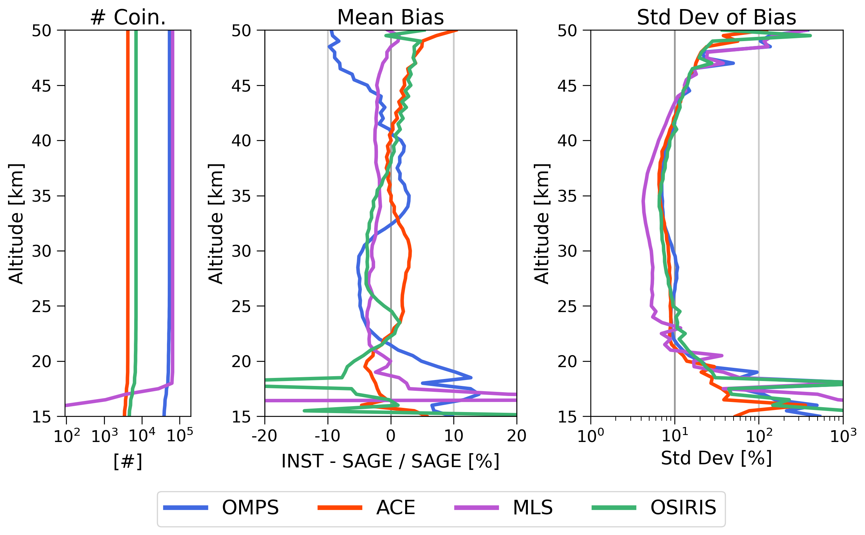
Bias relative to SAGE from 2017-2025
Total matches:
ACE: 4377
OSIRIS: 7080
OMPS: 54249
MLS: 65563
Notes:
Less matches with ACE and OSIRIS
Agreement to within 5% through most of the stratosphere
Standard deviation of differences over time mostly below 10%
Degrades slightly towards tropopause, and towards 50km, but mostly expected

Slide 5
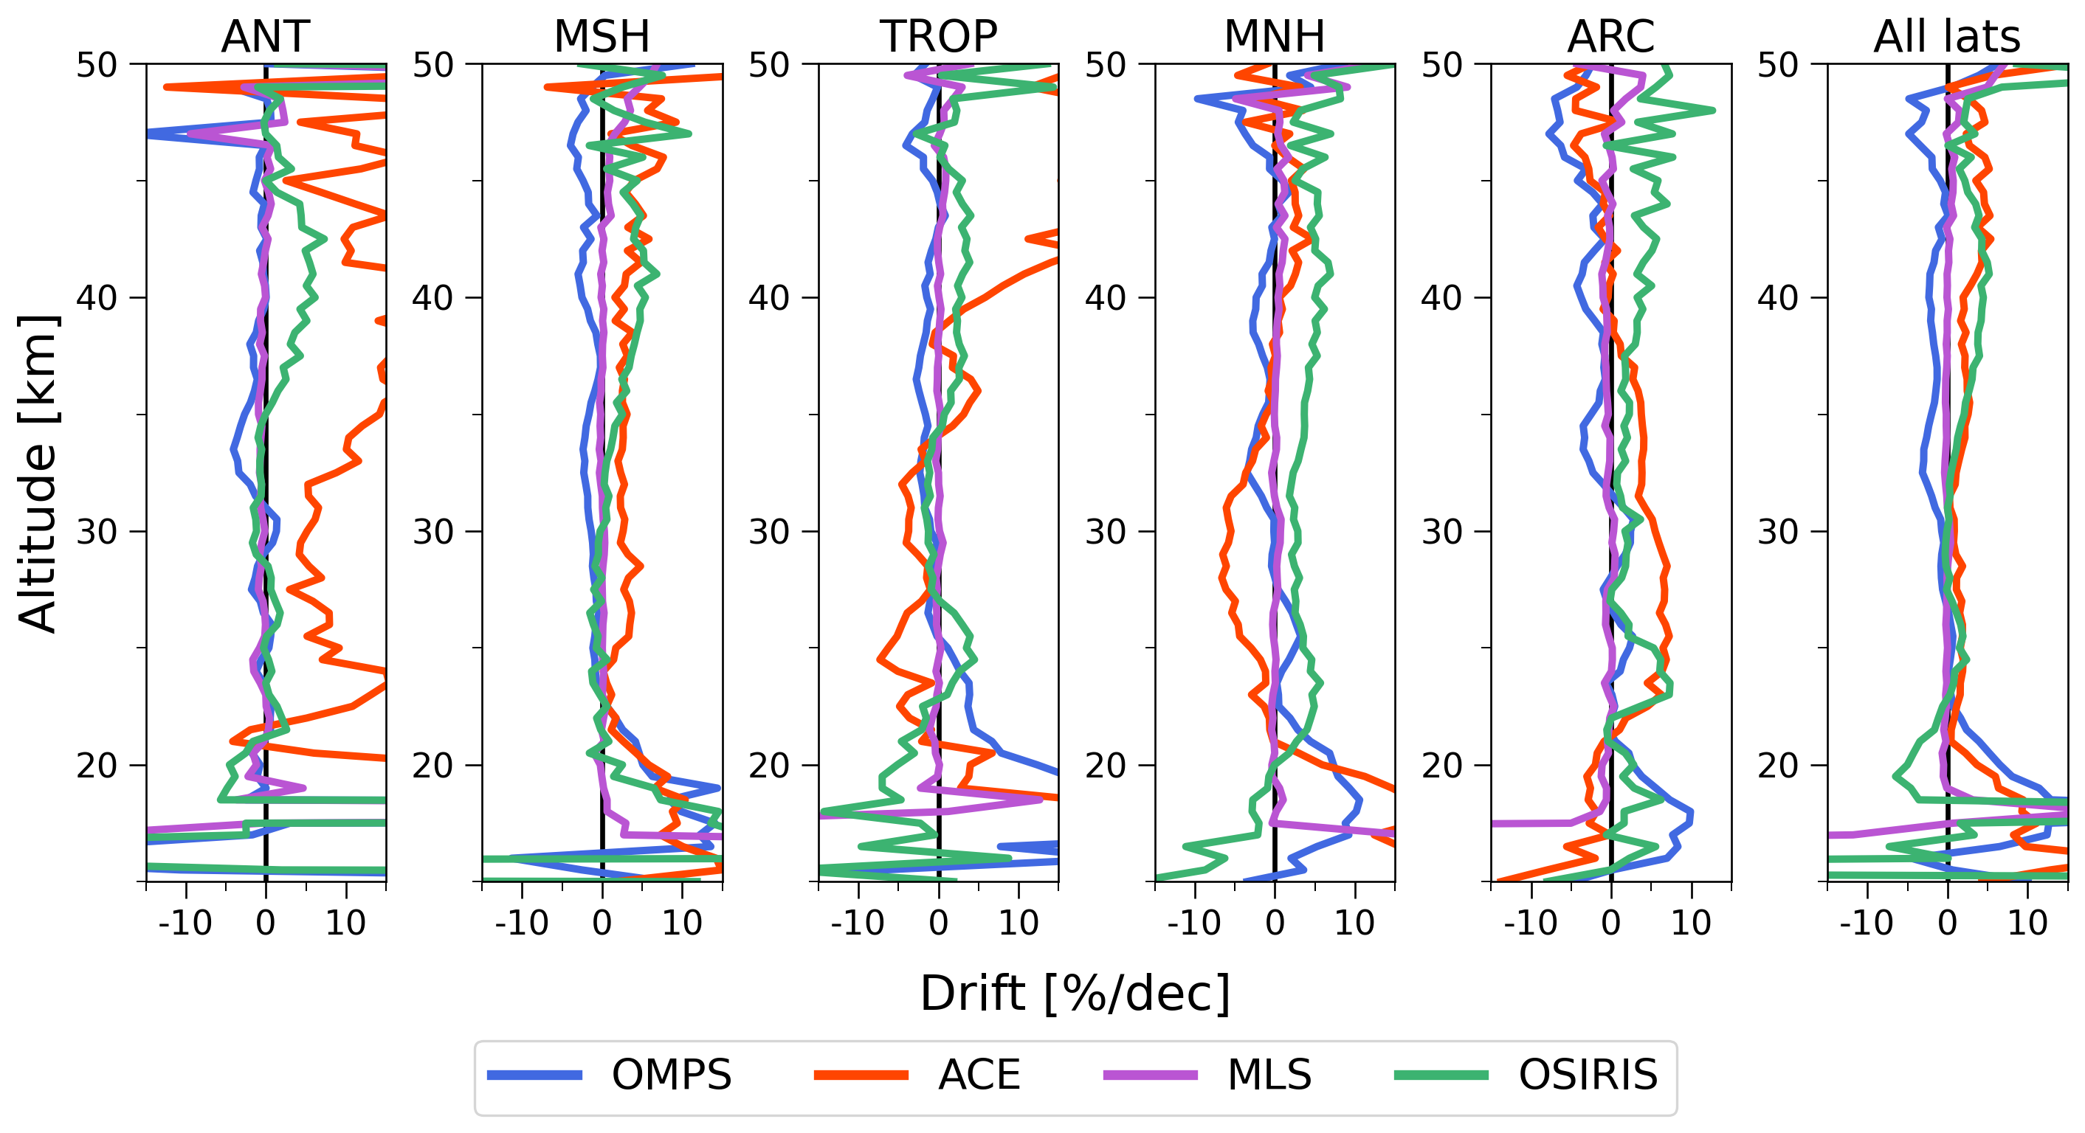
Drift relative to SAGE – By Latitude
Slope of linear regression of O₃ Bias [INST–SAGE/SAGE]
Latitude bins:
ANT: -80, -60
MSH: -60, -30
TROP: -30, 30
MNH: 30, 60
MSH: 60, 80
Notes:
Highest variability of drift over latitude is seen with ACE and OSIRIS due to limited number of coincidences
At all latitudes, drift is mostly less than 5-10% per decade through middle of altitude range
Next, look at the drift split up by each instrument

Slide 6
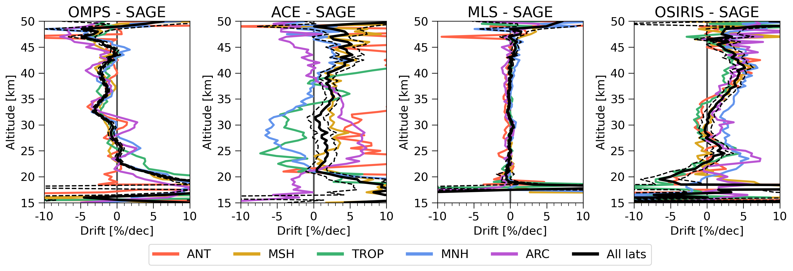
Drift relative to SAGE – By Instrument
N=54249 N=4377 N=65563 N=7080
Dotted black line: Slope +/- 95% confidence interval
Notes:
OMPS shows some variation with latitude but has fairly strong pattern over altitude with small confidence interval
ACE is highly variable across latitudes due to lack of coincidences. Wide margin of error.
MLS drift is very small and consistent across all latitudes and most of the altitude range… Drift is within ~1% between about 20-40km.
OSIRIS shows some variation across latitudes, but less varied than ACE. Strong pattern with altitude, opposite direction as OMPS pattern.

Slide 7
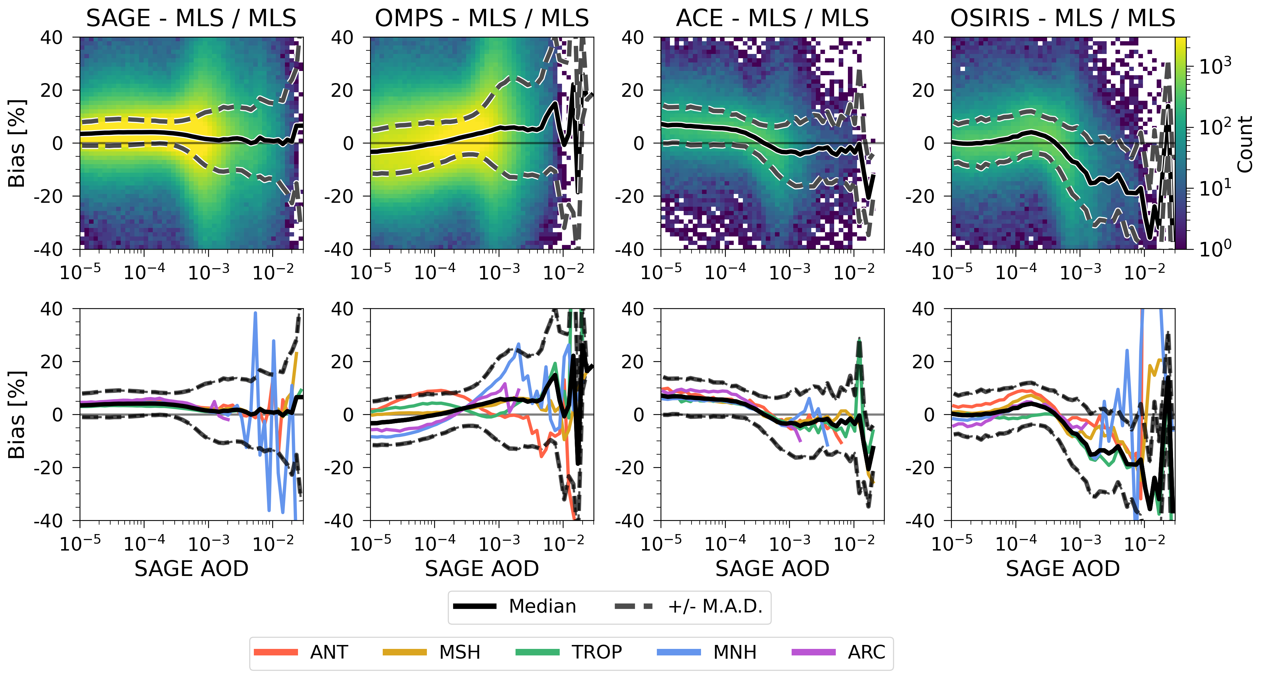
Ozone Sensitivity to Aerosol - Triplet Matches
O₃ % difference with MLS vs SAGE 1021nm Aerosol Optical Depth
Alt range:
15-30km
Notes:
This slide shows the results of finding triplet matches between SAGE, MLS, and each of these 3 instruments. The first column is simply the whole set of SAGE MLS matches.
Wanted to use MLS as the reference for this analysis as it is not sensitive to aerosol and would be a reliable reference for O3 compared to limb scatter observations. Has benefited from having a long time to refine their methods over their entire record and are widely recognized as a stable dataset.
Use triplet matches to be able to use SAGE aerosol and show how each of these instruments performs with ozone even in regions of high aerosol.
Focused in on 15-30km which mostly encapsulates areas with aerosol optical depth larger than 10x-5.
Histogram shows the distribution of the percent differences in ozone between MLS and each instrument compared with the SAGE observed aerosol optical depth at 1021nm.
The colorbar on the far right shows the bin count.
Black line shows the bin median of the bias relative to MLS across all AOD bins for each data point. Dotted is median +/- MAD.
The line plots below show the bin median for each of the latitude bands.
SAGE vs MLS is fairly flat across all AOD bins, theres more variability as the AOD increases which correlates to lower altitudes. Not much variability with latitude until you get to lower altitudes.
OMPS vs MLS shows a similar shape to the OMPS vs SAGE bias, with higher ozone values in regions of higher AOD / lower altitude. Quite a bit of variability with latitude across all AOD/altitudes.
.ACE vs MLS is not super flat, and has some variability, fairly consistent with the pattern of ACE vs SAGE bias with altitude.
OSIRIS vs MLS also shows a lot of variability with latitude and across all AOD/latitudes, with the most variability and bias in the high AOD / low altitude regions.
Overall these results lead to the conclusion that aerosol sensitivity is a factor in these O3 observations. Since aerosols have this impact especially at lower stratospheric altitudes, there is reason to suspect HTHH may have skewed the slope of the linear regression on the differences.

Slide 8
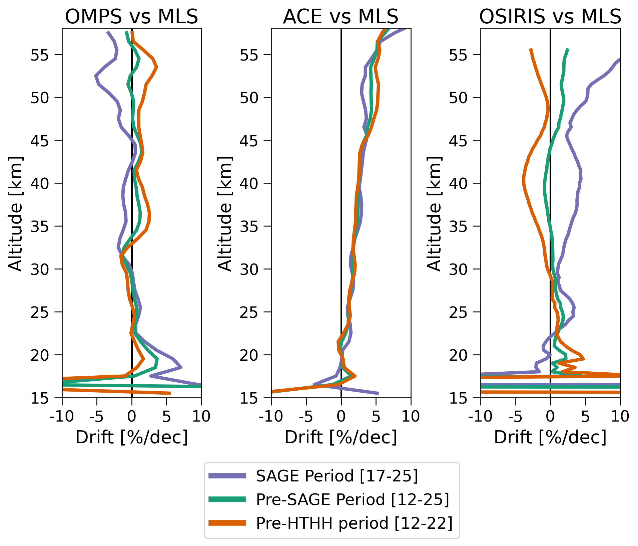
Pre-SAGE and Pre-HTHH O₃ Drift
ACE drift pattern is consistent over time though appears to have some altitude dependence
OMPS/OSIRIS drift in the lower stratosphere change over different time periods: consistent with aerosol sensitivity impacts
Cause of OMPS/OSIRIS drift in upper stratosphere is unknown but indicates the possibility of a different sensitivity or change in behavior
Notes:
Looking at the slope of these differences with MLS over several different time periods to assess the impact of HTHH on the linear regression.
Purple line shows the same time period we have been looking at, 2017-2025.
Focusing on the lower altitudes as it’s most influenced by aerosols:
OMPS: Slope says the differences have gotten more positive over these 8 years
ACE and OSIRIS are slightly negative
Green line shows the entire overlapping record for these 3 instruments, from 2012-2025.
The slope becomes less positive for OMPS, and even becomes slightly positive for ACE and OSIRIS
Orange line shows the period before HTHH, 2012-2022.
Slope for OMPS becomes very small, barely changes for ACE, slightly more positive for OSIRIS.
Overall, ACE does not show any dramatic changes, though still exhibits a pattern of positive drift above ~20km and increases with altitude.
OMPS and OSIRIS do display a systematic change in the pattern of drift over altitude, although they shift in opposite directions.
Does seem like aerosol dependence in O3 observations plays some role in the results of the relative drift of these instruments.

Slide 9
Conclusions
All correlative data sets agree to within 5-10% from ~20-45 km
SAGE and MLS have similar stability (drifts <1%/dec)
ACE/OMPS/OSIRIS show altitude-dependent drifts <5%/dec
OMPS and OSIRIS appear to have sensitivity to aerosol loading that artificially inflates drift estimates in the lower stratosphere
OMPS and OSIRIS may have other sensitivities or sudden changes in behavior during their mission lifetimes
Future Work:
Include additional datasets
Precision estimates, uncorrelated residual analysis, collocation uncertainty and sampling biases
Notes:
SAGE seems relatively stable dataset across all latitudes and through much of the stratosphere. Agrees with all correlative datasets to within 5-10% from ~20-45km. Fairly small drift over altitudes and latitudes, with some interesting features in each of the relative drifts that I will look further into.
Need to pay attention to aerosol sensitivity when doing this type of assessment, as the limb-scattering instruments included in this analysis showed some bias with higher AOD, especially during the period just after HTHH.
In the future, will be aiming to develop a more comprehensive O3 drift assessment across a wider array of satellites and timescales.
Some things I will be incorporating in the near-term are precision estimates, uncorrelated residual analysis, and other steps to create a more robust estimate of drift over time.

