Slide 1
Science Team Meeting
NASA Langley Research Center
08/13/2025

Slide 2
Mission Operations
Jamie Nehrir
Mission Operations Manager

Slide 3
Outline
Mission Operation Overview
What Has Change in the Last Year
Future Work

Slide 4
Ops Overview
Mission Operations Goals
  Commanding and downloading data on a weekly basis
  Respond to anomalies within a timely manner
    Average response is about 4.9 hours (time from the anomaly to returning to science taking)
  Maintaining the health and safety of the SAGE III payload
    Daily engineering checks
    Trending of engineering data and science metrics
    Supply contamination data to ISS for a detailed understanding of the space environment
    Execute maintenance activities (Boresight alignment analysis, Attenuator mechanism trending, CCD Characterization analysis, Azimuth Range of motion execution)
  Process and distribute SAGE III data
    Process Ground Support Equipment (GSE) and Solid State Memory Card (SSMC) in near real-time (8-5 ET)
    Processes 24 hours of SSMC data daily
    Generates daily SCF files
      Level 0 and ancillary data
    Generates and distributes daily ESA/TASI Hexapod data files

Slide 5
Ops Team
SAGE III Payload Operations Center
Jamie Nehrir | Mission Operations Manager
Andrew Peterson | Ground System Lead
Greg Paxton | Ground Systems Manager
Caitlyn Stone | Deputy Mission Operations Manager
James Farmer | Ground Systems Engineer
Rick Farmer | Ground Systems Engineer
Kenta Funada | Payload Engineer
Donald Cleckner | Payload Engineer
James Losey | Payload Engineer/ Contamination Engineer
Chris Brown | Payload Engineer

Slide 6
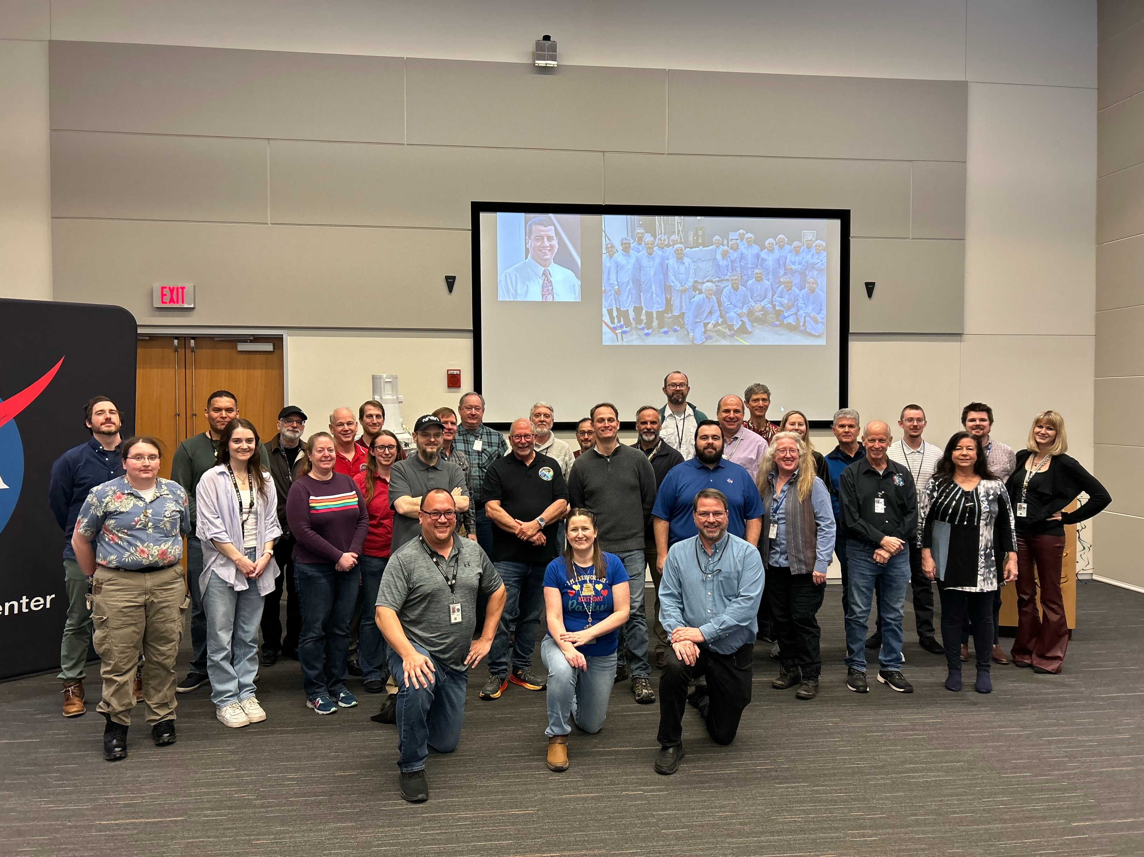
SAGE III Operations
SAGE III celebrated its 8th birthday on board the International Space Station
The SAGE III payload continues to operate as expected
SAGE has acquired about 78,000 occultation events!!

Slide 7
Phase-E Totals
7/1/2017 00:00 to 8/6/2025 09:00
Event Type | Total Planned | Total Acquired | Total % Acquired (vs. Planned)
Sunrise | 41056 | 37558 | 91.5%
Sunset | 41048 | 35586 | 86.7%
Moonrise | 5273 | 1947 | 36.9%
Moonset | 5637 | 3290 | 58.4%
All Occultation | 93014 | 78381 | 84.3%
Limb | 32154 | 31286 | 97.3%

Slide 8
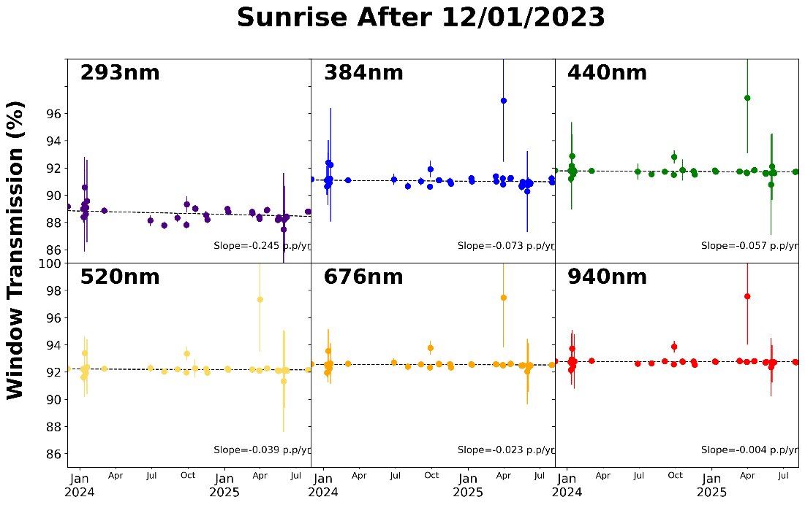
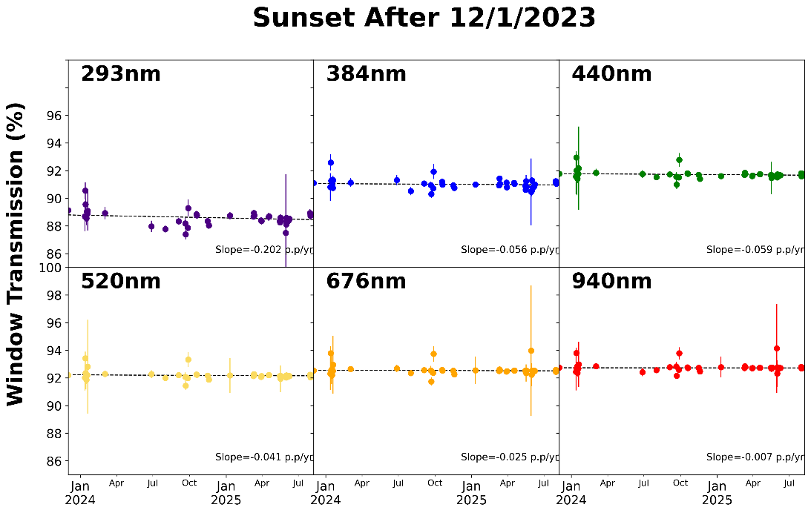
Window Transmission update
SAGE III Transmission through the contamination window
  As presented previously, a single event impulse contamination event occurred on November 29, 2021. The SAGE III team has continued to monitor the transmission, and no additional degradation has been observed.

Slide 9
Payload Highlights
Two items of note for Payload operations for 2025:
  Modification of the Instrument Assembly (IA) CCD TEC setpoint
  Failure of the Disturbance Monitoring Package

Slide 10
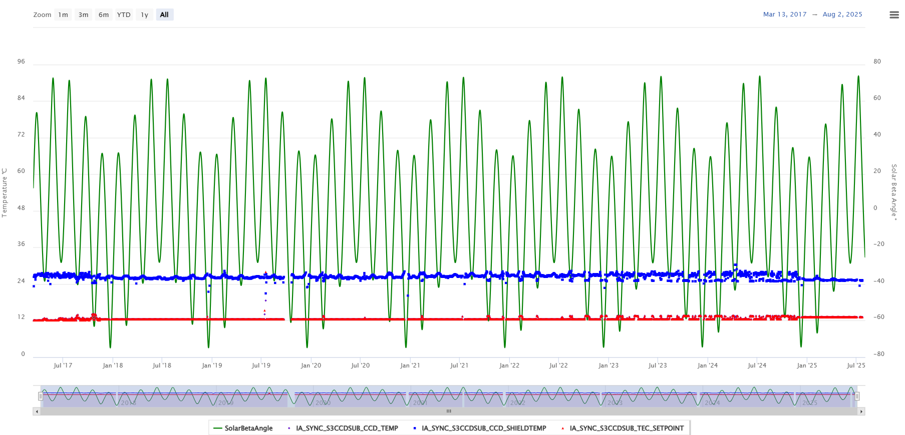
IA TEC Setpoint Change
The TEC setpoint for the IA was modified in Dec. 2025 to allow the CCD to be controlled more stably
The modification changed the setpoint from 12.5C to 13.2C
There is no noticeable detriment to the data product following this setpoint change

Slide 11
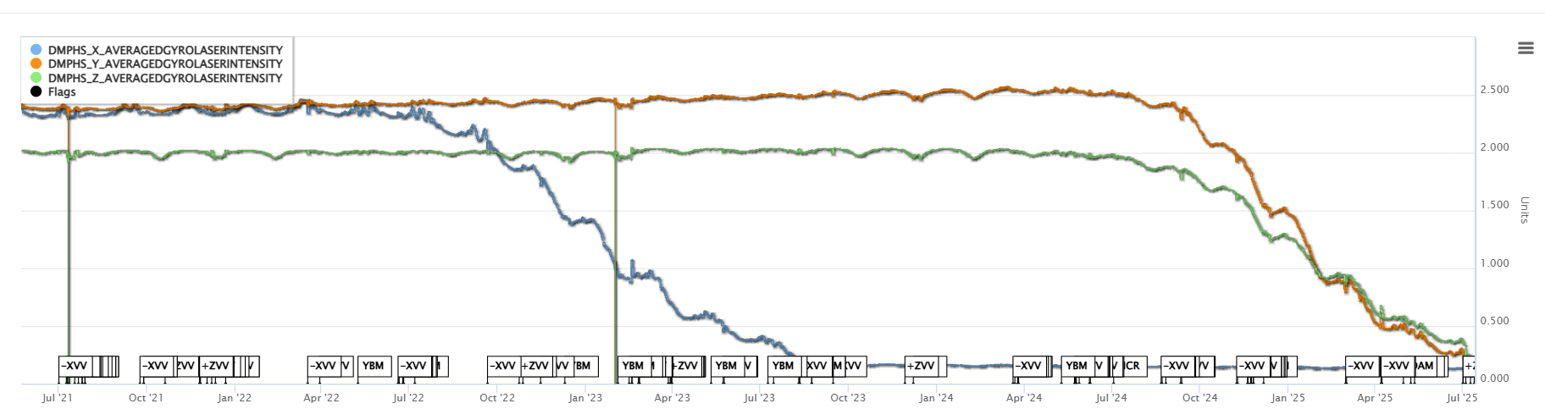
DMP Laser Intensity
The Operations team noted in July 2022 that the X-axis gyro laser intensity was decreasing in intensity, the full degradation of that sensor was observed in August of 2023.
During the trending review in 2024 the operations team noted that the Y and Z axis were starting to degrade similar to the X-axis, and in May 2025 the full degradation of all sensors was observed.
On July 9, 2025, the DMP was powered off as the data was no longer useful.
X-Axis Laser Intensity
Y-Axis Laser Intensity
Z-Axis Laser Intensity

Slide 12
Future Work
Update Instrument Assembly code to allow for tracking through low clouds.
  The SAGE III engineers along with the science team are working to incorporate a new feature, called smart scanning, which would allow for the SAGE III payload to recapture the sun following an obscuration through a cloud.
  The SAGE III operations team is hoping to load this but with the reduction in operations team the work for this has slowed down but will continue to move forward as availability allows.
A new Robo survey is due for the payload
  The last Robo survey was conducted in 2022 and so it is time for a new visual survey to see how the surfaces are aging
  This is done when the robotic arm is within our area and contingent on the robotic arm schedule

Slide 13
Questions

