Slide 1
Data Product Status (2025 Edition)
Robbie Manion¹
SAGE III/ISS Science Computing Facility
¹ ADNET Systems, Inc.

Slide 2
The “SCF”
The Team
Robbie Manion, Mike Heitz, Marsha Larosee
What We Do
Maintain, develop, and operate the algorithms which process SAGE III/ISS data into vertical profiles of aerosol and gas species
Where
Four dedicated servers at LaRC
When
Daily product generation with “expedited” processing (GEOS-IT met)
Monthly product releases with 3-8 week latency (MERRA-2 met)
Notes:
- Currently provided to NASA as part of the RSES contract

Slide 3
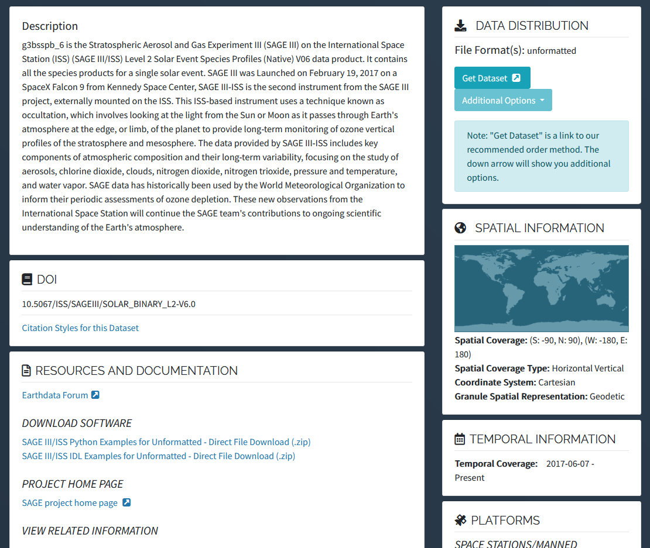
Version 6.0
Products
Level 1 and Level 2 products for solar occultation (72508 events)
Level 2 for lunar (4855 events)
Event-by-event: unformatted, HDF5
Whole month: netCDF4
Distributed by Atmospheric Science Data Center (ASDC)
Available in NASA Earthdata Search
Browse products in CMR Search (Scroll down to SAGE III/ISS)

Slide 4
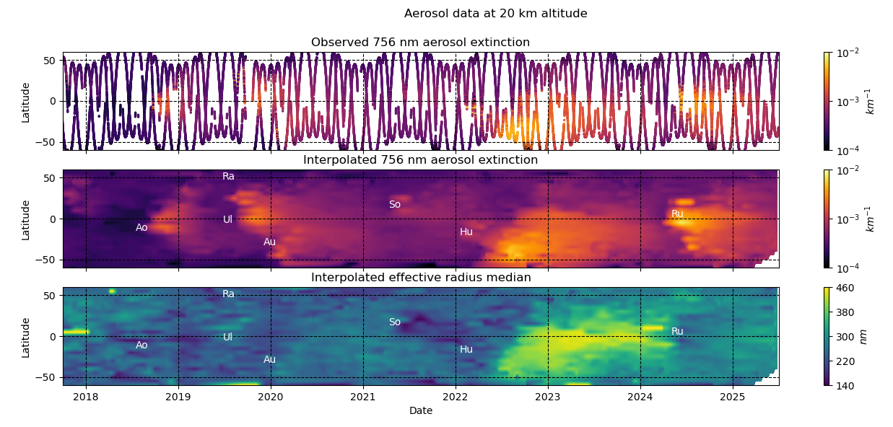
Over 8 years of data
Notes:
Note different particle size effects for different injections

Slide 5
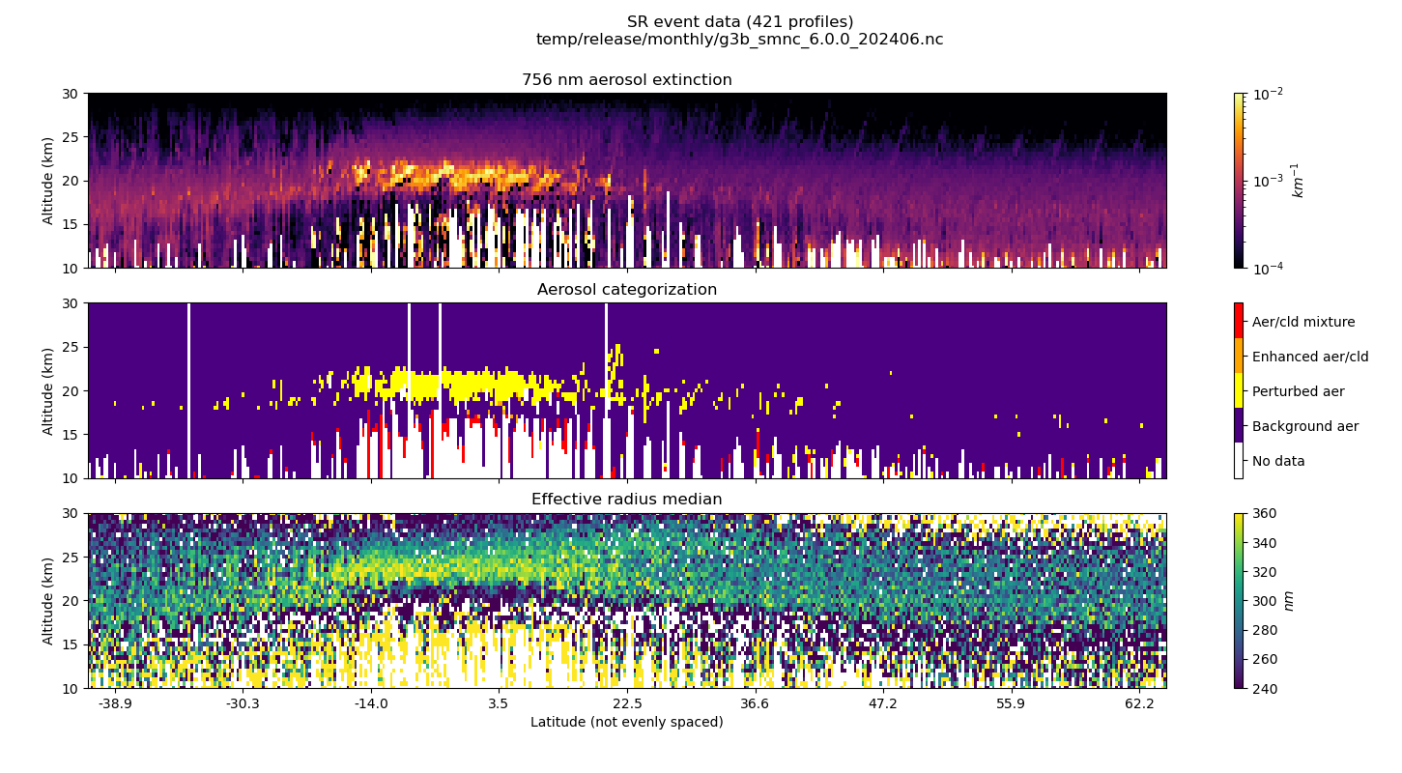
New aerosol products
Notes:
Covered “aerosol seagull” resolution last year. PSD products the result of algorithms developed under the second ROSES science team cohort

Slide 6
Patch notes
6.0.1: Scripting changes, effective January 2025
Revert parallel processing in pre-processing scripts to resolve transient failures
Remove hardcoding of end year in aerosol/cloud flag program
6.0.2: Disturbance correction removal, effective May 2025
Disable disturbance monitoring package (DMP)-based pointing correction from 24 May 2025
Accommodate removal of DMP telemetry from input data
6.0.3: Flag 2025 Canadian Wildfire event, effective June 2025
Flag aerosols as “enhanced”
Notes:
Patch version now transparent to users. Patches may or may not affect products, always maintain reproducibility for already-released products

Slide 7
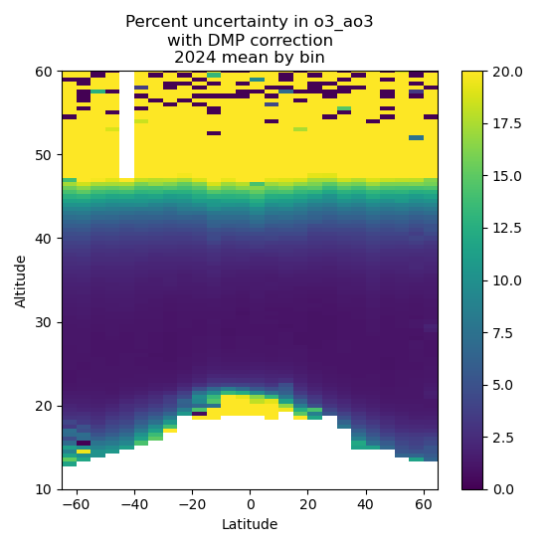
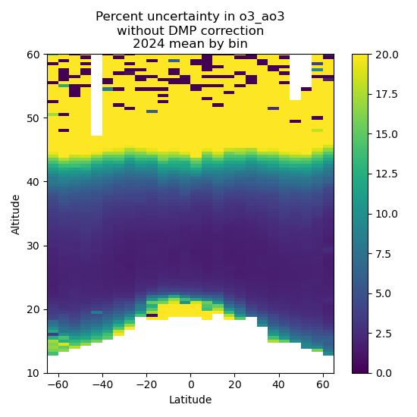
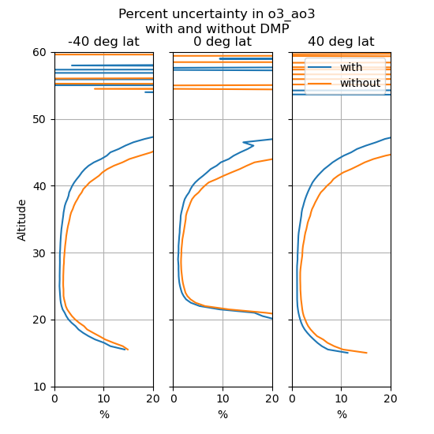
Ozone

Slide 8
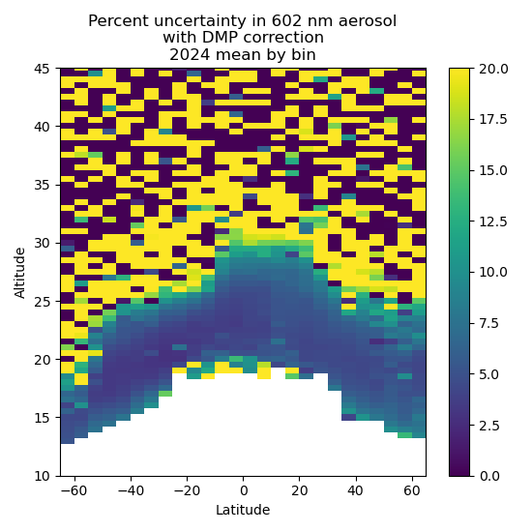
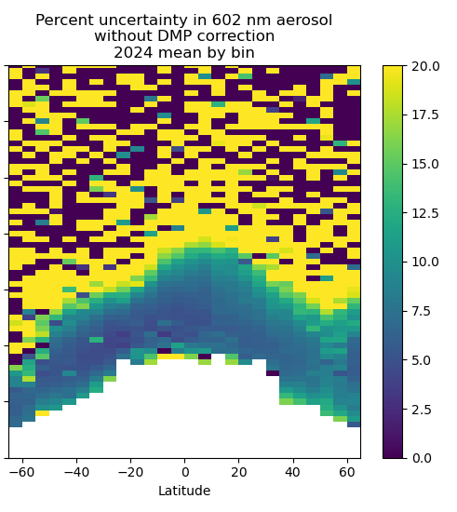
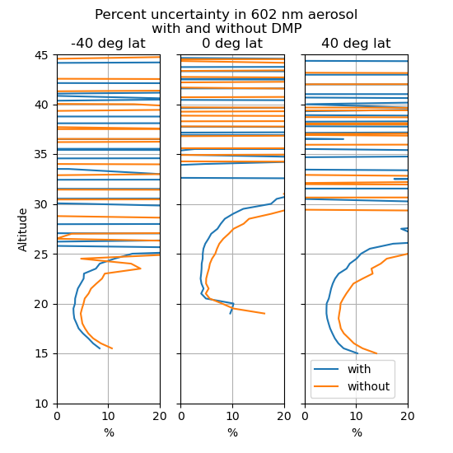
Aerosol

Slide 9
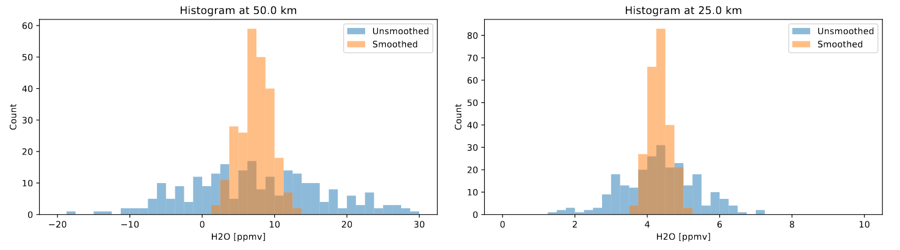
On deck for 6.1
Improve product formatting, attributes, adherence to conventions, documentation [Ongoing development as needed]
Add retrieved temperature and pressure profiles [In review]
Address noise in water vapor product [In development]
Improve particle size distribution products [In development]
Improve internal QA approach (👀 → 🤖) [In review]
Clear interfering oxygen absorption from 756 nm aerosol extinction coefficients [To do]
H2O ppmv distribution from 250 tropical profiles
Notes:
Histograms of ~250 events in the tropics. Noise from disturbance will also affect H2O going forward—smoothing can recover lost profiles.

Slide 10
The wish list
Examine remaining aerosol biases (most likely linked with ozone retrieval)
Examine sensitivity to increased aerosol loading (no such loading seen during M3M)
Examine spectroscopy, pressure broadening of NO2
Then…
NO2 diurnal effects (slant path inhomogeneity)
Mesospheric ozone (stray light)
Lunar altitude registration
Lunar NO2 and NO3

Slide 11



Thanks!
Robbie Manion, Science Computing Facility Lead robert.manion@nasa.gov
We speak…
Rob Damadeo, Lead Algorithm Scientist robert.damadeo@nasa.gov
David Flittner, Project Scientist david.e.flittner@nasa.gov

Slide 12
Kovilakam, M., Thomason, L., and Knepp, T.: SAGE III/ISS aerosol/cloud categorization and its impact on GloSSAC, Atmos. Meas. Tech., 16, 2709–2731, https://doi.org/10.5194/amt-16-2709-2023, 2023.
Knepp, T. N., Kovilakam, M., Thomason, L., and Miller, S. J.: Characterization of stratospheric particle size distribution uncertainties using SAGE II and SAGE III/ISS extinction spectra, Atmos. Meas. Tech., 17, 2025–2054, https://doi.org/10.5194/amt-17-2025-2024, 2024.
Damadeo, R. P., Sofieva, V. F., Rozanov, A., and Thomason, L. W.: An empirical characterization of the aerosol Ångström exponent interpolation bias using SAGE III/ISS data, Atmos. Meas. Tech., 17, 3669–3678, https://doi.org/10.5194/amt-17-3669-2024, 2024.

Slide 13
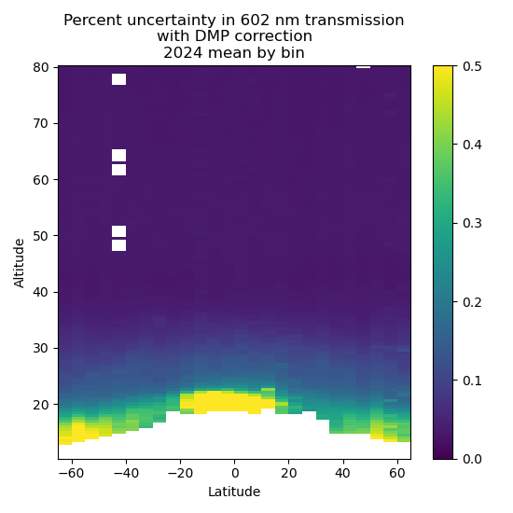
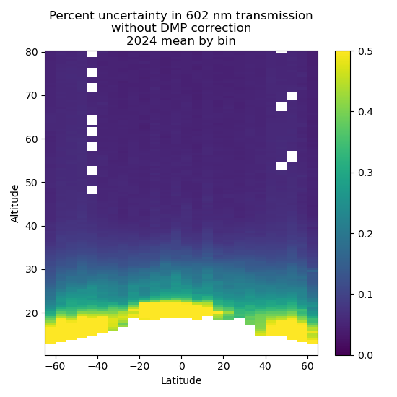
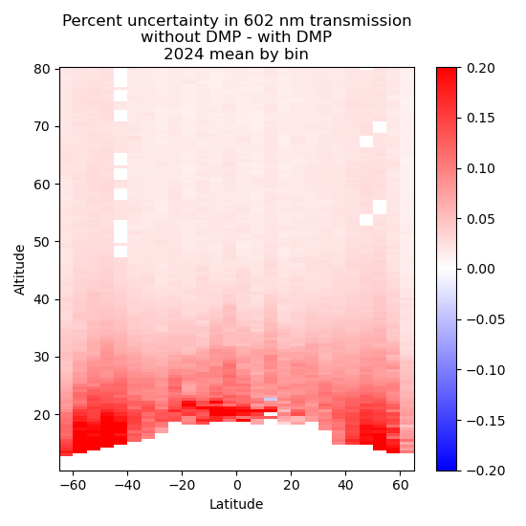
No more DMP-based pointing correction ☹
Notes:
Level 1 effect on slant-path transmission, scanning instrument needs to register samples to their position on the solar disk, simulation run by Marsha Larosee, she and Charles Hill drafting paper looking at the effect on Level 2 products

Slide 14
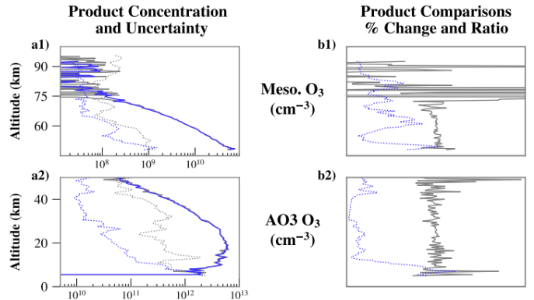
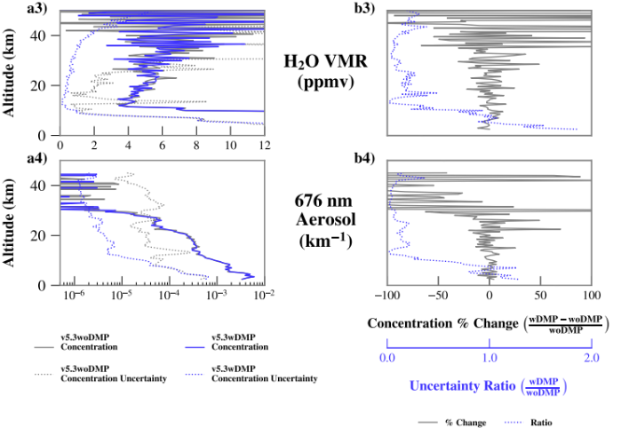
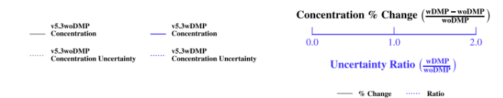
High disturbance event 2018051633SR

